Slide 1

CLIMATE RISK ASSESSMENT
CLIMATERISK ASSESSMENT
A BinUCom Initiative
M.Arch
Elective Course
Modules – 5
Conducted by:
Christine Wamsler
Mamta Patwardhan

Slide 2
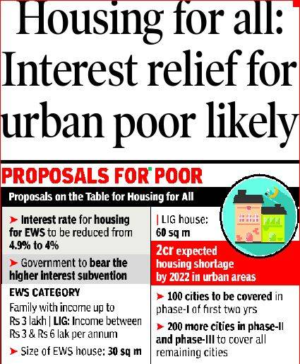
Introduction
Overview of the intersection between climate change, disaster risk and the urban poor in the city of Mumbai. It seeks to understand
what are the key aspects of the vulnerability of the urban poor in the city,
how climate change increases this vulnerability, and
policies and programs that can be developed that reduce the vulnerability of the poor, taking both current and expected future climate change into account.
A BinUCom Initiative M.Arch Elective Course Conducted by: Christine Wamsler and Mamta Patwardhan
Notes:
Rapid urbanization because of population growth and migration from rural areas, combined with lack of affordable housing, has been associated with the development of informal settlements on marginal land in and near cities

Slide 3
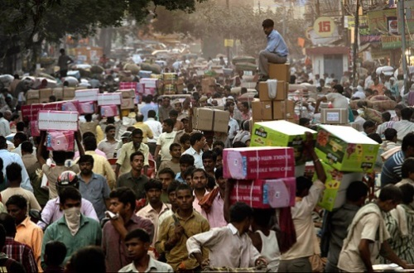
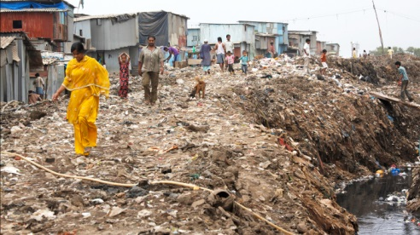
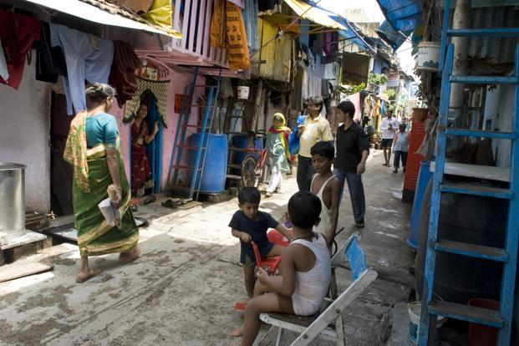
Module - 1
Climate Change and Urban Environment
Introdcution to climate change and urban environment
Introduction to vulnerability , hazards and disaster risks
Indroduction to climate change adaptation
A BinUCom Initiative M.Arch Elective Course Conducted by: Christine Wamsler and Mamta Patwardhan
Notes:
Climate change adaptation is the process of preparing for, and adjusting proactively to, climate change—both negative impacts as well as potential opportunities. Cities are often the first responders to climate impacts. Because cities are dynamic systems that face unique climate impacts, their adaptation must be location specific and tailored to local circumstances. The starting point in managing risks and building long-term resilience is for a city to understand its exposure and sensitivity to a given set of impacts, and develop responsive policies and investments that address these vulnerabilities.
V - The characteristics and circumstances of a community, system or asset that make it susceptible to the damaging effects of a hazard.
H - dangerous phenomenon, substance, human activity or condition that may cause loss of life, injury or other health impacts, property damage, loss of livelihoods and services, social and economic disruption, or environmental damage
DR - The potential disaster losses, in lives, health status, livelihoods, assets and services, which could occur to a particular community or a society over some specified future time period

Slide 4
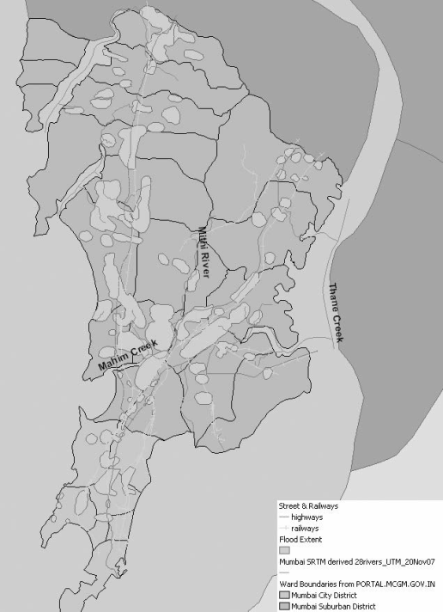
Module - 2
Impacts of Climate Change
Climate Change Impacts on Cities
Climate Change Impacts Related to Urban Poverty and Informal Settlements
Climate Change Adaptation with Disaster Risk Reduction
A BinUCom Initiative M.Arch Elective Course Conducted by: Christine Wamsler and Mamta Patwardhan
Notes:
Cities face significant impacts from climate change, both now and into the future. These impacts have potentially serious consequences for human health, livelihoods, and assets, especially for the urban poor, informal settlements, and other vulnerable groups. Climate change impacts range from an increase in extreme weather events and flooding to hotter temperatures and public health concerns. Cities in low-elevation coastal zones, for instance,
face the combined threat of sea-level rise and storm surges. The specific impacts on each city will depend on the actual changes in climate experienced (for example, higher temperatures or increased rainfall), which will vary from place to place.
They tend to live in marginal areas of the urban landscape: on steep slopes, along riverbanks and transportation corridors, and in floodplains
Climate change adaptation consists of “initiatives and measures to reduce the vulnerability of natural and human systems against actual or expected climate change effects” (IPCC 2007). Both through informal preparations and formal planning activities, cities can build their resilience and capacity to adapt to existing and future climate change impacts.

Slide 5
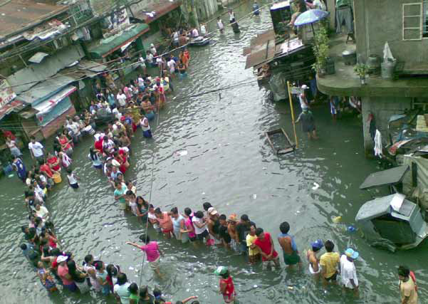
Module - 3
Urban Resilience
Urban Disaster Resilience
Risk, Uncertainty and Complexity
Disaster Risk management and Opportunities for Resilience
A BinUCom Initiative M.Arch Elective Course Conducted by: Christine Wamsler and Mamta Patwardhan
Notes:
The ability of a system, community or society exposed to hazards to resist, absorb, accommodate to and recover from the effects of a hazard in a timely and efficient manner, including through the preservation and restoration of its essential basic structures and functions.
Risk – of livelihood, tenure, location, health etc
Uncertainty is the essential element of any disaster, referring to the disaster impacts that cannot be quantified or are completely unknown.

Slide 6
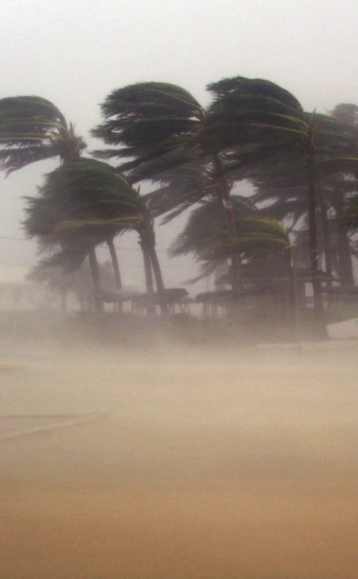
Module - 4
Risk Assessment through Case Studies
Hazard identification, exposure analysis, vulnerability analysis and risk analysis
Identification of hazards in the selected marginal settlement
Surveys conducted to establish consequences
A BinUCom Initiative M.Arch Elective Course Conducted by: Christine Wamsler and Mamta Patwardhan

Slide 7
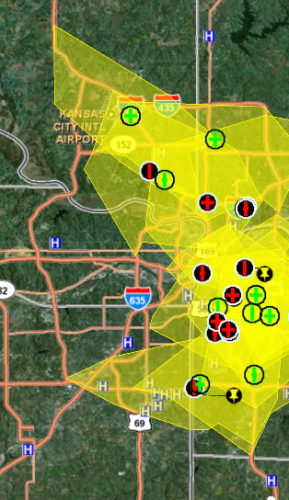
Module - 5
Mapping, assessing and evaluating risks
Hazard, vulnerability and Risk assessment with GIS
GIS Multi criteria analysis in vulnerability assessment.
Visualization of risk information (Using QGIS Software).
Risk mapping and database generation using Excel/QGIS.
Creating a risk map
Use of GIS in identification of the extent and magnitude of each hazard
A BinUCom Initiative M.Arch Elective Course Conducted by: Christine Wamsler and Mamta Patwardhan

Slide 8
Module - 6
Developing Adaptation Strategies
A BinUCom Initiative M.Arch Elective Course Conducted by: Christine Wamsler and Mamta Patwardhan

Slide 9
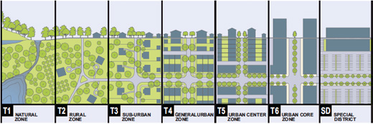
Urban Area
Definition :
An urban area can be defined by administrative criteria or political boundaries a threshold population size, population density, economic function or the presence of urban characteristics.
In 2010, 3.5 billion people lived in areas classified as urban.
Ref: UNICEf: SOWC 2012. Definitions
Notes:
An urban area can be defined by administrative criteria or political boundaries (e.g., area within the jurisdiction of a municipality or town committee), a threshold population size (where the minimum for an urban settlement is typically in the region of 2,000 people, although this varies globally between 200 and 50,000), population density, economic function (e.g., where a significant majority of the population is not primarily engaged in agriculture, or where there is surplus employment) or the presence of urban characteristics (e.g., paved streets, electric lighting, sewerage).

Slide 10
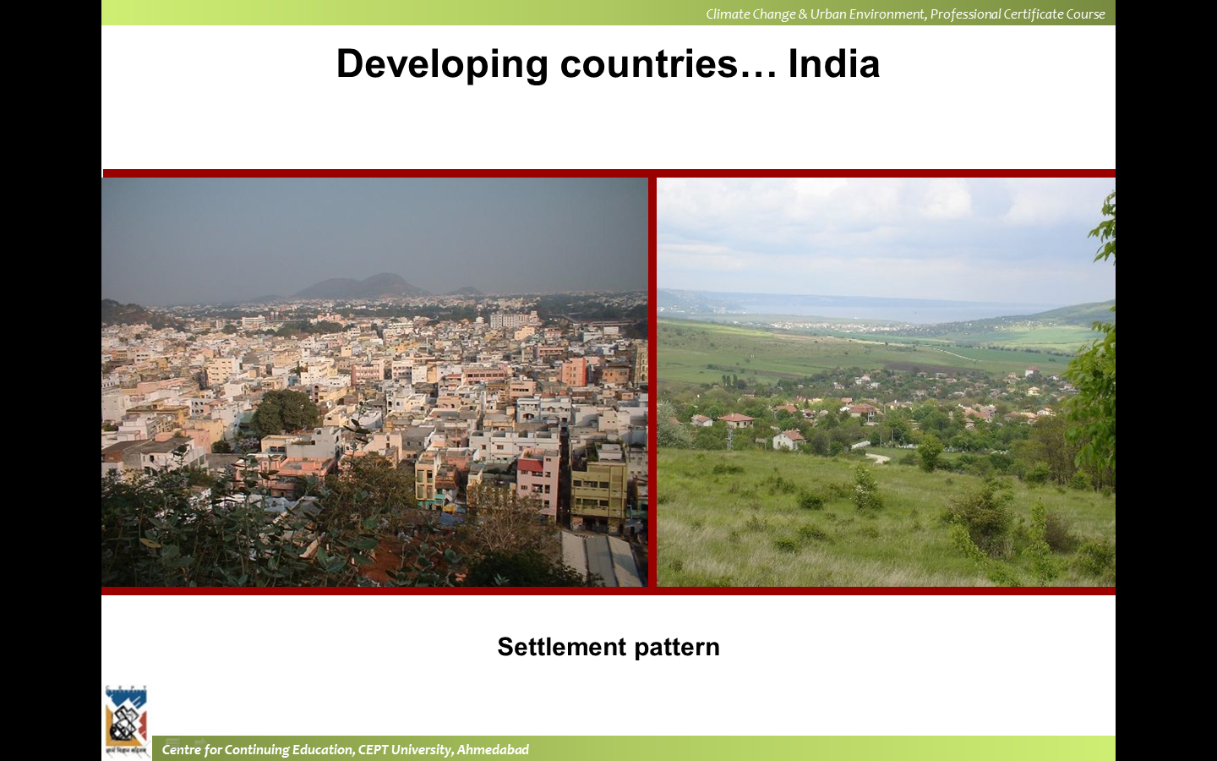
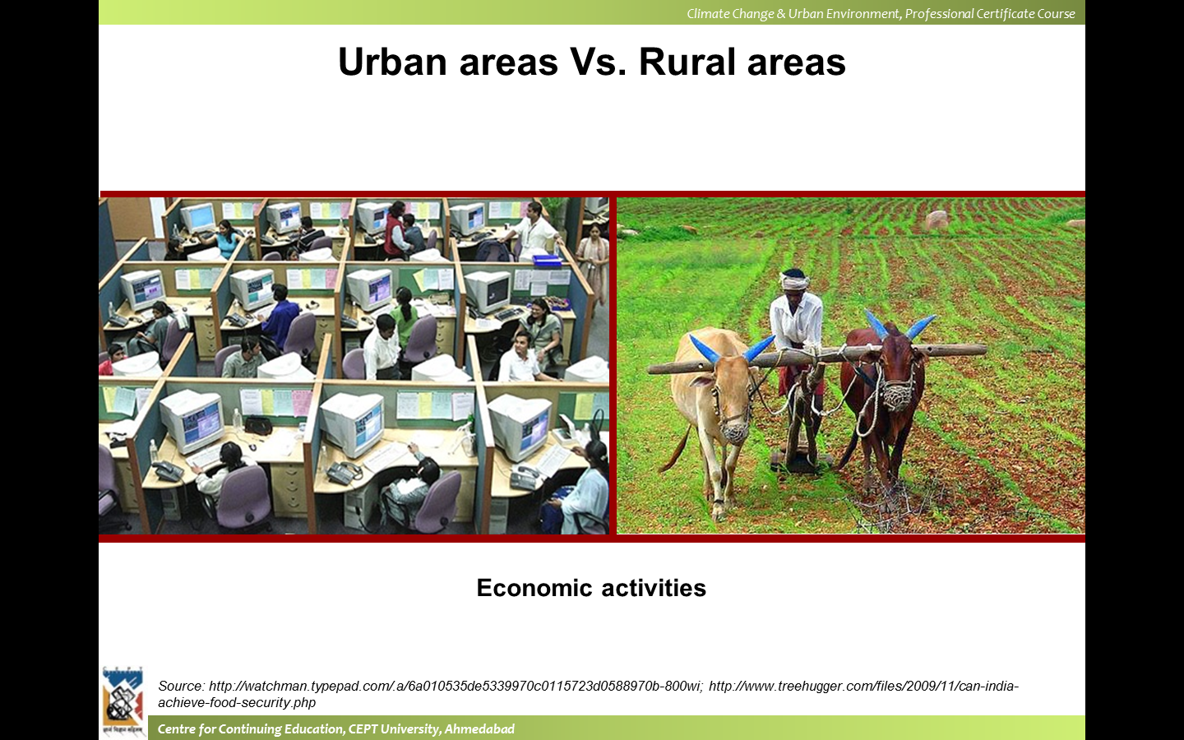
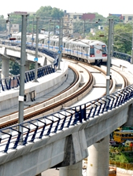
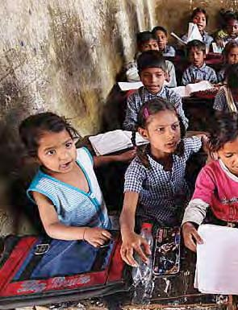
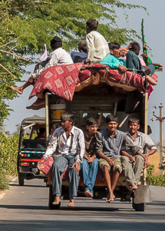
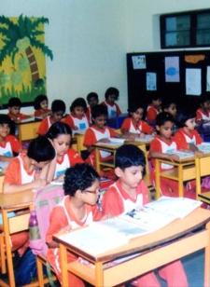
Urban Vs Rural
Notes:
In 2010, 3.5 billion people lived in areas classified as urban. EU – no gaps more than 200m, 3rd world – 75% not engaged in agri, CA – pop density -400/sq km, US aggl- 2500 and more, 50000 and more inhabitants, or urban clusters of 2500 and less than 50000 inh. Netherlands – municpalities of 2000 > and 20% less involved in agri , Swiz – 10000 > inh, France – communes of 2000 > inh ;living not more than 200m apart
.

Slide 11
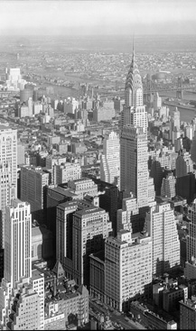
Urbanization
Urbanization
The proportion of a country that is urban.
Rate of urbanization
The increase in the proportion of urban population over time, calculated as the rate of growth of the urban population minus that of the total population.
Positive rates of urbanization result when the urban population grows at a faster rate than the total population.
Ref: UNICEf: SOWC 2012. Definitions
Notes:
For the first time ever, the majority of the world’s population is living in cities, and this proportion continues to grow. Putting this into numbers, in 1990 fewer than 4 in 10 people lived in urban areas. In 2010, more than half live in cities, and by 2050 this proportion will grow to 7 out of every 10 people. The number of
urban residents is growing by nearly 60 million every year

Slide 12
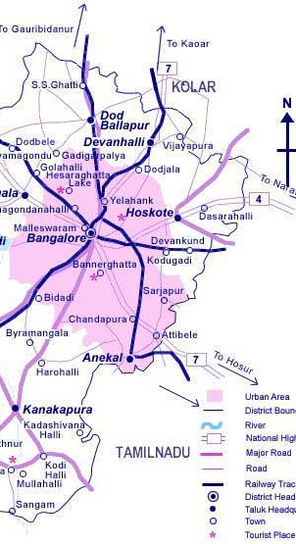
Urbanization
Urban Agglomeration
An urban agglomeration is a continuous urban spread constituting a town and its adjoining outgrowths (OGs), or two or more physically contiguous towns together with or without outgrowths of such towns. An Urban Agglomeration must consist of at least a statutory town and its total population (i.e. all the constituents put together) should not be less than 20,000 as per the 2001 Census. In varying local conditions, there were similar other combinations which have been treated as urban agglomerations satisfying the basic condition of contiguity.
Ref: UNICEf: SOWC 2012. Definitions
Notes:
Examples: Greater Mumbai UA, Delhi UA, etc. For example, The urban agglomeration of Tokyo includes the cities of Chiba, Kawasaki, Yokohama and others.

Slide 13
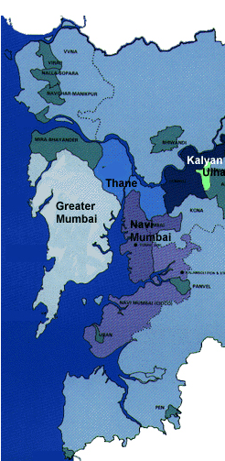
Urbanization
Metropolitan area/region
A formal local government area comprising the urban area as a whole and its primary commuter areas, typically formed around a city with a large concentration of people (i.e., a population of at least 100,000). In addition to the city proper, a metropolitan area includes both the surrounding territory with urban levels of residential density and some additional lower-density areas that are adjacent to and linked to the city (e.g., through frequent transport, road linkages or commuting facilities). Examples of metropolitan areas include Greater London and Metro Manila.
Ref: UNICEf: SOWC 2012. Definitions
Notes:
Examples: Greater Mumbai UA, Delhi UA, etc. For example, The urban agglomeration of Tokyo includes the cities of Chiba, Kawasaki, Yokohama and others.

Slide 14
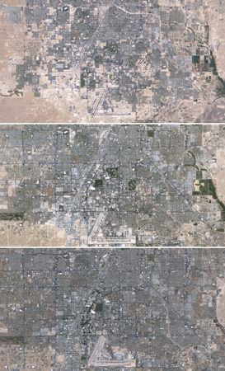
Urbanization
Urban sprawl
Also ‘horizontal spreading’ or ‘dispersed urbanization’. The uncontrolled and disproportionate expansion of an urban area into the surrounding countryside, forming low-density, poorly planned patterns of development. Common in both high-income and low-income countries, urban sprawl is characterized by a scattered population living in separate residential areas, with long blocks and poor access, often over dependent on motorized transport and missing well-defined hubs of commercial activity.
Ref: UNICEf: SOWC 2012. Definitions
Notes:
LA 1984, 1999, 2009

Slide 15
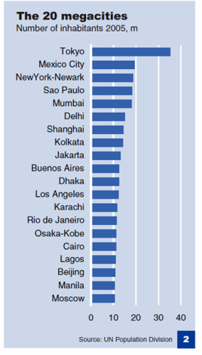
Urbanization
Peri-urban area
An area between consolidated urban and rural regions.
Megacity
An urban agglomeration with a population of 10 million or more. In 2009, 21 urban agglomerations qualified as megacities, accounting for 9.4 per cent of the world’s urban population.
In 1975, New York, Tokyo and Mexico City were the only megacities.
Ref: UNICEf: SOWC 2012. Definitions
Notes:
Shanghai (23.4 million), Beijing, and Guangzhou-Foshan (20.6 million), are in middle-income China. The remaining top ten megacities of Jakarta, Delhi, Manila, and Karachi (22.1 million) are low income (Figure: 10 Largest Cities in the World:

Slide 16
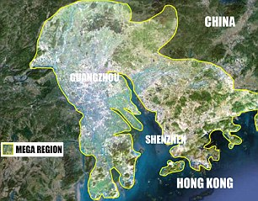
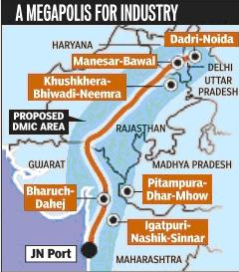
Urbanization
Metacity
A major conurbation – a megacity of more than 20 million people. As cities grow and merge, new urban configurations are formed. These include megaregions, urban corridors and city-regions.
Megaregion
A rapidly growing urban cluster surrounded by low-density hinterland, formed as a result of expansion, growth and geographical convergence of more than one metropolitan area and other agglomerations.
Urban corridor
A linear ‘ribbon’ system of urban organization: cities of various sizes linked through transportation and economic axes, often running between major cities.
Ref: UNICEf: SOWC 2012. Definitions
Notes:
Today, mega-regions are absorbing even larger populations than mega- or meta-cities, (which UN-HABITAT defines as hosting upward of 20 million residents), and their economic output is enormous. Examples cited in the report include: s #HINAS Hong Kong-Shenzen-Guangzhou mega-region, home to 120 million people s *APANSNagoya-Osaka-Kyoto-Kobe, likely to hold 60 million by 2015 s "RAZILSSão Paulo to Rio de Janeiro mega-region where 43 million people now live
Central Asia: the industrial corridor developing in India between Mumbai and Delhi, will stretch over 1500 KILOMETRES FROM jAWAHARLAL nEHRU port IN nAVI-UMBAI TO dadri and tughlakabad in South-East Asia: the manufacturing and service industry corridor in Malaysia’s Kuala Lumpur is clustered within the Klang Valley conurbation that stretches to the port city of Klang

Slide 17
Urbanization
How are urban areas defined in India according to the census of India
The 1961 census adopted a strict definition which was modified in 1971 census to treat all places satisfying the following conditions as towns:-
All municipal corporations, municipal boards, cantonments and notified areas.
All localities though not in themselves local bodies but forming part of a city or town agglomeration.
Other places satisfying all three following conditions.
Population exceeds 5,000
At least 75 per cent of the male working population engages in non agricultural pursuits
The density of population exceeds 400 persons per square km.
All towns and urban agglomerations, so identified, are grouped into following six classes according to population size:
Class I: population of 100,000 and above
Class II: population of 50,000 to 99,999
Class III: population of 20,000 to 49,999
Class IV: population of 10,000 to 19,999
Class V: population of 5,000 to 9,999
Class VI: population less than 5,000
Any urban area with population exceeding 1,00,000 is called a city.
Notes:
The term 'urban' is related to town or cities. Unlike in rural areas here majority of the employed inhabitants are engaged in non agricultural activities and it is endowed with large nucleated settlements and industries. Urban areas may be defined by national governments based on their own criteria for example size, population density, occupation of people and type of local government. The multidimensional character of urban areas posed hindrance in giving a precise definition for them. The census of India until 1951 defined an urban settlement based on municipalities and the population of area
In 1981 census some minor changes were incorporated whereby livestock, forestry, fishing, hunting, plantations, orchard etc. were treated as agricultural activity and places having distinct urban characteristics and physical amenities like industrial area, special project area, large housing colonies, places of tourist interest, railway colonies, etc could be regarded as towns at the discretion of the Director of Census operations in consultation with the concerned state governments.

Slide 18
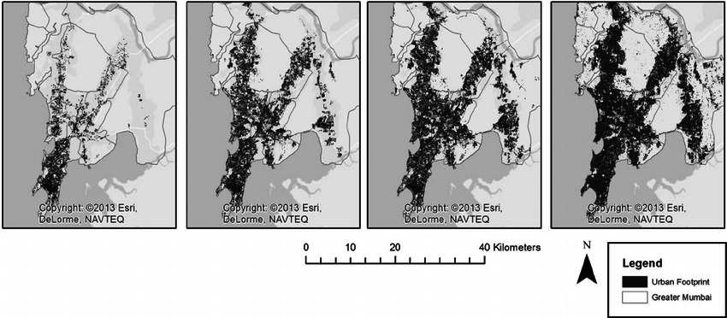
Urban Growth
Notes:
73, 90, 2001, 2010

Slide 19
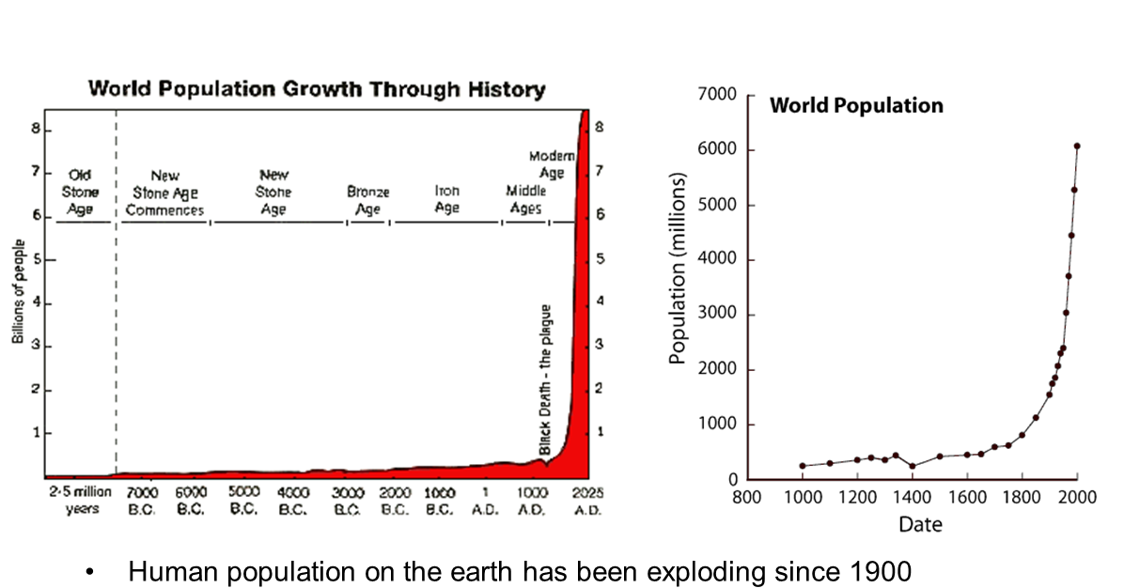
World Population
Notes:
73, 90, 2001, 2010

Slide 20
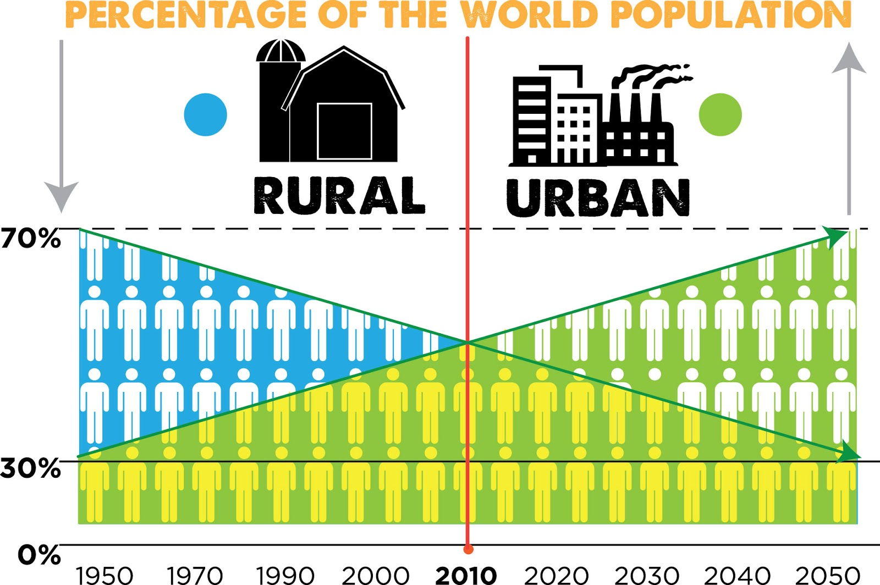
World Population

Slide 21
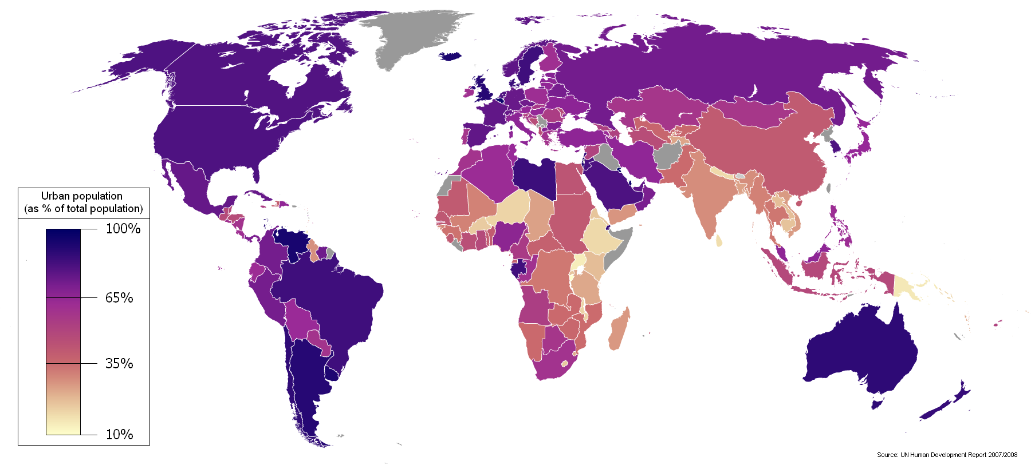
World Population
Notes:
. Industrialization:, Social factors: Employment opportunities, Modernization - sophisticated technology better infrastructure, communication, medical facilities, etc. People feel that they can lead a comfortable life in cities and migrate to cities.
Rural urban transformation, Spread of education:

Slide 22
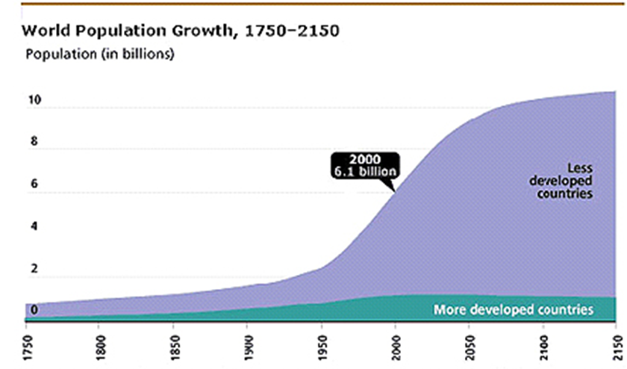
World Population
Notes:
Positive effect: Migration of rural people to urban areas. Employment opportunities in urban centers. iii. Transport and communication facilities. Educational facilities.
Increase in the standard of living. Problem of over population:
Concentration of population is a major problem of cities. It has resulted in accommodation problem, growth of slums etc.
2. Disintegration of Joint family:
Joint family can’t be maintained in cities on account of high cost of living: People prefer to live in the nuclear type of families so that cost of living might come down.
iii. Cost of living:
High cost of living is a major problem of cities. In Metro cities like Mumbai, Bangalore etc. it is very difficult for lower income groups to maintain a decent standard of living.
Increase in Crime rates:
Urban centers are known for high rate of crimes. Theft, Murder, Cheating, Pick pocketing, rape etc. are common in urban centers.
2. Impersonal relations:
Urban centers are characterised by highly secondary relations. The concept of neighborhood, community life are almost absent in cities. Urban life is highly monotonous. This may have an adverse psychological effect on individuals. People are often self centered and they have no concern for the fellow human beings.
3. Problem of Pollution:
In industrialized cities pollution is a major problems. It may be caused by industries or by excessive movement of vehicles.
viii. Stress:
Urban life is characterized by stress which may even strain family relations. In cities employment of women is almost inevitable to meet the increasing cost of living. Changing role of women in the family creates stress in the family which may result in divorce or strained relations.
Thus urbanization has its own merits and demerits. Urbanization can’t be avoided. But the negative effect of urbanization can be minimised.

Slide 23
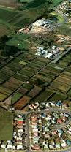
Urban Environment
Urbanization converts land at the rural urban fringe to uses such as residential, development, commercial estates, etc.
It may affect land which is regarded as an environmental asset such as remnant bush-land or a well-managed private holding, or which is economically valuable with agricultural or mineral potential.
Land at the rural-urban fringe is also used for activities that service urban areas such as waste disposal or gravel extraction
Ref: CEPT 2012. CCUE

Slide 24
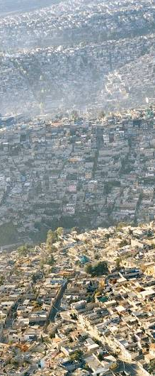
Urban Environment
The environmental impacts of urban expansion reach far beyond urban areas themselves. In rapidly urbanizing areas, agriculture intensifies on remaining undeveloped land and is likely to expand to new areas, putting pressure on land resources (Jiang et al., 2013). Furthermore, urban areas change precipitation patterns at scales of hundreds of square kilometres (Kaufman et al., 2007) . Urban expansion will affect global climate as well. Direct loss in vegetation biomass from areas with high probability of urban expansion is predicted to contribute about 5% of total emissions from tropical deforestation and land-use change (Seto et al., 2012).
Ref: CEPT 2012. CCUE
Notes:
The scope and scale of these impacts is yet to be fully researched. Although many studies have described how urbanization affects CO₂ emissions and heat budgets, effects on the circulation of water, aerosols, and nitrogen in the climate system are only beginning to be understood (Seto & Shepherd, 2009).
Mexico City, for example, highlights the issue of overpopulation

Slide 25
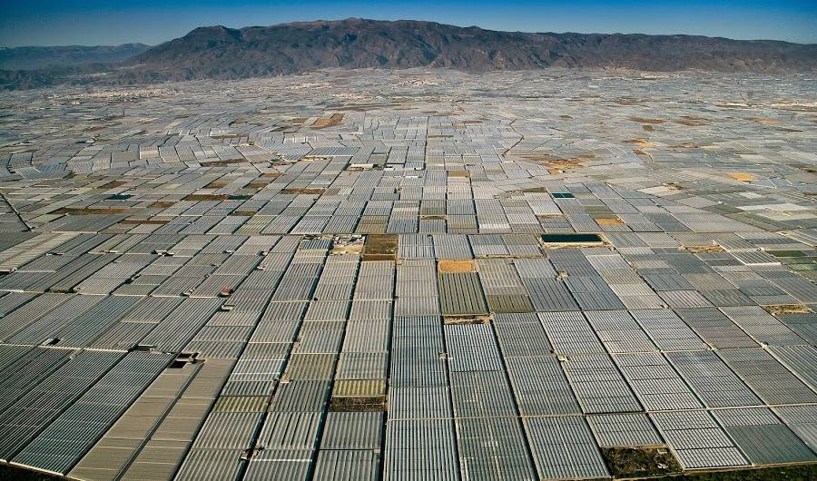
Urban Environment
Irrespective of being aware of the fact , more land is being put to urban use
We forget that for urbanization - “Man Is dependent on the environment.”
Human activities at various times has involved a good deal of irrational behaviour or behaviour without thinking of the consequences.
With increasing intensity of urbanization, human society has adapted environing nature and has made all kind of incursions into it.
Ref: CEPT 2012. CCUE
Notes:
his image shows industrial agriculture in Spain. These fields stretch for miles and have made a lasting impact on the landscape. This is a perfect example of what the foundation calls “the industrialization of all activities
ndustrial agriculture is a form of modern farming that refers to the industrialized production of livestock, poultry, fish, and crops. The methods of industrial agriculture are technoscientific, economic, and political.

Slide 26
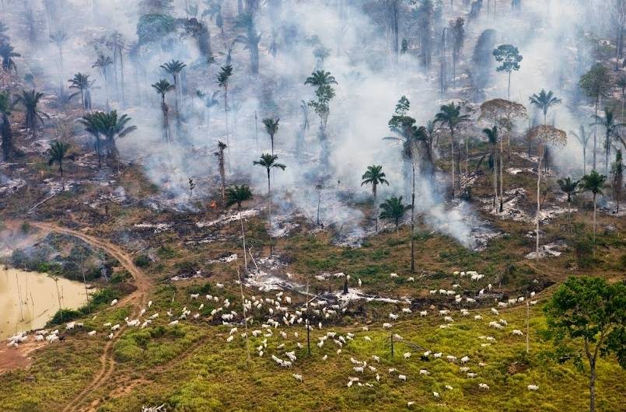
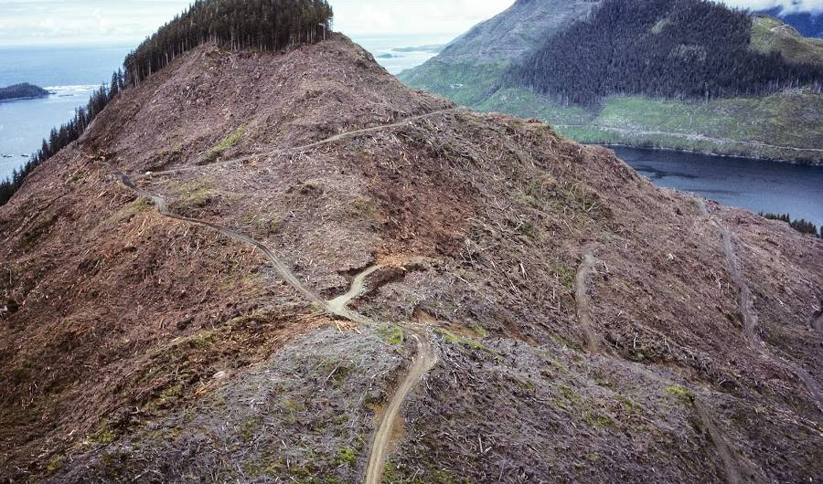
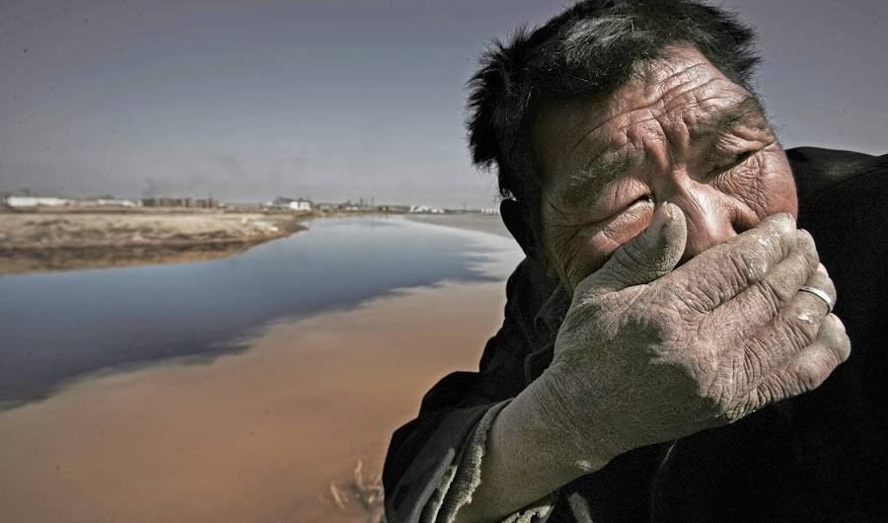
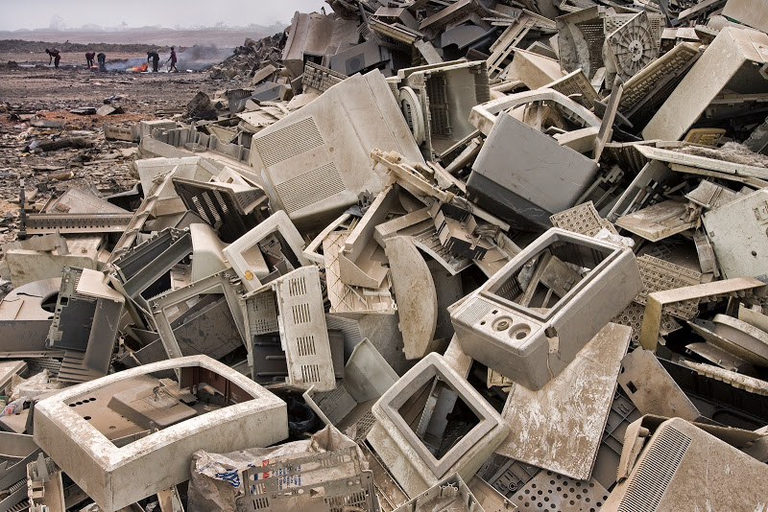
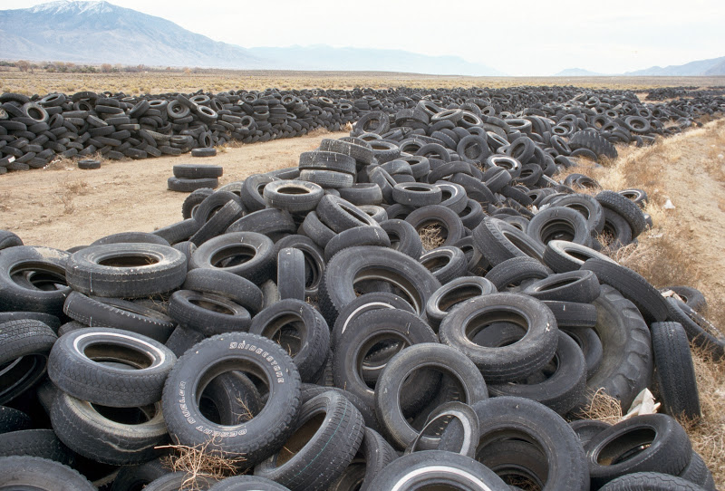
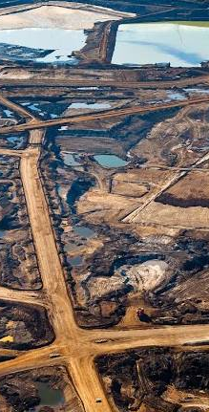
Urban Environment
The environmental impacts of urban expansion reach far beyond urban areas themselves. In rapidly urbanizing areas, agriculture intensifies on remaining undeveloped land and is likely to expand to new areas, putting pressure on land resources (Jiang et al., 2013). Furthermore, urban areas change precipitation patterns at scales of hundreds of square kilometers (Kaufman et al., 2007) . Urban expansion will affect global climate as well. Direct loss in vegetation biomass from areas with high probability of urban expansion is predicted to contribute about 5% of total emissions from tropical deforestation and land-use change (Seto et al., 2012). Although many studies have described how urbanization affects CO₂ emissions and heat budgets, effects on the circulation of water, aerosols, and nitrogen in the climate system are only beginning to be understood (Seto & Shepherd, 2009).
National Geographic: Rising Seas
Notes:
tar sands and open-pit mining in Canada. Tar sands are dug from the ground and then refined to extract bitumen. This is then used in the production of petroleum, giving off 12 percent more emissions than regular crude oil, according to the Government of Alberta. In fact, the landscape destruction from the mining site is so expansive, astronauts have photographed it from the International Space Station.
crapheap of computer monitors is not far from Accra, Ghana, where a large proportion of the world’s electronic waste ends up illegally. Here boys as young as seven earn $2.50 a day smashing open electronics and extracting their interior metals and minerals. Before it became a waste site, though, the area hosted a wetland and recreational space; now the smell of burning plastic fills the air.
this photo of car tires abandoned in the Nevada desert exemplifies the problem of vehicular waste.
Shows a man in China covering his mouth and turning away from the smell of the Yellow River. In 2007 the Yellow River Conservancy Commission found that 4.29 billion tons of waste and sewage were dumped into the river the previous year, and that a third of the river was now unsuitable, even for agriculture use.
Deforestation in canada
It shows a rainforest in the Amazon jungle being burnt to make room for cattle grazing. What’s more, with a contribution of about 30 percent, deforestation is almost an equal partner in greenhouse gas emissions as the global transportation sector.

Slide 27
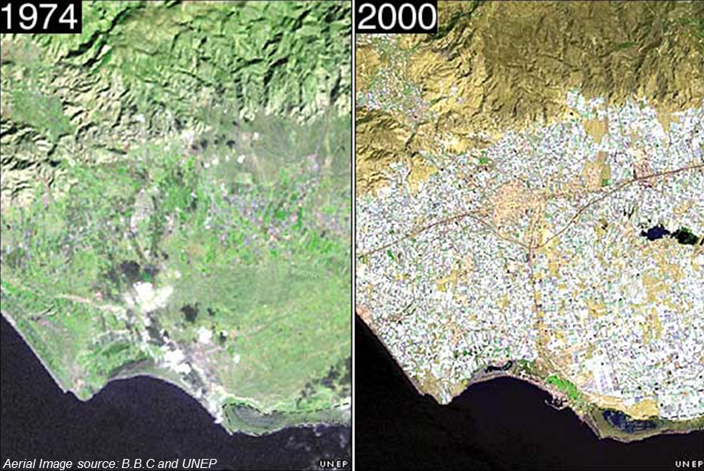
Urban Environment
Notes:
Almeira province of southern Spain – farmland converted to greenhouses for mass production

Slide 28
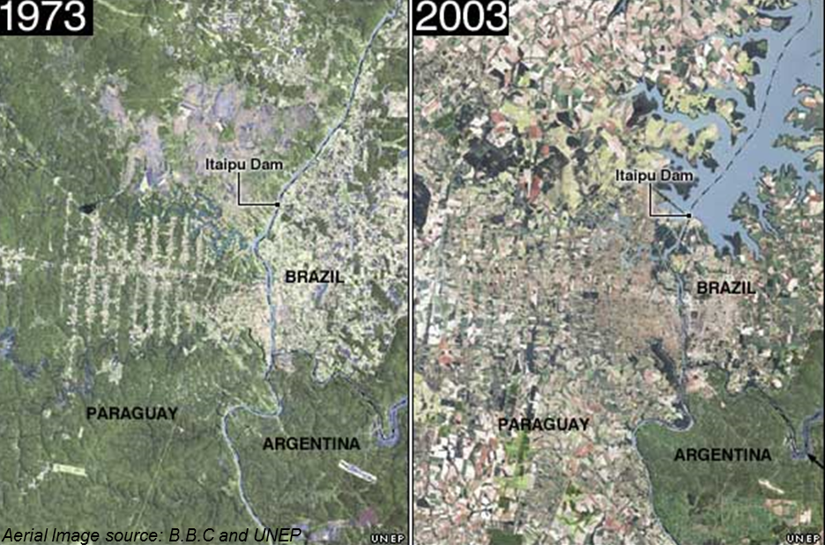
Urban Environment
Notes:
Igazou national park in Argentina near its borders with Brazil and Paraguay contains remnants of a highly endangered forest
Effect of deforestation

Slide 29
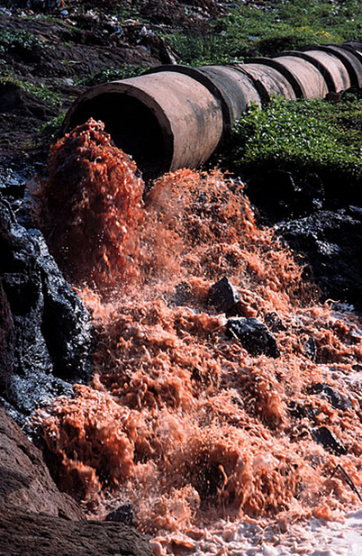
Consequences
Implications of rapid rise in population
Increased consumption of resources
Over exploitation and loss of forest areas and bio-diversity
Rise in generation of waste water, effluents, solid waste, etc.
Deteriorating air quality water quality, soil quality etc
Increase in disease outbreaks
Ref: CEPT 2012. CCUE
Notes:
Urbanization leads to development which in turn leads to consumption of fossil fuels
Various urban sectors, eg transpotation construction, industries etc consume large amount of fossil fuels
That generate GHG which has lead to global warming

Slide 30
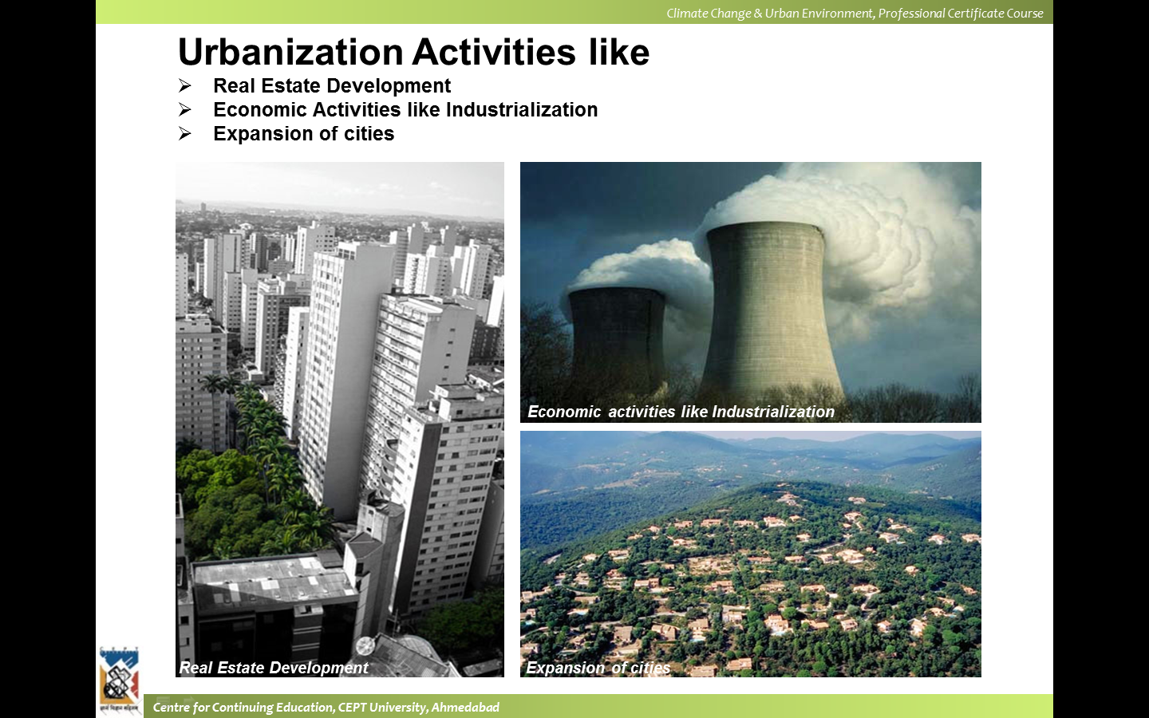
Consequences
Ref: CEPT 2012. CCUE
Notes:
Construction, Industrialization expansion of cities

Slide 31
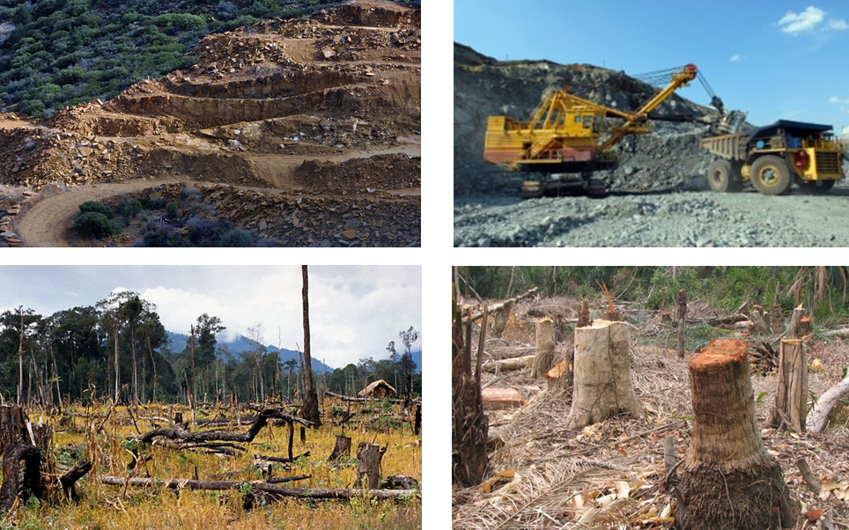
Consequences
Ref: CEPT 2012. CCUE
Notes:
Deforestation clearing of land, mining

Slide 32

Consequences
Ref: CEPT 2012. CCUE
Notes:
Air, land and water pollution

Slide 33
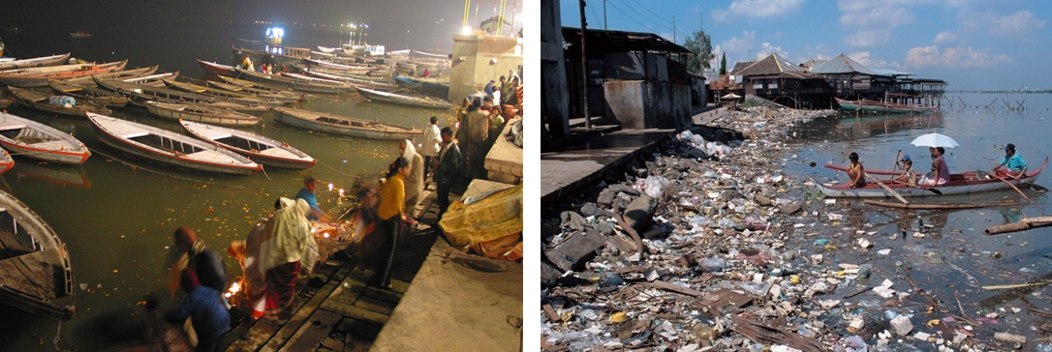
Consequences
Represents health and hygiene levels in the city
Indicates quality of life in the city
Decisive factor in creating the image of a city
Ref: CEPT 2012. CCUE
Notes:
Degradation of natural resources

Slide 34
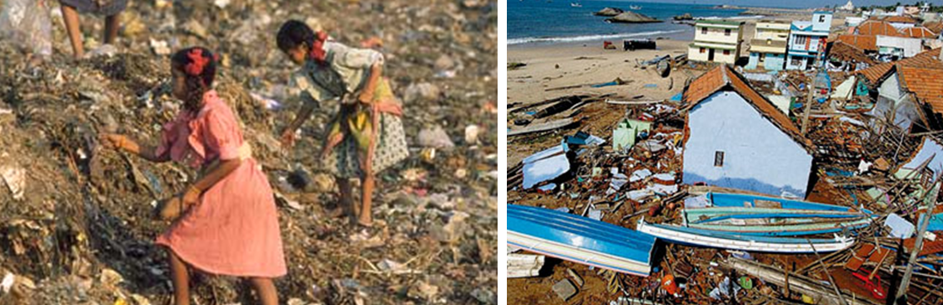
Consequences
Limited resources available – 2% of the earth’s surface consumes 75% of resources, 60% water goes to urban areas and rest for irrigation, industry and drinking
Apathetic attitude of citizens towards cleanliness of he city
Urban development mechanisms and urban management systems also adds to problems related to the poor environment quality
Ref: CEPT 2012. CCUE
Notes:
Cities claim ecological output and life support functions of nearby areas as well as distant regions
Emvironmental impact increases with urbanization as well as per capita demand
Cities become prone to natural hazards
Man – made hazards like health hazards
Polluted environment and disease outbreaks

Slide 35
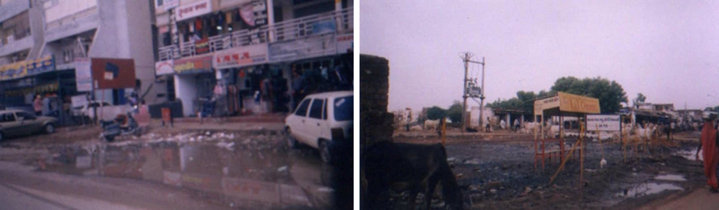
Consequences
Limited resources available
Apathetic attitude of citizens towards cleanliness of he city
Urban development mechanisms and urban management systems also adds to problems related to the poor environment quality
Ref: CEPT 2012. CCUE
Notes:
Ultimately you have poor, unhealthy and unlivable conditions
Basic needs of housing and services are not met
Pollution and environmeent degradation
Jobs and economic opportunities
Inadequate social and oublic utilities eg hospitals schools
Lack of infrastructure

Slide 36
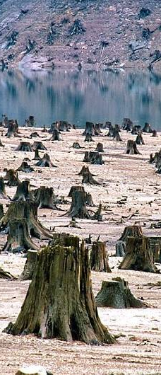
Environmental Concerns
Environmental Pollution
Air
Water
Soil
Noise
Industrial
Urban Environmental Quality
Urban Heat Island
Ref: CEPT 2012. CCUE
Notes:
t’s the remains of an old-growth forest in Willamette National Forest, Oregon, that was cut down in order to build a reservoir.
Old-growth forests are usually home to rare species, and leveling them can effect biodiversity both within the forest and the surrounding area.

Slide 37
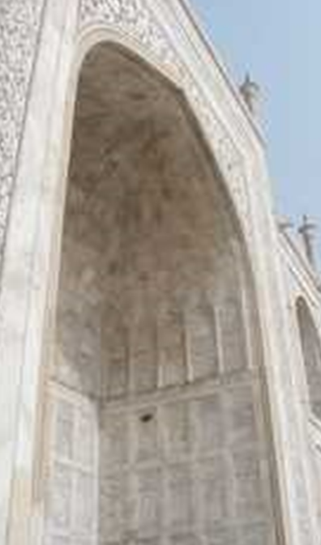
Environmental Concerns
Pollution
The presence in or introduction into the environment of a substance which has harmful or poisonous effects.
Environmental Pollution
An undesirable change in the physical, chemical or biological characteristics of the air, water, or land that can harmfully affect health, survival or activities of human or other living organisms
Ref: CEPT 2012. CCUE

Slide 38
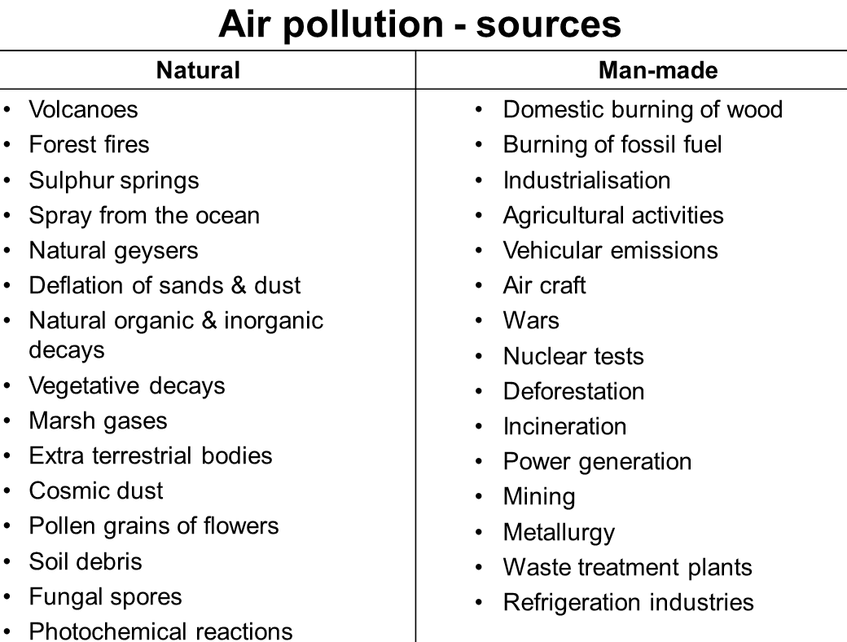
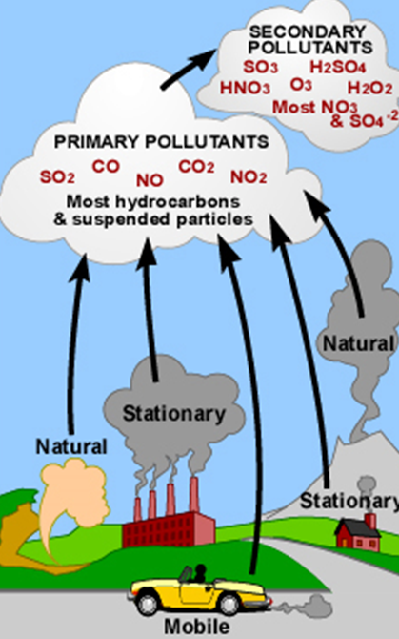
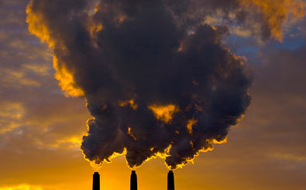

Environmental Concerns
Air Pollution
Industry
Vehicles
Burning of waste
Dust from vehicles, construction
Volcano
Forest Fires
Ref: CEPT 2012. CCUE
Notes:
Secondary – react to for new pollutants

Slide 39
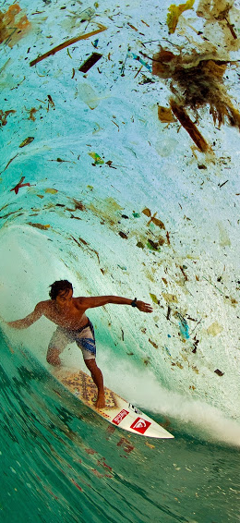
Effects of Pollution
Pollutants causing health effects
Sulphur Oxide
Carbon Monoxide
Hydrogen Sulphide
Ozone
Lead
Flourides
Hydrocarbon vapours
Carcinogenic agents
Insecticides
Radioactive Isotopes
Ref: CEPT 2012. CCUE
Notes:
Surfer riding a debris-choked wave in Indonesia. Moreover, according to National Geographic, there are more than 5 trillion pieces of plastic littering the ocean.

Slide 40



Effects of Pollution
Factors affecting human health
Nature of pollutant
Concentration
Duration of exposure
State of health of receptor
Age group of receptor
Ref: CEPT 2012. CCUE
Notes:
Secondary – react to for new pollutants
Particulate matter (PM), also known as particle pollution, is a complex mixture of extremely small particles and liquid droplets that get into the air. Once inhaled, these particles can affect the heart and lungs and cause serious health effects. dust, dirt, soot, or smoke. Some are emitted directly from a source, such as construction sites, unpaved roads, fields, smokestacks or fires.
PM 10 is matter that is less than 10 micrometers in dia

Slide 41

Effects of Pollution
Notes:
Secondary – react to for new pollutants

Slide 42


Environmental Concerns
Water Pollution
Phenomenon that is characterised by the deterioration of the quality of land water or sea water as a result of human activities
It affects the planet as a whole, both developed and under-developed nations
The nature of water problems varies from place to place
Ref: CEPT 2012. CCUE

Slide 43


Classification
Ref: CEPT 2012. CCUE

Slide 44

Sources of pollution
Ref: CEPT 2012. CCUE
Notes:
A feedlot or feed yard is a type of animal feeding operation (AFO) which is used in intensive animal farming for finishing livestock, notably beef cattle, but also swine, horses, sheep, turkeys, chickens or ducks, prior to slaughter

Slide 45




Effects of pollution
Ref: CEPT 2012. CCUE
Notes:
The most common source of fluoride pollution is coal, which releases fluorides when it is burned.

Slide 46

Environmental Concerns
Soil Pollution
Role of Soil
It forms part of natural and artificial environment and it is one of the ecosystem constituents alongwith the community of living organisms
It is merely a receptor of matter and energy flows reaching the earths surface, transforming and partly storing them
Ref: CEPT 2012. CCUE
Notes:
Soil is a natural layer on the surface of the eart that provides for the plant root system and soil organisms
Provides water and mineral salts to plants

Slide 47

Environmental Concerns
Soil Pollution
Fertility of soil is considered to be an important indicator to measure soil pollution
Pollution of soil is quite irreversible
Fertility of soil plays a large role in existence of vegetation and fauna as well as human welfare
Intensive cultivation of crops, mechanization and application of chemicals, irrigation and drainage works reduce soil fertility
Ref: CEPT 2012. CCUE
Notes:
Soil is a natural layer on the surface of the eart that provides for the plant root system and soil organisms
Provides water and mineral salts to plants

Slide 48


Sources of pollution
Ref: CEPT 2012. CCUE

Slide 49

Effects of pollution
Ref: CEPT 2012. CCUE

Slide 50

Environmental Concerns
Noise Pollution
Noise pollution or noise disturbance is the disturbing or excessive noise that may harm the activity or balance of human or animal life
Comparatively a new phenomenon but has seen an exponential increase due to population explosion, industrialization and urbanization
Occurs indoor as well as outdoor
It is characterized by short duration and decay time
Ref: CEPT 2012. CCUE

Slide 51


Sources of Pollution
Ref: CEPT 2012. CCUE

Slide 52

Characteristics
Ref: CEPT 2012. CCUE

Slide 53

Effects of pollution
Ref: CEPT 2012. CCUE

Slide 54


Effects of pollution
Ref: CEPT 2012. CCUE

Slide 55

Environmental Concerns
Light Pollution
Brightening of the night sky caused by street lights and other man-made sources, which has a disruptive effect on natural cycles and inhibits the observation of stars and planets.
Annoying Light
Excessive Light
Ref: CEPT 2012. CCUE
Notes:
Soil is a natural layer on the surface of the eart that provides for the plant root system and soil organisms
Provides water and mineral salts to plants

Slide 56



Environmental Concerns
Light Pollution - Types
Light Trespass
Over Illumination
Glare
Sky Glow
Causes
Advertising
Commercial Properties
Street
Lights
Stadiums (Sports)
Factories
Ref: CEPT 2012. CCUE
Notes:
Glare – contrast
Glow over populated areas – street, security, stadiums etc advertising
Lighht clutter

Slide 57

Effects of pollution
Ref: CEPT 2012. CCUE
Notes:
Urbanization and Governance in India
Evelin Hust and Michael Mann

Slide 58
Reading
Urbanization and Governance in India
Evelin Hust, Michael Mann
Manohar, 2005
Notes:
Urbanization and Governance in India
Evelin Hust and Michael Mann

Slide 59

Climate
Introduction to Climate
Climate in a narrow sense is usually defined as the average weather, or more rigorously, as the statistical description in terms of the mean and variability of relevant quantities over a period of time ranging from months to thousands or millions of years. The classical period is 30 years, as defined by the World Meteorological Organization (WMO). These quantities are most often surface variables such as temperature, precipitation, and wind. Climate in a wider sense is the state, including a statistical description, of the climate system.
Ref: CEPT 2012. CCUE
Notes:
We can study climate on a range of geographical scales. At the smallest scale, local climates influence areas maybe only a few miles or tens of miles across. Examples of local climatic phenomena include sea breezes and urban heating. At larger scales, regional climates provide a picture of particular patterns of weather within individual countries, or within climate zones that exist at different latitudes on the Earth. Climate zones include tropical, subtropical, desert, Savannah, temperate and polar climates. Different climate zones reveal variable patterns of temperature and rainfall. At the largest scale of all, climatologists study the global climate, for example when they are interested in how it has changed in the past, and how it may change in the future.

Slide 60

Influences on Climate
Influences on Climate
Latitude – Temperature
Prevailing winds
Location – Mountains
Oceans
Vegetation – Forests
Human Activities – Fossil Fuel
Measuring Climate
Temperature
Humidity
Atmospheric Pressure
Wind
Rain
Ref: CEPT 2012. CCUE

Slide 61


Climate Change
Climate change refers to a change in the state of the climate that can be identified (e.g., by using statistical tests) by changes in the mean and/or the variability of its properties, and that persists for an extended period, typically decades or longer.
Climate change may be due to natural internal processes or external forcings, or to persistent anthropogenic changes in the composition of the atmosphere or in land use. Note that the United Nations Framework Convention on Climate Change (UNFCCC), in Article 1, defines climate change as: “a change of climate which is attributed directly or indirectly to human activity that alters the composition of the global atmosphere and which is in addition to natural climate variability observed over comparable time periods.” The UNFCCC thus makes a distinction between climate change attributable to human activities altering the atmospheric composition, and climate variability attributable to natural causes.
Ref: CEPT 2012. CCUE
Notes:
california

Slide 62

Adaptive Capacity
The ability of a system [human or natural] to adjust to climate change (including climate variability and extremes) to moderate potential damages, to take advantage of opportunities, or to cope with the consequences.
An adjustment in natural or human systems in response to actual or expected climatic stimuli or their effects, which moderates harm or exploits beneficial opportunities.
Ref: ISDR
Notes:
california

Slide 63

Disaster Risk
Disaster risk signifies the possibility of adverse effects in the future. It derives from the interaction of social and environmental processes, from the combination of physical hazards and the vulnerabilities of exposed elements.
The hazard event is not the sole driver of risk, and there is high confidence that the levels of adverse effects are in good part determined by the vulnerability and exposure of societies and social-ecological systems (UNDRO, 1980; Cuny, 1984; Cardona, 1986, 1993, 2011; Davis and Wall, 1992; UNISDR, 2004, 2009b; Birkmann, 2006a,b; van Aalst 2006a).
Ref: ISDR
Notes:
california

Slide 64

Exposure
People, property, systems, or other elements present in hazard zones that are thereby subject to potential losses.
Comment: Measures of exposure can include the number of people or types of assets in an area. These can be combined with the specific vulnerability of the exposed elements to any particular hazard to estimate the quantitative risks associated with that hazard in the area of interest.
Susceptibility
The state or fact of being likely or liable to be influenced or harmed by a particular thing.
Ref: ISDR
Notes:
Exposure towards natural hazards such as earthquakes, cyclones, flooding, drought and sea level rise,
susceptibility depending on infrastructure, food, housing and economic framework conditions,

Slide 65

Hazards
Hazards are potentially damaging physical events, phenomena, or human activities that cause loss of life, injury, property damage, social and economic disruption, or environmental degradation (Makoka & Kaplan, 2005).
They are external factors that affect society or elements at risk, whereas vulnerabilities are the internal factors that affect the transformation of hazards into disasters.
Ref: ISDR
Notes:
california

Slide 66

Natural Hazards
Natural process or phenomenon that may cause loss of life, injury or other health impacts, property damage, loss of livelihoods and services, social and economic disruption, or environmental damage.
Natural hazards are naturally occurring physical phenomena caused either by rapid or slow onset events which can be geophysical (earthquakes, landslides, tsunamis and volcanic activity), hydrological (avalanches and floods), climatological (extreme temperatures, drought and wildfires), meteorological (cyclones and storms/wave surges) or biological (disease epidemics and insect/animal plagues).
Ref: ISDR
Notes:
Natural hazards are a sub-set of all hazards. The term is used to describe actual hazard events as well as the latent hazard conditions that may give rise to future events. Natural hazard events can be characterized by their magnitude or intensity, speed of onset, duration, and area of extent. For example, earthquakes have short durations and usually affect a relatively small region, whereas droughts are slow to develop and fade away and often affect large regions. In some cases hazards may be coupled, as in the flood caused by a hurricane or the tsunami that is created by an earthquake.

Slide 67

Man-made Hazards
Technological or man-made hazards (complex emergencies/conflicts, famine, displaced populations, industrial accidents and transport accidents) are events that are caused by humans and occur in or close to human settlements. This can include environmental degradation, pollution and accidents. Technological or man-made hazards (complex emergencies/conflicts, famine, displaced populations, industrial accidents and transport accidents)
There are a range of challenges, such as climate change, unplanned-urbanization, under-development/poverty as well as the threat of pandemics, that will shape humanitarian assistance in the future. These aggravating factors will result in increased frequency, complexity and severity of disasters.
Ref: ISDR
Notes:
california

Slide 68

Resilience
Resilience is the ability of a system, community or society exposed to hazards to resist, absorb, accommodate and recover from the effects of a hazard in a timely and efficient manner, including through the preservation and restoration of its essential basic structures.
Ref: ISDR
Notes:
A resilient community is one that can absorb disturbances, change, reorganize and then still retain the same basic structures and provide the same services.13 As a concept, resilience can be specifically applied to any community and any type of disturbance: natural, man-made, or a combination of the two. Disaster resilience can be seen as a public good that builds an appropriate amount of redundancy into urban systems and encourages communities to plan for dealing with disruptions

Slide 69

Vulnerability
The characteristics and circumstances of a community, system or asset that make it susceptible to the damaging effects of a hazard.
The degree to which a system is susceptible to, or unable to cope with, adverse effects of climate change, including climate variability and extremes. Vulnerability is a function of the character, magnitude, and rate of climate variation to which a system is exposed, its sensitivity, and its adaptive capacity.” (IPCC)
Ref: ISDR
Notes:
There are many aspects of vulnerability, arising from various physical, social, economic, and environmental factors. Examples may include poor design and construction of buildings, inadequate protection of assets, lack of public information and awareness, limited official recognition of risks and preparedness measures, and disregard for wise environmental management. Vulnerability varies significantly within a community and over time. This definition identifies vulnerability as a characteristic of the element of interest (community, system or asset) which is independent of its exposure. However, in common use the word is often used more broadly to include the element’s exposure.

Slide 70
Climate Change and Cities
Cities face significant impacts from climate change, both now and into the future.
These impacts have potentially serious consequences for human health, livelihoods, and assets, especially for the urban poor, informal settlements, and other vulnerable groups. Climate change impacts range from an increase in extreme weather events and flooding to hotter temperatures and public health concerns. Cities in low-elevation coastal zones, for instance, face the combined threat of sea-level rise and storm surges. The specific impacts on each city will depend on the actual changes in climate experienced (for example, higher temperatures or increased rainfall), which will vary from place to place.
Ref: IBRD 2011. Guide to Climate Change Adaptation in Cities
Notes:
So what is the problem? We have always faced these issues

Slide 71

Climate Change and Cities
Climate change will increase the frequency at which some natural hazards occur, especially extreme weather events, and introduce new incremental impacts that are less immediate.
However, few climate impacts will be truly unfamiliar to cities. Cities have always lived with natural hazards, such as earthquakes, tsunamis, hurricanes, and flooding. In some situations, cities will experience an increase in
the frequency of existing climate-related hazards, such as flooding.
Ref: IBRD 2011. Guide to Climate Change Adaptation in Cities
Notes:
So what is the problem? We have always faced these issues

Slide 72


Range of Impacts
The urban heat island effect—cities are generally warmer than surrounding rural areas because of higher heat absorption and relatively limited cooling associated with vegetation and permeable surfaces 
Air pollution, which is exacerbated by high temperatures
Existing climate extremes, such as hurricanes and typhoons (although the exact relationships with climate change have yet to be fully established)
Notes:
Nonclimate related trends, such as land subsidence, can also be drivers of risk for natural hazards, such as flooding, as noted in a World Bank study of three Asian coastal megacities (World Bank 2010a).
In conjunction with these existing issues, the impacts of climate change on cities will depend on the actual changes in climate experienced, such as higher temperatures and increased rainfall. These will vary from place to place. For example, cities in low-elevation coastal zones with land subsidence may be affected by rising sea levels and storm surges. Cities in hot climates (or in temperate regions with hot summers) may be affected by longer and more severe heat waves. The World Bank’s Climate Resilient Cities primer (available at www.worldbank.org/eap/climatecities) provides guidance on how cities can scope possible climate change impacts based on their geographic location (for example, sea level rise as a threat for coastal cities) (World Bank 2009).

Slide 73

Consequences
Changes in climate will in turn have a range of
short-term and long-term consequences for cities—
on human health, physical assets, economic activities, and social systems—depending on how well prepared a city is and how it responds
Ref: ISDR

Slide 74


Indirect Impact
Climate change will also affect cities indirectly through effects on areas and systems outside of cities.
Water quality and quantity may be reduced by expected increases in droughts, especially from sources (for example, snowpack) outside of city borders, with a host of consequences from threatened drinking water supply to reduced agricultural production that affects food security in cities
Energy transmission and distribution may be overstressed because of increased incidence or duration of summer heat waves, in conjunction with energy demand for cooling. Cities may also experience greater in-migration from rural inhabitants pressured by drought or other climate extremes. Climate change is increasingly being discussed as an emerging global security issue—a threat to the well-being, safety, and survival of people around the world
Notes:
Examples of historical and estimated costs of climate-related disasters include the following: Hurricane Katrina was estimated to cost the United States over $100 billion (NOAA 2011).

Slide 75

Informal Settlements
An informal settlement is characterized by its inhabitants’ complete or partial lack of basic rights and institutional as well as legal security. This particularly includes formal landownership or land use titling and the right to access basic (social) infrastructure. Informal settlements are often marginal settlements in places with unfavourable settlement conditions (e.g. close to dumpsites, in flood plains or at steep slopes). Informal settlements consist predominantly of makeshift housing. Their inhabitants often live below the poverty line. In most cases informal settlements are unplanned urban quarters.
Ref: IBRD 2011. Guide to Climate Change Adaptation in Cities

Slide 76

Slum
An inner-urban settlement with substandard living conditions which is, unlike informal or marginal settlements in peri-urban or newly urbanized areas, originally understood as an emergency accommodation in dilapidated parts of the existing city. The housing standards and the infrastructure conditions are correspondingly poor. In developing countries, but also in some industrialized countries, they often serve to absorb new urban immigrants. Slums are frequently of informal status.
Ref: IBRD 2011. Guide to Climate Change Adaptation in Cities

Slide 77

Impacts on the Urban Poor
People living in informal settlements (numbering nearly one billion worldwide, or nearly one-third of the world’s urban population) often lack the following critical living conditions:
Access to improved water
Access to improved sanitation facilities
Sufficient living area (not more than three people sharing room)
Structural quality and durability of dwellings
Security of tenure (UN-HABITAT 2006; UN-HABITAT 2008)
As a direct result, many of these people live with a constant risk to their lives and homes from disasters, such as storms, floods, landslides, heat waves, and droughts.
Notes:
Rapid urbanization because of population growth and migration from rural areas, combined with lack of affordable housing, has been associated with the development of informal settlements on marginal land in and near cities. The urban poor—an increasing number of whom are migrants from areas affected by climate change impacts— tend to live in marginal areas of the urban landscape: on steep slopes, along riverbanks and transportation corridors, and in floodplains.

Slide 78

Impacts on the Urban Poor
Climate change will place unique burdens on the urban poor, residents of informal settlements, and other vulnerable groups, such as women, children, the elderly and disabled, and minority populations.
A critical step in helping the most vulnerable adapt to climate change is to understand the specific impacts that they face in each city.

Slide 79

Climate Change Adaptation
Climate change adaptation consists of “initiatives and measures to reduce the vulnerability of natural and human systems against actual or expected climate change effects” (IPCC 2007).
Both through informal preparations and formal planning activities, cities can build their resilience and capacity to adapt to existing and future climate change impacts.

Slide 80
Why Adapt?
Climate change can affect a city’s ability to achieve existing development goals.
Major development decisions taken today in cities have long-term implications, offering important and time-sensitive opportunities to adapt.
Adaptation can offer co-benefits for climate change mitigation, and a well-balanced city climate agenda can increase opportunities for accessing climate finance.
Notes:
Climate change and its associated impacts can jeopardize progress in meeting the denied needs. For example, severe flooding could lead to indirect impacts (such as a localized increase in water-borne diseases) that had been previously reduced by improved sanitation.

Slide 81

Building Resilience
Just as cities assess, manage, and limit the risks of disasters in order to protect their populations, they can similarly address the risks of climate change impacts. Managing these risks—and building long-term resilience—involves understanding the level of exposure and sensitivity to a given set of impacts, developing policies and investments that will limit vulnerabilities, and enhancing adaptive capacity.
Ref: IBRD 2011. Guide to Climate Change Adaptation in Cities
Notes:
Climate change and its associated impacts can jeopardize progress in meeting the denied needs. For example, severe flooding could lead to indirect impacts (such as a localized increase in water-borne diseases) that had been previously reduced by improved sanitation.
Adaptive capacity is determined by: ‘the characteristics of communities, countries and regions that influence their propensity or ability to adapt’ (IPCC, 2001, p. 18). These characteristics have dimensions that are generic, and also those that are specific to particular climate change risks (Adger et al., 2007). A

Slide 82


Slide 83

Why Adapt?
Climate change can affect a city’s ability to achieve existing development goals.
Major development decisions taken today in cities have long-term implications, offering important and time-sensitive opportunities to adapt.
Adaptation can offer co-benefits for climate change mitigation, and a well-balanced city climate agenda can increase opportunities for accessing climate finance.
Planning for future variability is not new and can help cities to capture sustainable development and disaster risk reduction benefits today
Adaptation can offer co-benefits for climate change mitigation, and a well-balanced city climate agenda can increase opportunities for accessing
climate finance.
Ref: IBRD 2011. Guide to Climate Change Adaptation in Cities
Notes:
Cities may also find that effective strategies to manage present-day concerns are also helpful in coping with climate change impacts— implementing
a water conservation program in anticipation of increased future drought risk can offer immediate benefits for managing current droughts.
Some actions can reduce greenhouse gas (GHG) emissions while helping cities to adapt to expected climate change. Energy efficiency, for example, is a
common strategy to reduce GHG emissions, while also decreasing electricity consumption, thereby reducing vulnerability to gridoverload and outages.

Slide 84

Basic Concepts
Climate change is expected to increase the frequency and severity of climate related hazard events, including extreme weather, and to introduce new incremental impacts that are less obvious and immediate.
Many cities face existing challenges related to urban poverty, basic service delivery, and inadequate infrastructure that represent barriers to sustainable development—the “development deficit.”
Ref: IBRD 2011. Guide to Climate Change Adaptation in Cities
Notes:
hazard events may become disasters, depending on the magnitude, location, and severity of impact on lives, livelihoods, and overall societal functioning

Slide 85

Resilient City
A resilient city is one that is able to adapt to disaster and climate impacts now and in the future, thereby limiting the magnitude and severity of those impacts. Once an impact occurs, a resilient city is able to evolve cost-effectively and equitably for all stakeholders. Building resilience towards climate change requires robust decision making by those in positions of formal authority, as well as a strong web of institutional and social relationships that provides formal and informal safety nets for the most vulnerable populations
Basically it can get back on its feet as soon as possible and with least expense.
Ref: IBRD 2011. Guide to Climate Change Adaptation in Cities
Notes:
hazard events may become disasters, depending on the magnitude, location, and severity of impact on lives, livelihoods, and overall societal functioning
Floating city - NY

Slide 86

Urban Resilience
Components
Social resilience - refers to the demographic profile of a community including by sex, age, ethnicity, disability, socio-economic status and other key groupings, as well as a community’s social capital.
Infrastructural resilience - refers to the vulnerability of built structures including property, buildings and transportation systems. It also refers to sheltering capacity, health care facilities, the vulnerability of buildings to hazards, critical infrastructure, and the availability of roads for evacuations and post- disaster supply lines. Infrastructural resilience also refers to a community’s capacity for response and recovery
UN_HABITAT 2016. EAP Guidelines
Notes:
Social capital, although it is difficult to quantify, refers to a sense of community, the ability of groups of citizens to adapt, and a sense of attachment to a place.

Slide 87

Urban Resilience
Components
Economic resilience refers to a measure of a community’s economic diversity as well as to the overall employment, number of businesses, and their ability to function following a disaster
Institutional resilience refers to the governmental and non-governmental systems that administer a community.
UN_HABITAT 2016. EAP Guidelines
Notes:
Social capital, although it is difficult to quantify, refers to a sense of community, the ability of groups of citizens to adapt, and a sense of attachment to a place.
Jakarta flooding 2013

Slide 88

Risk, Uncertainty
Drivers of risks, including rapid urbanization, environmental degradation, climate change impacts, and development-related processes, shape and configure hazards.
Uncertainty is the essential element of any disaster, referring to the disaster impacts that cannot be quantified or are completely unknown.
Climate change adds an additional layer of uncertainty
UN_HABITAT 2016. EAP Guidelines
Notes:
Hazardous locations, livelihood means etc
order to cope with uncertainty, cities have to adopt a robust approach to decision-making. This means taking into account potential weak spots and system failures, and adapting to a wider range of futures rather than focusing on optimal design solutions.

Slide 89

Complexity
Urban infrastructure refers to key systems and services, which are critically important for emergency response and the quick recovery of the community and its economy.
The ability to be flexible and adaptable to known and unknown disturbances is an important characteristic of a resilient system. In planning for disasters, there is always an element of uncertainty that requires additional preparation and redundancy in the system design.
The need for redundancy and alternatives increases with the size and complexity of an urban area. The complexity of urban infrastructure increases exponentially as urban areas expand in population and density
UN_HABITAT 2016. EAP Guidelines
Notes:
Hazardous locations, livelihood means etc
order to cope with uncertainty, cities have to adopt a robust approach to decision-making. This means taking into account potential weak spots and system failures, and adapting to a wider range of futures rather than focusing on optimal design solutions.
The design of these systems, including water, sanitation, energy, communications and transportation, needs to prepare for its failure, finding ways to both operate through redundant and back-up measures, as well as ways to fail or shut-down “gracefully” or in a way that is least damaging to the society. Traditional cost-benefit analysis, for instance, does not work well when dealing with catastrophic tail risk. A different approach is needed, which focuses on robust design and builds on investments in risk information, strategic communication, cross-sectoral cooperation, and well-planned response

Slide 90

Complexity
Cascading failures occur in a series in which specific
system components overload and fail. Major electrical blackouts are typical of this type of failure.
Disasters can cause several components to fail simultaneously, thus triggering the cascade. Cascading failures can also jump from one system to
another – failure of the electrical grid can result in major traffic disruptions, and lack of communications, further compounding the disaster.
Collocation failures occur when a catastrophic failure of one of the lifelines, such as a water main, then undermines or otherwise affects neighboring utilities, such as gas mains, power cables, or road infrastructure.
Resilience is a forward-looking approach that goes beyond risk mitigation and seeks to enhance capacity.
UN_HABITAT 2016. EAP Guidelines
Notes:
Due to land use pressures, these types of complex failures are difficult to mitigate. Redundancy planning and designing for failure during the early stages of development of an urban region is the ideal solution, but can be difficult to achieve in practice. Introducing resilience approaches can be perceived as reducing the efficiency of urban systems and increasing costs. Helping communities to understand the long term cost savings of resilience is central to addressing issues of risk and uncertainty
Illustration of cascading failures: Balboa Boulevard, 17 January 1994 Northridge earthquake (Los Angeles, USA)

Slide 91

DRM
All governments have an obligation to protect their citizens. As local governments are the first institutional levels to respond to disasters, they have a particular obligation to reduce disaster risk and build resilience within their communities.
Public institutions are accountable to manage and communicate risk. Creating and enforcing the accountability of city and municipal governments to effectively manage and communicate risk can be challenging.
UN_HABITAT 2016. EAP Guidelines
Notes:
For city and municipal governments, this includes: guiding where development takes place; providing safe and affordable Infrastructure and services; regulating building design and construction; regulating hazardous activities that can produce disasters; influencing land availability and what can be built on it; encouraging and
supporting household/community action that reduces risk; and providing adequate disaster early warning, preparedness and response systems. When urban governments fulfill these key roles, the levels of risk for their populations and economies are much reduced, and urbanization is associated with much lower risks.

Slide 92

DRM
All governments have an obligation to protect their citizens. As local governments are the first institutional levels to respond to disasters, they have a particular obligation to reduce disaster risk and build resilience within their communities.
Public institutions are accountable to manage and communicate risk. Creating and enforcing the accountability of city and municipal governments to effectively manage and communicate risk can be challenging.
Notes:
For city and municipal governments, this includes: guiding where development takes place; providing safe and affordable Infrastructure and services; regulating building design and construction; regulating hazardous activities that can produce disasters; influencing land availability and what can be built on it; encouraging and supporting household/community action that reduces risk; and providing adequate disaster early warning, preparedness and response systems. When urban governments fulfill these key roles, the levels of risk for their populations and economies are much reduced, and urbanization is associated with much lower risks.
Authorities must balance a multiplicity of competing economic, political and social interests, for example, whether to protect the mangroves that buffer storm surges or allow industrial development in coastal areas, whether to try to control population movements to high-risk sites or to direct the incentives and infrastructure
investments which would guide population movements towards safer sites.20 Some decisions and resources also are beyond their control at regional or national levels, or beyond their jurisdiction or sector.

Slide 93

DRM
A combination of measures is needed to ensure the accountability of government to its citizens for their safety
The development and enforcement of a legal and
institutional framework –
Promotion of the meaningful participation of community and other interest groups in the design, delivery and monitoring of disaster and climate-related risk management including the use of tools such as social audits
Clear delineation of the roles and responsibilities of all levels of government and civil society actors for disaster and climate-related risk management.
UN_HABITAT 2016. EAP Guidelines
Notes:
For city and municipal governments, this includes: guiding where development takes place; providing safe and affordable Infrastructure and services; regulating building design and construction; regulating hazardous activities that can produce disasters; influencing land availability and what can be built on it; encouraging and supporting household/community action that reduces risk; and providing adequate disaster early warning, preparedness and response systems. When urban governments fulfill these key roles, the levels of risk for their populations and economies are much reduced, and urbanization is associated with much lower risks.
Authorities must balance a multiplicity of competing economic, political and social interests, for example, whether to protect the mangroves that buffer storm surges or allow industrial development in coastal areas, whether to try to control population movements to high-risk sites or to direct the incentives and infrastructure
investments which would guide population movements towards safer sites.20 Some decisions and resources also are beyond their control at regional or national levels, or beyond their jurisdiction or sector.

Slide 94

DRM
The disaster risk management framework offers many opportunities for enhancing resilience. Disaster risk management (DRM) stretches across different sectors and relies on coordination among factors.
A comprehensive DRM strategy is based on the following five pillars:
i) risk identification, assessment, and monitoring;
ii) risk reduction through prevention and mitigation measures;
iii) disaster risk financing and insurance;
(d) Emergency preparedness; and
(e) post-disaster response, recovery, and reconstruction that reduces risk from future events.
UN_HABITAT 2016. EAP Guidelines

Slide 95


DRM
From the perspective of urban planning, decision- makers face a trade-off between adequate preparedness versus potential future costs associated with the necessary response, recovery and reconstruction following a disaster
Analyzing disasters through the lens of the disaster cycle identifies opportunities for mitigation to break the chain of causation and make impactful change to disaster resilience
UN_HABITAT 2016. EAP Guidelines
Notes:
Using the framework of the disaster cycle, one has to bear in mind that the cycle is only a schematic representation of phases, which in reality take place in parallel.
While disaster risk mitigation is part of the resilience approach, with the overall aim of increasing preparedness and the capacity to respond to a disaster and swiftly recover from its impacts, resilience goes beyond mere mitigation measures.

Slide 96

DRM
The Mitigation Phase, strengthening community ties, social organizations and the economic base enhance resilience.
The Preparedness Phase focuses on preparing for the next disaster. Typical preparedness activities include disaster and evacuation planning, training and exercises and stockpiling of supplies
In the Disaster Phase, warnings and evacuation can
help to reduce losses and prepare the community to respond more quickly.
The Response Phase lasts hours to weeks depending on the scale and type of disasters and capacity of the affected areas.
UN_HABITAT 2016. EAP Guidelines

Slide 97

DRM
The Recovery Phase typically lasts weeks to months, depending on the size and scale of the disaster. During this phase, social and economic functions are restored, using temporary measures if required
The Reconstruction Phase fully restores what was lost, to the extent possible, and typically takes months to years.
UN_HABITAT 2016. EAP Guidelines

Slide 98

Risk Assessment
Risk assessment is a technical tool for quantifying the possible impacts of disaster and climate events in terms of the spatial distribution of damage and loss and the probability or likelihood of the events occurring.
■ Risk assessment is a technical tool for quantifying the probability and consequences of disaster and climate events.
■ Risk assessment is the primary tool for all urban infrastructure projects.
■ A risk assessment is ideally implemented in the identification or preparation phase of the project cycle.
■ Risk assessments include core components: hazard, exposure, and vulnerability.
UN_HABITAT 2016. EAP Guidelines
Notes:
The results of a risk assessment can be used to enhance resilience to disasters and climate change by informing the selection and design of infrastructure and other urban investments.
risk assessment should always be part of a larger planning process, which will help form a basic understanding of risk for communities, property owners, urban planners and different levels of government. risk assessments cannot be implemented without inputs from communities and stakeholders in order to define each of the elements within a risk assessment.

Slide 99


Investment Decisions
Technical risk information created during the assessment and evaluation stages provides the basis for risk reduction measures.
UN_HABITAT 2016. EAP Guidelines
Notes:
The results of a risk assessment can be used to enhance resilience to disasters and climate change by informing the selection and design of infrastructure and other urban investments.
risk assessment should always be part of a larger planning process, which will help form a basic understanding of risk for communities, property owners, urban planners and different levels of government. risk assessments cannot be implemented without inputs from communities and stakeholders in order to define each of the elements within a risk assessment.

Slide 100

Methodology
The four core elements of any risk assessment methodology must include:
Hazard identification
Exposure analysis
Vulnerability analysis
Risk analysis
Notes:
Urban planners must be careful to understand the quality of a risk assessment, which is dependent on the availability of data, the interaction of multiple hazards, the complex effects of disasters and the ability to involve experts in the process. Community risk mapping is an invaluable tool for community participation and grounds the risk analysis in actual versus assumed or projected risk data.
risk assessment includes the collection and analysis of underlying hazard data to produce a probabilistic event set and to define the localized/downscaled physical hazard conditions (such as elevation, soil type, and bathymetry

Slide 101

Hazard Identification
Probabilistic hazard models
The resolution of hazard analysis will determine the fitness-of-use of the overall risk assessment output.
Hazard mapping is the most common form of identification and is recommended for urban investment projects.
UN_HABITAT 2016. EAP Guidelines
Notes:
allow for the quantification of the impacts of climate change on disaster occurrence. The most valuable validation data are hazard empirical measurements or observation points from historical events, which can be used to test downscaling algorithms used to produce event footprints
It is an easy and intuitive way to identify areas at risk to disasters. Identification of hazards should include the frequency, duration, area extent speed of onset spatial dispersion and temporal spacing. The possibility of secondary hazards should always be understood as well. Multiple hazards should be treated separately and identified through parallel processes.

Slide 102
Exposure Analysis
Exposure analysis is intended to connect identified hazards with the elements at risk, which in urban infrastructure projects generally refer to human populations and infrastructure.
Physical characteristics
Monetary value
Spatial location
Understanding the application for the risk assessment is important for exposure development.
UN_HABITAT 2016. EAP Guidelines
Notes:
The detail and accuracy of the exposure data has a critical impact on the risk assessment output: location of exposure determines the type and intensity of hazard it will experience, physical characteristics influence the vulnerability and therefore the damage to the exposure, and finally monetary value coupled with the measure of damage estimate the expected losses that a community would incur during recovery.

Slide 103
Vulnerability Analysis
This analysis quantifies the susceptibility of exposed populations and their assets to different levels of hazard intensity.
UN_HABITAT 2016. EAP Guidelines
Notes:
It is important to recognize that vulnerability relationships should be defined to reflect the unique characteristics of the area being assessed. Vulnerability analysis must include estimates of human casualties based on distribution of population, damage, loss of assets and capacity analysis.

Slide 104
Risk Analysis
This analysis combines hazard, exposure and vulnerability analysis and provides a spatial assessment of risk based on hazards, vulnerable populations and the ability of the community to cope with disasters.
Risk analysis provides the basis for determining the acceptable level of risk and related land use planning interventions. It also provides data for calculating the benefit costs of various interventions.
UN_HABITAT 2016. EAP Guidelines

Slide 105
Risk Reduction
Analytical framework
It is quite agreed upon (as per UN_HABITAT, World Bank, etc.) that the urban poor endure the effects of changing weather patterns and natural hazards. One of the frequently cited works of Moser et al (2008), examines the role of assets, - “natural, physical, social, financial and human capital” – in increasing the adaptive capacity of the urban poor. The analytical framework will look at risks posed by natural hazards and their impact on the health of the cohort group in informal settlements.
The application of the analytical framework will focus on building resilience by means of upgradation using design and planning methods.
Disasters are seen as products of the interaction between natural hazards and societies’ vulnerability to those hazards, which is represented by
DISASTER RISK = HAZARD * VULNERABILITY.
Christine Wamsler
Professor at LUCSUS (Lund University Centre for Sustainability Studies)

Slide 106
Risk Reduction
Further development of that equation (including elements of vulnerability that relate to the phases before, during and after a potential disaster) gives ,
DISASTER RISK = HAZARD * VULNERABILITY * INSUFFICIENT RESPONSE PREPAREDNESS * INSUFFICIENT RECOVERY PREPAREDNESS
See e.g. the book At Risk by Wisner et al., and Christine’s book Cities, Disaster Risk and Adaptation, or our paper in Environment & Urbanization.
Hazard= A dangerous phenomenon, substance, human activity or condition that may cause loss of life, injury or other health impacts, property damage, loss of livelihoods and services, social and economic disruption, or environmental damage. (UNISDR, 2009)
(impact of climate change factors that aggravate the health issues arising out of lack of basic services and environment)
Vulnerability = The characteristics and circumstances of a community, system or asset that make it susceptible to the damaging effects of a hazard. (UNISDR, 2009)
Exposure =People, property, systems, or other elements present in hazard zones that are thereby subject to potential losses. (UNISDR, 2009)

Slide 107
Risk Reduction
Resilience is the ability of a system, community or society exposed to hazards to resist, absorb, accommodate to and recover from the effects of a hazard in a timely and efficient manner- (UNISDR, 2011.)
RISK = HEALTH HAZARD x EXPOSURE x VULNERABILITY
Health Hazard= impact of lack of basic services; insecure tenure; unmanaged locations on people and environment – level of planning
Vulnerability = the circumstances of the community that make it susceptible to the adverse impacts of the hazard –
Exposure = Cohort group, property present in the hazard zones that are subject to potential losses or damage
Adaptive capacity = ability of the system to adjust to the hazard to moderate potential damage or cope with the consequence

Slide 108
Risk Reduction
HAZARD EXPOSURE | VULNERABILTY | DEFICIENCIES IN RESPONSE | DEFICIENCIES IN RECOVERY
Unsafe drinking water | Water-borne disease | Ignoring water quality Unaffordability of clean drinking water | Unaffordability of good treatment
Poor sanitation | Cholera, typhoid, infectious hepatitis and ascariasis. | Absence of investment to build resilience
Hazardous Location-dumpyard | Respiratory diseases/ Fire | Livelihood demands
Christine Wamsler
Professor at LUCSUS (Lund University Centre for Sustainability Studies)

Slide 109
Risk Reduction
Mainstreaming in general sector work
& related professions
Mainstreaming at institutional level
T
Mainstreaming at local level
STRATEGIES I/ II
T
Top - Down
Bottoms - up
STRATEGIES III/ IV
Internal organization and co-operation
STRATEGIES V
Policies and Regulations
STRATEGIES VI
Christine Wamsler
Professor at LUCSUS (Lund University Centre for Sustainability Studies)

Slide 110
Risk Analysis
The flow of information from the hazard and exposure components to the vulnerability function which yields estimated damage as a measure of risk. Visualization of risk assessment results through risk maps is very useful in the decision-making process as well as in communicating the risks to various stakeholders.
Risk analysis must include estimates of loss of
human life as well as direct and indirect economic loss.
UN_HABITAT 2016. EAP Guidelines

Slide 111
Probability Risk Modelling
In urban areas, probabilistic risk assessments can guide urban planning, ensuring that buildings, schools, hospitals and other assets are located in safe areas.
The outputs of probabilistic risk assessments can have many policy applications, for instance:
■ Territorial planning to identify, for example, flood plains or geographic damage scenarios from earthquakes or tsunamis;
■ Infrastructure risk assessment for an assessment of expected damage from specific hazard scenarios;
■ Cost benefit analysis for mitigation measures;
■ Preparedness measures for support of emergency
and contingency planning for different crisis scenarios;
■ Insurance premium calculations for provision of accurate information about annual expected loss and probable maximum loss for a specific area.
UN_HABITAT 2016. EAP Guidelines

Slide 112


