Slide 1
Gender & Vulnerability
Karin Steen
PhD Sustainability Science, Lund University Centre for Sustainability Studies
Director of Studies LUMES Masters
Director Masters in Development, Graduate School
Notes:
’peer teaching’= Often used synonyms are ’peer tutoring’ och ’peer learning’.
Related and similar pedagogies are: ’active learning’, ’cooperative learning’ och ’critical pedagogy’
A DEMOCRATIC CLASSROOM IS NEEDED FOR ALL STUDENTS TO LEARN AND SO THAT ALL PARTICIPATE IN CREATING THE BEST KNOWLEDGE IN CLASSROOM – equality and quality reasons
My overall goal as a pedagogical leader is to teach students to become thinking, acting and
reflecting democratic citizens. In my definition such citizens are critical, reflexive and
unpresuming. It means that I have to be aware of multiple intersectional inequalities in
identities and in experiences of exclusion and subordination (Davis 2008) and actively
promote change towards a ‘democratic classroom’. For that I use strategies to motivate
students to learn and grow as democratic citizens. My research interest influences my
pedagogical values: It requires a power perspective such as intersectional theory in feminist
studies, which states that individuals face subordination based on multiple identities (Davis
2008), which I find in the international classroom. Moreover, and in accordance with feminist
studies, I seek to empower students to make their own informed choices of how to learn. In a
democracy this has to come from within a person (Freire 1998).

Slide 2
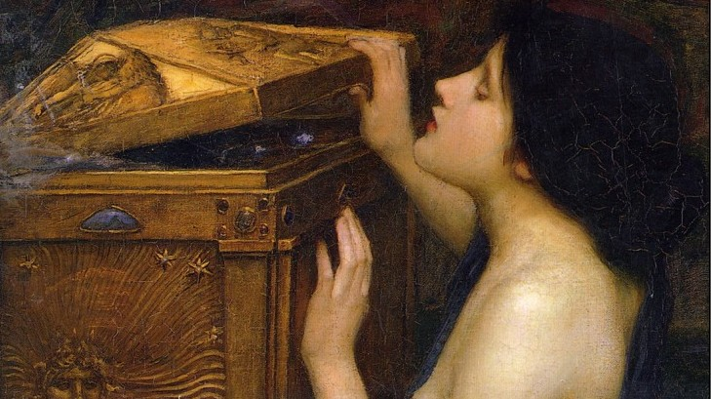
Open the box of gender…
Araceli Pandora 1896

Slide 3
Topics
1 On gender & resilience
2 Contribution from feminist theory
- on knowledge production
- tool of intersectionality
3 Gender and sustainability
E.g. vulnerability and flooding
4 Gendered places
E.g. building in Dhaka

Slide 4
Resilience v.s. Vulnerability
Different wordings for the same issue?
Vulnerability from social sciences – power analysis
Resilience from natural sciences – depolitisised?
Notes:
There are different interpretations regarding the relation between resilience and vulnerability.
Some merely see vulnerability as the ‘flip side’ of resilience, i.e., more of one means less of the other.
But some scholars* warn against how resilience is increasingly taking over climate change and development discussions, since the two concepts point at different thing. Vulnerability is often considered to be a better lens for revealing power issues, such as gendered / structural differences in disaster impacts, while resilience has been criticised for depoliticizing “the causal processes inherent in putting people at risk” (Cannon and Müller-Mahn, 2010, p. 633)

Slide 5
Why study gender & what is it?
A social category in all (?) societies in time and space
Cutting through all aspects of society
Compare with class, ethnicity, cast etc.
Gender as relational and fluid
not something you are or have
continously negotiated
Study gender relations by exploring how people
’do gender’.
Feminism asumes power
Notes:
I do not only investigate gender, but also power and institutional change as h.o.p., basic structures in society.
Look at higher order processes of gender and power and inst change
Thus I need theories on G P and I

Slide 6
’Every day practices’ –where can we identify gender?
In behaviours, roles, norms, institutions
(formal & informal), legislation
Expected behaviour
Division of work/tasks, professions
Access to and control of resources
Political and public participation
In the gendering of basic social systems in society
Transport, water, energy, labour market, working life, planning
Study systems in terms of legislation, policy, governance

Slide 7
From counting women to analytical category
From ‘women in’ to ‘gender and’ and to ‘gendering of’ social relations
Different questions asked
Counting women and men
Analysing gender as social relations
Explaining identity and diversity beyond gender and into intersectionality
Reflexive questioning of knowledge production
Notes:
over time gender studies have changed from measuring variables to seeing gender as a fundamental analytical category and higher order process in society. With that, active gender equality work must shift from focusing on patriarchy and subordination towards a focus of complex social institutions, practices and structures that span the public-private divide. In addition gender is often found to be dynamic and continuously negotiated in processes that are embedded in norms and values influenced by diffuse and widely dispersed power. There are four typical approaches for how to address gender, each of which has its own particular focus, issues and methods: counting women and men; analysing gender as social relations; explaining identity and diversity beyond gender and into intersectionality; and reflexive questioning of knowledge production.
Focus on subordination or focus on complex social institutions, practices and structures
gender is often found to be dynamic and continuously negotiated in processes that are embedded in norms and values influenced by diffuse and widely dispersed power

Slide 9
2 Contribution from feminist theory - on knowledge production - tool of intersectionality

Slide 10
Feminist theory on knowledge production
Who can know?
’Standpoint’ (D Smith)
’Situated knowledge’ (D Haraway)
What can be known?
How power relations effects the focus of research(er)
social dimension of knowing
Taken for granted objective research questioned
I.e. problems to make generalisations on human beings based on all-male studies
Questioning universal claims of knowledge (C Mohanty, G Spivak)

Slide 11
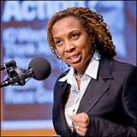
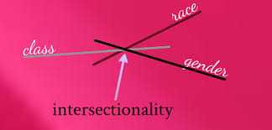
Intersectionality as a tool
Various biological, social and cultural categories such as gender, race, class, sexual orientation, and other axes of identity interact in power/sub-ordination
The ‘intersections’ reinforce systematic social inequality
An intersectional analysis of climate change
Illuminates how different individuals and groups relate differently to climate change…
… due to their situatedness in power structures
(Crenchaw)
Kimberlé Crenshaw
Notes:
Intersectionality is a feminist sociological theory first highlighted by Kimberlé Crenshaw (1989).
One criticism of feminist epistemology is that it allows social and political values to influence its findings.^{[72]}
Susan Haack also points out that feminist epistemology reinforces traditional stereotypes about women's thinking (as intuitive and emotional, etc.),
Meera Nanda further cautions that this may in fact trap women within "traditional gender roles and help justify patriarchy".^{[73]}
Intersectionality holds that the classical conceptualizations of oppression within society, such as racism, sexism, homophobia, and religion-based bigotry, do not act independently of one another; instead,
Collins argued that cultural patterns of oppression are not only interrelated, but are bound together and influenced by the intersectional systems of society, such as race, gender, class, and ethnicity (Collins, 2000).
A methodology of studying the relationships among multiple dimensions and modalities of social relationships and subject formations" (McCall 2005).
The term gained prominence in the 1990s when sociologist Patricia Hill Collins reintroduced the idea as part of her discussion on black feminism. This term replaced her previously coined expression "black feminist thought", "and increased the general applicability of her theory from African American women to all women" (Mann and Huffman, 2005, pg. 61). Much like her predecessor Crenshaw,
Collins' theory is one of particular interest because it represents the sociological crossroads between modern and post-modern feminist thought.
experiences of class, gender, sexuality, etc., cannot be adequately understood unless the influences of racialization are carefully considered. Feminists argue that an understanding of intersectionality is a vital element to gaining political and social equality and improving our democratic system.
11

Slide 13
3 Gender and sustainability
Notes:
13

Slide 14
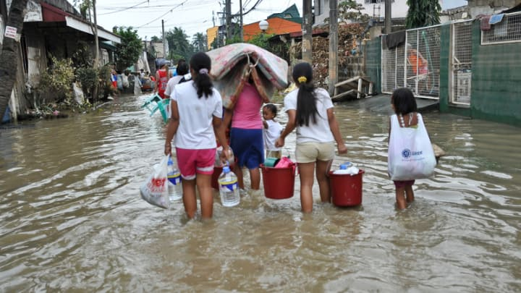
Ex. 1 Gendering climate change
Climate change impacts tend to
reinforce existing power structures
based on gender and other intersecting factors.
Gendered:
Impacts
Mitigation
Adaptation
Policy processes
’No climate justice without gender justice’
at COP2007 Bali

Slide 15
Ex. 1 Gendering climate change
The effects of climate change is unevenly distributed– intersectional perspective
Different groups have different…
Understandings of the effects
Responses
Cooping ability
Examples of water related situations from Asian patriarchal societies in Sultana 2013
Both too much and too little water
(Sultana 2013)
Sultana 2011. Suffering for water, suffering from water:
Emotional geographies of resource access, control and conflict. Geoforum, 42:163-172

Slide 16
In resource dependent societies
Access, control, use and knowledge about resources are gendered (Agarwal 1992)
Climate change can alter these power structures.
While some seem to be persistant such as fetching fresh water (Sultana 2014)

Slide 17
Balancing inclusion without essentialising women
Women often vulnerable, but a risk to essentialise all experiences into one narrative about women’s vulnerability.
Risk to romantisize women’s knowledge and participation.
Masculinites and femininities can be negotiated and altered during climate change processes.
(Sultana 2014)

Slide 19
4 Gendered places - Different groups have different access to different spaces

Slide 20
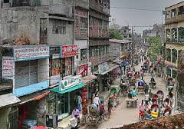
Ex 2 Planning in Dhaka
The relation between
built environment and
vulnerability and
resilience
Jabeen 2014. Adapting the built environment: the role of gender in shaping vulnerability and resilience to climate extremes in Dhaka. Environment & Urbanization. 26(1):147-165

Slide 21
Ex 2 Planning in Dhaka
Gender roles
Division of labour between
men and women
Extreme heat and
heavy rains
The effects of ’climate extremes’ are
also gendered. The power relation is
manifested in ’spacial practices’.
(Jabeen 2014)

Slide 22
Ex 2 Planning in Dhaka
Exterior/front rooms are more public
e.g. shops
Interior/ inside room are for women
During extreme heat interior rooms
without ventilation become to hot
However, women do not go outside to public areas
These experiences are not observed in building projects as this is a male domain/arena and men do not have this experience.
(Jabeen 2014)

Slide 23
Planning in Dhaka
Power relations are manifested in
’spacial practices’
House building is an activity for men
It includes planning, designing, building private and public buildings, rooms, streets
Gendered spaces, places, areas, rooms,
compartments are reproduced – no change.
(Jabeen 2014)

Slide 25
Summing up… How is gender theory useful for planning?
All social relations are gendered – don not include ‘women/gender’ only as an add-on
If power dimensions are not considered, there is a risk that planning strategies reinforce existing power structures.
An intersectional analysis illuminates how different individuals and groups relate differently to climate change…
… due to their situatedness in power structures
Use ’situated knowledge’ for inclusion & participation

Slide 27
Literature refered to in lecture
Agarwal 1992. A field of one’s own: Gender and land rights in South Asia. Cambridge University Press
Foote 2009. ’Sense of place’. International Encyclopedia of Human Geography. Thrift, N. & Kitchen, R. (eds.). Oxford: Elsevier, Vol. 8
Jabeen 2014. Adapting the built environment: the role of gender in shaping vulnerability and resilience to climate extremes in Dhaka. Environment & Urbanization. 26(1): 147-165
Jerneck et al 2011. Structuring sustainabilty science. Sustainability Science, 6(1): 69-82
Leach 2007. Earth mother myths and other ecofeminist fables: How a strategic notion rose and fell. Development and Change 28(1): 67-85

Slide 28
Literature refered to in lecture (cont.)
Resurrección 2013. Persistent women and environment linkages in climate change and sustainable development agendas. Women’s Studies International Forum, 40: 33-43
Sultana 2011. Suffering for water, suffering from water: Emotional geographies of resource access, control and conflict. Geoforum, 42:163-172
Sultana 2013. Gendering climate change: geographical insights. The Professional Geographer, 66(3): 372-381
Taylor 2009. ’Belonging’. International Encyclopedia of Human Geography. Thrift & Kitchen (eds.). Oxford: Elsevier, 8, p. 294-299
Truelove 2011. (Re-)conceptualizing water inequality in Delhi, India through a feminist political ecology framework. Geoforum, 42: 143-152
Shiva 1989. Staying Alive: Women, Ecology and Development. London: Zed Books
WHO 2014. Gender, climate change and health. http://apps.who.int/iris/bitstream/10665/144781/1/9789241508186_eng.pdf?ua=1

Slide 29
Further reading
Agarwal 2000. Conceptualizing environmental collective action: why gender matters. Cambridge Journal of Economics, 24: 283–310
Cho, Crenshaw, & McCall 2013. Toward a field of intersectionality studies: theory, applications, and praxis. Signs, 38(4): 785–810
Doan 2010. The tyranny of gendered spaces – reflections from beyond the gender dichotomy. Gender, Place & Culture: A Journal of feminist Geography, 17(5)
Elmhirst 2011. Introducing new feminist political ecologies. Geoforum, 42: 129-132
Gender, Place & Culture: A Journal of Feminist Geography
Hanson, Susan 2010. Gender and mobility: new approaches for informing sustainability. Gender, Place & Culture: A Journal of feminist Geography, 17(1)
Kaijser & Kronsell 2014. Climate change through the lens of intersectionality. Environmental Politics, 23(3): 417-433
Magnusdottir & Kronsell 2013. The (In)Visibility of Gender in Scandinavian Climate Policy-Making. International Feminist Journal of Politics (17:2): 308-326

Slide 30
Further reading (cont.)
Massey 1994 Space, place & gender. Cambridge: Polity Press
Rocheleau, D. Thomas-Slayter, B. & E. Wangari 1996. Feminist political ecology. Global issues and local experiences. New York: Routledge
Silvey, Rachel 1998 ‘”Ecofeminism” in geography’. Philosophy & Geography, 1(2): 243-249
Terry, Geraldine 2009 'No climate justice without gender justice: an overview of the issues' in Gender & Development, 17(1): 5-18

Slide 32
Why a focus on women in planning policy?
Effieciency/wellfare reasons?
Instrumental – ’a tool’
Practical gender needs (Moser 1989)
Equity reasons?
Intrinsic – ’for its own value’
Strategical gender needs (Moser 1989)
Women as instrument or end goal?

