Slide 1
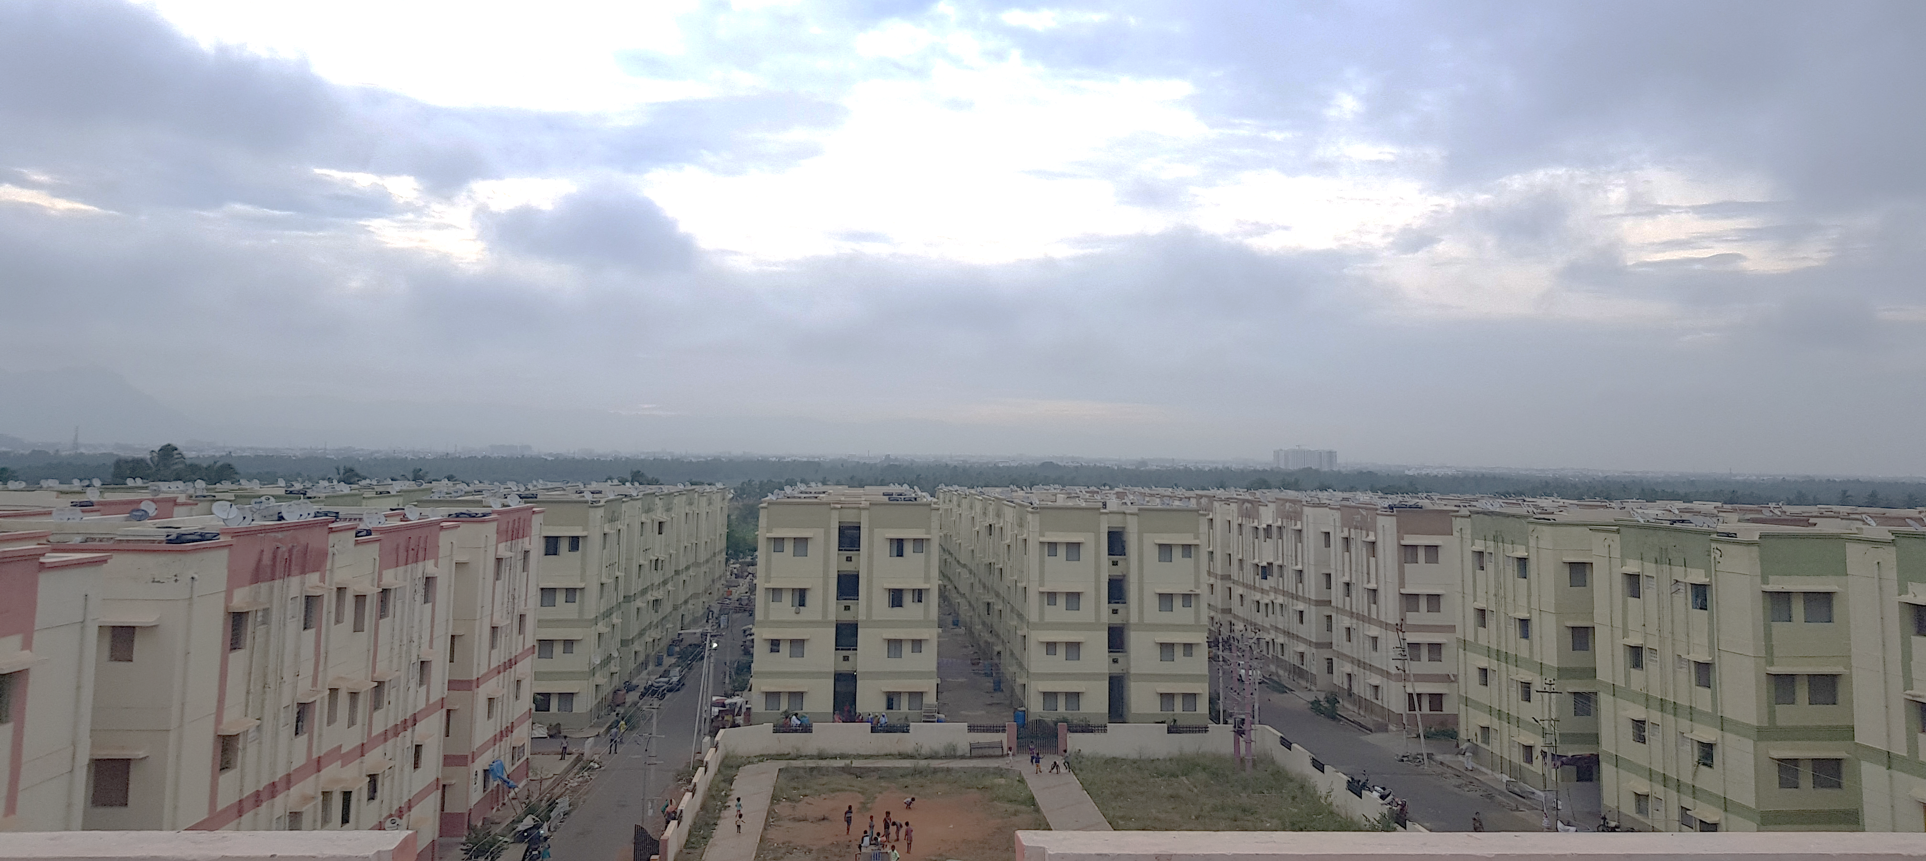


Add Image
Living in transition:
An exploratory case on the impacts of resettlement on the livelihood of CMC colony dwellers.
- Hiranmayi Shankavaram
Notes:
The approach to slum free cities includes slum redevelopment though mass slum clearances, demolition of poor quality houses and provision of newer improved buildings. This expensive and tedious process involved relocation of slum dwellers to the fringes. Where most people were content with the quality of services, the experts criticized the social implications of the idea. To tackle this, the World Bank proposed two standpoints: one completely refusing the idea of displacement and the other tackling the methodological aspects of easing negative impacts irrespective of overcoming complexities. The weave of World Bank’s strategies in the 1970s with the Tamil Nadu Slum Clearance Board’s (TNSCB) visions, particularly in the housing sector, restructured TNSCB to limit political shadows and the degree of dependence on state capital. With in-situ developments and upgrading in its initial years, the TNSCB in the 90s, shifted back to weak trails as a testimony to a struggle oriented action against evictions and as a response to relocation. Dynamics in the occupancy of slums, divisive party politics within slum communities and gentrification of TNSCB tenements tarnished the unity essential for the success of such schemes/initiatives. The case under study – Vellalore, one of the largest resettlement colonies in the city of Coimbatore is researched to address the archaic traits of resettlement and the presumptive repercussions on the livelihood of those displaced. The colony housing 24 different slums displaced mostly from the center of the city puts forth immediate challenges of the municipal workers (CMC colony) specifically in terms of access to infrastructure, added financial burdens and social implications - delimiting to the current transitional period post resettlement.

Slide 2
CONTENTS:
THE BIGGER PICTURE – HOUSING SHORTAGE AND REDEVELOPMENT POLICIES IN INDIA
RESETTLEMENT
STAGES, TRANSITIONS AND IMPLICATIONS OF RESETTLEMENT
RISK REVERSALS AND STRATEGIES
RESETTLEMENT: A PRETEXT FOR GENTRIFICATION?
LIVELIHOOD
LIVELIHOOD INTERVENTIONS
LIVELIHOOD APPROACH
CRITICISM
PILOT
THE CASE
PLACE – Destination and Departure slums
PEOPLE – Target population
PROCESS
SURVEY
Mapping exercises
Impact maps and stakeholder maps
Household survey
FINDINGS/CONCLUSION

Slide 3

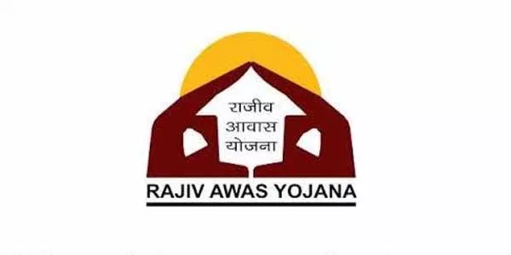


National Slum Development Programme (NSDP),1996
To minimize involuntary resettlements due to high impoverishment risks and disruptive processes.
Restore former living standards.
Necessary compensations (land, infrastructure or other).
Short distance between the departure and relocation sites
Compromises between distance and economic opportunities to be balanced.
Promotion of participation.
Equipped with good infrastructure and services.
Inter-agency consultations and co-ordination.
Subsidized commuting costs.
Safety and accessibility of the new site. Problems such as drug abuse, alcoholism should be screened.
THE BIGGER PICTURE – HOUSING SHORTAGE AND REDEVELOPMENT POLICIES IN INDIA
Basic Services to Urban Poor (BSUP) under JnNURM
Housing for All under PMAY
(Source: Hindman, et al., 2015).
Notes:
CLICK: The rise in productivity and GDP became a cause to celebrate urbanization in the global context. However, the developing world catered high levels of urbanization without growth where the quality of opportunities depreciated. Decent housing gathered high precedence in such contexts.
In the global context, during the 1970s, the approach to slum free cities included slum redevelopment though mass slum clearances, demolition of poor quality houses and provision of newer improved buildings. This expensive and tedious process involved relocation of slum dwellers to the fringes. Where most people were content with the quality of services, the experts criticized the social implications of the idea leading to the next phase of policies (by 1990s) concentrating on in-situ upgrading, provision of tenure security – to overcome the social costs of relocation.
The demand side of housing illustrates shortage of close to 19 million houses in Urban India, more than 50% of which belong to the Economically Weaker Section (EWS) whose monthly household income is less than Rs.25, 000. The lack of access to formal financing agencies or Housing Finance corporations (which ideally cater to the middle and higher income groups) make the urban poor vulnerable and incapable of maintaining a quality life.
The supply side supposes the affordability of a slum household to be priced under a forty-month income i.e., the house unit should be lesser than Rs 400,000. This is a substantive challenge for developers who often fail to provide decent housing at the aforementioned price (Hindman, et al., 2015).
Furthermore, the availability of urban land, increased construction costs and local regulations constrain the supply of affordable housing. With limited amount of urban land within the city and the complexities in land licensing, most of the housing projects are pushed to the peripheries or the fringes as resettlement projects.
The development of housing policies in India can be mapped under –
CLICK:
The objectives of National Slum Development Programme (NSDP) in 1996 to improve physical amenities such as water supply, storm water drains, sanitation – common baths and toilets. The dwellers were provided with loans and subsidies to improve their housing while the government provided for the common amenities. This programme, however, faced lags due to administrative concerns.
The Urban Infrastructure and Governance (UIG) financed infrastructure projects in most JnNURM (Jawaharlal Nehru National Urban Renewal Mission) projects and have commanded development led displacements of the urban poor with disruption to livelihood, social networks, access to amenities and inequities in benefits and social justice (Patel & Mandhyan, 2014). The objectives of Basic Services to Urban Poor (BSUP) to provide security of tenure at affordable prices along with improved infrastructure. This was related as a subsidized housing construction program by the government. The shortfalls of this initiative included the incapacities of the government in implementation, lack of transparency and poor monitoring (during construction) leading to poor quality housing.
The year 2015 which witnessed an ambitious vision of Housing for All scheme/policy by the government aimed at the provision of adequate and affordable housing for all by the year 2022. The proposals in this regard articulate in-situ redevelopments and resettlement (on-site and off-site) through subsidized housing; sometimes with the participation of the private sector. The scheme can be articulated through four sub-initiatives –
In-situ Slum rehabilitation using land as a resource, with active participation of private developers.
Public-Private Partnership for affordable housing.
Affordable housing through Credit Linked Interest Subsidy – the research case under study
Beneficiary led individual house construction or enhancement.
CLICK:
At the global context, the World Bank in 1990 adopted remedial measures for the complexity of issues arising from displacement and proposed operational guidelines. The shortfall, however, was pointed towards the interpretation of improved living standards only with income restoration and to some extent livelihood replacement (Nayak, 2011)
World Bank thus proposes two standpoints: one completely refusing the idea of displacement and the other tackling the methodological aspects of easing negative impacts irrespective of overcoming complexities.
The propositions of the World Bank range from minimization of involuntary resettlements, compensations at replacement costs, subsidized commute costs, safety ad accessibility to participatory processes.
The ideals of Slum free city in the context of Tamil Nadu, The slum free city plan, initiated in 2010, under Rajiv Awas Yojana (currently known as Pradhan Mantri Awas Yojana (PMAY)) entailed remedial measures for shortage of urban land, shelter and amenities in two ways – upgrading and resettlement of existing slums with property rights, housing and reservation of land (to avoid new slum formation). The arrival of private sector in such schemes emanated as a response to ambiguities in the objectives and vision of the public sector wherein the slums have swayed between illegalities and exclusion on the one hand and tolerance and recognition on the other.
The weave of World Bank’s strategies in the 1970s with the Tamil Nadu Slum Clearance Board’s (TNSCB) visions, particularly in the housing sector, restructured TNSCB to limit political shadows and the degree of dependence on state capital. With in-situ developments and upgrading in its initial years, the TNSCB in the 90s, shifted back to weak trails - as a testimony to struggle oriented action against evictions – a response to relocation – which was a tolerable option in the 1980s with persuasion of the Community Development Wing (CDW) and several interconnected trends (tough stance of the state agencies, strenuous outreach etc.,). Furthermore, the introduction of state sponsored self-help groups mediated by the NGOs promoted systems of patronage and power struggles between the state and the NGOs and the NGOs with the slum. Dynamics in the occupancy of slums, divisive party politics within slum communities and gentrification of TNSCB tenements tarnished the unity essential for the success of such schemes (Hochart, 2014).

Slide 4
THE INTERVENTIONS OF WORLD BANK
To minimize involuntary resettlements due to high impoverishment risks and disruptive processes.
Restore former living standards.
Necessary compensations (land, infrastructure or other).
Short distance between the departure and relocation sites
Compromises between distance and economic opportunities to be balanced.
Promotion of participation.
Equipped with good infrastructure and services.
Inter-agency consultations and co-ordination.
Subsidized commuting costs.
safety and accessibility of the new site. Problems such as drug abuse, alcoholism should be screened.

Slide 5
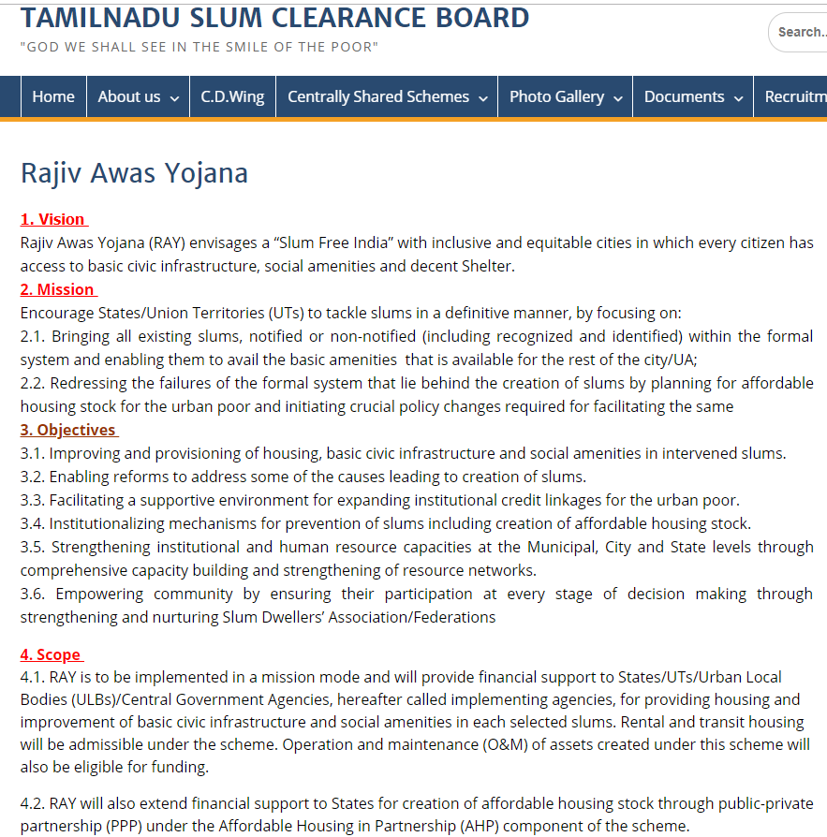
SLUM FREE CITY IN THE CONTEXT OF TAMIL NADU
Notes:
Slum free city in the context of Tamil Nadu.
The slum free city plan, initiated in 2010, under Rajiv Awas Yojana (currently known as Pradhan Mantri Awas Yojana (PMAY)) entailed remedial measures for shortage of urban land, shelter and amenities in two ways – upgrading and resettlement of existing slums with property rights, housing and reservation of land (to avoid new slum formation). The arrival of private sector in such schemes emanated as a response to ambiguities in the objectives and vision of the public sector wherein the slums have swayed between illegalities and exclusion on the one hand and tolerance and recognition on the other.
The weave of World Bank’s strategies in the 1970s with the Tamil Nadu Slum Clearance Board’s (TNSCB) visions, particularly in the housing sector, restructured TNSCB to limit political shadows and the degree of dependence on state capital. With in-situ developments and upgrading in its initial years, the TNSCB in the 90s, shifted back to weak trails - as a testimony to struggle oriented action against evictions – a response to relocation – which was a tolerable option in the 1980s with persuasion of the Community Development Wing (CDW) and several interconnected trends (tough stance of the state agencies, strenuous outreach etc.,). Furthermore, the introduction of state sponsored self-help groups mediated by the NGOs promoted systems of patronage and power struggles between the state and the NGOs and the NGOs with the slum. Dynamics in the occupancy of slums, divisive party politics within slum communities and gentrification of TNSCB tenements tarnished the unity essential for the success of such schemes (Hochart, 2014).

Slide 6

RESETTLEMENT
“
The process of identification and transfer of a group, large or small, from their local habitat/ native place to a host place, which may or may not have agreed to admit them. It may happen voluntarily, when people or communities migrate from one place to another on will. It may also happen involuntarily, when it is forced by the public agency for the larger public good/benefit. Resettlement usually happens with some compensation; the benefits, monetary or non-monetary or in any form, that the person resettled is provided in lieu of the lost locale, assets, work places, relationships, etc. In the case of slum dwellers, compensation is provided in the form of land or housing at highly subsidized rates to eligible slum families.
(Singh & Khosla, 2014, p. 1).
”
Notes:
Migration theories propose push and pull factors whose occurrence and scale determine the premises of resettlement. In case of involuntary resettlements, the push factor (diminished decision making) overpower to render the affected powerless (Ayyar, 2013). Voluntary resettlment is differentiated with the involuntary type with the former’s migration being gradual with less time for adaptation in the socio-economic spectrums while the latter’s process deems to be indiscriminate disrupting the socio-economic mechanisms (Contractor, et al., 2006).
The aspect of resettlement is most often juxtaposed between the provisions of good quality services, essential amenities, better social living and most importantly a legal recognition embossed on it. These parameters are not necessarily disparate, for example, with the provision of security of tenure and evasion from the fear of evictions, household investments diverge to cater housing, health and education with subsequent influence on income levels and better living conditions - physical and social health, wellbeing - to further better morbidity and mortality rates. A contention to this premise is directed towards the location or the context of resettlement.
The developmental aspects of resettlement are based on the perceptions of enhanced use of land and property. To its best, relocation should be undertaken at the will of the dwellers. “At worst, resettlement is little better than forced eviction with no attempt at consultation or consideration of the social and economic consequences of moving people to distant, often peripheral, sites with no access to urban infrastructure, services or transport”
Insecure tenure increases the possibility of involuntary resettlement as well as affecting the necessary compensation and assistance to the affected households (United Nations Human Settlements Programme, 2003). Apart from political upheavals and natural calamities as a basis for resettlement, many of them are an effect of unplanned, unanticipated developmental projects desired by agencies of the government, businesses etc. (Ayyar, 2013)
Involuntary resettlement has been exclusively researched upon by Michael M. Cernea(2004) who explains two distinct yet closely linked components – the first being the displacement of people and the second reconstruction of their livelihood which entails rehabilitation.

Slide 7
STAGES, TRANSITIONS AND IMPLICATIONS OF RESETTLEMENT:
Landlessness
Joblessness
Homelessness
Marginalization
Food insecurity
Loss of access to common property
Community disarticulation
Gender related concerns
Increased drop out rate
Notes:
Cernea (2004)proposes risk reversals and strategies to reestablish livelihoods by firstly defining the process of resettlement, the impoverishment risks and the risk reversal methodologies.
The process of recruitment, transitions, development and handing over, along with the understanding of resident’s response and stress behaviors are articulated to define patterns and conceptual models and frame a toolbox for researchers.
The model assesses the effects and losses through a synchronic process to propose recovery strategies after resettlement. Dismantling the effects, Cernea (2004) talks about components of
Landlessness – foundation of dweller’s activities and livelihoods are expropriated leading to losses in terms of natural and man-made capital to end with pauperization.
Joblessness – loss of wage employment, assets, loss of land, shift to tertiary occupations and failure in creation of new jobs to match obtainable human skills entails a substantive investment; failure of which leads to unemployment and underemployment. Skill training as a remedial component need not necessarily provide jobs.
Homelessness - alienation and deprivation in social status are repercussions of loss of common community space and individual homes. This aspect is closely linked to joblessness, marginalization and morbidity rates compelling the need for better financing (of the project and the compensation based on assessed market value).
Marginalization - economic instabilities, obsolete human skills for the new context, time bound improvements in the standards of living and downward trends in social mobility are common grounds for marginalization along with the overlooked facets of psychological consequences, behavioral impairments, anxiety etc.,
Food insecurity and increased morbidity – nutrition related issues arise from the impacts of landlessness and joblessness. Social stresses arising from these, relocation based illnesses (environment quality of the relocation site) work as differential consequences on physical and mental health across gender and age.
Loss of access to common property resources - a component that hinders livelihood since they remain uncompensated by the government i.e., loss of school, religious spaces, community spaces, burial grounds etc.
Community disarticulation – social fabric gets disturbed by fragmentations within communities, networks and patterns of organization. These are overlooked and uncompensated by the programs. Rebuilding the prior bonds remains a tedious affair. Piecemeal relocation radically imposes stress in prior ties, inter-personal behaviors and cohesion within households. Participation in societal activities after relocation remains challenged. Facing social uncertainties is the heaviest costs of all inducing stress on poverty and adds to vulnerabilities owing to powerlessness and dependency.
Gender and social concerns - Compensation biases in the case of women were revealed under a gender oriented study of the framework (Cernea, 2004). In multistoried structures, women may often face issues in terms of the time spent in collecting water and the struggles of carrying to the upper floor. Many who work as domestic help at middle-income households might lose their jobs post resettlement – attributed mainly to the lack of transport facilities, costs incurred and time of travel. The public spaces or the common amenities such as the parks, playgrounds, community halls may sometimes be restrictive to women provided the evident mixed neighborhood-led consequences. The men of the other community can be mostly judged as a threat (Ayyar, 2013).
Lastly, an increased dropout rate amongst students was another aspect of concern after relocation.
It is also imperative to touch upon the pressure relocation imposes on the host land and resources (physical and social). The economic impacts (rise in prices), health impacts, cultural concerns endure for a considerable period of time. The inequities in opportunities should be minimal. It is, therefore, imperative to state that these processes and risks occur simultaneously and thus their reconstructive strategies have to be multidimensional, comprehensive and systematic.

Slide 8



PROCESS: RISK REVERSALS AND STRATEGIES
Reconstructive strategies
Planning and indicative function
Exploration, explanation and assessment function
Propositions for reconstruction and reestablishment
Investigative function
Community rebuilding
Social security
Privatization
Notes:
Cernea (2004)proposes risk reversals as focused strategies enduring as chain effects and synergies that direct –
Landlessness and joblessness to land-based resettlement and re-employment respectively – co-ownership of new lands, provision for new employments and skill enhancement.
Homelessness to house construction.
Marginalization to social inclusion.
Restoration of common assets and services.
Community rebuilding.
Improved healthcare and adequate nutrition.
The risks and their reconstructive strategies, on a general platform, can be indicated under four tasks –
Planning and indicative function – predictive in nature. This includes an encounter with the community to assist and comfort for the shock induced vis-à-vis the news of resettlement along with mapping of the existing socio-economic profile.
Exploration, explanation and assessment function – a diagnostic approach. Sensitivity towards the repercussions due to breakdown of social networks, loss of livelihood, education, and mobility should inform the design of resettlement framework. Participatory tools and mechanisms to be adopted at every stage.
Propositions for reconstruction and reestablishment – a problem-resolution function. A social Impact Assessment is prepared as a monitoring tool post resettlement “ to understand the hardships of the people while resettlement, the lacunae of the process, the benefits and welfares received as planned, the issues and concerns of the involved departments and the learning from the exercise (Singh & Khosla, 2014) and
Investigative function to conduct research and formulate hypotheses – a research function.
Community rebuilding:
With the current practices of redundant cost-benefit analyses, discounting of the sensitivity analyses and risks, multivariate pressures on the residents seem to exist with emphasis mainly inclined towards rates of return for the project investors rather than protecting people’s interests and welfare; and this, by large conflicts the policy’s objective in tackling poverty.
Access to community-owned resources as a fallback strategy for the reestablishment of social ties providing access to resources are mapped. Organized and collective actions for the marginalized and vulnerable can improve inclusion. Common cultural values help overcoming material deprivations, economic instabilities etc.
Social security:
This entails not just the provision of asset but the access to it as well such as “access to reasonable employment opportunities, transportation to access the workplaces, food security through ration shops, hospital and health care services, educational facilities to acquire skills, and emergency benefits and care” (Contractor, et al., 2006, p. 40).
Privatization
The Public Private Partnerships as a part of slum free India promotes the development and access to slum lands to developers through Transferable Development Rights (TDR) in exchange for housing provided for the displaced slum households. The pitfall in a democratic setting is the increased privatization which undermine the institutional and political practices specifically in terms of governance that promote people’s participation

Slide 9
RISK REVERSALS AND STRATEGIES
Planning and indicative function
Exploration, explanation and assessment function
Propositions for reconstruction and reestablishment
Investigative function
STAGES, TRANSITIONS AND IMPLICATIONS OF RESETTLEMENT
Reconstructive strategies
Increased dropout rate
Landlessness
identification and transfer
Homelessness
Loss of access to common property resources
voluntary
Joblessness
involuntary
RESETTLEMENT
Community rebuilding
Marginalization
Food insecurity and increased morbidity
compensation
Community disarticulation
Gender and social concerns
Social security
Privatization
Notes:
Now, What is resettlement? It is “The process of identification and transfer of a group, large or small, from their local habitat/ native place to a host place, which may or may not have agreed to admit them. It may happen voluntarily, when people or communities migrate from one place to another on will. It may also happen involuntarily, when it is forced by the public agency for the larger public good/benefit. Resettlement usually happens with some compensation; the benefits, monetary or non-monetary or in any form, that the person resettled is provided in lieu of the lost locale, assets, work places, relationships, etc. In the case of slum dwellers, compensation is provided in the form of land or housing at highly subsidized rates to eligible slum families.”
(Singh & Khosla, 2014, p. 1).
Michael M Cernea (2004)proposes risk reversals and strategies to re-establish livelihoods by firstly defining the process of resettlement, the impoverishment risks and the risk reversal methodologies.
The process of recruitment, transitions, development and handing over, along with the understanding of resident’s response and stress behaviors are articulated to define patterns and conceptual models and frame a toolbox for researchers.
CLICK: The model assesses the effects and losses through a synchronic process to propose recovery strategies after resettlement. Dismantling the effects, Cernea (2004) talks about components of
Landlessness
Joblessness
Homelessness
Marginalization
Food insecurity and increased morbidity
Loss of access to common property resources
Community disarticulation
Gender and social concerns
Lastly, an increased dropout rate amongst students was another aspect of concern after relocation.
It is also imperative to touch upon the pressure relocation imposes on the host land and resources (physical and social). The economic impacts (rise in prices), health impacts, cultural concerns endure for a considerable period of time. The inequities in opportunities should be minimal. It is, therefore, imperative to state that these processes and risks occur simultaneously and thus their reconstructive strategies have to be multidimensional, comprehensive and systematic.
CLICK: The risks and their reconstructive strategies, on a general platform, can be indicated under four tasks –
Planning and indicative function – predictive in nature.
Exploration, explanation and assessment function – a diagnostic approach.
Propositions for reconstruction and reestablishment – a problem-resolution function.
Investigative function to conduct research and formulate hypotheses – a research function
CLICK: Further to these, community rebuilding for better access to community owned resources, collective actions to tackle exclusion and other deprivations; social security measures to obtain rightful access to assets; privatization that promote PPPs with access to lands in exchange for housing for slum dwellers are also suggested as reconstructive strategies. However, the pitfall in a democratic setting is the increased privatization which undermine the institutional and political practices specifically in terms of governance that promote people’s participation.

Slide 10
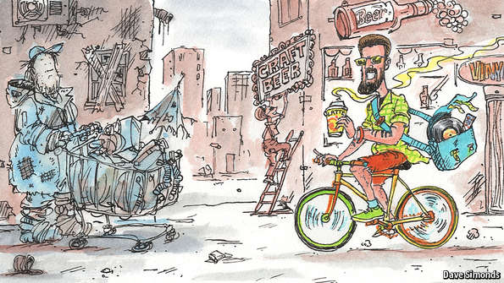
RESETTLEMENT: A PRETEXT FOR GENTRIFICATION?
Presumed patterns of re-investment in land
Slum demolitions → gentrification
Uprisings (political debates)
Weak relation
traditional struggles against gentrification
VERSUS
RESETTLEMENT
a response to urban revolution (a capitalist approach),
enclosures (privatization of public lands) and
accumulation by dispossession
Source: The Economist
incremental investment
endorsed as underinvested spaces rather than disinvested spaces
Re-investment in disinvested spaces
SLUM REMOVAL
Weak justification
Notes:
Resettlement of slums to periurban areas, slum demolitions and land privatizations are off late largely characterized and tagged as gentrification - for higher and better use, (for example: Sabarmati Riverfront Development - (Desai, 2012)).
CLICK:
The presumed patterns of re-investment in land brings out the notion of slum demolitions (a regular phenomenon and cause for displacement in the context of India) being attributed to gentrification.
The argument here is that the uprisings (political debates) that prevail are remotely related to the traditional struggles against gentrification.
CLICK:
Also, the outcomes of demolitions or resettlement have been termed by researchers as a response to urban revolution (a capitalist approach), enclosures (privatization of public lands) and accumulation by dispossession.
CLICK:
With squatting and landlordism prevalent in such contexts and the consent of politicians and state agencies (as a part of socialistic planning), the squatters transform degraded lands (near water bodies, along railway tracks, swamps, low-lying areas etc.,) and structures from temporary (kachcha) huts to pakka (Permanent) structures of concrete and brick – with time and tenure. This, termed as incremental investment is often seen in the global context – endorsed as underinvested spaces rather than disinvested spaces. Such areas display high productivity with scarce or fixed capital. In conclusion, it can be argued that the premise of gentrification as a reinvestment in disinvested areas may not fit the agenda of slum removal.

Slide 11

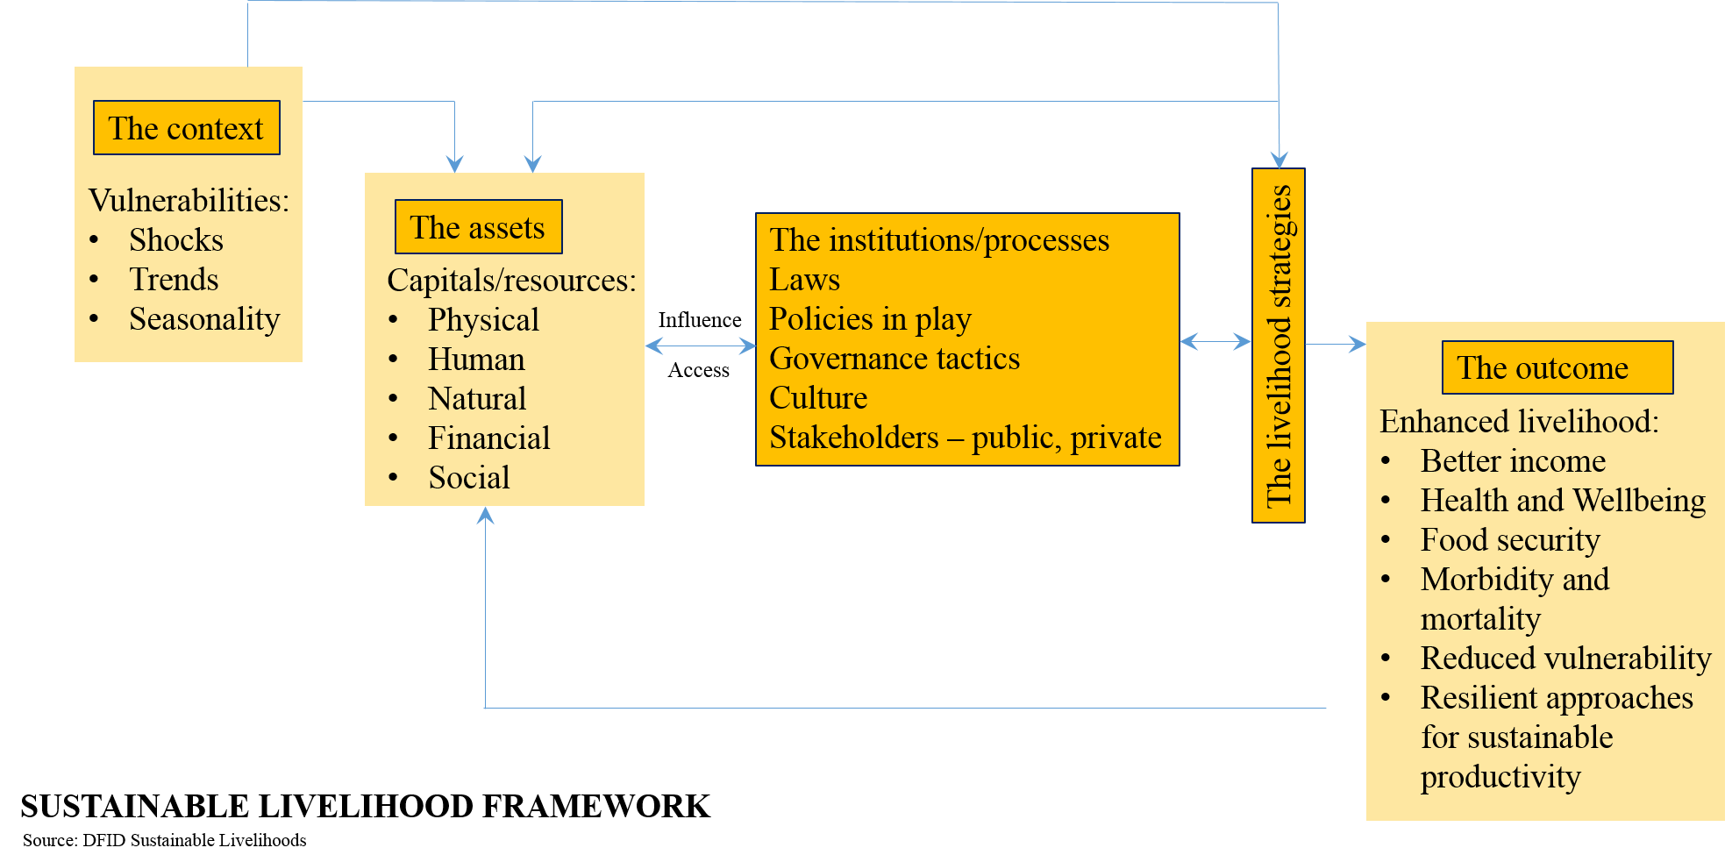
LIVELIHOOD
LIVELIHOOD APPROACH
LIVELIHOOD INTERVENTIONS
Circumspective approach
Context: Poverty alleviation through resettlement and rehabilitation
that understands the diversity that exists at the moment to propose participatory interventions
Livelihood promotion
Livelihood provisioning
Retrospective approach
a longitudinal comparison between livelihoods that studies the pre-existing contexts, trends of change, institutional frameworks and relationships between macro, meso and micro levels – to highlight the vulnerability matrices and impoverishment trajectories.
LIVELIHOOD
Livelihood protection
Prospective approach
that influence policy with considerations of past policies under different political regimes, the rationales of development and interventions at various levels, and the procedures of monitoring and evaluation that help build alternate livelihood frameworks to facilitate opportunities
Notes:
Displacement in the name of development entails “a perverse and intrinsic contradiction” (Cernea, 2004, p. 1). The inequities in the distribution of benefits and losses in the process raise ethical concerns. Restoration of livelihood has been an undying challenge - mitigating through risks of impoverishment.
Along with physical exclusion from a context, social exclusion from a regular system of functioning is beheld. This, adding to impoverishment, necessitates the adherence to equity norms, social justice and respect for civil rights and entitlements.
CLICK:
The UN and the DFID adapts the Chambers and Conway definition as
“A livelihood comprises the capabilities, assets and activities required for a means of living. A livelihood is sustainable when it can cope with and recover from stresses and shocks and maintain or enhance its capabilities and assets both now and in the future, while not undermining the natural resource base.”
The probable interventions proceed along three stages:
Livelihood provisioning looks into critical items for recovery;
Livelihood protection deals with replacing and rebuilding productive assets that existed in the earlier contexts and;
Livelihood promotion deals with interventions that strengthen the economic viability and sustainability for resilient futures.
CLICK:
The diversity in the modes of livelihood exists both within and between households. To bring these complexities into one bubble, three distinct yet related approaches are taken note of –
A circumspective approach that understands the diversity that exists at the moment to propose participatory interventions.
A retrospective approach - a longitudinal comparison between livelihoods that studies the pre-existing contexts, trends of change, institutional frameworks and relationships between macro, meso and micro levels – to highlight the vulnerability matrices and impoverishment trajectories.
A prospective approach that influence policy with considerations of past policies under different political regimes, the rationales of development and interventions at various levels, and the procedures of monitoring and evaluation that help build alternate livelihood frameworks to facilitate opportunities (Murray, 2001).
CLICK:
Understanding the core principles of the Sustainable Livelihoods Approach (SLA) that dictate people-centric holistic initiatives, sustainable solutions etc., and assessing the context to map the dynamics in play in terms of social relatedness, governance tools, delivery and accessibility of services; the design, framework and implementation of policies etc., an analytical toolbox was devised to be called the Sustainable Livelihood Framework.
The Sustainable Livelihoods Framework (SLF) as illustrated in the figure assists in mapping -
The vulnerability context shaped by factors such as seasonal shifts and constraints (or opportunities), economic instabilities and other trends.
The role of livelihood assets or capitals, their inter-relatedness and their utility by the people.
The set of institutions and processes that govern the assets.
The use of asset base to frame strategies for improved livelihood.

Slide 12

CRITICISM
Non-compliance of social and economic factors.
Time gaps in the process of resettlement.
Availability of land
Flaws in its implementation (and rehabilitation).
Increased commuting time and transport costs.
Change in social ecology.
Caste based differences. Insecurities and crime.
Consultations over co-planning.
The role of NGOs.
…. a tedious affair
Notes:
CLICK: The development effectiveness of resettlement and rehabilitation has scoured owing to the non-compliance of social and economic factors that mold complex diverse livelihood systems. This has led to low standards of living and often to marginalization. Time gaps in the process of resettlement - between planning and initiation – give rise to many uncertainties and social anxieties.
CLICK: Resettlement carries with it the premise of availability of land close to the slum/settlement to be displaced. This proves to be a colossal feat for cities and the state agencies to find urban lands with suitable public and social infrastructure to prevail over common losses (in assets)
The complexity in finding suitable financing agencies, construction deals, population management (of the displaced) and prevention of further encroachments after relocation tote up to the existing hassles which necessitates constant interest of the state agencies. The main challenge for the displaced resident is the urban land - more often than not, chosen along the urban fringes. These deprive the residents of their independence in the choice of location, design of the house, employability and the tedious relocation process in itself.
CLICK: With relocation sites placed along the fringes, increased commuting time and transport costs are discernable outcomes. These bring about concerns of affordability, joblessness (vulnerability addressed more in the case of working women), financial stress, health related stress (mental and physical), pressures within households, between households and overlooked social interventions fragmenting the networks and support systems.
CLICK: Vulnerabilities from the change in social ecology arise from the fragmentation of communities and their traditional systems challenging the complex of rights, individual and the community. Such disruptions seem to arise primarily after relocation, once the project loses momentum often referred to as “developer’s fatigue” (Bartolome, et al., 2000, p. 7). Restoration of pre-relocation standards remains inadequate and limited.
Large resettlement colonies are liable to tackle social losses when there is a mix of different backgrounds amongst the poor put in one place. The relocation by large entails a social mix where the community lacks a sense of belonging and safety. Restricted approaches may give rise to vulnerabilities along financial and social facets where the claims of human rights can be contested.
Insecurities and crime become a part of such settlements due to the mix of social groups. The unoccupied part of the buildings (if any) attract unscrupulous activities. Such a context affect the safety and security of the area (marked by rampant eve-teasing and crude remarks), thereby causing segregation amongst the residents who by and large struggle for the same cause.
Freedom is tampered amongst young women who might need constant monitoring for safety and insecurities. With the loss of jobs, women usually help in contributing to the household incomes by vending daily items on carts on the streets and corridors. Such activities often face evictions which turns out to be a routine struggle.
CLICK: Consultations with the dwellers, in decision making throughout the project remain as consultations rather than co-planning in most cases. The induction of such initiatives are mostly absent in the developing countries due to weak institutional capacities of the state agencies.
The role of NGOs and other mediating agencies play as either providers or harbingers for the residents. The power struggles with the NGO and state and the reluctance of the residents (due to social pressures, caste or religion based) in their roles as a part the NGO continually amplify the woes (isolation) of a deteriorating livelihood (Ayyar, 2013).
Till today, incapacities may be pointed towards preventing victimization, discriminations and de-capitalization. Imperative norms to enable affected people in reaping the benefits of development on both economic and social/moral grounds should be a part of resettlement frameworks famously termed as the “economics of recovery”
CLICK: all these parameters render the process a tedious one.

Slide 13
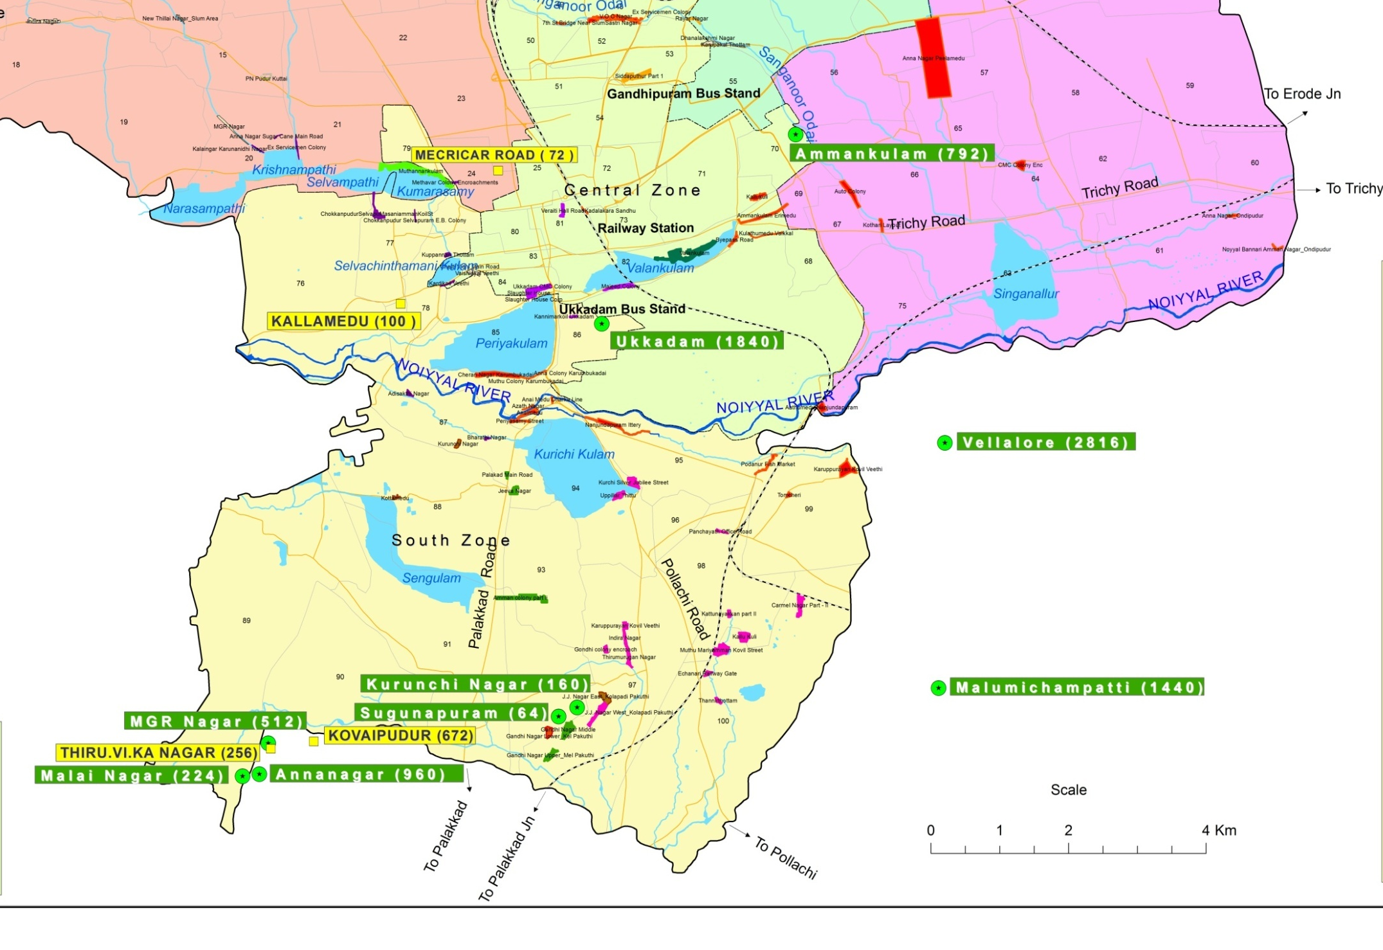
Anna Nagar, Peelamedu
239 beneficiaries
9-9.5km from Vellalore tenements; 1-1.5 hr of bus travel (change at Townhall)
PILOT…
Visit to Malumichampatti housing colony (un-occupied)
2. Visit to Vellalore (2,816 tenements)
Choice of research case
Largest resettlement colony
Diversity of slums displaced
Field observations
CMC colony, variety Hall Road
434 beneficiaries
10-13km from Vellalore tenements; 45 mins – 1hr. of bus travel
A visit to 4 departure slums (of the 24 in total) – based on the large number of beneficiaries displaced
Anaimedu (phase 1 and 2) – along the nallah
Auto Driver’s colony - along the nallah
CMC colony (choice of study) – Municipal workers
Nanjundapuram Ittery (dominated by Muslims)
Auto Drivers Colony
133 beneficiaries
9-9.5km from Vellalore tenements; 1hr of bus travel (change at Townhall)
Anaimedu (Phase 1 & 2)
393 beneficiaries
7-8 km from Vellalore tenements; 30 mins. of bus travel
Nanjundapuram Ittery
305 beneficiaries
6-6.6km from Vellalore tenements; 25 mins. of bus travel
Observations/current scenario:
Families moved; houses demolished
Transport and connectivity issues to the displaced area
Social conflicts
Notes:
The background studies of the theories relevant to this research necessitates a mixed methodological approach in the data collection process. Newspaper articles portraying uprisings as a response to the resettlement initiative steered the choice of study and the need to explore the translation of the project on ground.
CLICK:
The initiation of the study included a visit to resettlement projects proposed at Malumichampatti (currently unoccupied) and Vellalore (2816 total tenements with 85% occupancy rate). The choice of Vellalore as the context of study was primarily because of its scale (the largest resettlement colony in Coimbatore), the occupancy rate, the diversity of relocated slums (24 slums from different parts of the city) and the current visual experience that the site poses (lack of maintenance, poor waste disposal etc.).
CLICK:
The overall list of resettled slums aided in narrowing down the target population under study solely based on the total number of households resettled i.e., slums with high numbers of evictees were selected. This instigated a visit to departure slums such as Anaimedu (phase 1 and phase 2 included 393 HouseHolds), auto driver’s colony (133HH), Nanjundapuram Ittery (305HH), Variety hall CMC colony (434 HH).
CLICK:
All these slums were, by now, evicted and demolished. Spontaneous interviews with the neighborhood primarily indicated concerns of transport and employment i.e., relocated dwellers still travel to departure slums for employment.

Slide 14
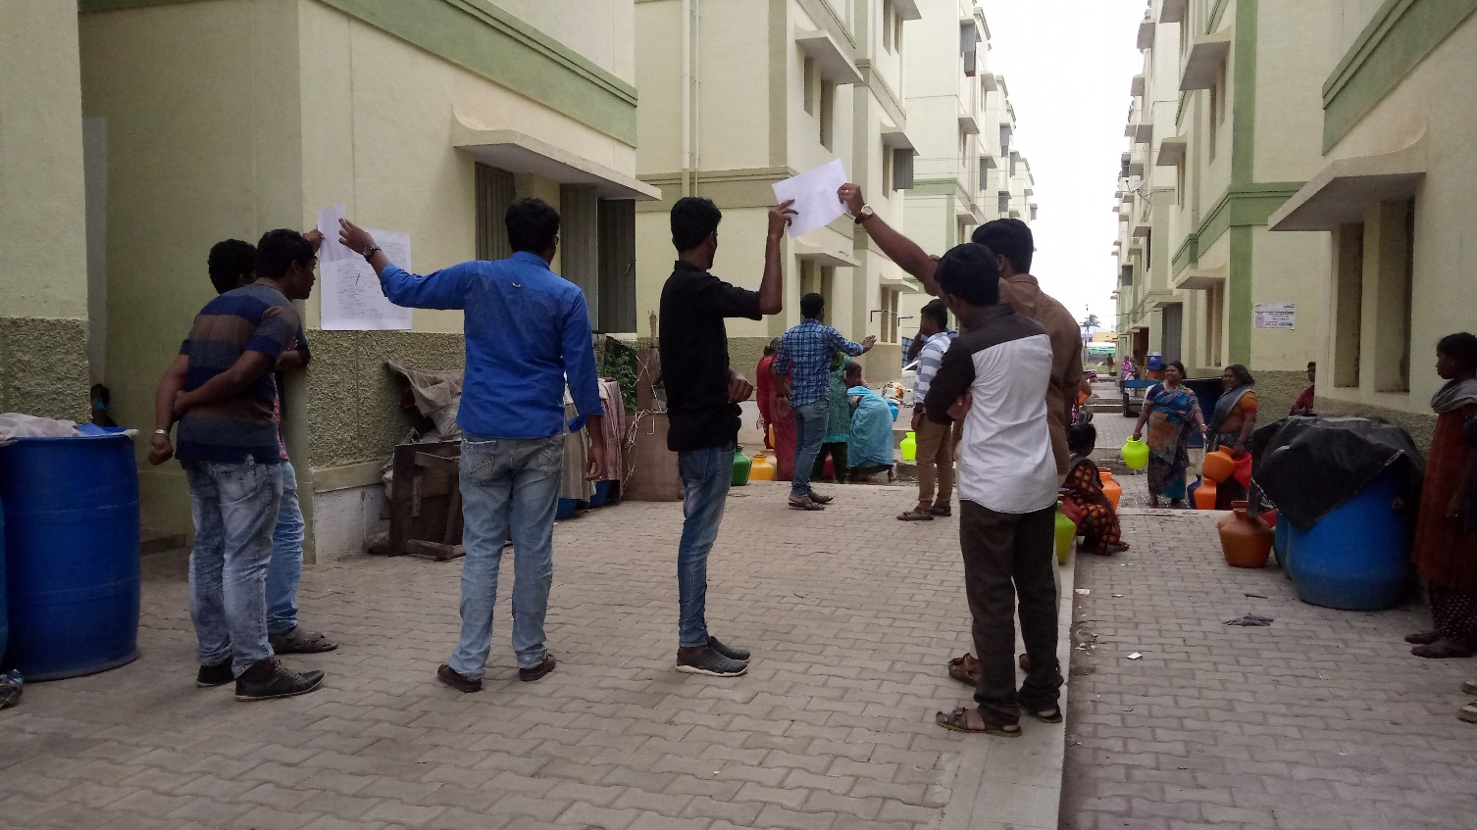
THE CASE…
3.2 Research Aim:
To explore the implications of resettlement on the livelihood of CMC dwellers of Variety Hall Road relocated to Vellalore resettlement colony.
3.3 Research Question(s):
What are the primary aspects of resettlement that impact livelihood (physical and social) of CMC dwellers of Variety Hall road in Vellalore resettlement colony?
What entails the process of resettlement in the context of Vellalore?
What is the background (socio-economic and physical) of the departure slum i.e., CMC colony dwellers of Variety Hall road?
What are the primary livelihood concerns faced post relocation by the CMC dwellers?
Awareness and entry point into the settlement: The students of KAHE performing a drama
Participatory mapping exercises
Place of employment, schools and social amenities
Time-activity charts
Priority mapping – on physical and social infrastructure
Safety mapping
Impact mapping
Household surveys – target group constrained to CMC colony
With the entire settlement
Mixed Methodology
Notes:
Methodology:
The ensuing activity included a participatory exercise at the resettlement colony as a trust building exercise with the dwellers which helped sketch an overview of the implications that the project brings about. At about 3pm, when the women of the community were busy fetching drinking water, the students performed a skit with an awareness building theme on aspects of cleanliness and waste disposal to gather the attention of the dwellers. This played a key role in engaging respondents for the activities arranged which included –
CLICK:
1. Mapping exercises to identify the place of employment, schools and other amenities that the dwellers use.
2. A time-activity chart that indicates the change in activities and their duration post relocation.
3. Priority mapping of identified factors such as housing, transport, employment, community living, health, water supply, sanitation and education.
4. Mapping of safe/unsafe zones.
5. A drawing opportunity for children to express the changes post relocation.
The above process (skit and the activities) was repeated at a different location at around 5pm to target the working populations.
The subsequent visit to the relocation site aimed at mapping the timeline of the project, stakeholders involved and impact mapping. This was intended to be a focused group discussion, but, was altered to be an extension of the previously conducted participatory exercise. The results of the same provided a fair insight of the aforementioned and reinforced the primary issues of the respondents.
Furthermore, the large population of the resettlement colony imposed a need to constrict the target population under study. The choice of CMC colony from Variety Hall (VH) road was opted for obvious reasons such as the total number of households, its location (11.6 km by road from Vellalore - farthest) and the socio-economic profile (discussed under context of study). With a population of 434 Households (HH), the individual house survey was targeted to include a minimum of 50 surveys. The total surveys completed summed up to 92HH.
CLICK:
The research aim and questions were devised to map and assess the process of resettlement with detailed study on the exiting contexts both in terms of place and its people. The explorations dealt on a discovery into -
What are the primary aspects of resettlement that impact livelihood (physical and social) of CMC dwellers of Variety Hall road in Vellalore resettlement colony?
What entails the process of resettlement in the context of Vellalore?
What is the background (socio-economic and physical) of the departure slum i.e., CMC colony dwellers of Variety Hall road?
What are the primary livelihood concerns faced post relocation by the CMC dwellers?

Slide 15
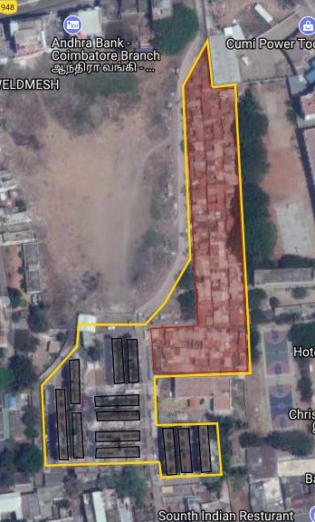

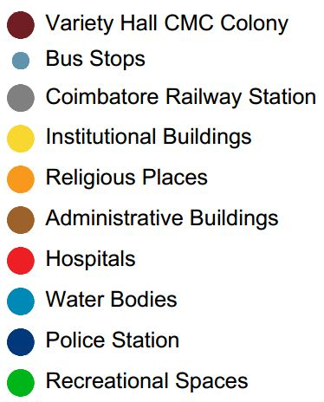
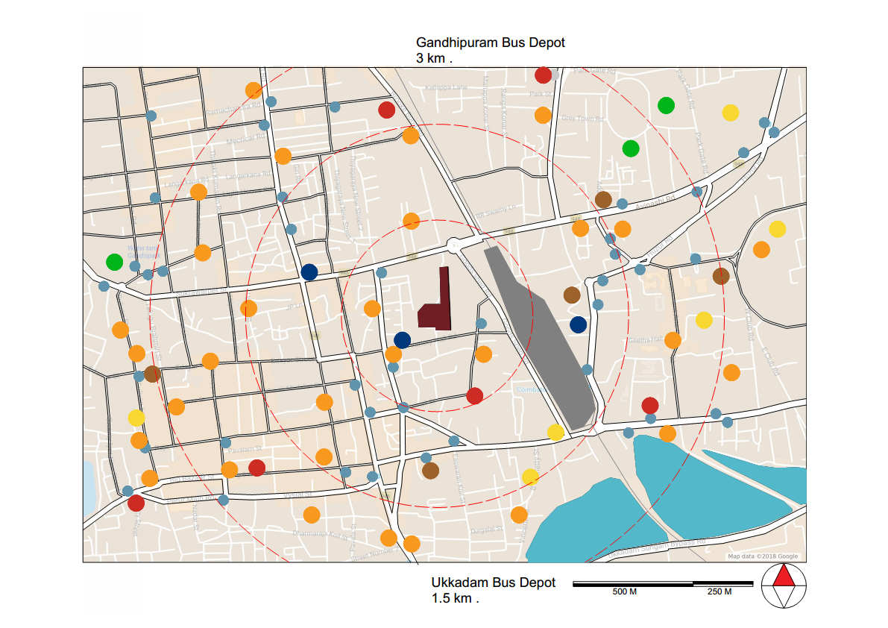
THE PLACE…
Departure Slum - CMC Colony, Variety hall road
Notes:
The departure slum:
CMC Colony gets its name from the dwellers who work for the municipality i.e., the Coimbatore Municipal Corporation (CMC). It is located near Variety Hall Road in the midst of the Coimbatore city (central zone), Tamil Nadu. The colony enjoys perks of its location with transport modes such as the Coimbatore railway station at a walkable distance of 800 m and Ukkadam Bus Depot located at 1.5 km & Gandhipuram Bus Depot located at 3 km for intrastate & interstate mobility. Being situated in the oldest part of the city, the colony utilizes resources (social and economic) for daily sustenance.
Assessing the physical assets, access (or the ease of access) to infrastructure - both social and physical, provided opportunities on the one hand and created a sense of security on the other. Most of the dwellers (both men and women) in the settlement were either employed as corporation workers or as coolie (porters) at city railway station; and thus the accessibility to their respective workspaces was either by walking or by public transport at affordable costs. Women in the settlement were also employed as domestic help in the surrounding residential areas contributing to the household income and financial stability.
With the dwellers residing for more than two generations, thick social networks have held them strong against external stressors - mainly evictions, with a sense of security being restored. With the occupancy on objectionable land and the lack of secure tenure, the semi-pucca typology of the settlement (434 households) were evicted, relocated to Vellalore in November 2017 and consequently their households were demolished.
The colony houses a total of 734 families, out of which 300 families reside in 15 blocks of housing units (G+3 typology) constructed by the Housing Board nearly 30 years ago, and the rest 434 families occupied the Semi-Pucca houses (only ground floor). These 434 households were opportunistic encroachments living on objectionable lands who did not enjoy the security of tenure, and were assessed with a deficiency matrix of 2x3 under Rajiv Awas Yojana (RAY). This became the premise for their relocation to Vellalore.
Each unit of TNSCB housing complex constructed with an approximate area of 20 sq.m, consisted of a multipurpose room, a kitchen, individual bathroom and toilet. They were provided with individual domestic water connection through overhead water tanks, and drinking water collection points at ground level. The remaining 434 households of Semi-Pucca typology had common collection points for both drinking and domestic water supply.

Slide 16
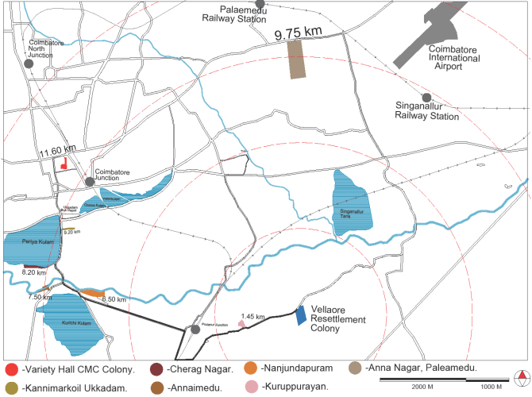

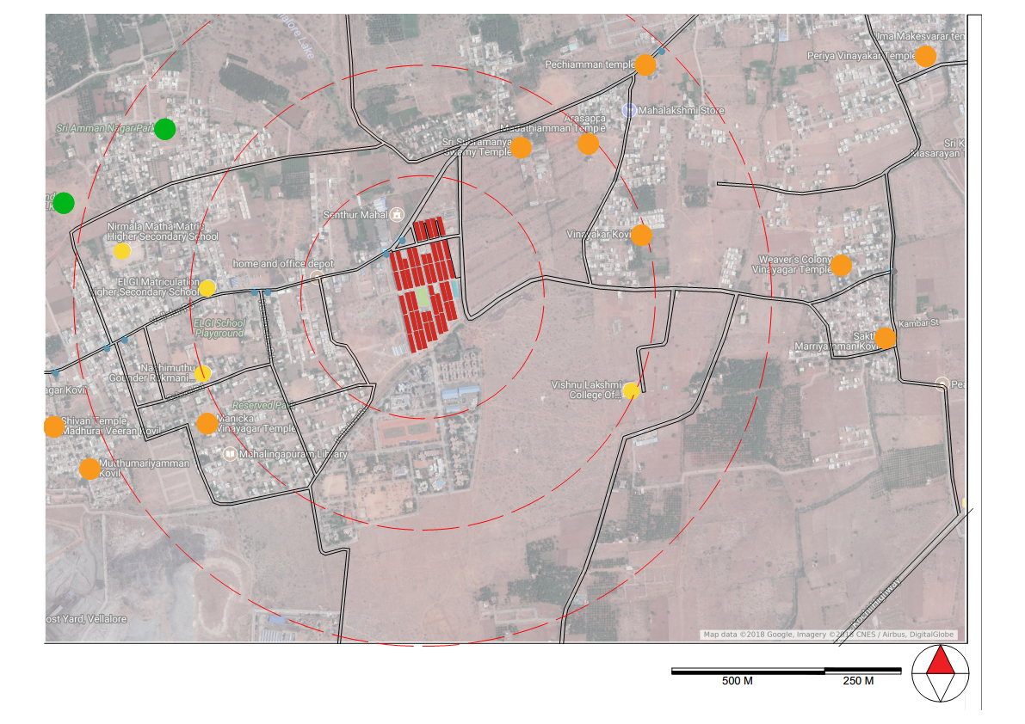
THE PLACE…
Destination – Vellalore Housing Units
Proximity
Sewage Treatment Plant
Notes:
The destination slum:
Vellalore is a town located along the south-east fringe of Coimbatore city. The jurisdiction, as yet, is still under the Vellalore town panchayat encompassing a population of 17,294 (Census 2001) with a sex ratio of 50% (male and female). Literacy rate is 64% (59.5% is national average) with 70% amongst men and 59% amongst women.
Vellalore Resettlement colony is the largest resettlement program (amongst eleven other such projects in the city - initiated by the Tamil Nadu Slum Clearance Board (TNSCB) under the JnNURM and Housing for All scheme. The project entails construction of 2,816 tenements in 20 acres of land with the project cost amounting to Rs. 172 crores (Rs. 1.72 billion). It houses nearly 24 slums as discussed previously.
The colony finds its main access through Vellalore road with the town center and Podanur Railway Station at 3kms distance. As shown in the proximity map above, the dwellers can access public transport with a bus stop outside the colony. Although accessibility is not a concern, the frequency of buses connecting to the city center is less which may force the dwellers to resort to private modes of transport. This might pose concerns of affordability and time spent on travel. The map also illustrates the number of religious spaces, institutional and recreational spaces, choice and access to amenities around the colony. This portrays a contrasting setup in comparison to the earlier map discussing the accessibility around the departure slum. It is also important to observe the presence of one of the largest sewage treatment plant at 1km distance from the settlement. This treatment plant has continually posed issues to its immediate neighborhoods due to fire outbreaks, indicating probable vulnerabilities in terms of health.

Slide 17


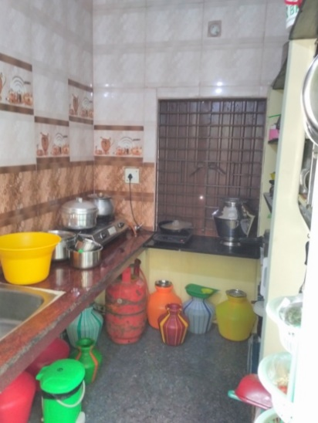
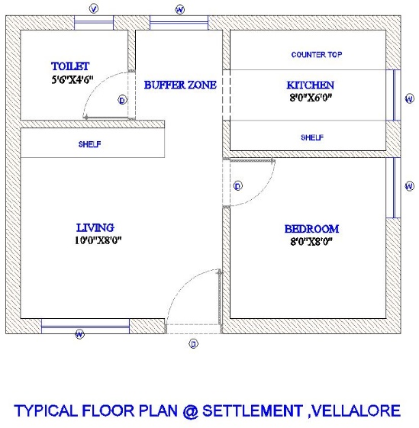
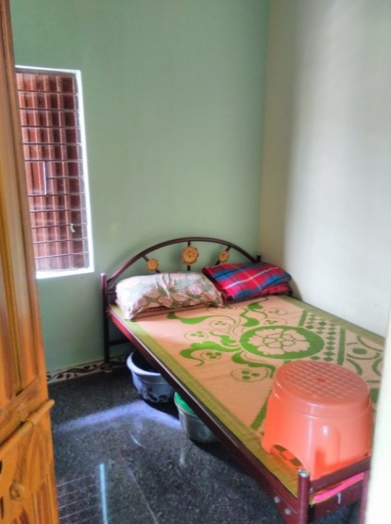
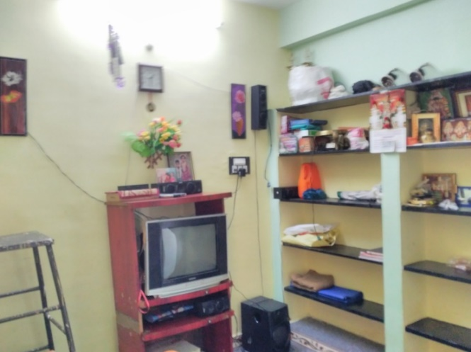
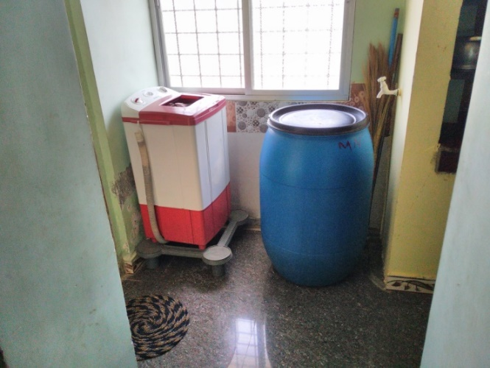
Kitchen Area. Plan of Housing Unit. Bedroom.
Living Area. Buffer Zone/Utility area.
Notes:
The colony houses a community space with a playground at the centre of the precinct, a government school (not functional as yet), two ration shops, an Integrated Child Development Services (ICDS) centre, a common hall, 19 petty shops and a Public Health Centre.
The housing unit with 2,816 households (approximately 400 HH unoccupied) is divided amongst 88 blocks of height G+3. Each block receives domestic water through 16 Over Head Tanks and the space between blocks have drinking water collection points - supplied every alternate day between 4pm and 6pm. Access roads to the blocks are 5m wide (exclusive the underground drains and rainwater culverts) with 6m distance between blocks that consist of soak pits along with the aforementioned water collection points (2 water collection points for every 4 blocks).
CLICK:
The individual unit consists of a multipurpose hall/living, a bedroom, kitchen, bathroom and toilet - similar to the other housing units constructed by TNSCB. The total built up area is 30 sq.m and the unit’s plan is as above

Slide 18
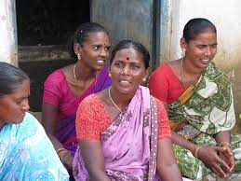
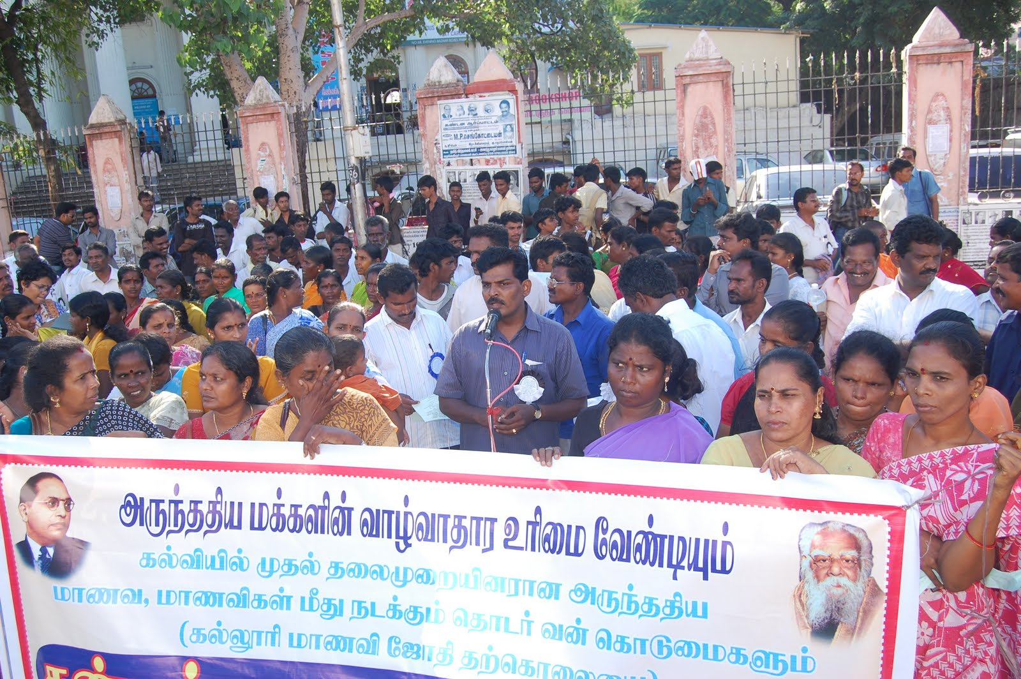
THE PEOPLE…
Arunthathiyars: “the Dalit among dalits”
Spread across Western Tamil Nadu, migrated from Andhra Pradesh.
Accompaniers as cooks, servicemen to warriors during Vijayanagar empire.
Followers of Madurai Veeran, the army general of Vijayanagar empire.
6.5% of the total 19% Scheduled Caste population of Tamil Nadu
Followers of Hinduism
Live in segregated colonies - cherrys of rural areas and slums in urban areas
Primary occupation involved making leather goods. With formation of Municipal Corporations after independence, they were roped in for scavenging activities
Often associated with miserable living conditions
Consumption of alcohol is seen in both men and women – leading to deteriorated health, negligence in child care and undying poverty
Victims of discrimination and atrocities by the higher castes
The women self-help group
The arunthathiyars of Chennai staging a protest against discrimination
Source: Krishnasamy, 2011
Name | Literate without education level | Below Primary | Primary | Middle | Matric/Secondary/higher secondary, intermediate etc., | Technical and non technical diploma | Graduate and above
Arunthathiyar | 10.5 | 23.6 | 34.0 | 16.1 | 13.5 | 0.5 | 0.7
Literacy rate is 53.7%, High drop out rates.
Victims of bonded labour
Economic instabilities affecting education levels
SOURCE: Tamil Nadu DATA HIGHLIGHTS : THE SCHEDULED CASTES Census of India 2001, http://ijlljs.in/wp-content/uploads/2016/02/16.pdf
Notes:
Vellore resettlement colony witnessed a plethora of cultures being housed in one precinct. This induced an exploration into the influence on social assets that to a large extent marks the success of the initiative. The population under study accounts to at least 9,500 people [{2816 HH - 400 (unoccupied)} x 4 (average family size)] rendering a large number for the selection of sample size. This necessitated the delimitation of the sample to one of the largest populations relocated i.e., the CMC colony.
CLICK:
The social asset of CMC colony is identified through the caste that the majority of the dwellers belong to. The dwellers are called by different names such as the Arunthathiyars, Chakkaliar, Adi Dravida, Madari etc. This community is largely spread across the western part of Tamil Nadu - historically claimed to have migrated from Andhra Pradesh.
The Arunthathiyar clan forms a large portion (nearly 771,659 according to 2001 census i.e., 6.5% of the scheduled caste population (19%) in Tamil Nadu. Arunthathiyars are considered as a sub-caste of Chammar caste and are also one of the three main sub-groups of Dalits or Schedule Caste (SC) in Tamil Nadu, the other two subgroups being Paraiyar and Pallar. They have a literacy rate of 60% which is inferior in comparison to the other two Sub-Groups.
Traditionally, their primary occupation involved making leather goods. Just after independence, with the influence of British rule and the formation of municipal corporations in each town/city, the arunthathiyars were roped in for scavenging works, cleaning of drains, sweeping etc.,( in Tamil Nadu, 95% of the arunthathiyars are scavengers). Today, they spread across many other occupations (such as cobblers, laborers, construction workers etc.,) and are quite often associated with miserable living conditions. Women also participate in culture based occupations and add to the household’s income.
The Arunthathiyars, till today, are considered as an untouchable community because of their menial work. They are frowned upon by not only by upper castes but also the other Dalit subgroups. Hence they are called “Dalits among Dalit”.
Consumption of alcohol is seen in both men and women – leading to deteriorated health, negligence in child care and undying poverty
They are often Victims of discrimination and atrocities by the higher castes.
CLICK:
The socio-economic profile of the caste also reveal high drop-out rates amongst school goers. This is mostly attributed to economic instabilities and the lack of opportunities for social mobility.

Slide 19




THE PROCESS…
Construction
September, 2017
2012 : initiation of idea
February, 2015
August, 2016
Resettled
June, 2017
2014
Allotment
2015
2016
2017
Planning
Notes:
The technicality of resettlement theory entails pre-relocation processes, the transition or the relocation and the post-relocation processes. The interview with the engineer of TNSCB provided firsthand information on the planning and execution. Along with this, interactions with the dwellers guided in mapping a basic timeline for the project.
CLICK:
The idea of Resettlement was proposed in the year 2012 under the political reign of the Indian National Congress and under the Central government’s city modernization scheme of Jawaharlal Nehru National Urban Renewal Mission (JnNURM), branching out to the states to provide for affordable housing under Housing for All (HFA).
CLICK:
Between the years, 2012-2015, the transactions related to land, call for tenders for construction, mapping of socio-economic profiles of the departure slums were carried out. The year 2014, witnessed a change in political reign at the Centre to Bharatiya Janata Party (BJP). However, the project continued under the terms of JnNURM scheme. The informal settlements on objectionable land, riverbeds, lake beds etc., were evicted, to be resettled.
Vellalore seemed to be a potential location for the project with a proposal for a large scale bus depot and lorry-pet (a place where lorries are stationed for servicing and also designed as resting areas for lorry drivers) in the near future. These proposals were planned to assist in providing employment opportunities (as drivers, watchmen etc.,) for the displaced dwellers with salaries ranging from Rs. 8000-13,000. Necessary skill training in this regard should be provided. Few women were trained at Nirmala College, under RHYTHEM to be employed as nurses, tailors, beauticians and most of all entrepreneurs. However, the outreach of this training program may be questioned.
CLICK:
Construction of the resettlement colony commenced around February 2015 with three companies - SK Builders, Sundarasamy & Co and Sanmugam & Co. The construction spanned across a good one and half years i.e., till August, 2016. The TNSCB continued mapping the departure slums through house demarcations (allotting a house number), assessing family sizes (in cases where more than one family/generation lived together), satellite imaging for topographical information, creating socio-economic profiles, skill training initiatives and finally allotment of numbers to the displaces.
CLICK:
The allotment process based on the marked house numbers started in June, 2017 and spanned over 2 months. A general lot was called for to assign the block and the respective unit to the beneficiaries. Preferences (of opting ground floor) were given to households with senior citizens or physically disabled. The beneficiaries had to submit a payment of Rs. 36,000 (at once or periodically) to the TNSCB in exchange for a sale deed spanning across 20 years. This deed constricts the owner from selling the house till after 20 years when they receive the ownership of the unit.

Slide 20
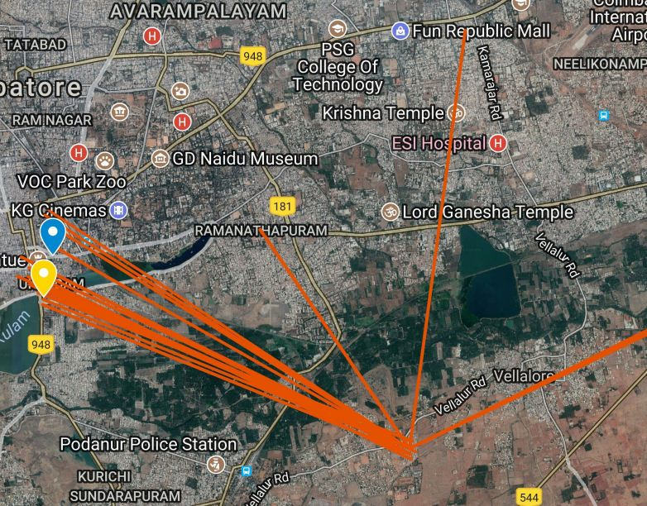
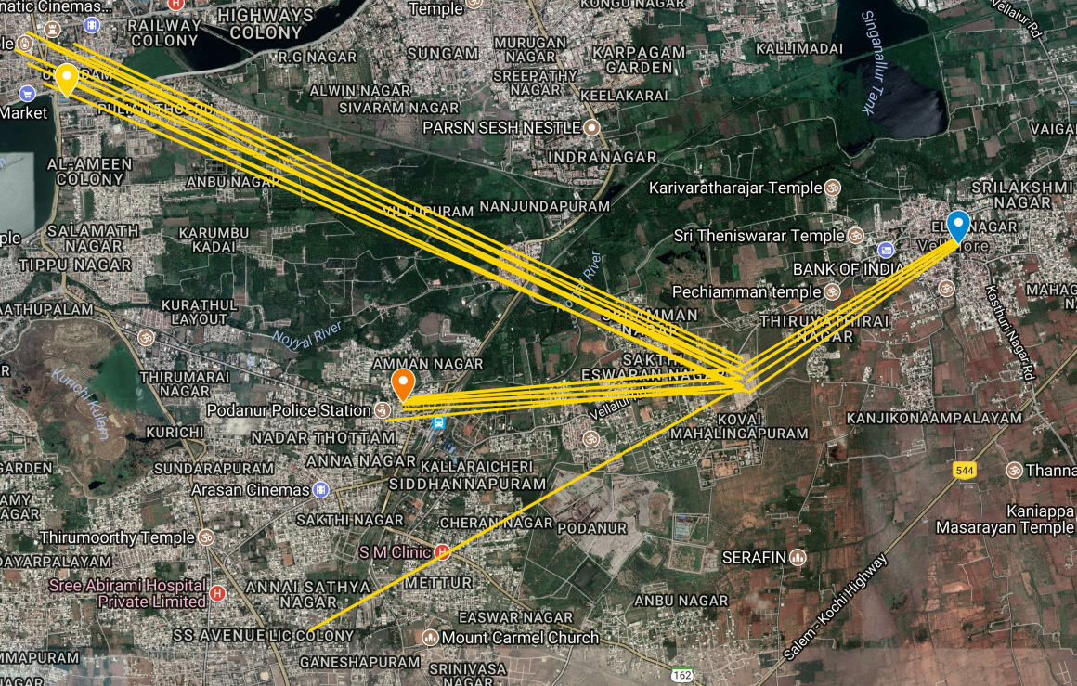
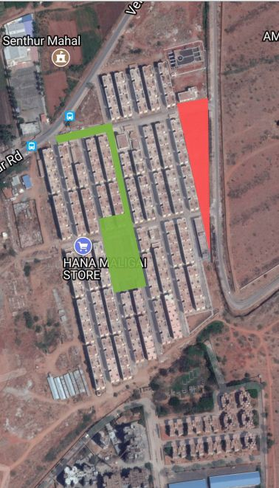
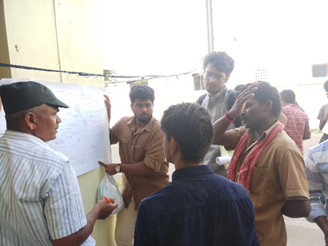
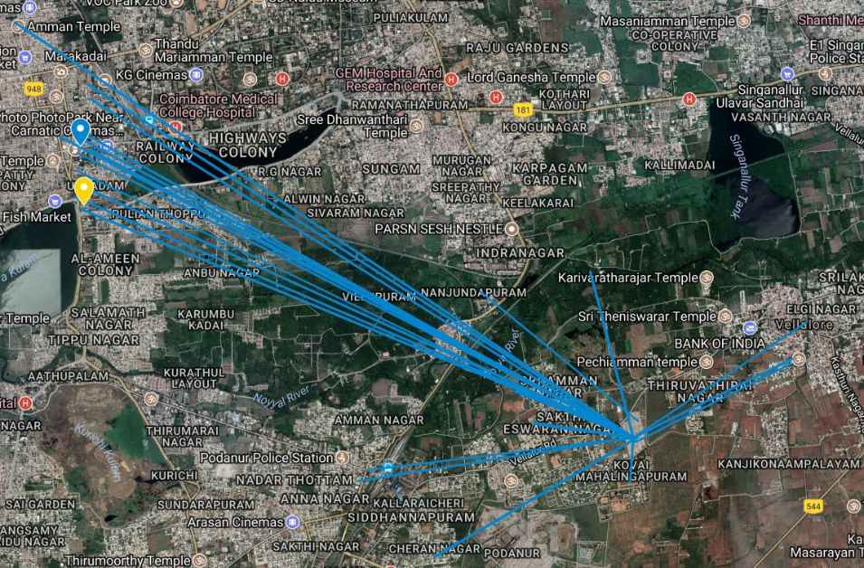
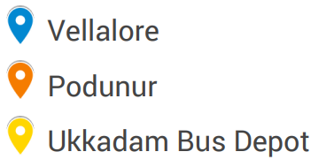
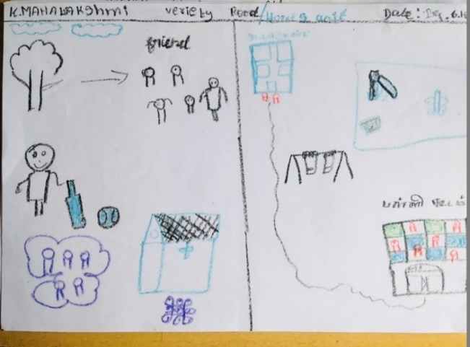
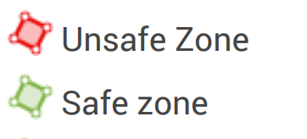
THE PARTICIPATORY MAPPING EXERCISE
EMPLOYMENT
HEALTH
Vellalore settlement
SAFETY
EDUCATION
Notes:
Mapping exercises were conducted to help gain a broad overview of the effects of displacement on people. The first step included mapping of the displacee’s current place of employment, school and hospitals. This was conducted to understand the impact of the transition or the shift in accessing basic amenities and resources.
CLICK: Employment:
As observed in the map, most of the dwellers, till today i.e., 10 months past relocation, travel back to the area of departure for employment. Most of the dwellers report to the city centre for work and the access is with at least one intermediate change in transport near Podanur junction. The travel distance ranges from 8 kms -12 kms and the time taken to travel amounts to 2-3 hours per day (back and forth) since there are no direct buses. Also, the corporation workers report to work during the early hours of the day i.e., 5am. This requires the dwellers to report at the bus stop at least by 4am. Women, who worked as domestic help had to give up on their jobs since the travel time and costs seemed practically unviable. The inconvenience of time, infrequent bus services, time spent on travel and added costs for transport may indicate stresses (financial and physical) on the dwellers.
CLICK: Education:
A similar reasoning holds good for the access to social amenities, especially schools. Children travel long distances to reach their schools. The time taken and the costs of travel add to financial pressures in a household. The transition to schools located close to Vellalore is mostly absent. This can be attributed to the availability of good quality schools, the oddly timed relocation (shift to other schools may have led to the loss of an academic year) and the reluctance of the children to adjust to a new setting (due to the fear of losing their friends). As a remedial measure, most of the dwellers have come together to arrange for private vehicles (autos and vans) for pickup and drop services. However, this has been expressed as a costly affair. The school, presently being constructed within the relocation campus is designed for students up to primary level i.e., grade 5.
CLICK: Health:
The provision of a Public Health Centre within the campus has failed to address the concerns of dwellers. The functioning has been reported to be inconsistent with non availability of doctors or nurses in case of emergencies. During all the visits by the team for the survey, the centre remained shut. The dwellers expressed concerns on the availability of ambulances and the time taken by them to reach Vellalore during emergencies with the closest hospital at 3 km. Most of the dwellers visit the government hospital near the city center since they avail treatments at subsidized rates. However, these add to the pressures of cost on travel.
CLICK: Safety:
During the initial days post resettlement, a team of police officers were positioned for vigilance. However, these services failed to subsist. In due course, crime within the colony increased with the unoccupied blocks misused for illegal activities, social tensions between dwellers and family troubles. The nearest police station i.e., Vellalore police station and Podanur police station are at 3 km’s distance. The map portrays the safe and unsafe areas identified by the dwellers as part of the participatory exercise. Stickers of red and green were provided to mark the unsafe and safe zones respectively.
With further inquiry the dwellers expressed their insecurities with the unoccupied blocks and vacant lands as spaces for illegal activities such as drug abuse, alcohol consumption by minors along with a few residents’ supposition of prostitution. Since alcohol consumption is an evident cultural trait amongst corporation workers (men & women), many residents have expressed discomfort in their actions positing an unsafe environment for girls and women.

Slide 21
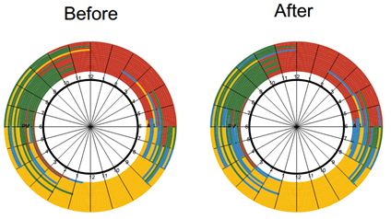
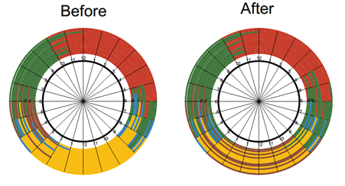
TIME-ACTIVITY MAP
Men
Women
Notes:
CLICK:This was an experiment to compare how resettlement has influenced the daily schedule of both men and women. In the chart (activity wheel) below, it can be observed that the men stay outdoors for longer hours - often spent in travel. This has affected their leisure time and sleep schedules.
CLICK:Women, who lost their jobs post resettlement, spend most of their time at home, specifically during the afternoon and evening. The sleep time has comparatively reduced since the women wake up much early than before to prepare for their husbands and children. This shows an indirect influence of men’s activity change on women. The work time is replaced by leisure or afternoon naps amongst the women. Household related activities seem to have increased in the evening hours for women.

Slide 22
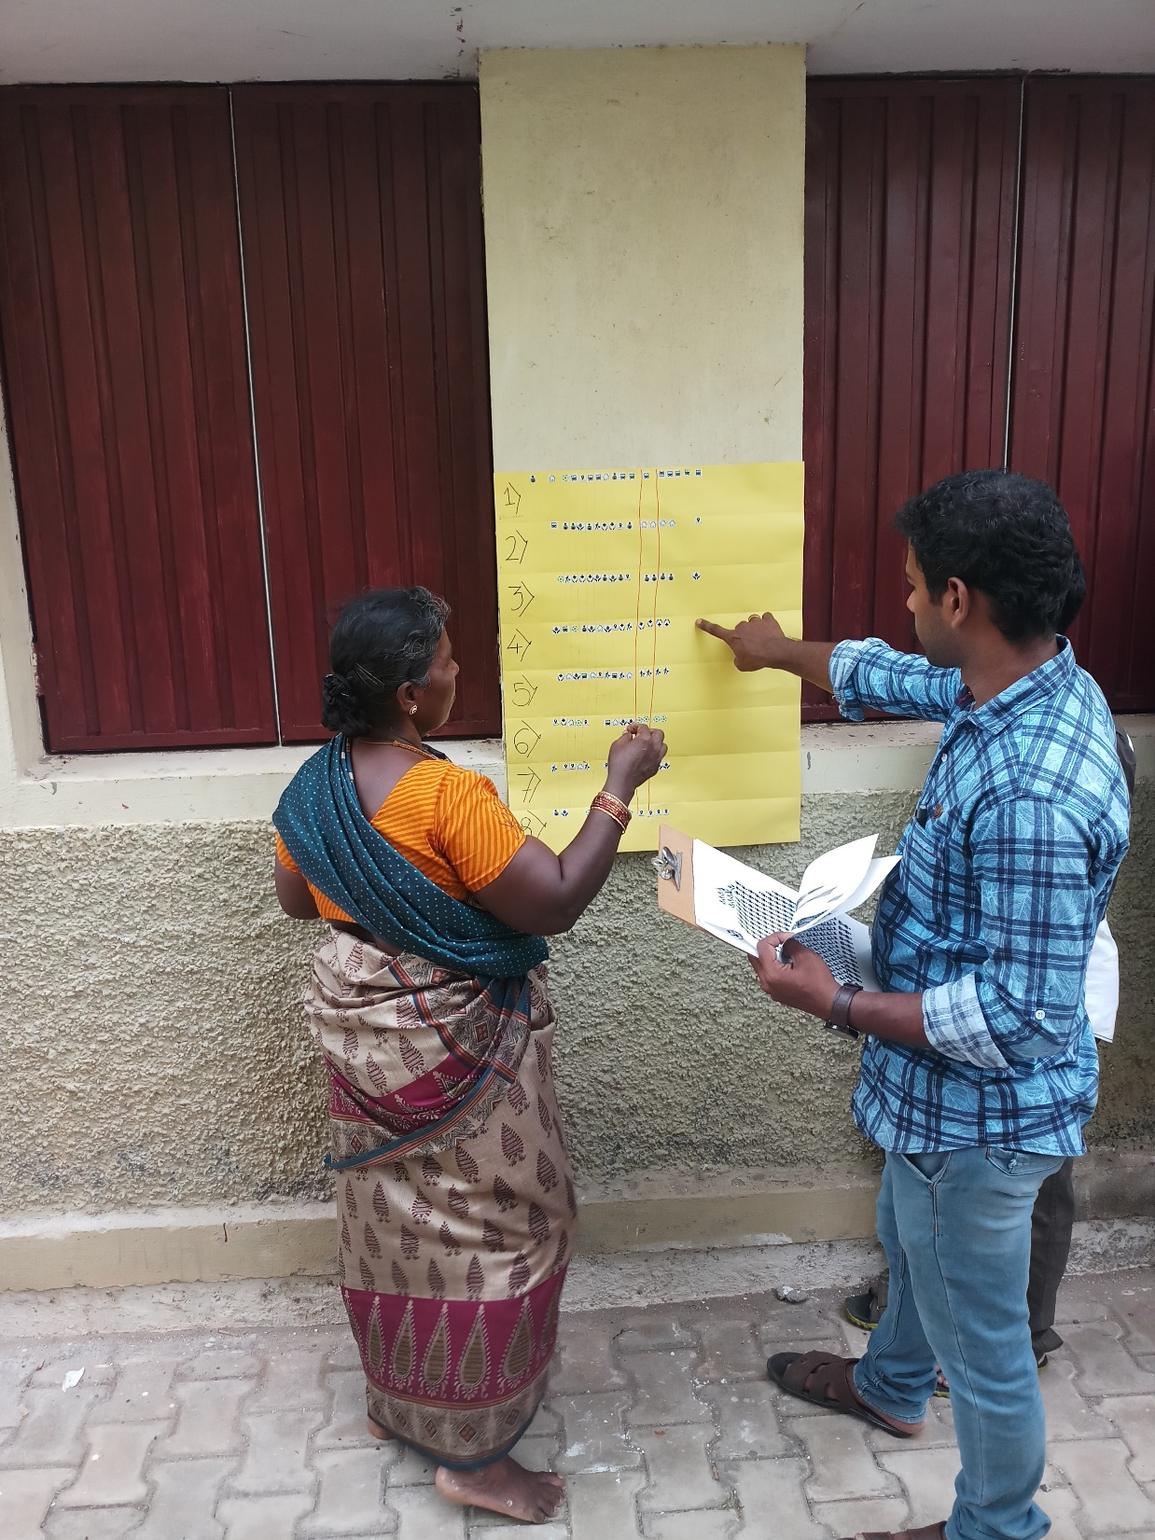
PRIORITY CHART
Priorities | House | Education | Location | Community Living | Employment | Health | Water | Transport
1) | 05 | 10 | 08 | 01 | 0 | 04 | 01 | 25
2) | 05 | 10 | 02 | 0 | 02 | 07 | 01 | 04
3) | 01 | 09 | 01 | 02 | 01 | 08 | 05 | 0
4) | 06 | 02 | 04 | 01 | 02 | 08 | 03 | 01
5) | 06 | 0 | 04 | 0 | 10 | 02 | 02 | 06
6) | 02 | 0 | 02 | 17 | 05 | 01 | 02 | 02
7) | 04 | 0 | 08 | 08 | 05 | 01 | 06 | 02
8) | 02 | 02 | 04 | 10 | 05 | 0 | 02 | 0
Rank 1 | Transport - infrastructure and services (access ann quality)
Rank 2 | Education - access and quality
Rank 3 | Health - access and quality
Rank 4 | House - quality
Rank 5 | Employment - access and opportunities
Rank 6 | Community living - social networks
Rank 7 | Location - proximity to infrastructure and amenities
Rank 8 | Water supply
Notes:
The dwellers were assisted in prioritizing their basic needs and ranking them according to their preferences. In the above chart, it can be observed that highest importance was given to the accessibility of transport services, followed by inter-related concerns of education (rank 2 and 3) i.e., the issues of access to transport has affected the access to education. Health concerns (access and quality) are prioritized at 3rd and 4th ranks followed by provision for a good quality home at 4th and 5th ranks. Employment ranks at 5th, followed by community living on the 6th and 8th rank. Water supply and ease of access are ranked at both 5th and 7th. A cumulative ranking has been articulated in the second table.

Slide 23
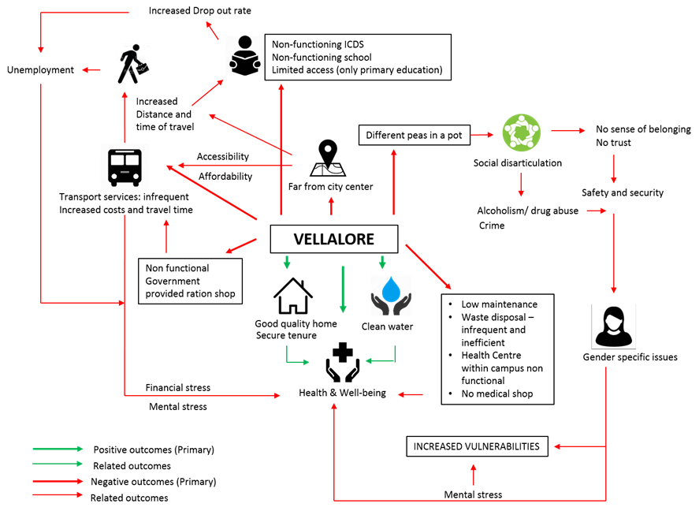
IMPACT MAP
First-hand analysis
Notes:
The figure illustrated here is an outcome of the inter-related concerns of the neighborhood post resettlement providing inferential analyses on the posed concerns. The positives of the whole project is mainly associated with the provision of good quality home, regulated water supply leading to better health and well-being. However, the issues identified vis-à-vis transport, social disarticulation, non functioning or poorly maintained amenities contributing to stress (physical, mental and financial)overshadow the optimistic renditions to the setup causing increased vulnerabilities and transitional effects on health and well-being. This impact map can be a starting point for in-depth investigations, corresponding to a particular group (CMC colony in this case), based on gender, occupation, social status etc.

Slide 24
STAKEHOLDER MAP
State Government
Housing for All and JnNURM by the Central government
Members of Legislative Assembly (MLAs)
Local governance system
Financial Corporations
Local Political Heads
Ward councilors
Coimbatore Municipal Corporation
Grama Vidiyal – a microfinance institution
Loans for women (no formal reciprocity/no formal credit)
Awareness and Allotment
Appointment
Land permit
Project finance
Vellalore Town Panchayat
Loans without formal credit
Mediators
Caste-based or
Political leadership
Recently added under corporation limits
Dwellers/displacees
Tamil Nadu Slum Clearance Board (TNSCB)
Provision of housing unit
Evictees from 24 different slums of the city
Project Steering Committee – vision 2023
Resettlement and Rehabilitation Scheme (R&R Scheme)
Appointment through tenders
Appointment
Builders/ construction companies
SK constructions
SPS constructions
JSR/SSK constructions
Rehabilitation through skill training for women
Skill training institutions
RHYTHEM SOCIAL SERVICE SOCIETY FOR WOMEN
Vellalore Resettlement Project – 2816 Households
Notes:
CLICK: The project initiated under the Central government scheme of Housing for All, executed by the state governments through the Urban Local Bodies (here, the Coimbatore Municipal Corporation) encompasses the political circle along with the project steering committee of the Tamil Nadu Slum Clearance Board (TNSCB).
CLICK: The state and the central government endorses TNSCB for the resettlement and rehabilitation scheme (R&R) under the Right to Fair Compensation and Transparency in Land Acquisition, Rehabilitation and Resettlement Act.
CLICK: The chief stakeholders in this case are the resettled dwellers or displacees and the TNSCB.
CLICK: Local political heads - either appointed at ward level (councilors) or at the corporation level (Member of Legislative Assembly) act as mediators to voice the issues of the dwellers on the one hand and on the other create awareness and help during the allotment of housing units. This unusual interaction - considering trust issues that exist, has to a large extent eased the allotment process in the case of Vellalore. The reciprocity in this case can be related to caste based or leadership based influences i.e., the local head of a particular caste (appointed based on the same) or belonging to a political party (at the state level where personality politics is largely evident in Tamil Nadu) can impact the assertions of the dwellers.
CLICK: Financial corporations (appointed under the state) such as Grama Vidiyal, a charitable trust to a regulated Non-Bank Financial Company (NBFC) help provide loans for women with no formal credit.
CLICK: The TNSCB appoints the builders or construction companies through tenders and resorts to institutions such as RHYTHEM for skill training (in this case, only for women). The devolution of such initiatives are, however, questionable.

Slide 25
HOUSEHOLD SURVEY: CMC COLONY, VARIETY HALL ROAD (DEPARTURE SLUM UNDER STUDY)
Human capital
Table showing the age group recorded
Age Groups | Male | Female | Total
1-15 | 0 | 0 | 0
16-30 | 10 | 20 | 30
31-45 | 18 | 16 | 34
46-60 | 11 | 9 | 20
61 and above | 6 | 2 | 8
Education
Skills: language and its influence on employment.
Physical capital
Preference, access and affordability of services and infrastructure through priority ranking exercise.
Table showing the marital status
Marital Status | Male | Female | Total
Married | 41 | 34 | 75
Unmarried | 4 | 4 | 8
Widowed | 1 | 10 | 11
Divorced | 0 | 0 | 0
Financial capital
Employment status, household income, assets and compare with expenditures.
GENERAL OVERVIEW
Table showing the family size
Social capital
Family Size | Respondents
1-2 | 14
2-4 | 59
4 & Above | 21
Networks in play, reciprocity and trust.
Gender issues, discriminations if any
Notes:
CLICK: The inferences from participatory exercises demanded a funneling down of the target population for household surveys. The context of CMC dwellers has been discussed previously justifying the premise for a selective sample. Triangulation of data is achieved by cross relating the analyses of household surveys with the inferences from participatory exercises. Along with a basic understanding of the household profile - family size, age etc., the questionnaire devised attempted to encompass the measuring indices of livelihood capitals as follows –
Human capital - measured with details of education, skills available such as language and its influence on employment, health and wellbeing.
Physical capital - preference, access and affordability of services and infrastructure through priority ranking exercise.
Financial capital - employment status to understand the household income, assets and compare with expenditures. This is closely linked to both human and physical capital.
Social capital - to understand the networks in play, reciprocity and trust that exists.
Natural capital in this specific case does not influence the livelihood due to the absence of natural resources around the settlement. Vellalore Lake is currently dried up and converted to other land uses. Sustainability measures in terms of adding to the natural resource base does not seem to fit in this context.
Data collected from 92 respondents is analyzed henceforth:
CLICK: The first table indicates 62 % of total respondent in household survey belonging to the age groups (16 – 30) years and (31- 45) years. This infers a suitable sample of youth and working populations to map the impact of resettlement on physical and financial assets.
CLICK: The second table indicates that 81.5% of the sample population are married. The interviews with non-working female respondents indicated the income of their partners - to help in assessing the probable financial concerns. It may also be important to note the widowed population to highlight social concerns (discriminations under gender, status etc.,). However, the current study provides an overview but does not delve deep into these sensitivities.
CLICK: Overcrowding in departure slums make it a tedious affair for the officials to assign households based on the family size, especially in contexts where more than one generation reside together. However, the allotment is based on Aadhaar card (a 12-digit unique identity number that can be obtained by residents of India, based on their biometric and demographic data) of the beneficiary and one tenement is provided for one family. In the target sample, 15% of household have family size of 1-2, 64% of households have family size of 2-4 and 21% of household have family size of 4 & above – this may indicate a concern for overcrowding in the future bearing its implications on health and wellbeing.

Slide 26
HOUSEHOLD SURVEY: CMC COLONY, VARIETY HALL ROAD (DEPARTURE SLUM UNDER STUDY)
Table showing the type of employment
Type of Employment | Male | Female | Total (of 92)
Municipality/ CMC | 15 | 8 | 23
Other Government Agencies | 0 | 3 | 3
Private Sector | 10 | 6 | 16
Self Employed | 6 | 11 | 17
Others | 12 | 0 | 12
Education Level | Male | Female | Total
Primary | 4 | 3 | 7
Secondary | 15 | 13 | 28
High School | 11 | 10 | 21
Pre-University | 0 | 1 | 1
Degree and Above | 3 | 5 | 8
Uneducated | 13 | 15 | 28
EDUCATION
Table showing the rate of employment
Employment rate | Male | Female | Total (of 92)
Employed | 43 | 24 | 67
Unemployed | 3 | 18 | 21
Previously Employed | 0 | 11 | 11
Table showing the education levels
Table showing the income generated
Income | Male | Female | Total (of 92)
1,000-5,000 (15-70 $) | 8 | 7 | 15
5,000-10,000 (70- 140 $) | 21 | 20 | 41
10,000-15,000 (140- 210 $) | 4 | 11 | 15
15,000 & Above (>210 $ ) | 11 | 10 | 21
EMPLOYMENT AND INCOME
Table showing the expenditures per month
List of Expenditures: | Amount (Rs / $)
Medical | 500 – 2,500 / 7 - 36
Electrical | 100 – 300 / 1.5 – 4.3
Gas connection/ kerosene stove | Approx. 750 / 10,8
Grocery | Approx. 3,500 / 50
Water supply | -
Notes:
CLICK: Education:
30% of the target population are either uneducated or have completed secondary school. This justifies the low education levels of the arunthathiyars caste discussed earlier which implies effects on the employment type. Telugu and Tamil are the languages widely spoken amongst the lot.
CLICK: Employment type:
25% of the sample population work for the corporation while almost an equal percentage work for the private agencies (17%) or are self-employed (18%). With close to 23% of them having high school education, a shift in employment type (to private or self-employment) may indicate a faint occurrence of social mobility (or occupational mobility). The caste based discriminations that exist and the high rates of school dropouts, till date, have their implications on intergenerational occupational mobility of the Arunthathiyars. Apart from these, the probability of being employed by other government jobs remains low due to trust issues (from the dwellers with the agencies). Hence they resort to owning petty businesses or working for the private sector as a part of housekeeping.
CLICK: Rate of employment:
The table reveals that 74% of the sample surveyed were employed. It is interesting to note here that the unemployment rate has increased amongst women post resettlement (Table 5.8). This indicates the loss of jobs as an effect of resettlement affecting women who may have worked as domestic help in residential areas around Variety hall. Low development in the housing sector in Vellalore, indicates fewer opportunities available.
CLICK: Income:
44.5% of the survey sample earning between Rs. 5,000-10,000 indicates the income levels of daily wage (or minimum wage) workers (Table 5.11). An estimated range of expenditures per month have been devised below to compute income versus their expenditures, indicating the dynamics of the financial capital after resettlement. It is also important to observe that close to 23% of the sample population earn beyond Rs. 15,000 (salary for an entry level graduate in most private firms) which may point out the nature of employment and add a presumptive note on occupational mobility of those associated with private agencies or those who are self-employed. However, the added expenditures that may affect their savings have to be noted.
CLICK: Expenditure:
Expenditures were computed considering basic necessities such as an individual gas connection (for cooking), electrical charges, medical expenses and groceries (Table 5.12) .Since most of the dwellers are provided with medical subsidies and free medical checkup (through medical care provided by the government) in government hospital, they travel to Ukkadam and Town Hall for medical attention. In case of emergencies, the nearest hospital is in Podanur (3kms from resettlement colony) or Vellalore Government Hospital (2 kms from resettlement colony). However, the outreach in terms of services and quality is, as yet, inefficient.
The electrical expenses for a single family of 4 member range between Rs. 100-350 for a period of two months, apart from the subsidies provided by the electricity board (where the first 100 units of billing is completely free of charge, to all its citizens). To negotiate the added expense, most of the dwellers saved on the electrical consumption with the use of kerosene stoves instead of induction cooker.
The cooking Gas connection or the LPG connection have not been updated with new addresses posing a problem with respect to the delivery of services. As a remedial measure, the dwellers have resorted to kerosene stoves for cooking and heating purposes.
Groceries are availed through government provided ration shop (at subsidized rates) with the proof of a ration card (an official document issued by state governments in India to households that are eligible to purchase subsidized food grain from the Public Distribution System (under the National Food Security Act). They also serve as a common form of identification for many Indians). However, these are not updated, till today. The residents travel to their departure slums for subsidized ration adding to the cost and effort in travel. Also, the government Ration Shop designed within Vellalore resettlement colony is still non functional. During informal interviews, the dwellers mentioned that men avail the grocery from government ration shop in Town Hall limits, on their way back from employment - once every week.
Apart from these, it is important to note that the costs of travel have increased substantially with Rs. 35 per day per person to travel by bus to the city centre. Assuming a family of two working professionals, the costs on travel would range between Rs 1,750 - 2,100. The school goers also have to pay for transport adding to the overall costs. The fuel costs for a two wheeler (assuming a mileage of 40km/ltr) would range between Rs. 1,000 - 1,500.
This would make the range of expenditures between Rs.5,000-7,000 which makes savings a dreadful task.

Slide 27
HOUSEHOLD SURVEY: CMC COLONY, VARIETY HALL ROAD (DEPARTURE SLUM UNDER STUDY)
Table showing the location of employment
Table showing degree of interaction
Location of Employment | Distance ( km) | Dwellers
Gandhipuram | 13.50 | 18
CMC Colony | 11.60 | 12
R.S.Puram | 11.00 | 13
Ukkadam | 10.00 | 13
Selvapuram | 11.50 | 2
Town hall | 10.50 | 12
Sowripalayam | 9.30 | 4
Vellalore | 3.00 | 6
Degree of Interaction | Male | Female | Total
Always | 3 | 5 | 8
Often | 10 | 7 | 17
Sometimes | 22 | 18 | 40
Rarely | 6 | 9 | 15
Never | 5 | 7 | 12
Table showing those who made friends after shifting to Vellalore
 | Male | Female | Total
Yes | 13 | 16 | 29
No | 33 | 31 | 64
Table showing the mode of transport
EMPLOYMENT LOCATION AND TRANSPORT
Mode of transport. | Household
Two Wheeler | 30
Public Transport | 56
Others | 6
Table showing with whom the dwellers celebrate festivals
SOCIAL NETWORKS
Celebrates with: | No. of Households
Relatives | 65
Friends | 19
Neighbors | 8
Notes:
CLICK: The mode of transport widely adopted by the dwellers is the public transport system - close to 61% of the survey sample and 32% of them own private vehicles. On the one hand, these figures defend the aforementioned woes of the transport system (time, cost and frequency) and on the other show a slow shift in transport modes tagging an extra fuel cost to the monthly expenditures.
CLICK: Measuring the Social capital:
The diverse social groups that are housed in the colony and the random housing unit allotment procedures of the TNSCB have disturbed the social networks that once held the community together. Low interactions between communities have been expressed in the name of religion or religious practices, caste etc., as expressed by one of the dwellers below. Issues of trust and reciprocity are but obvious in such scenarios which subsequently hinder the safety and security of the dwellers.
CLICK: Degree of interaction: The dwellers were questioned based on the interactions with neighbors (as a measure of immediate help). 43.5% of the sample population have interacted seldom with their neighbors, although the maximum response remains neutral to the data intended with a feeble indication towards weak trust and reciprocity.
CLICK: When further questioned about probability of new networks being formed, close to 70% of the dwellers have failed in making new friends post relocation.
CLICK: The festivals in India bring people together for a common celebration. The dwellers of CMC colony, celebrate Hindu festivals and festivals germane to their caste. The strong networks that make these celebrations seem mostly undisturbed with 40% of the dweller’s relatives residing within the resettlement colony. However, there are still a few others who travel back to their slums for celebrations. With only 20% of dwellers celebrating with friends and 10% with neighbors within the settlement indicate weak networks outside their comfort zones (i.e., caste or religion). An ostensible observation can be made to deduce a low sense of belonging or community living.

Slide 28
HOUSEHOLD SURVEY: CMC COLONY, VARIETY HALL ROAD (DEPARTURE SLUM UNDER STUDY)
Priorities | House | Education | Location | Community Living | Employment | Health | Water | Transport
1) | 56 | 04 | 02 | 0 | 0 | 06 | 0 | 19
2) | 03 | 09 | 18 | 06 | 04 | 09 | 41 | 08
3) | 0 | 09 | 22 | 26 | 10 | 19 | 08 | 04
4) | 0 | 14 | 21 | 14 | 21 | 16 | 08 | 04
5) | 01 | 20 | 13 | 22 | 23 | 06 | 06 | 01
6) | 02 | 20 | 13 | 08 | 23 | 18 | 05 | 01
7) | 03 | 09 | 08 | 11 | 10 | 15 | 22 | 09
8) | 26 | 06 | 0 | 04 | 01 | 03 | 04 | 47
Rank 1 | House
Rank 2 | Water
Rank 3 | Community Living
Rank 4 | Location - proximity to amenities
Rank 5 | Employment
Rank 6 | Education
Rank 7 | Health
Rank 8 | Transport
PRIORITY CHART
Notes:
The priority ranking conducted during participatory exercises was reiterated in the household survey. However, the intent for this slightly changed to incorporate priorities based on an individual’s basic needs. The list included services such as water, education, health, good quality house, transport, proximity to amenities (location), employment and community living. The shared ranks were further prioritized to create a cumulative rank.
Ironically, transport was the least of their priorities when compared to a good quality house, access to clean water and community living. With the provision of house and water supply in Vellalore, community living and advantages of location appear to be the disregarded elements in promoting the well-being of dwellers.

Slide 29
KEY FINDINGS AND CONCLUSION
Access and affordability of services and infrastructure: specifically transport related issues.
Fragmented social networks, weak trust levels and lack of reciprocity.
Loss of jobs and unemployment.
  Rise of informal commercial activities within the house and on the streets.
  Weak devolution of rehabilitation strategies/livelihood strategies.
    Skill training restricted/absent.
    Job provisions unclear and prolonged.
Lack of mediating bodies/ ineffectual block committee.
Consultations versus co-planning (non-participatory).
Lack of maintenance (by dwellers and the corporation).
Notes:
CLICK: Firstly, with more than 10 months into resettlement, dwellers are facing issues primarily related to transport and its related services. The issue is intensified with majority of those resettled travelling back to their departure slums for employment, schools, hospitals and other social amenities. Accessibility concerns (good quality education, health care services, etc.), increased travel time and costs and infrequent public transport services are asserted to poor provision of infrastructure. The school, ration shops, ICDS and the health centre within the premises remain non-functional, till date.
CLICK: Secondly, high levels of social disarray is witnessed in the colony housing different slums with varied social backgrounds (religion or caste). The chaos has been mainly attributed to the allotment system undertaken by the TNSCB wherein the call for lots has dispersed the dwellers with priorities given only to households having senior citizens or physically handicapped. Discontent in this regard has further weakened the plausible ties that could have been established. The matters of concern could have been largely scaled down (through the comfort of network) if the pre-existent networks were directly transformed in the new setting. Fragmented social networks, weak trust levels and lack of reciprocity have raised alarming concerns of safety and security.
CLICK: Thirdly, displacement has led to loss of jobs mostly amongst women which has its effects on the financial stability of the household. Moreover, it was observed during the field visits that the utility area within the housing unit, is being used as a space to sell condiments and petty household items. These were mostly handled by women, unemployed after resettlement. These activities also indicate a sprout of informal activities as a medium of restoration in assets (mainly financial) lost or more so as a bottom-up livelihood strategy. The roads within the colony are occupied by cart sellers by the evening. All these can point towards weak planning and assessment during the pre-relocation period in gauging the socio-economic profiles documented by TNSCB. Proposals for street vendors and petty shop owners could have been incorporated during the design of the colony.
CLICK: Rehabilitation through job provisions and skill training are more or less absent. The interventions of RHYTHEM (appointed by TNSCB) remained restricted to women only from Aathupalayam slum (about 50 women), thus posing a weak devolution of rehabilitation strategy. It is also important to note that the CMC colony residents are associated with caste-based occupation which makes them more vulnerable in combating livelihood issues. Furthermore, the ineffectual promises of employment opportunities in the proposed Bus Depot and Lorry Pet in Vellalore and the added pressures during this transitional period may provoke withdrawal by the dwellers to move back to the old location or elsewhere. It is important to note that the demolished slum land currently remains under the jurisdiction of the municipal corporation. If this is left undeveloped, opportunistic encroachments are not far from occurrence (adding to the story of many failed resettlement projects).
Fourthly, the concerns related to the colony are presently being voiced out to block committee members appointed post relocation. The members of the block committee are selected based on religion (at least one Hindu, Muslim, Christian etc.,) with women members completely absent. Although, the committee organizes meetings every week (on Tuesdays between 8pm-8.30pm), participation by the dwellers is meek revealing trust issues. Constant persuasions by the committee to better the living conditions have been rendered futile.
CLICK: Fifthly and most crucially, the entire process of resettlement i.e., pre-relocation planning, transitional processes and the post-relocation planning, has been completely non-participatory in nature. The news of resettlement was informed through the local councilors with consultations only during the allotment processes. These consultations were conducted just a month prior to relocation/shifting. The process of allotment was through the call of lots with very little preference or decision making power vested in the hands of the dwellers.
CLICK: Lastly, the colony, ten months into occupancy, endorses an unkempt look with the first glance. The reasons can be many ranging from low quality infrastructure revealing cracks in the walls, leaking plumbing lines etc., to low maintenance by the officials (corporation) and the dwellers specifically in terms of waste disposal. The rain water culverts are clogged by undisposed wastes. The dwellers and the corporation endure in a complex web of blame game (of liability on dirty surroundings) with long run consequences on health and wellbeing.

Slide 30
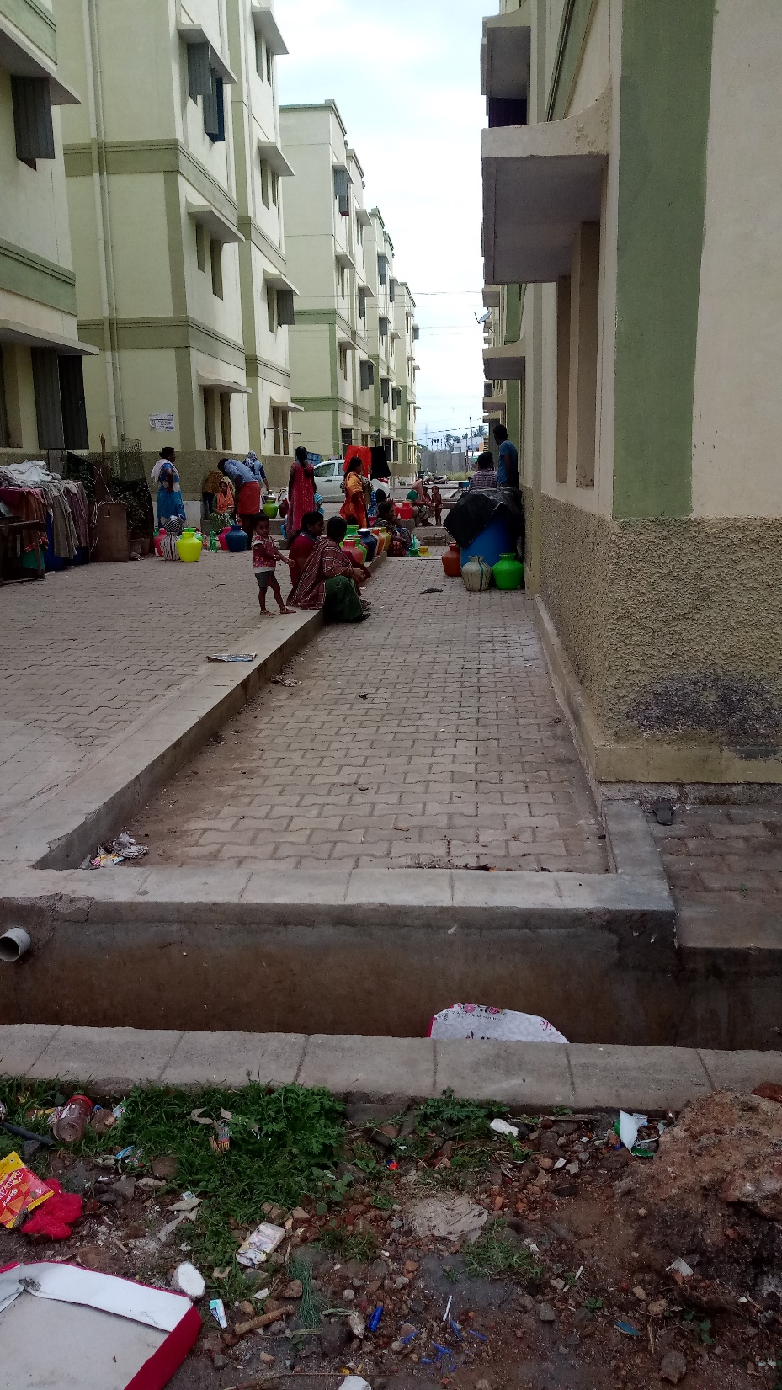
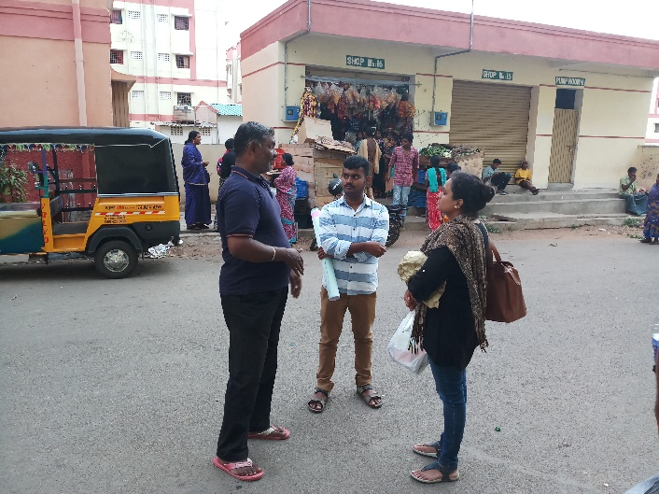
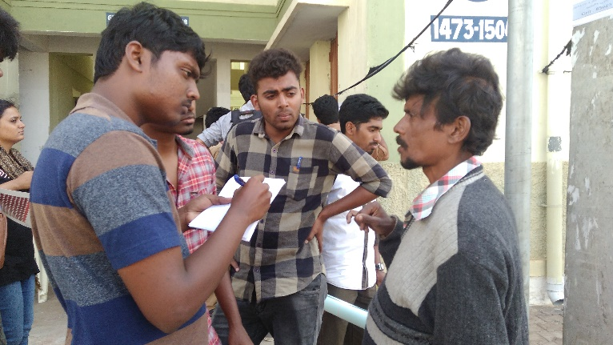

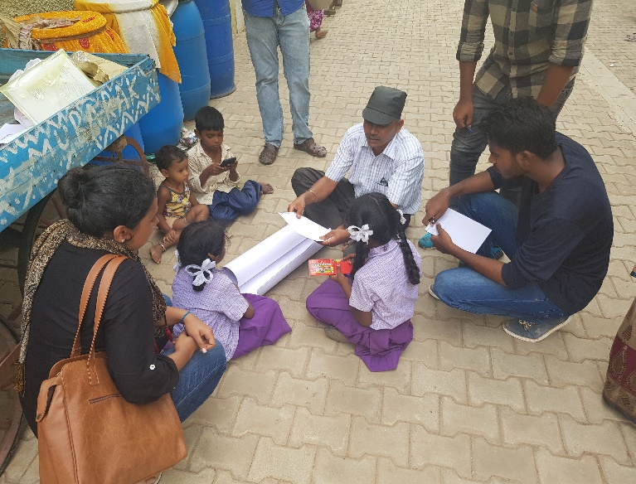
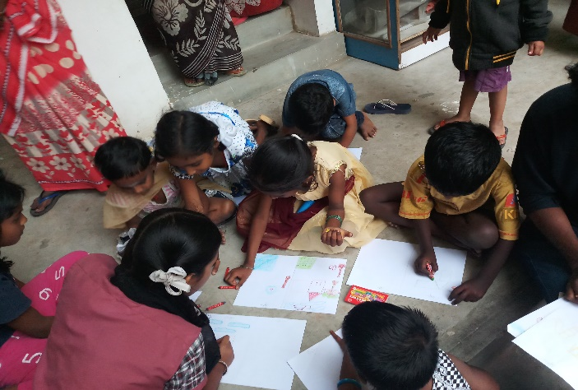
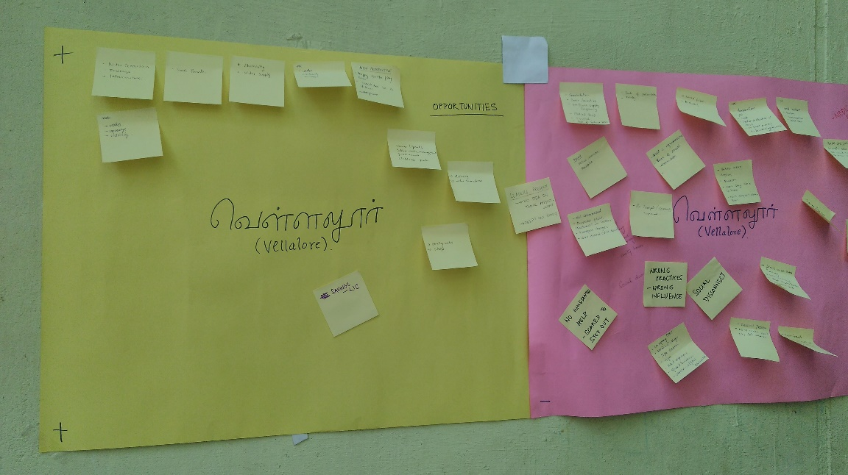
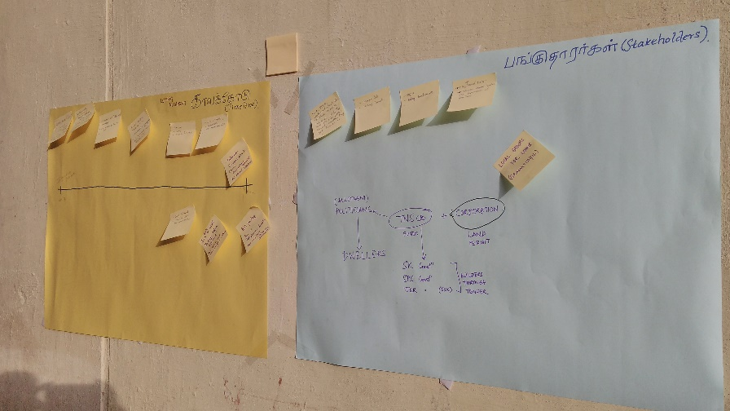
EXPLORATIONS
Notes:
In Conclusion:
As expressed by Ms. Ananya Roy(2005, p156), quote-unquote “Confronting the failures and limitations of models (policy models) provides a more realistic sense of politics and conflicts, and also forces planning to face up to the consequences of its own good action. Such outcomes must be seen as something more than simply unintended consequences“. Saying so, Vellalore resettlement project conceives a rather repressive theory wherein resettlement theories in the global context have been replaced by in-situ redevelopment concepts, right based policies and participatory developments.
Reiterating the SLF, the processes and institutions (resettlement policy and TNSCB) that assess the livelihood assets and propose livelihood strategies seem to falter in the case of Vellalore with distressing outcomes such as lack of employment opportunities, inaccessible infrastructure, and affordability concerns - recycling of poverty, adding to the existing vulnerabilities.
Planning in this sense brings the attitude of a “casual shrug” (Roy, 2005, p. 156) stating inabilities in managing the advocacies of complex social systems .The weak social capital is thus another primary concern that renders the context fragile - which may augment vulnerabilities. Pressures on land - both on resettlement premises (infrastructure pressure) and on the departure lands (shift of economy) may influence the dynamics of micro-economics and thereby impact livelihood.
This report questions the snowballing of issues highlighted in the earlier chapters to embark upon a vertical slum in the making - if immediate remedial measures are left unheeded. However, as the title of this research puts across an understanding of the lives in transition, the observations made, though restricted to the current scenario, may give rise to ensuing hypotheses (specific to gender, caste, religion, employment, social networks etc.,) rooting from the inferences made.

