Slide 1

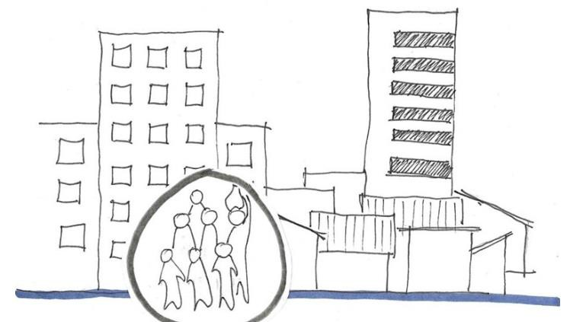

A HISTORY OF SLUM AREA MAPPING
MONIKA KUFFER
VIJAYAWADA , FEBRUARY 2019

Slide 2
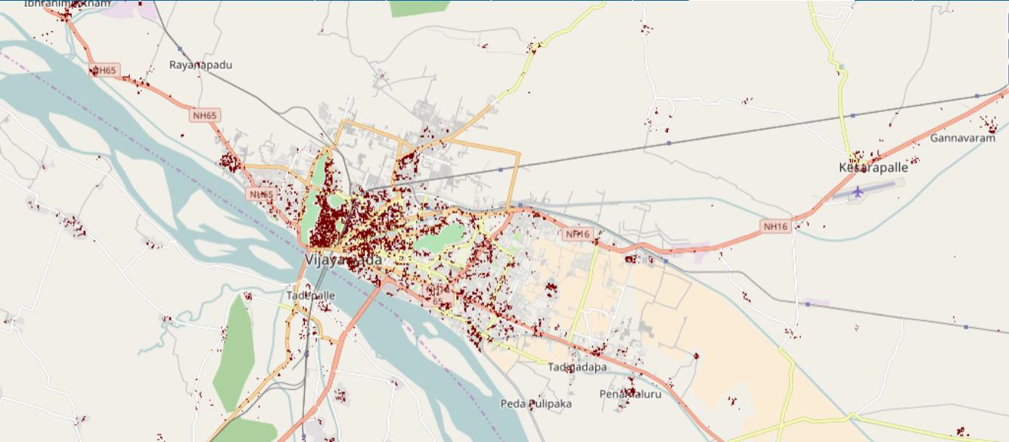
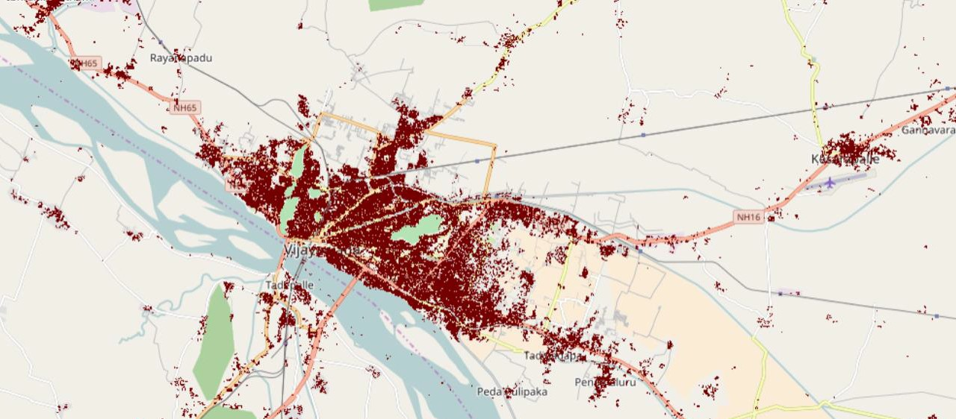

TOWARDS A GLOBAL REPOSITORY OF SLUMS?
The Global Human Settlement Layer https://ghsl.jrc.ec.europa.eu/visualisation.php#
1975
2015

Slide 3

THE DILEMMA TO DEFINE SLUMS

Slide 4
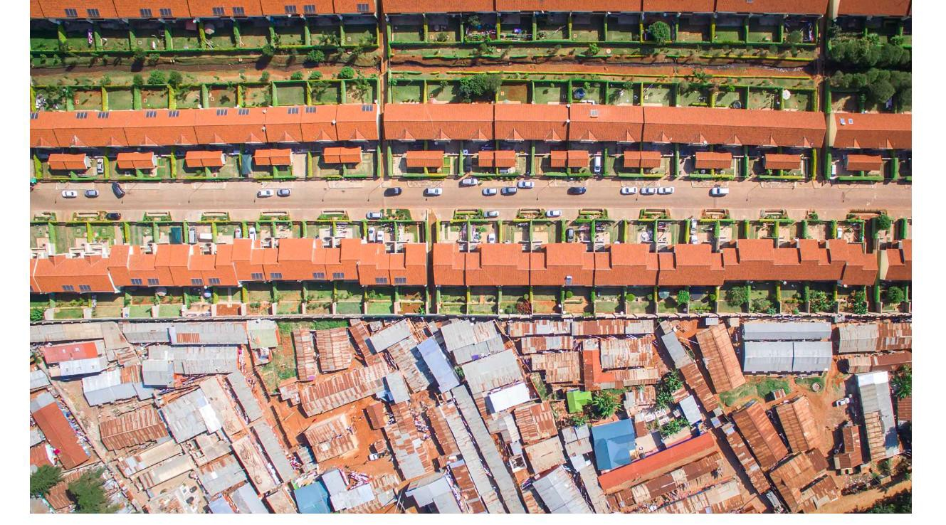




THE URBAN DIVIDE
Source: Johnny Miller - http://unequalscenes.com/nairobi

Slide 5
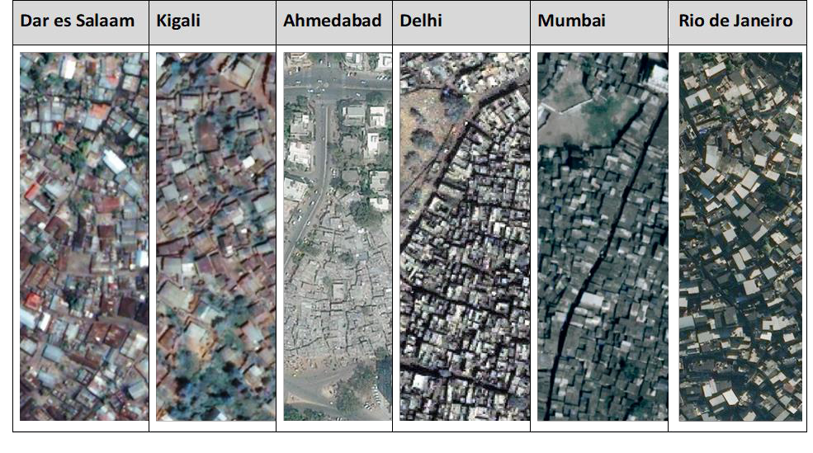
THE URBAN DIVIDE – THE MORPHOLOGY

Slide 6
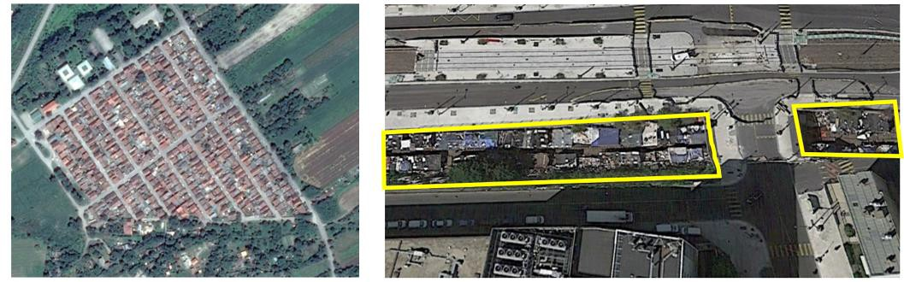
SLUMS IN EUROPE?
Serbia
Paris, France

Slide 7
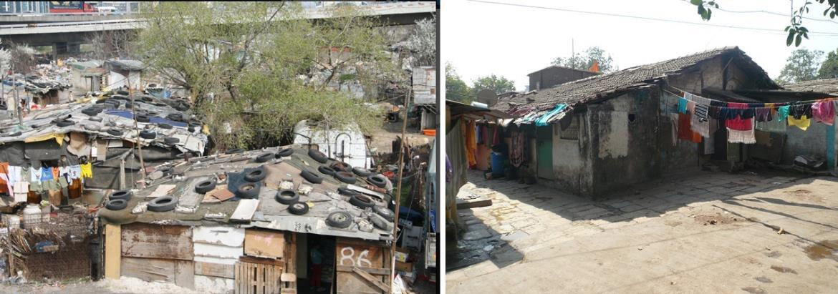
SLUMS IN EUROPE?
Roma camp in Serbia
Mumbai

Slide 8
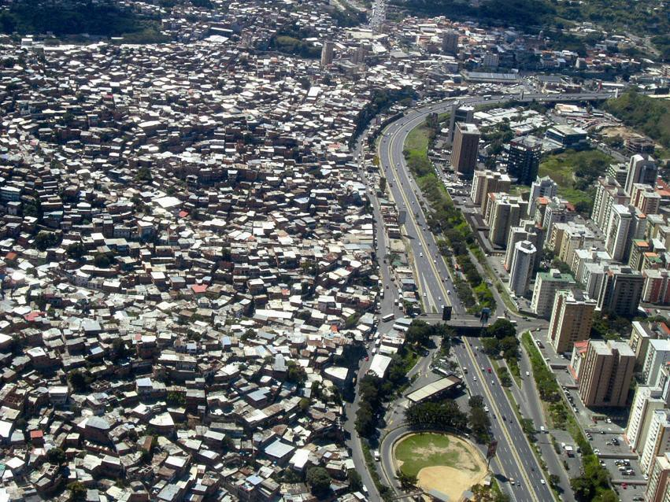
THE GENERIC SLUM ONTOLOGY
Object Level
Settlement Level
Neighborhood Level
Kohli, D.; Sliuzas, R.V.; Kerle, N.; Stein, A. An ontology of slums for image- based classification. Comput. Environ. Urban Syst. 2012, 36, 154–163.

Slide 9
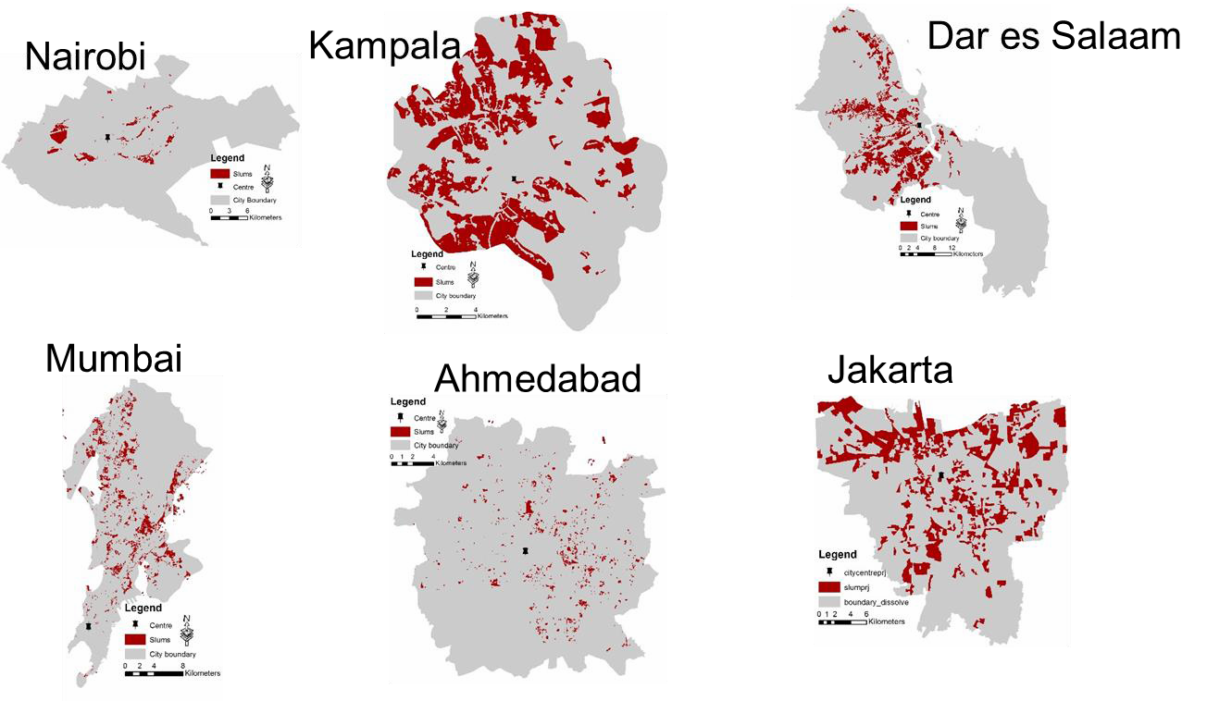

THE URBAN DIVIDE – SPATIAL PATTERNS

Slide 10

WHY DO WE NEED DATA ON SLUMS?

Slide 11
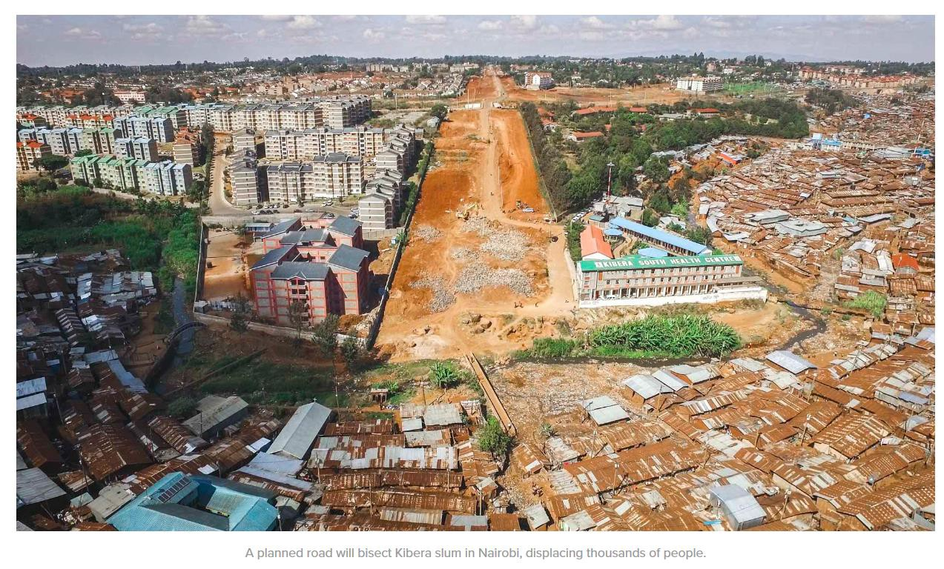
WHY DO WE NEED DATA ON SLUMS?
Source: Johnny Miller - http://unequalscenes.com/nairobi

Slide 12
INFORMAL VS FORMAL DEVELOPMENT PROCESS
The Example: Supporting_{PH}p_{Y}l_{S}a_{IC}n_{A}n_{L}i_{D}n_{E}g_{VE},_{L}u_{O}p_{PM}g_{E}r_{N}a_{T}d_{PR}in_{OC}g_{ES}a_{S}n_{E}d_{S}
Informal Formal
BUILDING SETTLEMEN
servicNeot provisionT
applicable
Not applicable
Time
Vacant land
Vacant land
Appear
Not applicable
O
1
P
Appear
Not applicable
2
B
S
Evolve (grow)
Not applicable
3
S
B
Appear
Evolve (reduce & disappear)
Not applicable
4
P
O
Appear Evolve
Appear (criteria required e.g.
5
minimum size,
Monitor citizen led development
Monitor plan^{number of}
buildings,
implementat^{s}i^{p}o^{ac}n^{ing}
between buildings or building clusters)
Sliuzas et al., 2017 https://ieeexplore.ieee.org/document/792A4p5pe8ar9
Evolve (grow
Expand Densify

Slide 13
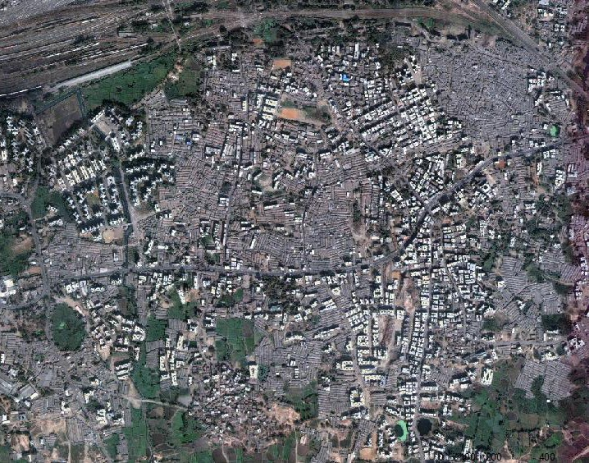
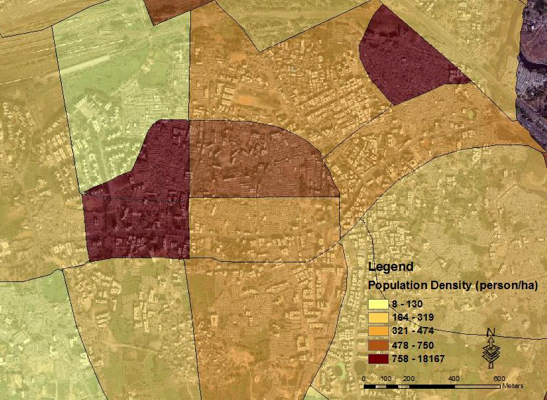
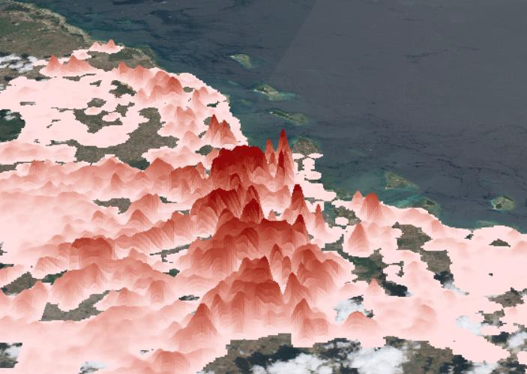
ESTIMATING THE POPULATION IN NEED
The Example: Supporting health interventions

Slide 14


IMAGE DATA

Slide 15
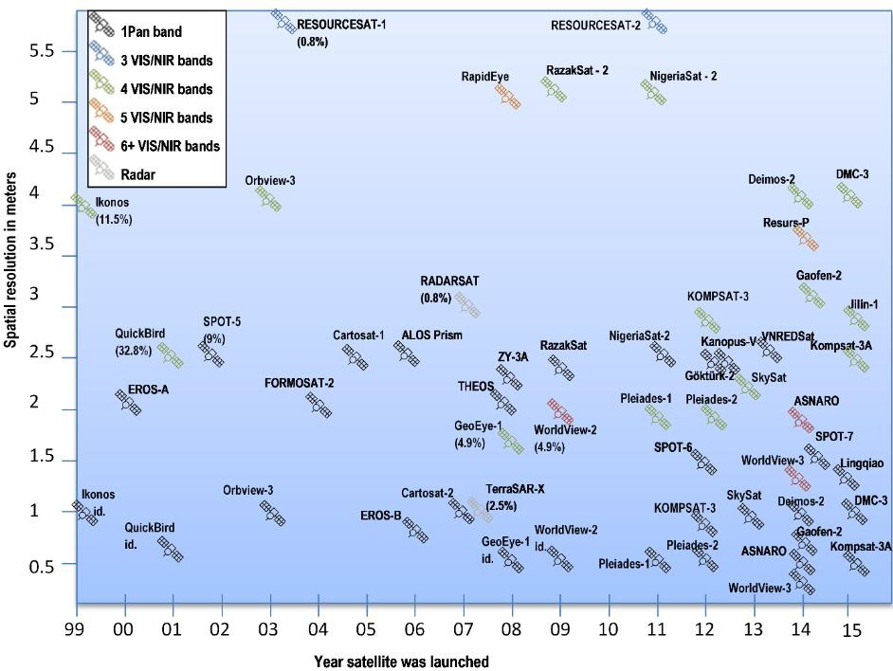
MAPPING SLUMS FROM SPACE
Very-High-resolution sensors
15 years of slum mapping using remote sensing
(Kuffer, Pfeffer and Sliuzas, 2016)

Slide 16
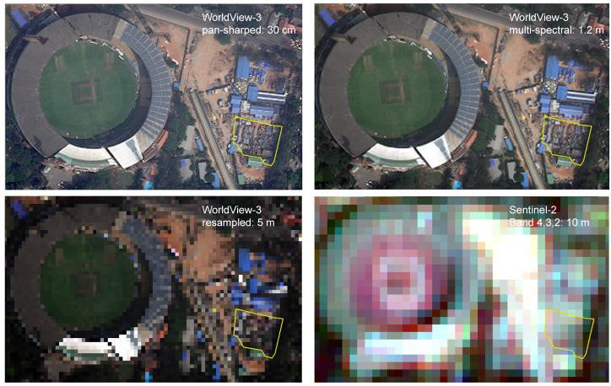
MOST SUITABLE SPATIAL RESOLUTION OF IMAGES
Costs versus computational costs!

Slide 17
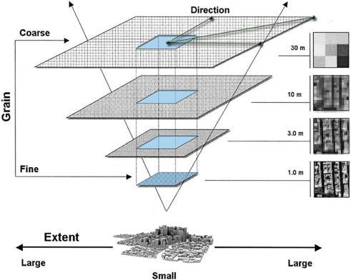
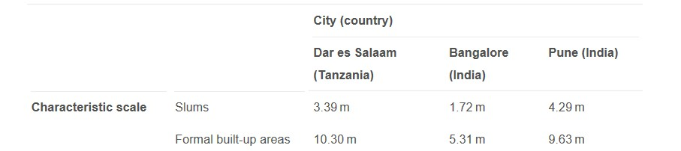
CHARACTERISTIC SCALE OF SLUMS

Slide 18
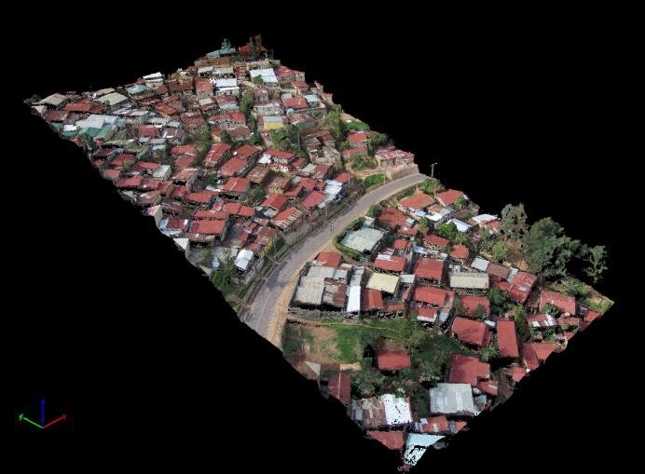
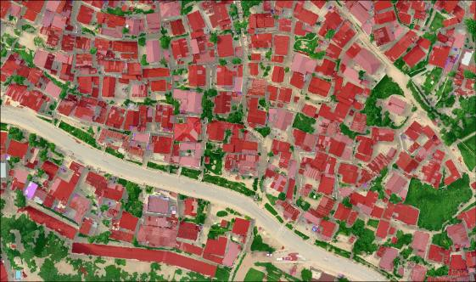
POINT CLOUD FROM UAV IMAGES, KIGALI, RWANDA
(IMAGE BY C. GEVAERT)

Slide 19

MACHINE LEARNING

Slide 20
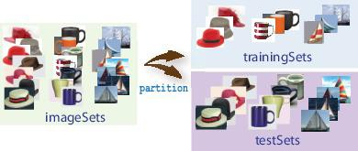
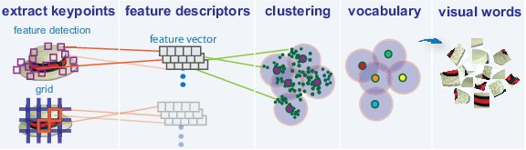
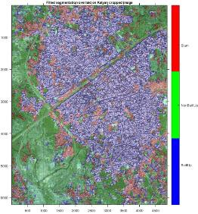
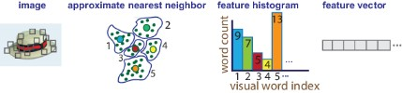
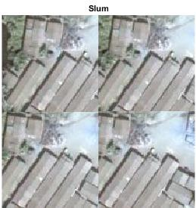
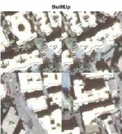
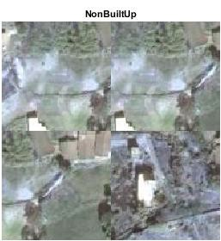

DETECTING SLUMS WITH BOVW FRAMEWORK
(DYNASLUM)
1. Set Up Image Category Sets 2. Create Bag of Features
3. Train an Image Classifier with BoVW
4. Classify an Image or Image Set
Slum Accuracy: 88.124
Ranguelova et al. Image based classification of slums, built-up and non-built-up areas in Kalyan, India. In EARSeL Symposium,
Prague, 2017.

Slide 21
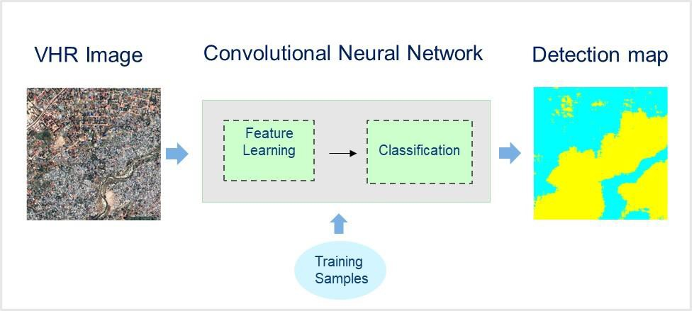
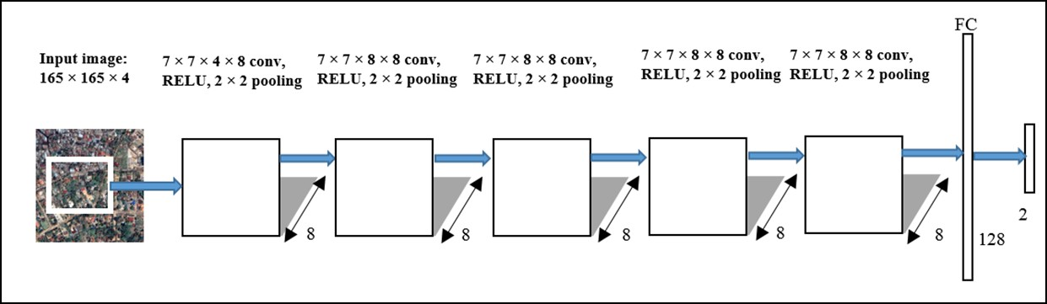
THE URBAN DIVIDE - DEEP LEARNING APPROACH
Deep learning methods such as Convolutional Neural Networks`(CNNs)
can automatically learn spatial features from the input image.
Mboga, Persello, Bergado, Stein, “Detection of Informal Settlements from VHR Satellite Images using Convolutional Neural Networks, IGARSS 2017.

Slide 22
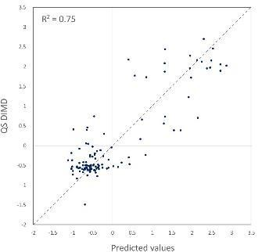
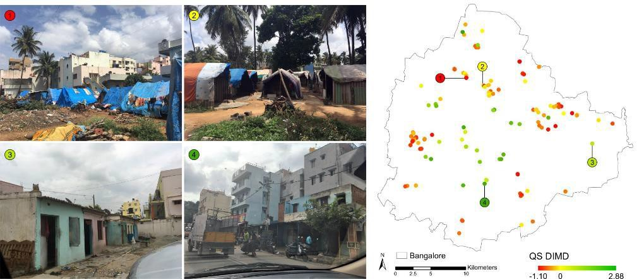
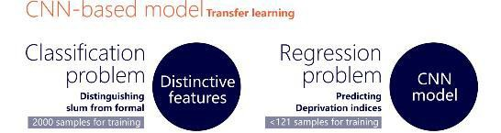
DEGREE OF DEPRIVATION USING CNNS
Source: A. Ajami et al. forthcoming

Slide 23
CHALLENGES – SOME THOUGHTS

Slide 24
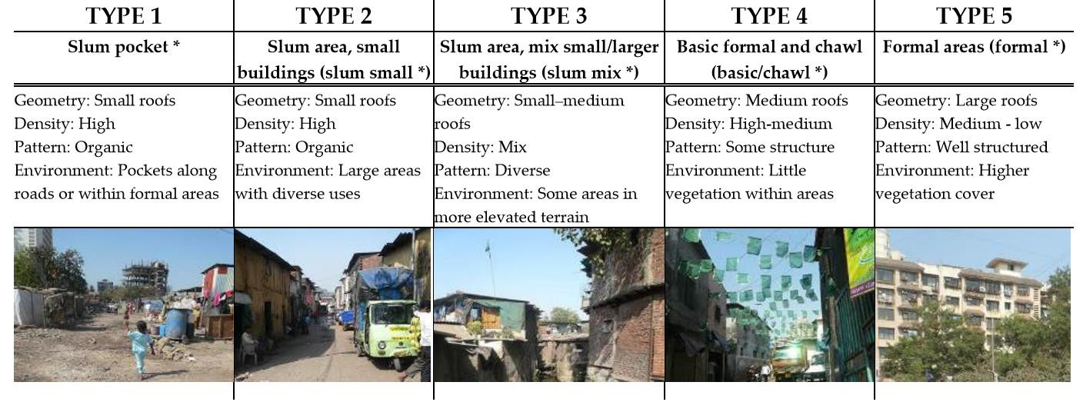
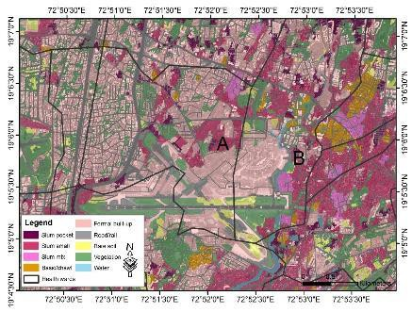
CHALLENGE 1:
UNDERSTANDING SLUMS NOT AS BINARY PROBLEM
Mapping the diversity of deprived areas (multi-class approach)
Relationship between image features and urban poverty
Kuffer et al., 2017: https://www.mdpi.com/2072-4292/9/4/384/htm

Slide 25
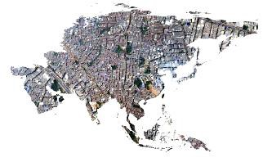
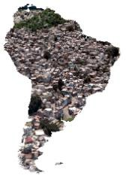
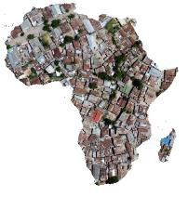
CHALLENGE 2:
CAN WE COMPUTE A GLOBAL SLUM MAP?
Transferability of methodology (temporal – spatial)?
Suitable data (spatial resolution, cost…)
Incorporating different slum development stages, dynamics and typologies?
Feature selection – training – assessment – which algorithms and reference data?
Combining ground data (e.g., from Slum Dwellers
International) with satellite images

Slide 26
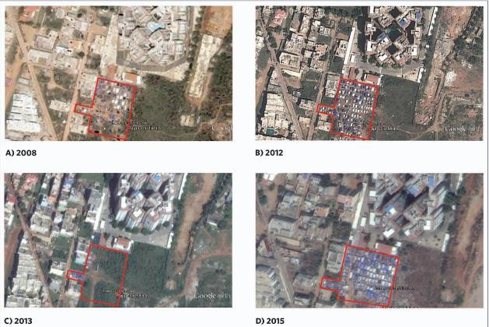
TEMPORAL DYNAMICS
Ranguelova et al. 2017
https://www.tandfonline.co m/doi/full/10.1080/2279725 4.2018.1535838
Emergence and Growth of a slum in Huidi, Bangalore (marked with a red polygon). a) Slums emerge near a construction Site in 2008. b) Slum grows near the same site. c) Slum disappear when construction is complete in 2013. d) A slum re-emerge at the same site in 2014 (Images– Google Earth) (Source: Dynaslum)

Slide 27
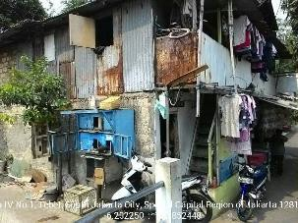
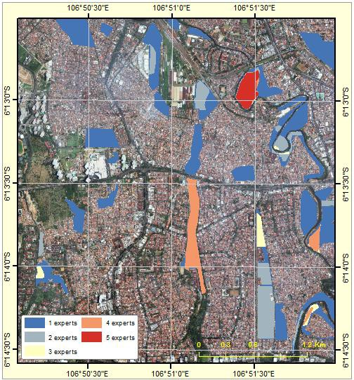
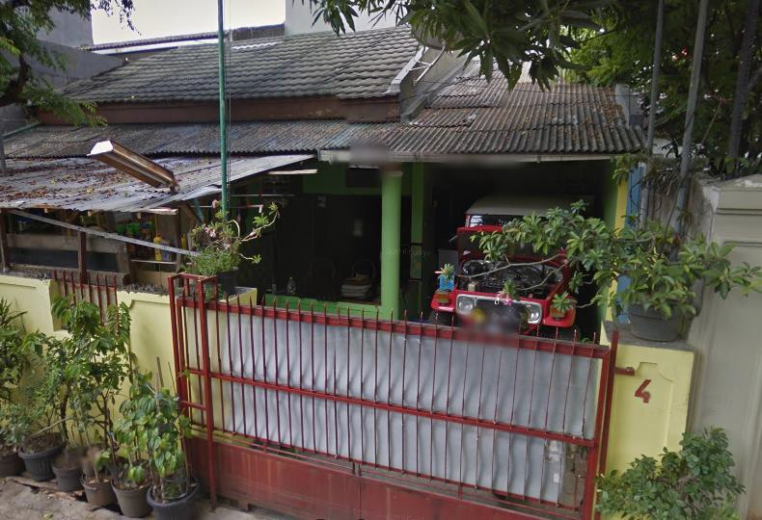
UNCERTAINTIES IN THE REFERENCE DATA
In area with higher agreement shows (on the ground): poor building materials, high density and
Source: Pratomo et al., 2017: https://www.mdpi.com/2072- 4292/9/11/1164
located in the riverbank
Misclassifications: high density and have a roof from asbestos, but not a slum

Slide 28
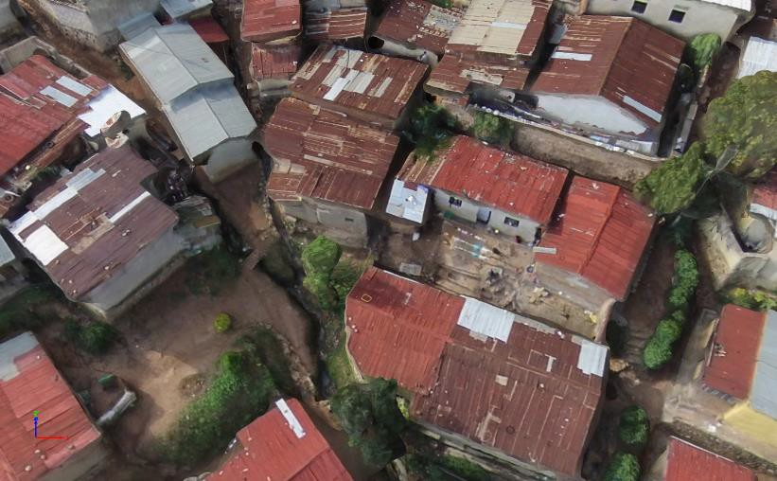
CHALLENGE 3:
INFORMATION NEEDS AND ETHIC CONSIDERATIONS
Source Gevaert et al. 2018: https://www.mdpi.com/2220- 9964/7/3/91
Shall we make slum maps and images publically available ????
https://www.sicherheitspolitik-blog.de/2018/07/11/the-digitalization-of-the-globe- machine-learning-about-population-in-need-of-support/

Slide 29
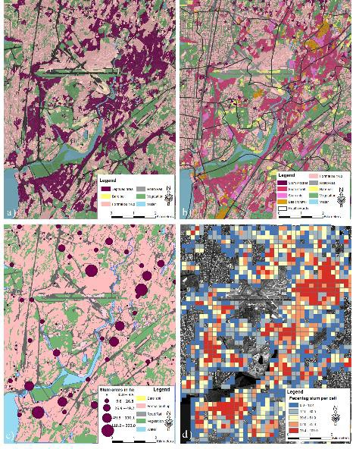
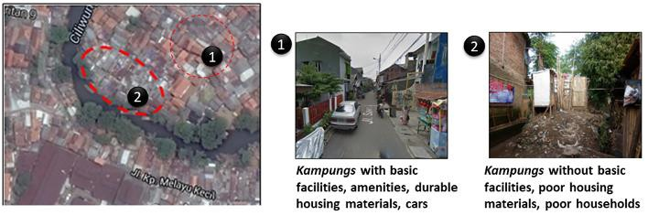
HOW CAN WE SHOW THE FUZZINESS IN MAPS
Not the highest detail might be necessary!
Ethic considerations not making data
on slums publically available?!

Slide 30
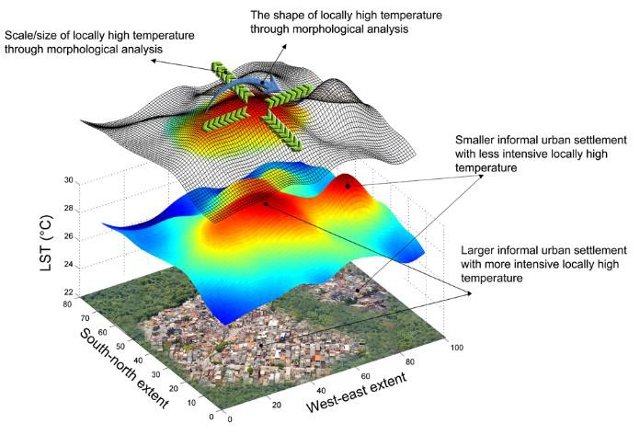
CHALLENGE 4: UNDERSTAND BETTER ENVIRONMENTAL CONDITIONS OF SLUMS
WANG, J., Sliuzas, R., Kuffer, M., Kohli, D. https://www.sciencedirect.com/science/article/pii/S0048969718337811

Slide 31
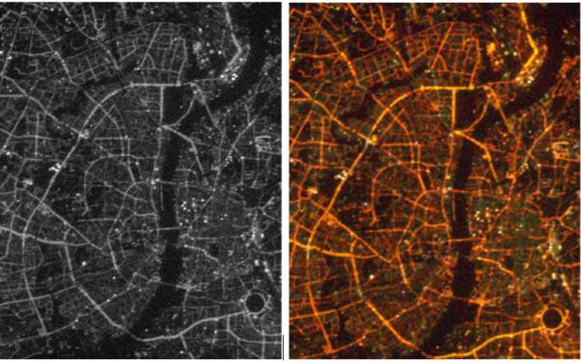
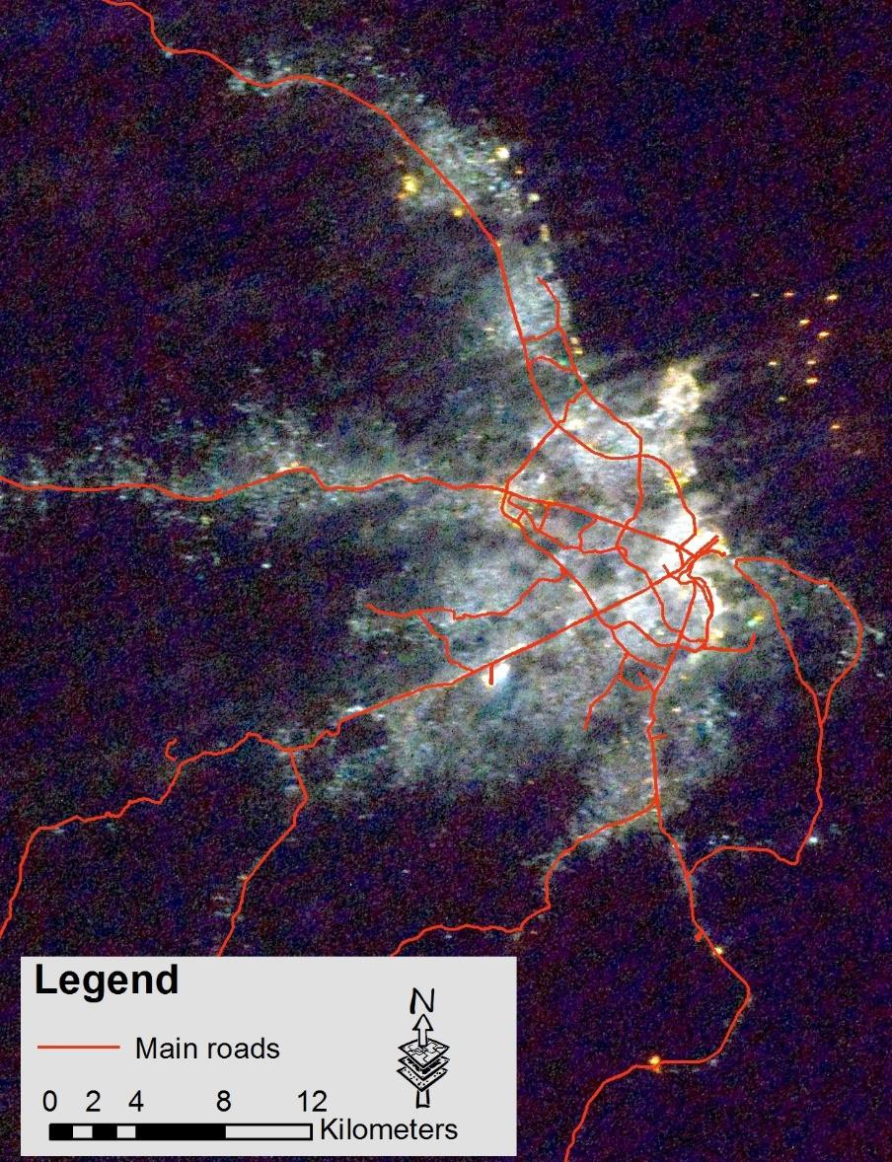
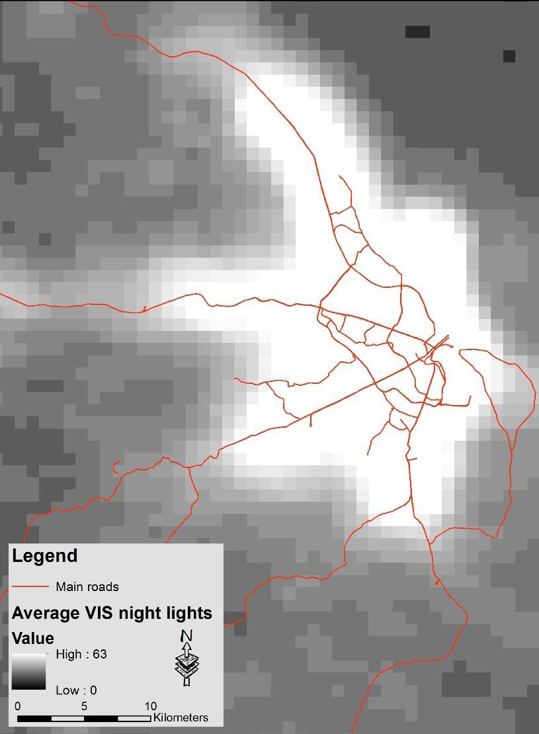
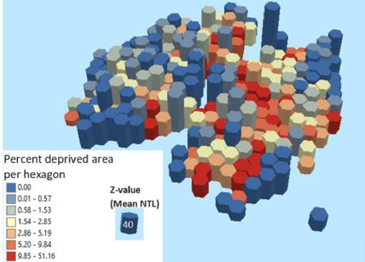
ENVIRONMENTAL CONDITIONS OF SLUMS
Nightlights from the International Space Station
DMSM-OLS
International Space Station
Kuffer, Pfeffer, Sliuzas, Taubenböck, Baud and van Maarseveenet. https://ieeexplore.ieee.org/document/8362725/

Slide 32

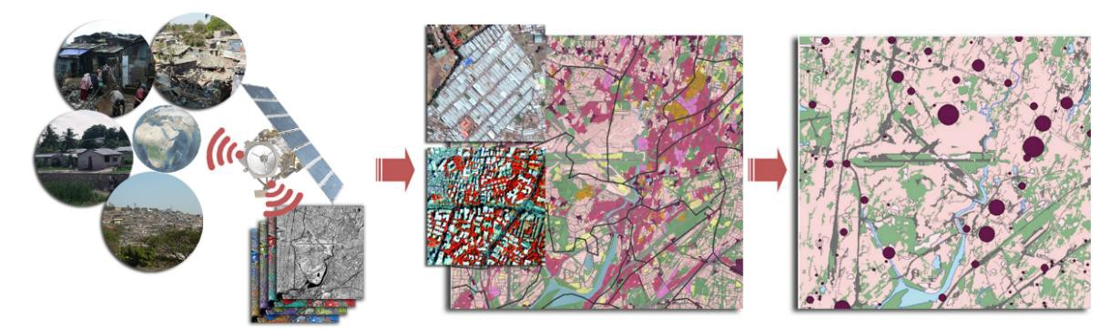
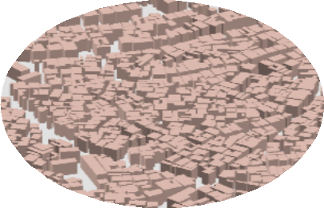
FINAL THOUGHTS
Better understanding user requirements – bridging the
communication gap
Making products relevant to support local service provision
Building model

Slide 33

Special Issue in Remote Sensing
Urban Planning Indicators – submit your paper: http://www.mdpi.com/journal/remotesensing/special_issues/Urban_planning
END
THANKS FOR YOUR ATTENTION

