Slide 1




NATIONAL CONFERENCE
6-8 February 2019, SPAV, Vijayawada, India
Mapping Unequal Quality-of-Life Conditions: A Geographic and Mixed Methods Approach
Javier Martinez
University of Twente, Faculty of Geo-Information Science and Earth Observation.
Enschede, The Netherlands. Email: j.martinez@utwente.nl
Mapping Unequal Quality-of-Life Conditions

Slide 2



INTRODUCTION
Unequal urban quality-of-life (QoL) conditions represent a challenge towards achieving most of the Sustainable Development Goals set by the United Nations in order to ensure prosperity for all by 2030.
Sustainable communities are inclusive communities.
2

Slide 3
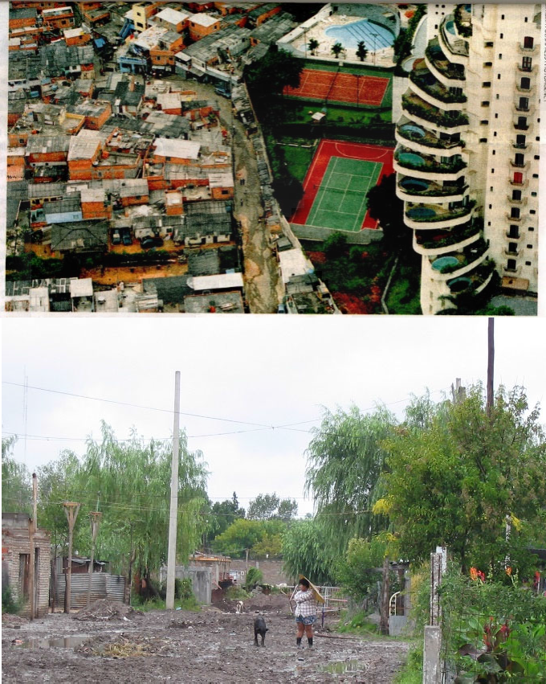
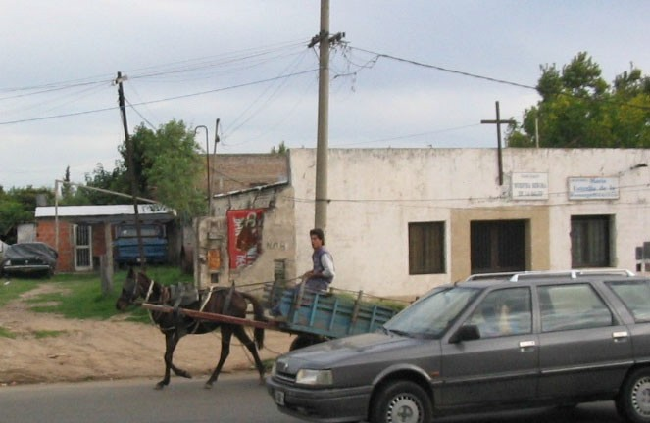
INTRODUCTION
HOUSING IS A KEY DOMAIN IN QUALITY OF LIFE
Housing is a key domains in QoL, where deprivations (e.g. lack of sufficient living space) disproportionally affect disadvantaged groups.
A better understanding of spatial variations in QoL conditions could help in identifying where people are suffering from relatively low QoL conditions and move towards a just city and inclusive communities
3

Slide 4
MAPPING UNEQUAL QUALITY-OF-LIFE CONDITIONS
TOWARDS A JUST CITY / INCLUSIVE COMMUNITIES
What is a just city?
“a city in which public investment and regulation would produce equitable outcomes rather than support those already well off” (Fainstein, 2010 : 3)

Slide 5

THE JUST CITY – MAIN CONCERNS
The Just City attributes:
EQUITY
DEMOCRACY
DIVERSITY
Fainstein (2010)

Slide 6
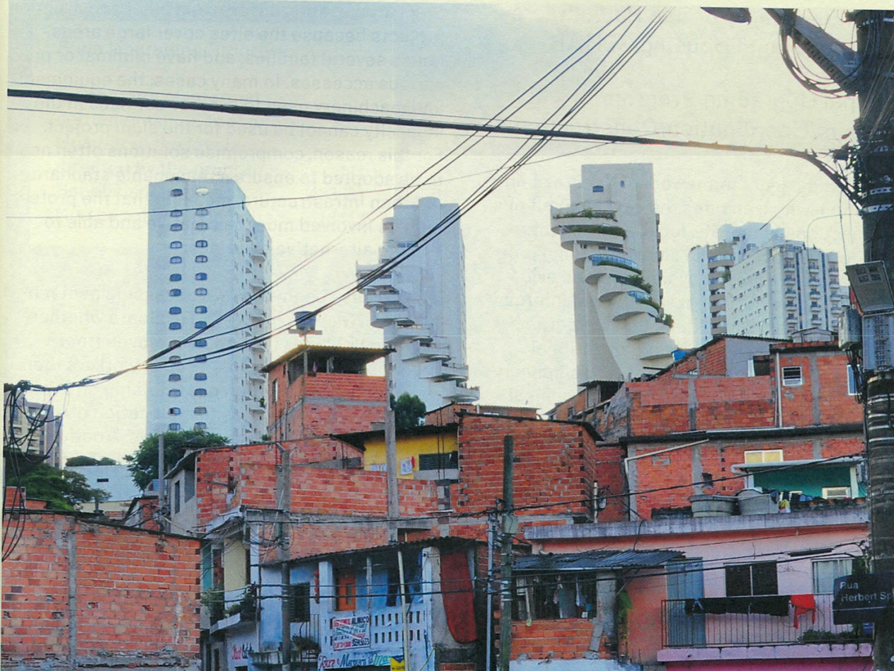
EQUITY

Slide 7
THE JUST CITY - EQUITY
Equity implies fairness (distributional equity) ”in which policy aims at bettering the situation of those who without state intervention would suffer from relative deprivation”
Main sector where planners are confronted with equity issues relate to urban regeneration, social services, transportation and housing.

Slide 8
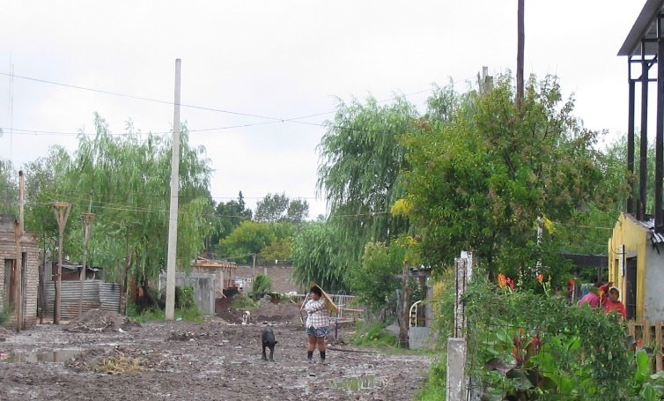
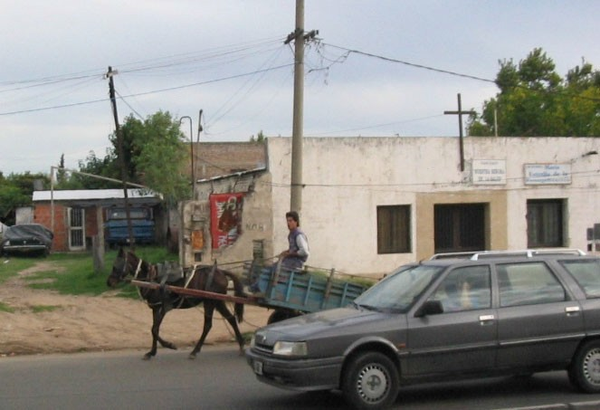
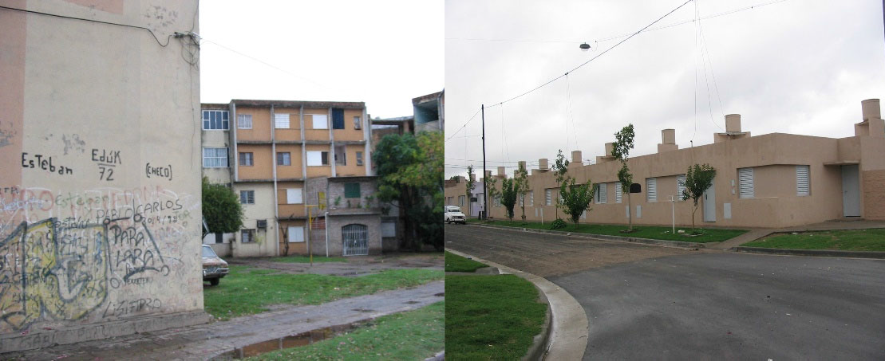
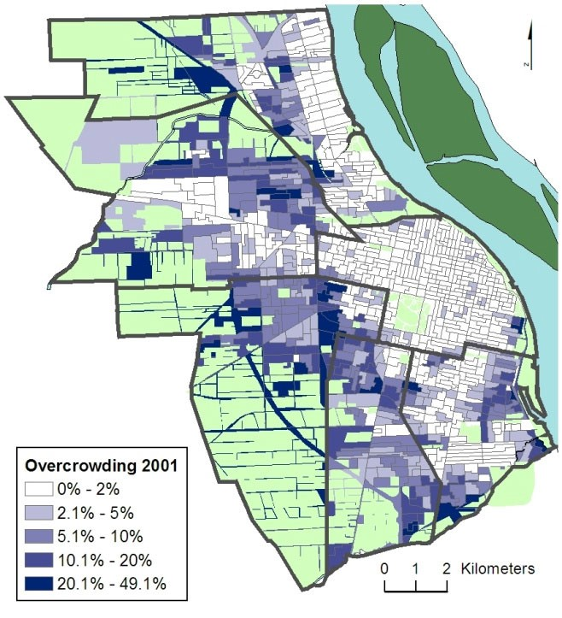
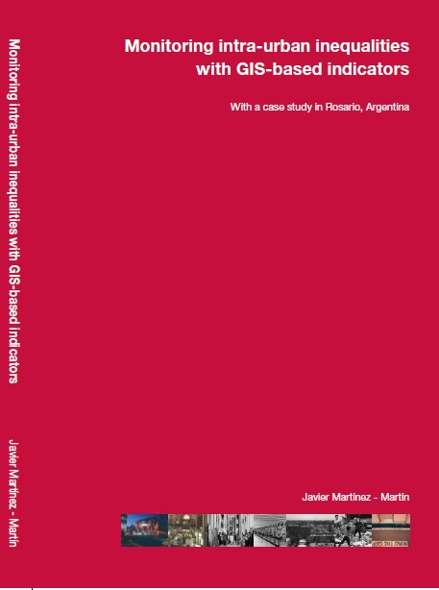

INEQUALITY MAPPING
SOCIAL JUSTICE PERSPECTIVE
12.0%
11.3%
10.0%
District “Oeste”
8.0%
8.2%
District “Sudoeste
7.8%
District “Noroeste District “Sur” District “Norte” District “Centro”
6.0%
6.0%
4.4%
4.0%
2.0%
2.7%
1.6%
1.3%
1.0%
0.5%
0.4%
0.1%
0.0%
Rosario
District
Best-Off / Worst-Off Neighbourhood Area
8

Slide 9
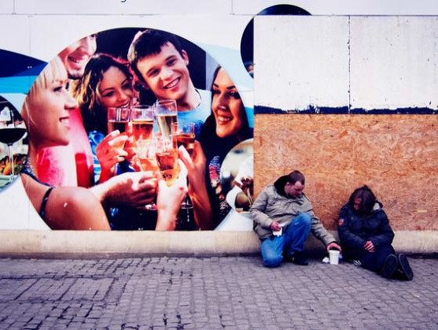
DEMOCRACY

Slide 10
THE JUST CITY - DEMOCRACY
Distributive vs procedural justice (focus on outcomes or processes and participation – institutionalized citizens participation).
Fainstein relates this to the participatory or communicative rationality planning . It calls for “knowledge that is situated contextually and that relies on reasoning, empathy, and a variety of kinds of evidence to support policy proposals” (Fainstein, 2010 : 25)
But argues that a just process not necessarily produce a just result. It may poorly operate in situations of social and economic inequality Fainstein argues not to ignore “the reality of structural inequality and hierarchies of power” (Fainstein, 2010 : 30)

Slide 11
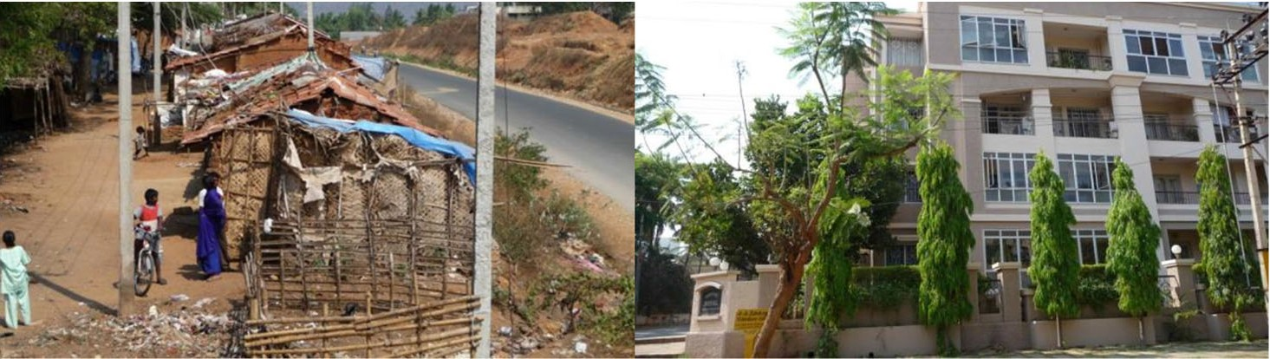
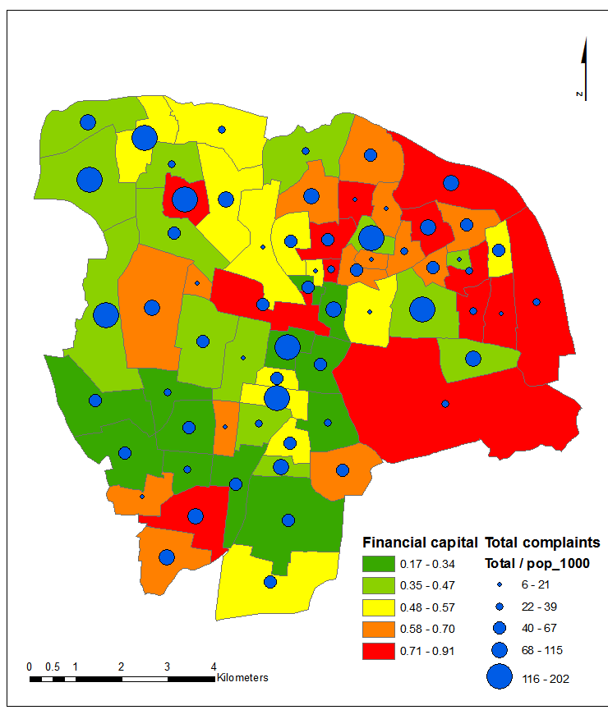
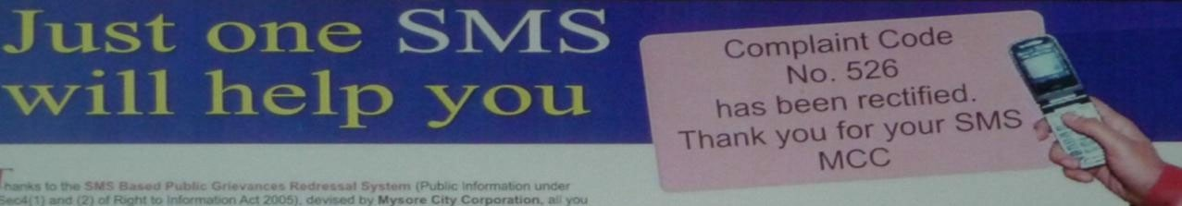
DEMOCRACY
PARTICIPATION BIASED TOWARDS THE MIDDLE CLASS
Martínez, J., Pfeffer, K., & van Dijk, T. (2011). E-Government Tools, Claimed Potentials/Unnamed Limitations. Environment and Urbanization Asia, 2(2), 223- 234.

Slide 12
DIVERSITY

Slide 13
THE JUST CITY - DIVERSITY
Recognition of difference including race, ethnicity, gender, religion, and culture. “Group differentiation is both an inevitable and a desirable aspect of modern social processes. Social justice required not the melting away of differences, but institutions that promote reproduction of and respect for group differences without oppression” (Young 1990 : 47)
“social differentiation without exclusion” (Young 1990 : 238)
Material equity + recognition of difference = social inclusion

Slide 14
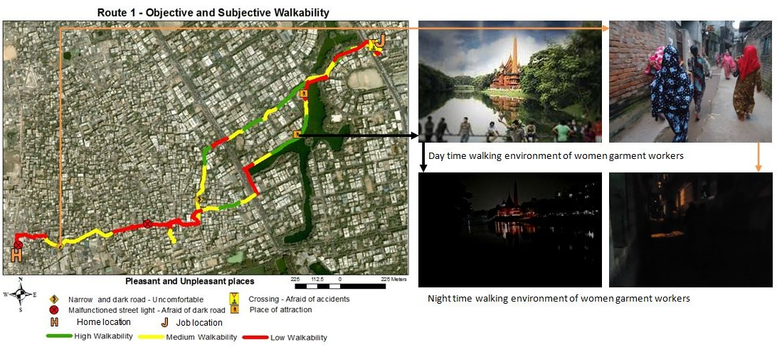
QUALITY OF LIFE AND GENDER
In Shumi et al. 2014, we used a mixed-method approach and elicited emic views to understand how the quality-of-life of women garment workers in Dhaka (Bangladesh) was affected by the walking conditions of the routes the take from home to work.
14

Slide 15
THE JUST CITY CHALLENGES

Slide 16
THE JUST CITY - CHALLENGES
Equity, democracy and diversity may have conflicting agendas
“Much of planning and policy development involves the collection and aggregation of data and the choice of how to present it. To the extent that experts present analysis not just of benefit/cots ratios but of who gets the benefits and who bears the costs, they can shift the debate toward a concern with equity” (Fainstein 2010 : 181)
A more sensitive form of analysis will require different forms of knowledge (not only the technical or scientific knowledge) and
the recognition of the convergent and divergent views.

Slide 17
FACTORS SHAPING CARTOGRAPHIC REPRESENTATIONS OF INEQUALITIES
A) Conceptualization of deprivations
Deductive (theory- driven)
Empirically defined, context-embedded
Inductive (content-/community-/ practice-based)
Data-driven geography
& aggregations
Context-embedded/ professionally validated
Pre-defined
Standard codifications Expert/codified
C) Spatial representation
B) Knowledge sources
Martínez, J., Pfeffer, K., & Baud, I. (2016). Factors shaping cartographic representations of inequalities. Maps as products and processes. Habitat International, 51, 90-102.

Slide 18
ARE WE COUNTING WHAT COUNTS FOR PEOPLE? ETIC VS EMIC VIEWPOINTS
Experts
People
Experts
Experts

Slide 19
ARE WE COUNTING WHAT COUNTS FOR PEOPLE? ETIC VS EMIC VIEWPOINTS
ETIC / EMIC

Slide 20
QUALITY-OF-LIFE
A distinction is made between “objective” and “subjective” conditions.
  Objective QoL is usually measured by using indicators that represent observable and measurable conditions. A relatively “objective” assessment done by experts. E.g. durable housing assessment based on specific standards.
  A “subjective” assessment done by residents relates to the perceived or (self-)expressed (dis)satisfaction with specific domains or life in general. E.g. satisfaction with housing.
20

Slide 21
GEOGRAPHIC DIMENSION
The geographic dimension in this approach elicits spatial variations within and between neighbourhoods.
This is of particular relevance for policy and planning because it maps the locations of deprived and well-being areas and places experiences and perceptions in their actual spatial context.
We recognize the notion of geographical space as both Cartesian as well as subjective, experiential space (Mikkelsen and Di Nucci 2015).
21

Slide 22


OBJECTIVE VS. SUBJECTIVE QUALITY OF LIFE
ETIC VS EMIC VIEWS
States of quality of life
Objective condition
(external point of view: etic)
Good Bad
Well-being
Subjective condition (internal point of view: emic)
Good
Adaptation
Bad
Dissonance
Deprivation
Martínez, J.A., Verplanke, J.J. and Miscione, G. (2017) A geographic and mixed methods approach to capture unequal quality-of-life conditions. In: Handbook of community well-being research / edited by R. Phillips and C. Wong. Dordrecht: Springer Netherlands, 2017. ISBN: 978-94-024- 0878-2. (International Handbooks of Quality-of-Life). pp. 385-402

Slide 23
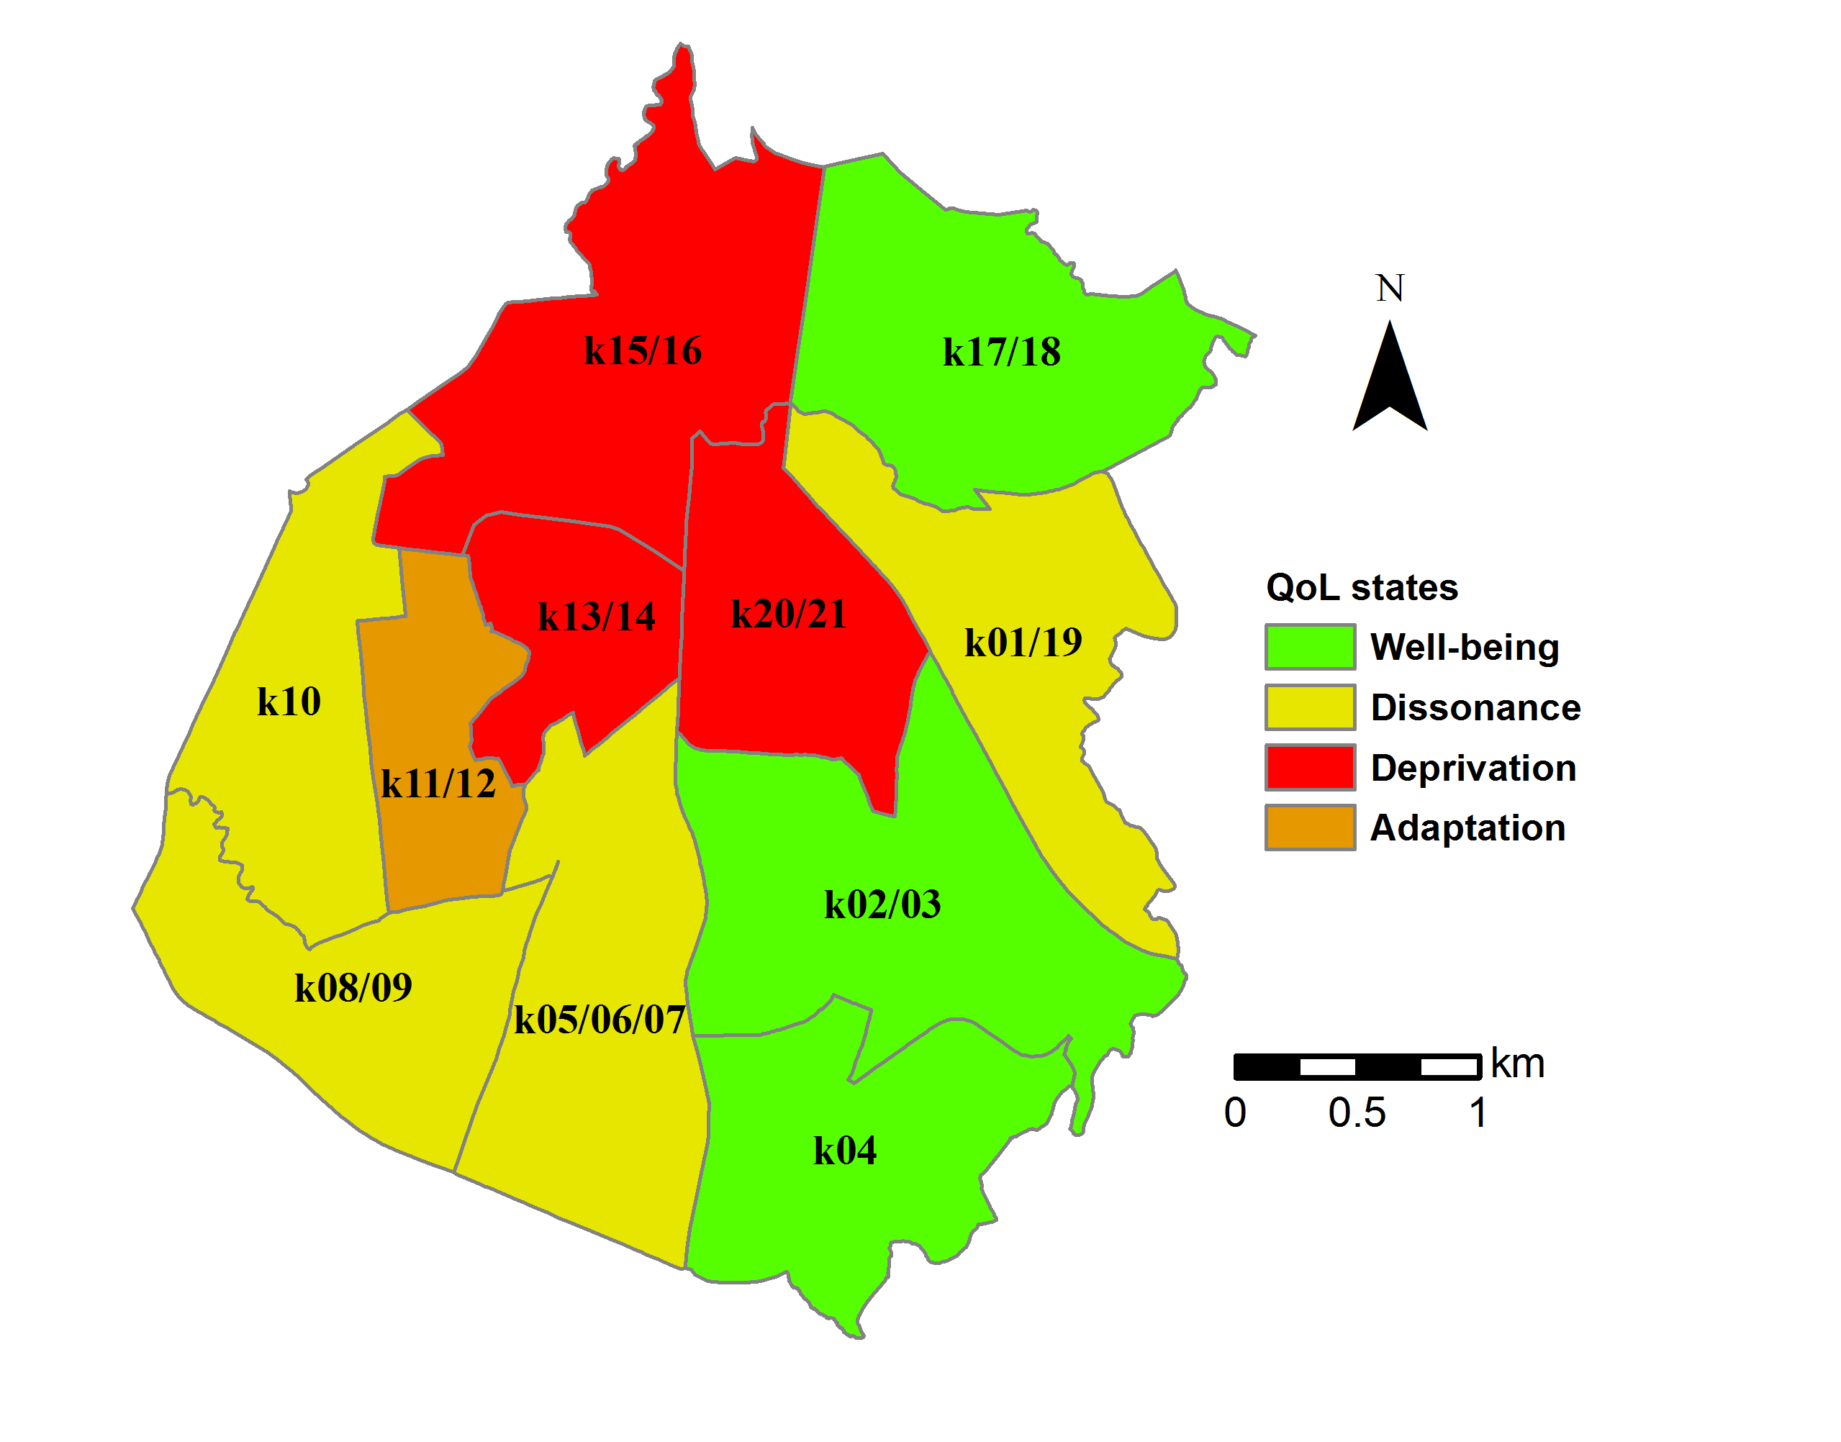
OBJECTIVE VS. SUBJECTIVE QUALITY OF LIFE
WELL-BEING – DEPRIVATION / DISSONANCE - ADAPTATION
Tesfazghi, E., Martinez, J., & Verplanke, J. (2010). Variability of Quality of Life at Small Scales: Addis Ababa, Kirkos Sub-City. Social Indicators Research, 98(1), 73-88.

Slide 24
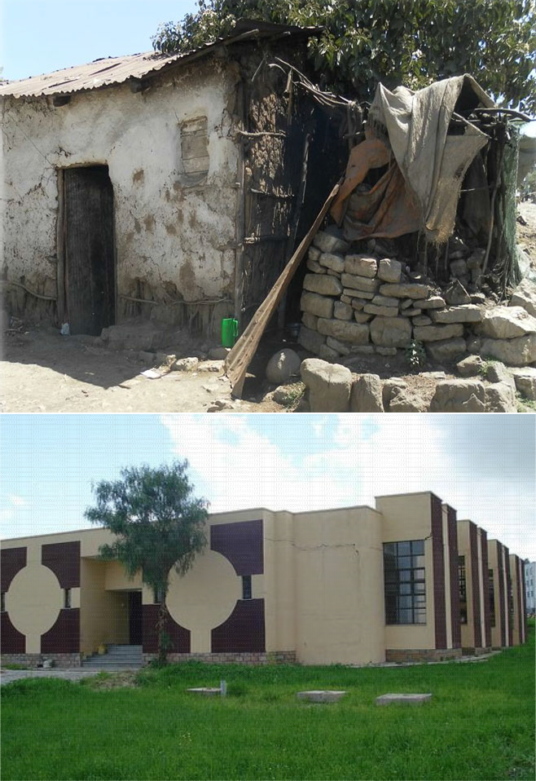
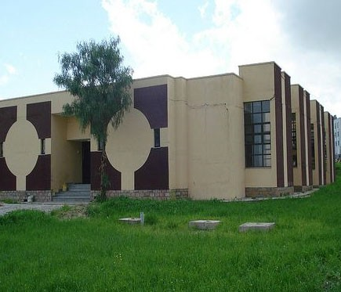
(WALKING) INTERVIEWS
UNDERSTANDING REASONS BEHIND ADAPTATION AND DISSONANCE
“the house is small and it is not in a good condition but I am satisfied because I cannot pay more than what I am paying now for house rent if I do so my kids will starve”
while “objective” (GIS) measures of accessibility to social infrastructure show good conditions walking interviews with residents revealed dissonance and other dimensions attached to accessibility (e.g. affordability / schools located at the side of high ways > children are exposed to traffic accident)
Berhe, R., Martinez, J., & Verplanke, J. (2014). Adaptation and Dissonance in Quality of Life: A Case Study in Mekelle, Ethiopia. Social Indicators Research, 118(2), 535-554. doi: 10.1007/s11205-013-0448-y
24

Slide 25
CONCLUSIONS
Mapping inequalities in QoL cannot rely only in expert’s views. “Objective” QoL measures (e.g. of accessibility) as externally viewed by experts do not necessarily converge with “subjective” needs and dimensions considered by emic views of residents.
There are characteristics of QoL and inequality that quantitative methods cannot measure that need to be complemented and explained by qualitative methods.
25

Slide 26
CONCLUSIONS
Relevance of eliciting inequalities with the context of the global call for prosperity for all as promoted by the UN in the SDGs.
Importance of equity, democracy and diversity towards just cities.
We claim that a more sensitive and empathic form of mapping towards just cities is needed. It will require different forms of knowledge (not only the technical or scientific knowledge) and the recognition of convergent and divergent views between different groups.
26

Slide 27
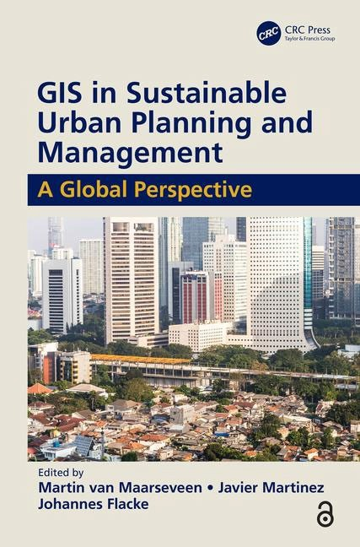

www.itc.nl/urbangis
THANKS!
j.martinez@utwente.nl
27

Slide 28
ADDITIONAL INFORMATION
BIBLIOGRAPHY
Martínez, J., Pfeffer, K., & Baud, I. (2016). Factors shaping cartographic representations of inequalities. Maps as products and processes. Habitat International, 51, 90-102.
Martinez, J., Miscione, G., & Verplanke, J. (2016). A Geographic and Mixed Methods Approach to Capture Unequal Quality of Life Conditions. In R. Phillips & C. Wong (Eds.), The Handbook of Community Well- Being: Springer. IN PRESS.
Berhe, R., Martinez, J., & Verplanke, J. (2014). Adaptation and Dissonance in Quality of Life: A Case Study in Mekelle, Ethiopia. Social Indicators Research, 118(2), 535-554.
Al Arasi, H.A., Martínez, J.A. and Amer, S. (2016) Children's perception of their city centre : a qualitative GIS methodological investigation in a Dutch city. In: Children's geographies, 14(2016)4, pp. 437-452
Shumi, S., Zuidgeest, M. H. P., Martinez, J. A., Efroymson, D., & van Maarseveen, M. F. A. M. (2015). Understanding the Relationship Between Walkability and Quality-of-Life of Women Garment Workers in Dhaka, Bangladesh. Applied Research in Quality of Life, 10(2), 263-287.
Tesfazghi, E., Martinez, J., & Verplanke, J. (2010). Variability of Quality of Life at Small Scales: Addis Ababa, Kirkos Sub-City. Social Indicators Research, 98(1), 73-88.
UPM / Dr. Javier Martínez

