Slide 1
Participatory Local Governance: Theory and Praxis
National Conference on
‘Building Inclusive Urban Communities (BInUCom)
School of Planning and Architecture, Vijayawada
February 6-8, 2019
Dr. Anurima Mukherjee Basu
Assistant Professor
Faculty of Planning, CEPT University
Ahmedabad

Slide 2
Introduction
Participatory (local) governance has emerged as a practical response to a ‘new’ context of governing
Adopted by diverse range of organizations in pursuit of ‘good governance’ and ‘inclusive governance’
Encompasses an array of diverse practices – from participation in projects to local councils

Slide 3
Basic tenents of participatory governance
Multiplicity of actors with diverse interests
Emphasis on inclusion of people, especially the poor and marginalised
Process of collective decision-making
Changes the way local governments work
Importance on processes, and role of institutions in facilitating involvement of actors/ organisations

Slide 4
Conceptualising participatory governance
Theoretical roots:
Influence from political science – political empowerment through participation – direct role in policy-making – citizenship as a core concern of participatory exercises
Development Studies (neoliberalism and new institutionalism) – apolitical view of civil society – as ‘beneficiaries’, ‘users’, ‘consumers’ with entitlements and not rights
‘Political’ participatory governance vs ‘developmental’ community based participation

Slide 5
The case studies
Participation in SWM component of Swachh Bharat Mission – Surat
Participation through Ward Committees, Users’ Groups & grassroots organisations in a small town in West Bengal

Slide 6
Participation in SWM in Surat
SBM as a ‘people’s movement’ or ‘janandolan’- with participation from wide range of stakeholders
Active participation of Ward Committees, Area Sabhas, Resident Welfare Associations, NGOs, Civil Society Groups and private sector
Guidelines on “Swachh Neighbourhood”, emphasizes the need for citizen engagement for making neigbourhoods ‘swachh’ and garbage free

Slide 7
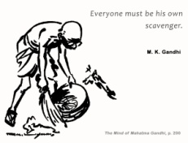
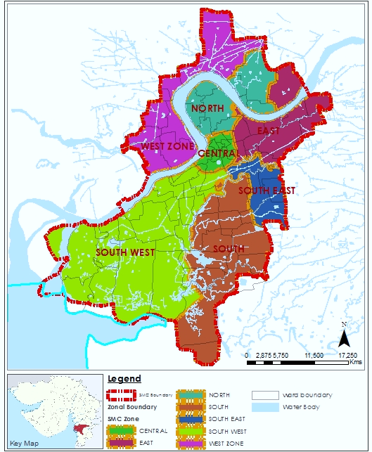
Surat - background
7 ADMINISTRATIVE ZONES
100 ADMINISTRATOVE WARDS
87 SANITARY WARDS
Each zonal officer vested with complete authority to build, maintain and operate the basic amenities of the area under that zone
Plague outbreak in 1994- led to administrative reforms, decentralisation and involvement of local organisations, residents
Zone | Area | Population - Census 2011 | Density per Sq.km.
 | (Sq. Km.)
Central | 8.2 | 408760 | 49971
South West | 111.9 | 347714 | 3107
South | 61.8 | 694768 | 11249
South East | 19.5 | 748295 | 38390
East | 37.5 | 1138809 | 30348
North | 36.4 | 703494 | 19346
West | 51.3 | 424986 | 8288
Total | 326.5 | 4466826 | 13680

Slide 8
PARTICIPATORY INITIATIVES OF SMC IN SBM
Involvement of NGOs, SHGs, Religious leaders, ragpickers, volunteers ( Swachhgrahis)
Anudan Scheme for residential societies
Private sector - treatment of plastic waste, PPP contracts for management of biomedical, e-waste, organic waste, D2D collection contracts

Slide 9
Participation in SWM
NGOs - Engaged in awareness generating activities.
SHGs - Organized groups mainly through UCD dept. of SMC involved in organizing campaigns for waste management.
RELIGIOUS LEADERS - Involved in activities aimed at raising awareness regarding waste management practices.
SWACHHAGRAHIS - Registered volunteers for conducting awareness drives
Ragpickers - Integrated in the SWM chain for segregated collection; they are provided training by Zonal officials
Zone name | NGOs | SHGs | Religious leaders | Swachhagrahis | Ragpickers
Central | 0 | 0 | 17 | 5 | 35
East | 47 | 206 | 134 | 50 | 79
North | 7 | 5 | 6 | 10 | 25
South | 0 | 2 | 6 | 36 | 101
South east | 12 | 9 | 2 | 10 | 39
South west | 23 | 0 | 32 | 30 | 19
West zone | 10 | 0 | 34 | 3 | 10

Slide 10
Participation in SWM
Zone | Events held |  |  | Nos attended
 | Meetings | Campaigns | Promotional campaigns | RWAs | SHGs | Religious leaders
Central | 1 | 5 | 1 | 0 | 0 | 17
East | 116 | 50 | 16 | 83 | 0 | 51
North | 1 | 10 | 0 | 0 | 0 | 138
South | 2 | 36 | 16 | 12 | 0 | 0
South east | 3 | 12 | 1 | 3 | 0 | 0
South west | 12 | 30 | 0 | 2 | 2 | 2
West zone | 27 | 3 | 0 | 27 | 0 | 0
Meetings, campaigns and promotional events are regularly held
No involvement of ward committees
Less attendance of RWAs, SHGs though they are mobilised for awareness generation activities
Participation is limited to attending campaigns, meetings

Slide 11
Participation in anudan scheme
Initiated in 1999 to achieve 100% garbage collection in Surat
Partnership with residential societies to maintain internal cleanliness
At present total 865 numbers of societies are registered covering approx. 19% of total population
Role of society - primary collection; segregation at source and maintaining cleanliness, purchasing necessary equipments
Role of SMC – regular inspection and transfer of Anudan for 25% of layout area @ 80 paise per sq.m.

Slide 12
Participation in anudan scheme
Only registered housing societies are covered
Survey conducted in 3 zones with maximum Anudan societies show – mostly housing societies with larger layouts and low rise housing typology are covered
Coverage of scheme is low in areas with low-income housing – SMC does not reach out to these societies

Slide 13
Comparison – anudan vs non-anudan
Society Name | Anudan Society |  | Non-Anudan Society
 | Shantivan society | Umiyanagar society | Upal towers
Individual house Layout area (sq.m.) | 1200 sq.ft. | 576 sq.ft. | 400 sq.ft
Annual SWM user charges to SMC | Rs. 1296 | Rs. 972 | Rs. 810
No. of household units in society | 72 | 42 | 120
Society’ layout area | 16,000 sq.m. | 8000 sq.m. | 5000 sq.m.
Anudan amount | Rs. 3200 | Rs. 1600 | 0
Monthly society expenses for SWM | 8200 | 5000 | 9500
Monthly Expense/ hh unit (for SWM only) | 113 | 119 | 80
Presence of society head | Yes | Yes | Yes

Slide 14
Subsidizing societies with larger layout area
No objective criteria for selection of societies for partnership
SMC’s efforts to increase coverage under the scheme is less
Awareness about Anudan scheme was less amongst residents
NGOs, CBOs not aware of this scheme – they have been mobilised only for campaigns
What about Janandolan!

Slide 15
Participatory local governance in Chandannagar
Ward Committees (WC) in all 33 wards of CMC – Councillor with WC members (9-17)
Users’ groups of slum residents formed under KUSP (DFID aided programme) – one for each slum
Presence of other local organisations
SJSRY institutions - NHCs-NHGs-CDSs, nagarik committees (NC), bustee committees

Slide 16
SJSRY Institutions
CDS with members from each NHC
NHCs with 2 members from each NHG
RCVs in each NHG
Community Development Society (CDS) at city level (3)
Neighbourhood Committees (NHCs) at Ward Level (33)
Neighbourhood Groups (NHGs) at para level (423)
Notes:
x

Slide 17
Participatory institutions
CITY LEVEL
Community Development Societies (CDS)
Sanjukta Nagarik Committee (SNC) of Left Front
WARD LEVEL
Ward Committees (WC)
Neighbourhood Committees (NHCs)
Nagarik Committees (NC)
SLUM LEVEL
Neighbourhood Groups (NHGs)/ SHGs
Users’s groups (BWMCs)
Bustee Committees (BC)

Slide 18
Participation in Ward Committees
WC Rules 2001 of the state makes it mandatory to have women members from BPL families in WCs – usually CDS/ NHC members are included
In some wards NC and BC members are also represented in WCs
Users’ groups could attend meetings of WCs and get involved in other programs

Slide 19
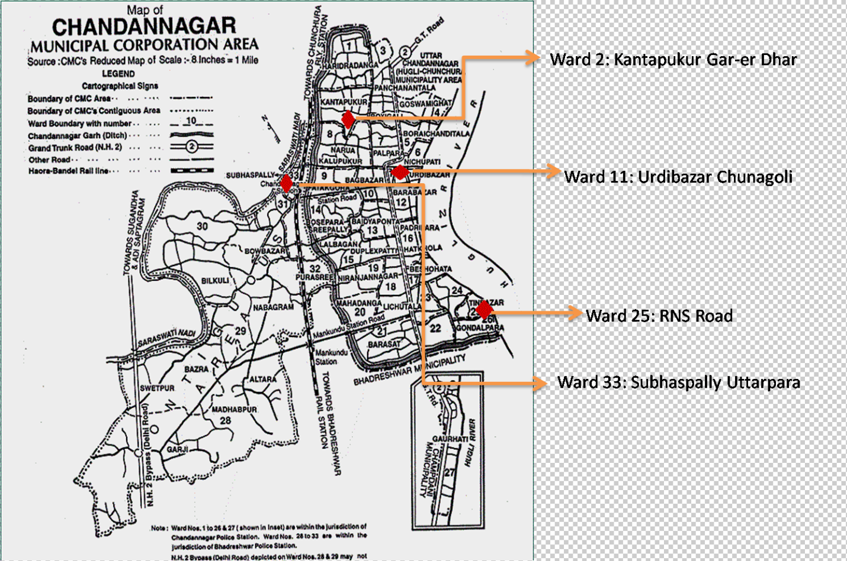
Slums selected for study
TMC
Left Front
TMC
Left Front
Notes:
Ward 2, 25 – under AITC
Ward 11, 33 – under Left Front (CPIM)

Slide 20
Functional Participatory institutions/spaces in study slums
Ward No | Name of slum | Ward Committees | SJSRY insts | User Groups | Grassrootsorg of Left parties
TMC
2 | Kantapukur Gar-er Dhar
33 | Subhaspally Uttarpara
Left Front
11 | Urdibazar Chunagoli
25 | RNS Road

Slide 21
Participation in Ward Committees
WCs do not regularly meet in all wards. In some, they function as administrative wing of CMC.
WC members area nominated by Councillor – act as ‘gate-keepers’
Users’ groups are active in few slums - lack of encouragement and support from CMC
NCs and BCs mobilise slum residents on some issues but fail to claim larger space

Slide 22
Participation in Ward Committees
CDS/NHC/SHGs
Restricted scope, has failed to mobilise poor women on other development issues
Members are not aware/ not interested in taking up wider role as community representatives
Suffer from role-conflict, members are not able to question the authorities, function more as ground-level staff taking orders

Slide 23
Concluding observations
Participation in SWM in Surat –
Campaigns and meetings -
Subsidising the ‘elite’
Participation in WCs – West Bengal – inclusion of urban poor is enabled but is it enough?
Weak links amongst local institutions and no link with democratic local institutions
Mobilisation outside formal spaces/ institutions on issues of access to various services- these do not get institutional expression

Slide 24
Concluding observations
Elite capture of participatory spaces - or is it construed that way?
Essentially linked to legal property ownership – constructing ‘citizens’
Participation as a ‘development’ project does not enable engagement wider politics
HOW DO WE INTERPRET AND ‘DO’ PARTICIPATION?

Slide 25
Thank you

