Slide 1
Engaging citizens in slum mapping and upgrading
September 2017 SES project
Dr. Richard Sliuzas
Faculty of Geo-information Science and Earth Observation (ITC), University of Twente,
The Netherlands

Slide 2
contents
Traditional mapping > co-production of maps
Participation and partnership slum mapping and upgrading
UAV images, mapping and participation
Proposition

Slide 3
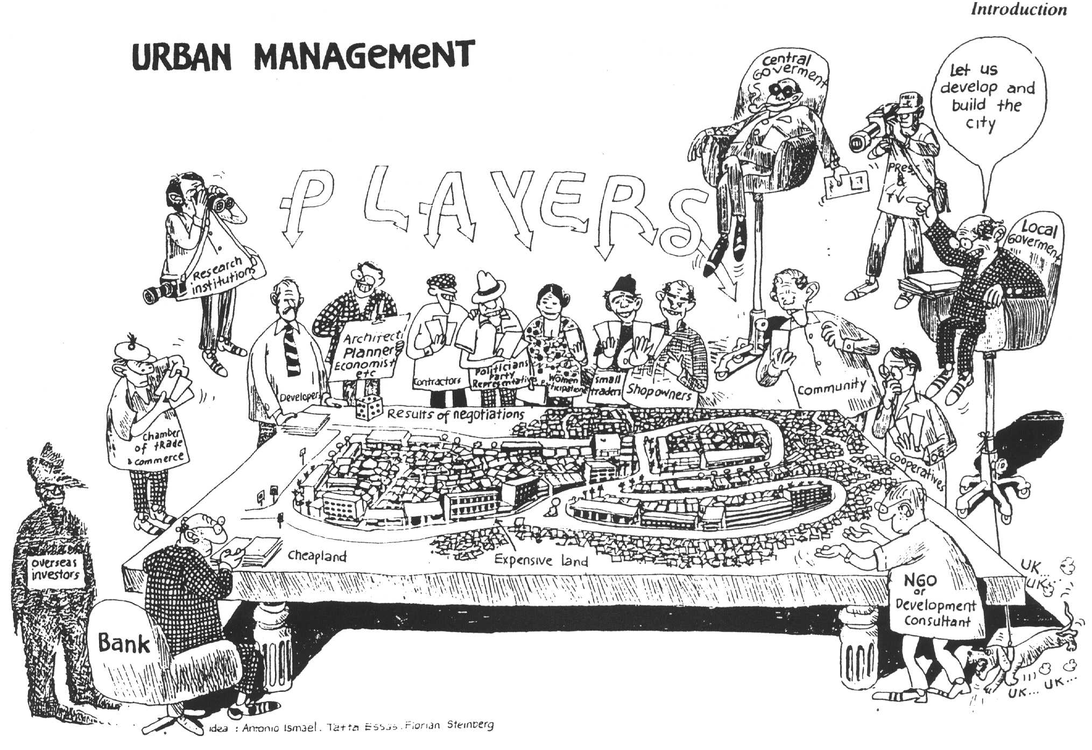
Urban Management Information combining data (including slum data) into a common database
Notes:
Issues here:
Incomplete coverage of actual situation
No sharing
No common baseline
On what basis are plans to be developed? Bearing in mind that uprading may involve relocations and is therefore highly contentious.

Slide 4
Dilemmas
How old is the map/data?
Whose reality is mapped?
If you are not on the map you don’t exist.
If you are on the map you may be evicted.
Can developments in geo-spatial technologies support more inclusive mapping and upgrading processes?

Slide 5
Typical mapping process for upgrading
Base Mapping

Slide 6
Scenario planning model

Slide 7
Is knowledge aligned?
Notes:
Do we share the same starting point?

Slide 8
How to engage citizens - Ladder of participation
Bottom-up
Self enumeration (SDI)
Co-production of knowledge & plans
Knowledge Sharing & Alignment
(Reich et al 2014)
Citizen control
Delegated power
Partnership
Placation
Consultation
Informing
Therapy
Manipulation
Top-down
Centralised mapping & planning
forced evictions,
resettlement
Arnstein, 1969

Slide 9
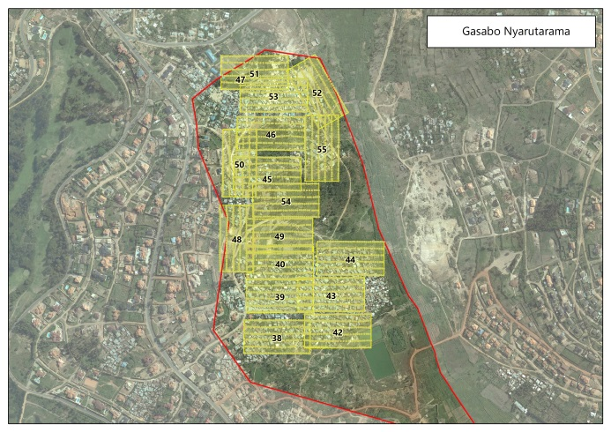
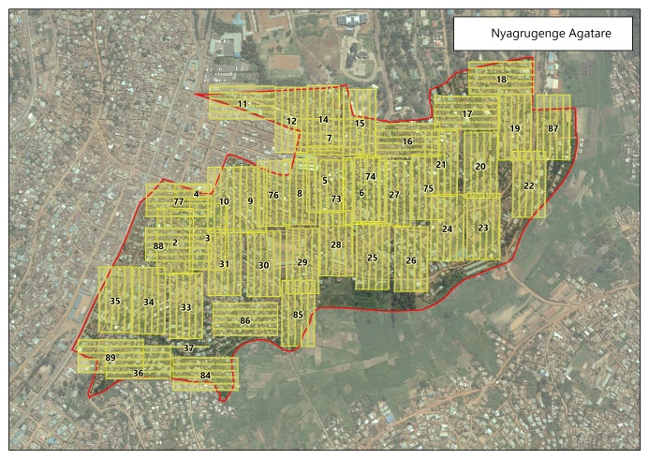

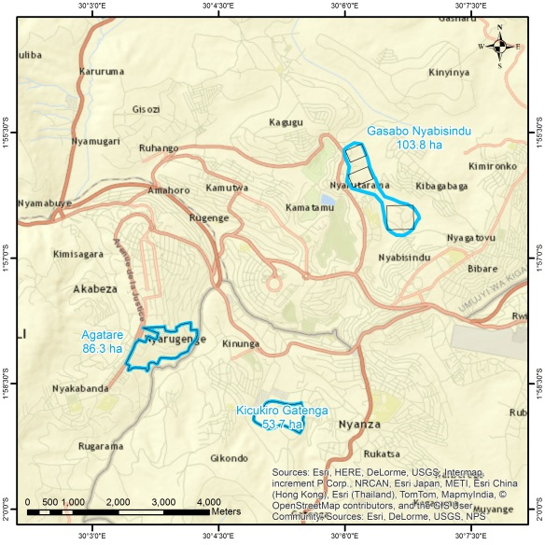
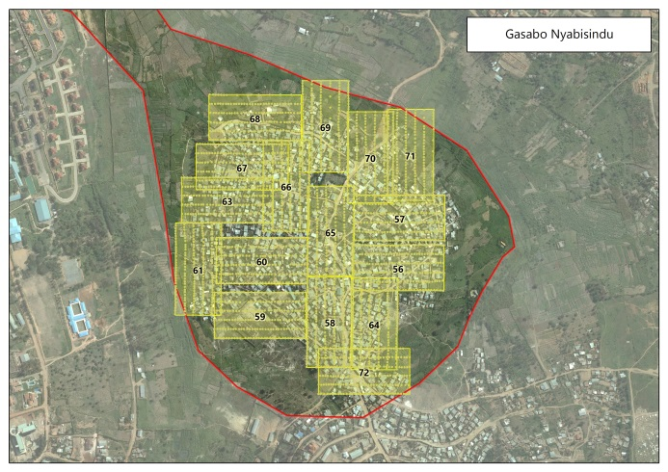
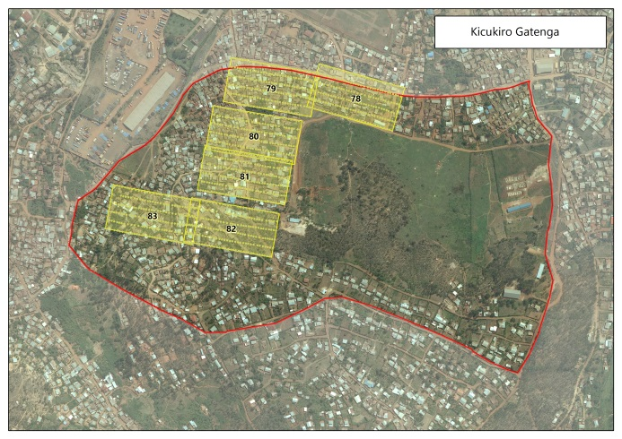
UAV flights Kigali May 2015
Agatare: 86 Ha – 4000 households – 19000 persons
11 days, 89 flights, 150 ha, 15 700 images
DJI Phantom 2 Vision+, 1.2 kg., 14MP RGB camera, fish-eye lens,
Flight planning with Pix4D app for smartphone
Source: Caroline Gevaert
Notes:
Photographer/pilot on the ground and visible/accessible to residents.
Massive number of images to cover relatively small area.

Slide 10
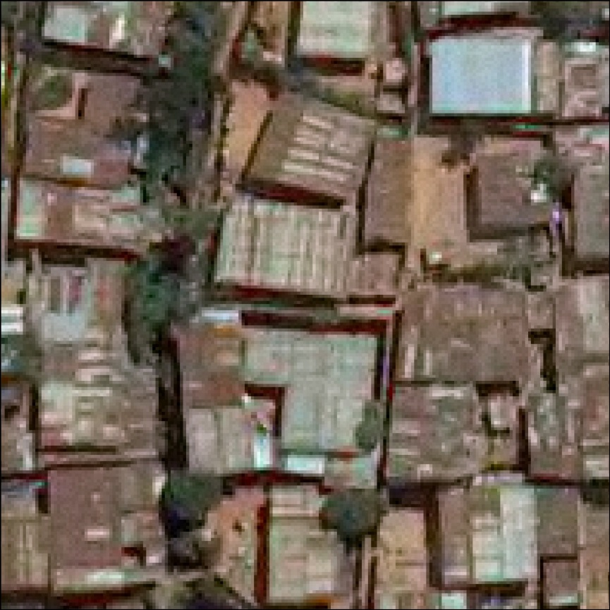
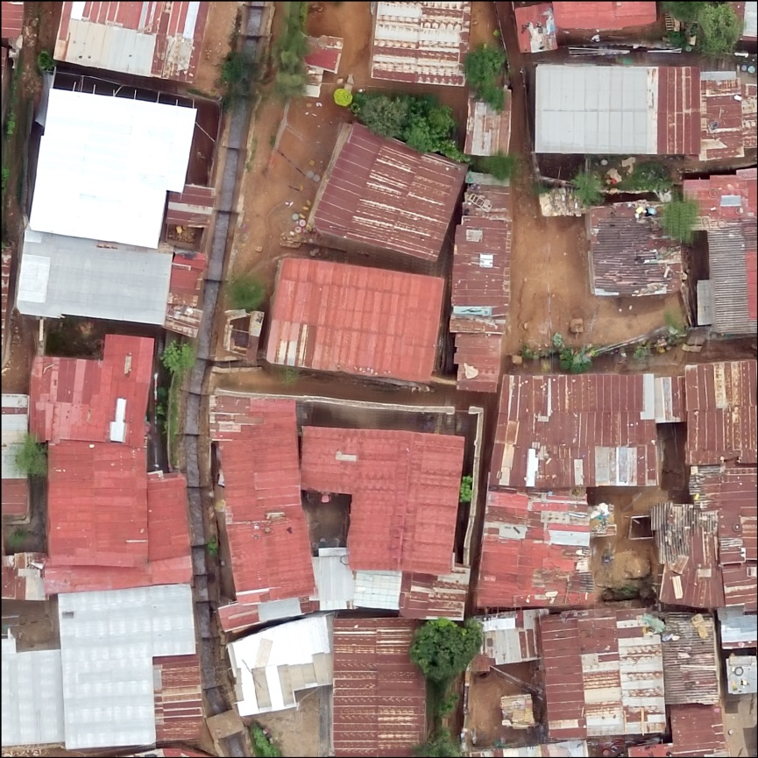
Significance for upgrading projects
Describe area and prioritize interventions
Existing Orthophoto (2008, 20 cm pixels)
UAV Orthophoto (2015, 3 cm
pixels)

Slide 11
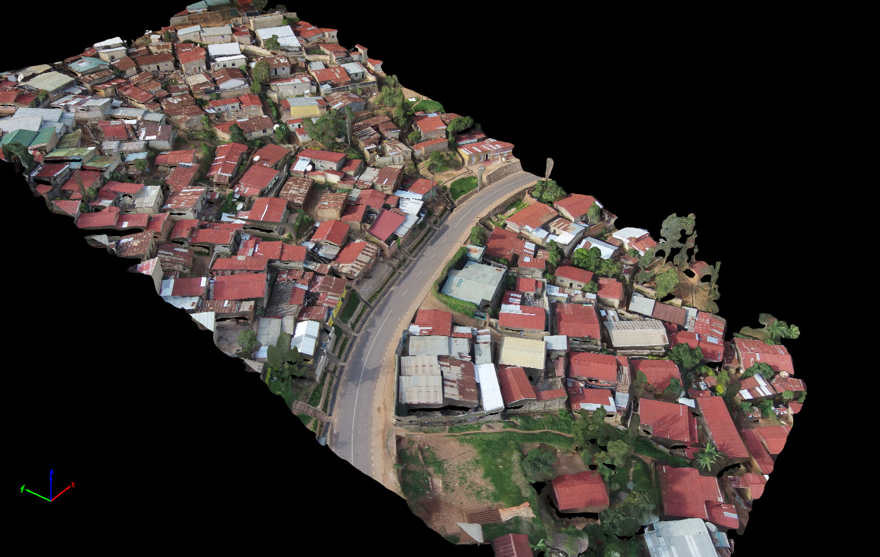

Slide 12
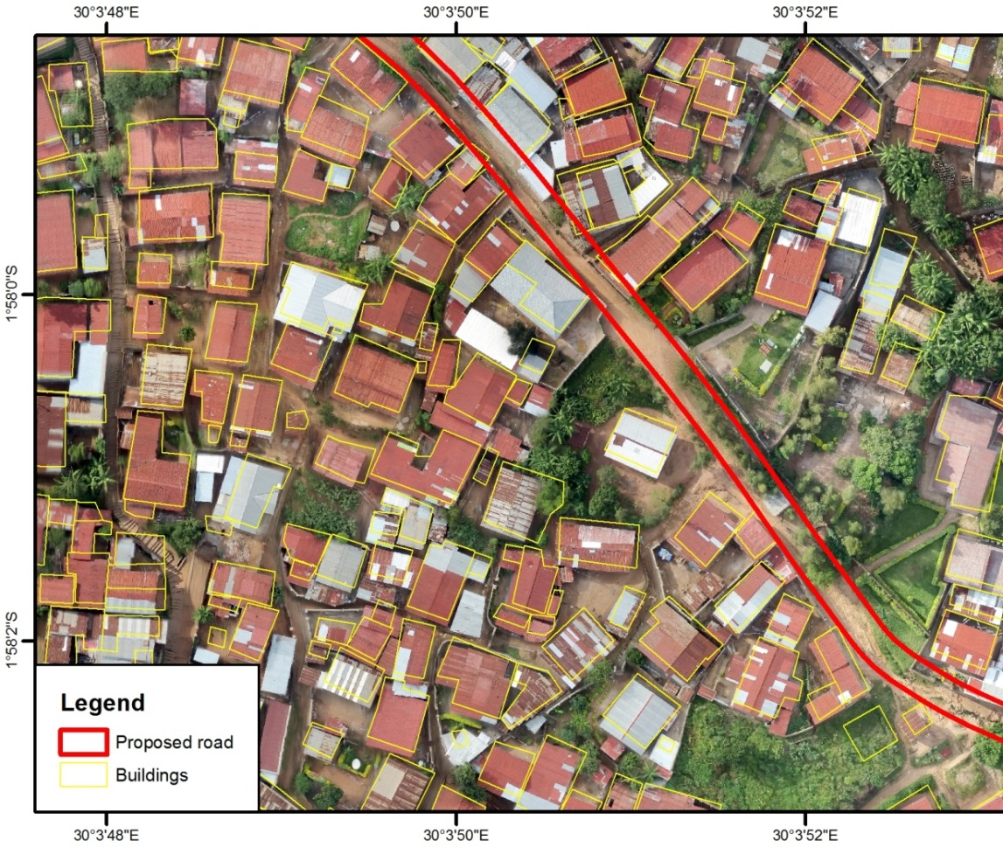
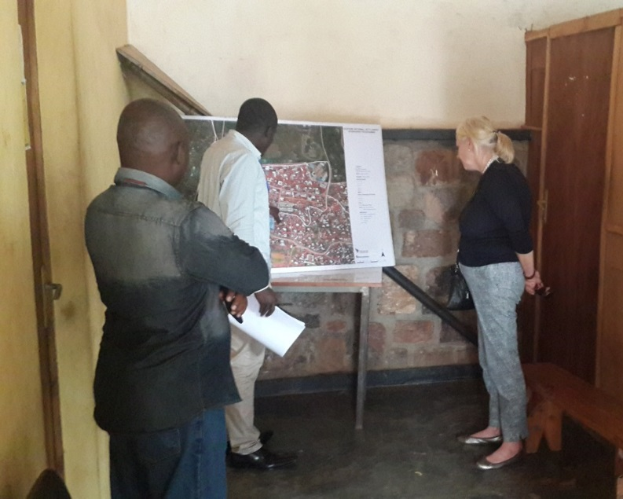
Significance for upgrading projects
Current usage – participatory design of upgrading
Feasibility
Prioritize
Implement
Design
    Design to mitigate expropriation
    Speed up field work
    Integrated overview of area
    Communication with residents

Slide 13
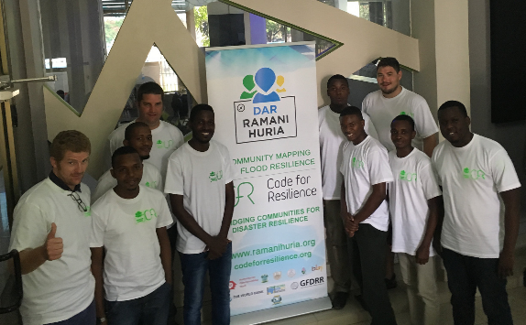
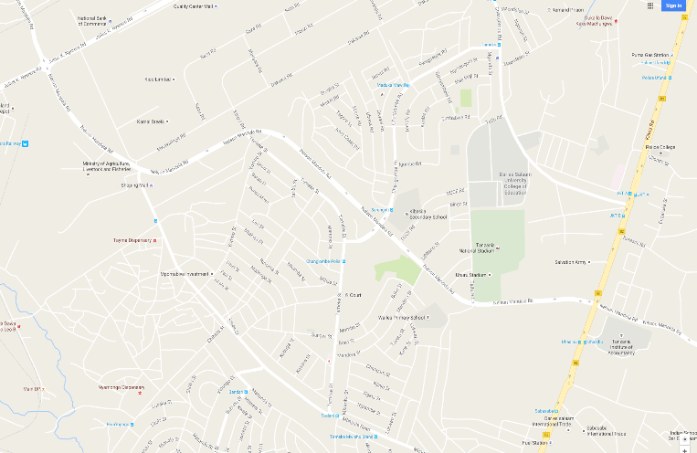

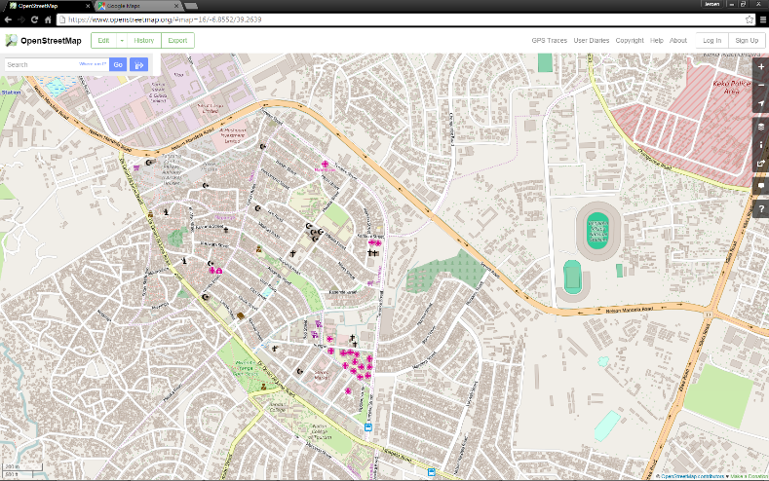
The effort of Ramani Huria
tanzania
Putting Settlements on the map

Slide 14
The methodology of RAMANI HURIA
The need for curriculum development
Bottom-up process of inclusive mapping
Ramani Huria is ambitious – Tanzania is large
Capacity development is key for sustainability
Strong involvement of higher education in Tanzania
Institutional commitment comes from the curriculum
Objectives of COCOMAP project
Develop a “cookbook” with complete methodology
Design a curriculum for Higher Education

Slide 15
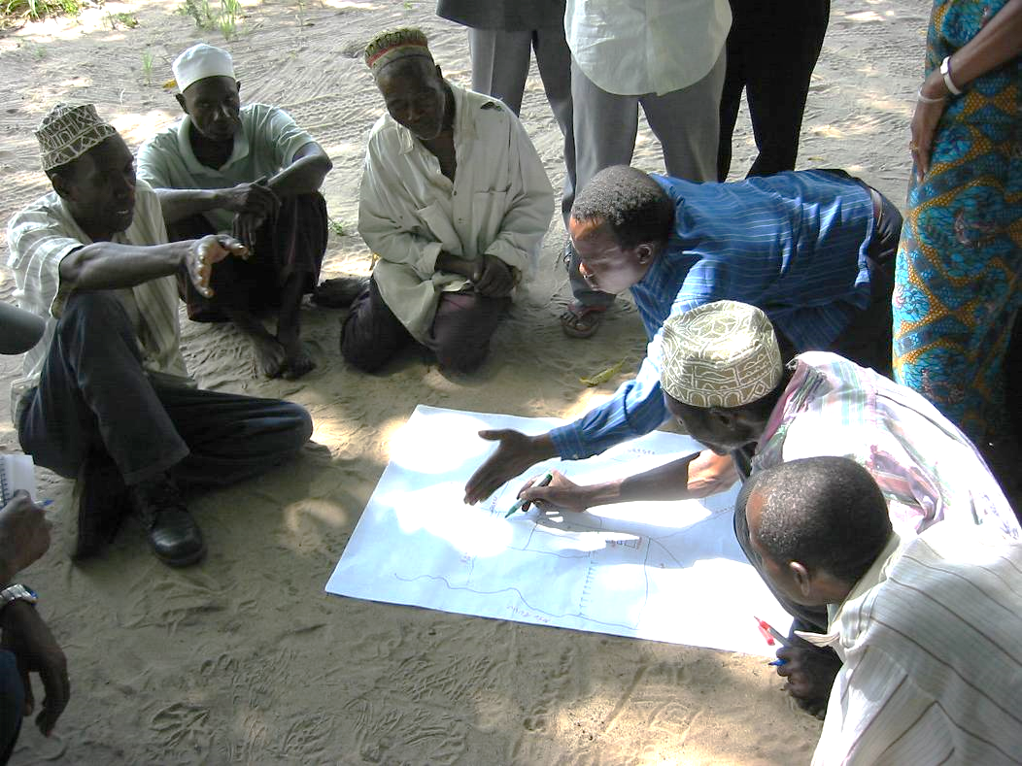
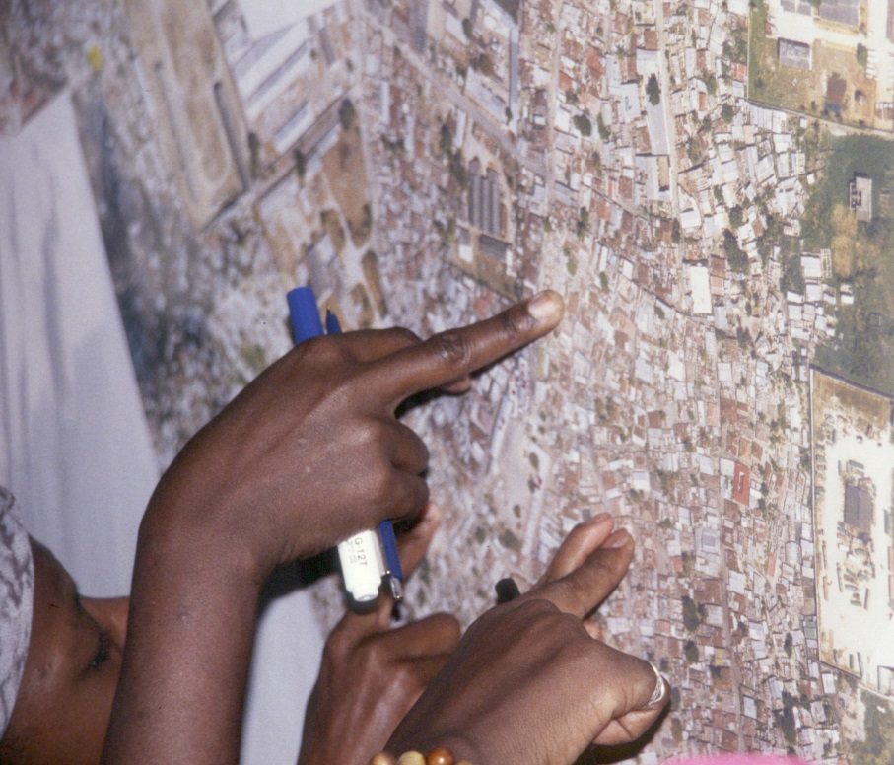
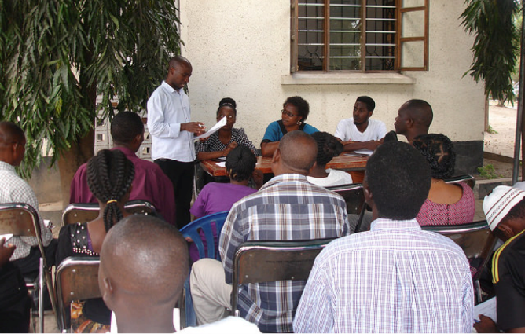
Elicit community knowledge
to verify mapping products and vulnerability assessment
The Practice of Community Mapping – incorporated into academic courses including internships.

Slide 16
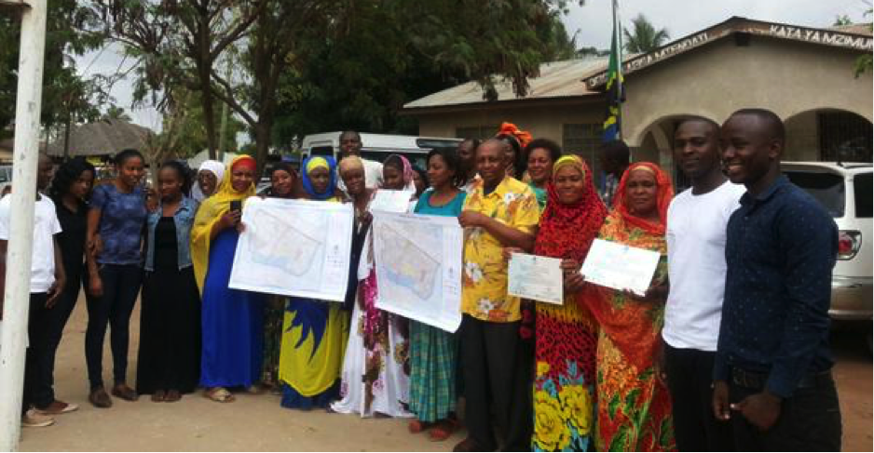
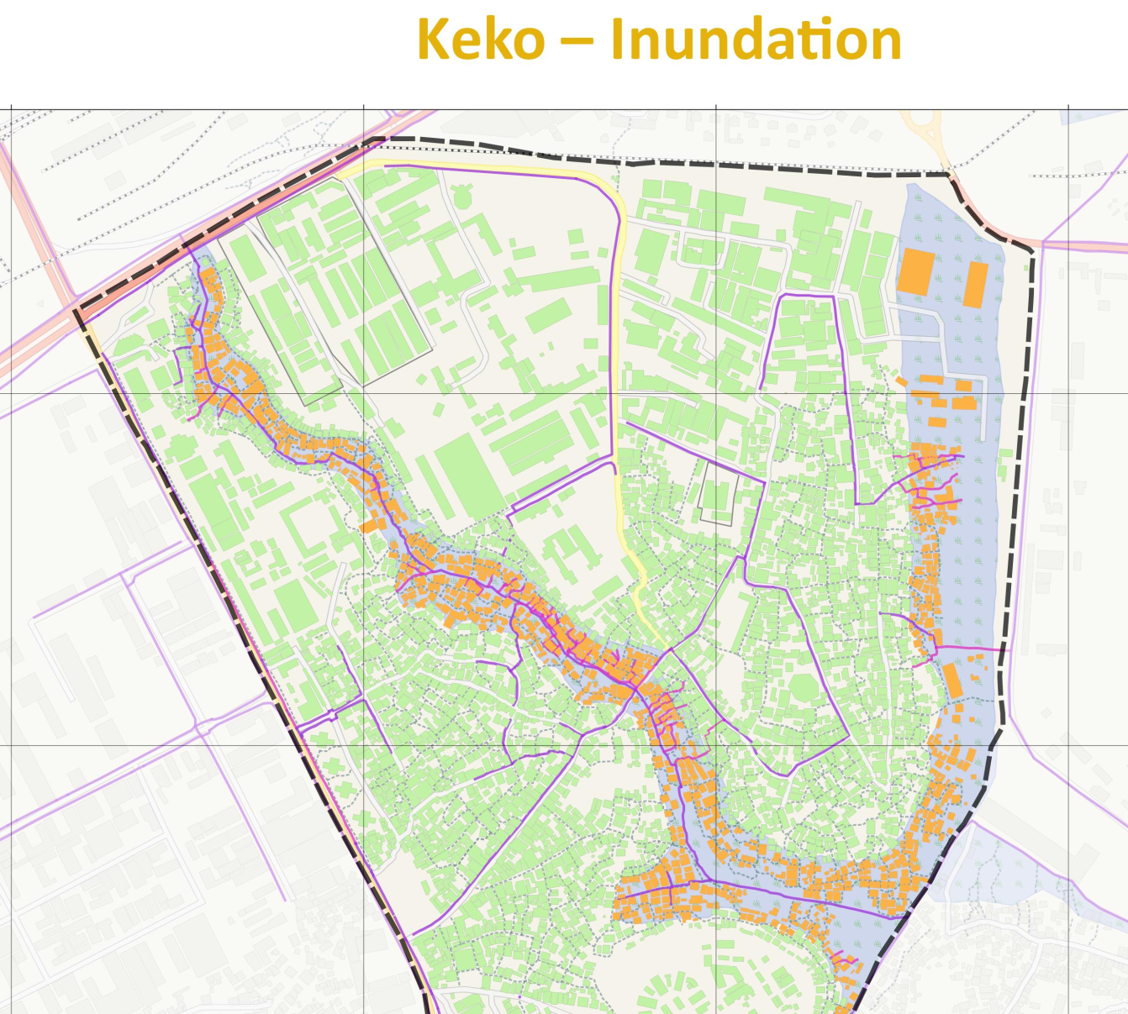
Present a spatial urban resilience analysis
to decision makers and with community members
Not just training
Delivering quality mapping &
planning capacity

Slide 17
Summing up
Developments in GIT such as UAVs create many opportunities for slum mapping.
Social and institutional issues – governments have the power to recognize and legitimize community based slum mapping or reject it, and as well to open their spatial databases to their citizens. These choices are crucial to engage citizens as partners in urban planning and management
Mapping is not a one off exercise: slums change rapidly so need to also maintain data on slums – think in terms of databases not maps.
Building knowledge and capacity and actions more important than the geospatial technologies and the maps themselves.

Slide 18
Proposition
By seeking higher levels of engagement and co-production of knowledge through community based mapping and enumerations, slum/neighbourhood upgrading can be significantly enhanced.

