Slide 1
Challenges and prospects of informal settlement and implications for urban planning in Gondar city, Amhara Regional state, Ethiopia
Kassahun Gashu, Department of Geography and Environmental Studies, University of Gondar,
E-mail: kg19me@gmail.com, P.O.Box: 196, Gondar, Ethiopia

Slide 2
Points of presentation:
Introduction
Problem statement
Objectives
Analysis & results
Way forward

Slide 3
Introduction
Informal settlements, according to UN-Habitat (2011) are residential areas where
Inhabitants have no security of tenure vis-à-vis the land or dwellings they inhabit, with modalities ranging from squatting to informal rental housing,
The neighborhoods’ usually lack, or are cut off from, basic services and city infrastructure and
not comply with current planning and building regulations, and is often
situated in geographically and environmentally hazardous areas.

Slide 4
Why informal settlements formed: views
Informal settlement views are classified in to three classes:
A. Liberal views
It is founded based on liberal theories.
According to this view, the main reason of creating informal settlements is population and immigration. .
In general, increased population is the main factor of developing such views and its solution is controlling the population (Dadash pour & Alizade, 2011).

Slide 5
B. Fundamentalist views
Come in to being since 1970s
forming marginalization of informal settlement’
tries to discern the reasons of informal settlement is space political economy (Ahadiyan & Shaker Ardakani, 2013).
In contrast to liberal view, space political economy investigates genesis of different settlements trying to be involved in the issue origins.
This view assigns mono-city of urban system and its heterogeneity to external factors making any efforts to solve the problem by adjusting working, production, distribution, and consumption structures (Hakimi et al, 2013).

Slide 6
C. Socialist or goal-orienting view
informal settlement and emerging marginal groups in urban communities of developing countries results from the natural trend of the contrast between work and investment (capital).
Goal-oriented perspective in 1980s and 1990s, continuing to the present, expresses why informal settlement and marginalization occur; and, regarding the history of interventions in marginal contexts,
in practice, opposed to concepts of destruction;
it mostly considers notions like empowerment, improvement, and renovation.

Slide 7
Around one quarter of the world’s urban population continues to live in informal settlements.
Since 1990, 213 million informal settlers have been added to the global population.
Over 90% of urban growth is occurring in the developing world and an estimated 70 million new residents are added to urban areas of developing countries each year.
Over the next two decades, the urban population of the world’s poorest regions-Sub-Saharan Africa is expected to double, suggesting that the absolute numbers of informal settlement and slum dwellers in these regions will dramatically grow.
In Africa, over half of the urban population (61.7%) lives in informal settlements and by 2050, Africa’s urban dwellers are projected to have increased from 400 million to 1.2 billion.

Slide 8
Statement of the Problem
Debate on informal settlements has been a centre of concern for many researchers (UN-Habitat, 2007).
Ethiopia is one of the least urbanized countries in the world. Even by African standards, the level of urbanization is low.
An increasing number of people try to solve their housing needs by getting a plot of land informally in the transitional peri-urban areas

Slide 9
The average level of urbanization for Africa in general was 36% in 2002; Ethiopia had only 20% of its population living in urban areas.
Despite the low level of urbanization and the fact that the country is predominantly rural, there is rapid rate of urban growth, which is currently estimated at 5.6% per year (MUDH, 2015).
Population of Gondar city is increasing at alarming rate every year.
It is evidenced by observing the following five recent years of increment in 2014(306,246), in 2015(323,387), in 2016(341,991), and in 2017(360,600) (MUDHCo & ESCU,2015).

Slide 10
In many cities and towns major informal settlements are found in the peripheral areas, where they are characterized by their irregular shape and large plot sizes.
As a result, they have significantly contributed to the unplanned and rapid horizontal expansion of the built-up area.
As a result of rapid horizontal expansion and the spontaneous growth, Gondar city is now confronted with different types of problems, one of which is the emergence and development of informal settlements.

Slide 11
Illegal building and illegal land uses are very common practices in the city.
The number of informal settlers who were registered as informal settlers in Gondar city was about 700 households (Belachew, 2010).
This number increases and the city land supervision report indicated that about 2187 informal settlers were registered in seven kebeles only (Municipality of Gondar city, 2011/2012).
Therefore, this study focuses on the challenges and prospects of informal settlements in the Gondar city taking Makaraki and Azezo Demaza sub-cities as sample of study.

Slide 12
Study Objectives
The general objective of the study is to assess the challenges and prospects of informal settlements and the policy implications in the light of urban planning in Gondar city.
The specific objectives are to:
Describe main causes of informal settlement in the study area
Make some way forward to help to alleviate the problem of informal settlement and its negative consequences.

Slide 13
Conceptual framework
Informal settlement
Cause of informal settlement
-High demand and limited supply of land
-Weak governance
-Location
-Inefficiency of lease system
- Lack of Planning and regulation
Challenges
-problem of getting utilities
-Informal land use
-good governance problem
-Substandard house
Opportunities
- Assets/land access
-Job opportunity
-brokerage/doing business
Implications for Urban Planning
Positive-Policy formulation to improving land management
Negative -Infrastructure deficiency; Conflict of ownership

Slide 14
Research Methodology
employed a mixed approach.
The qualitative: interview& observation
The quantitative: survey questionnaire
Sampling Techniques and Sample Size
Representative samples were purposely selected from Maraki and Azezo-Dmaza sub-cities in Gondar city.
The main logic behind selecting the two kebeles is because of the high prevalence of informal settlement.
Respondents were selected proportionately in accordance with the sampling frame from the two kebeles.
The sample size determination for the respondents was calculated based on Yamane’s statistical formula

Slide 15
Table 1: Number of sample size in the study area
Kebele name | Household Number | Sample size
Maraki kebele | 439 | 186
Azezo-Dmaza | 105 | 45
Total | 544 | 231
For analysis purpose, the quantitative data were summarized using descriptive statistics (percentage and mean value) while the qualitative data were transcribed and analyzed using text-analysis techniques

Slide 16
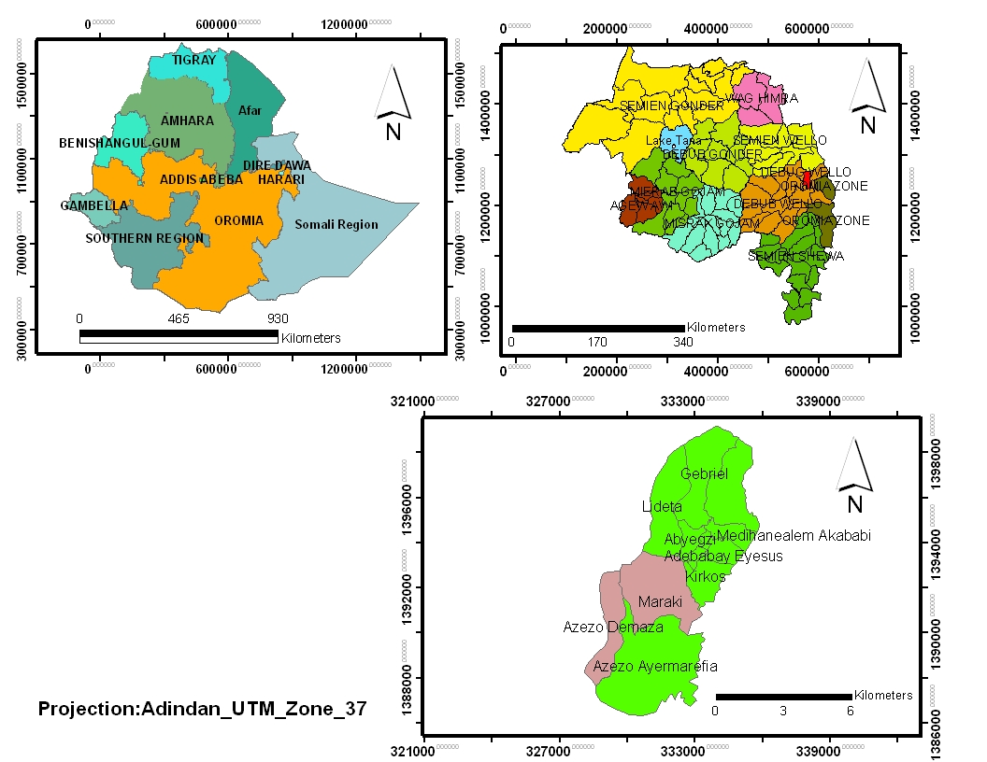
Description of the study Area
Map of study area

Slide 17
Table 2: Extent of Urban expansion in the Cities of Amhara region
^{No.} | ^{Name of City} | ^{Population Growth Rate (%)} |  | ^{Annual Rate} ^{of Settlement Expansion (%)} | Periods Considered to Measure Settlement Expansion | ^{Extent of Sprawl}
 |  | Used by the CSA to Project the Population | ^{Between 1994-2007} ^{Census} |  |  | ^{Option 1} | ^{Option 2}
 |  | Option 1 | Option 2
1 | Bahir Dar | 2.5 | 3.7 | 2.75 | 2005-2013 | 1.1 fold | *
2 | Debre Markos | 2.5 | 1.8 | 3.38 | 2006-2013 | 1.4 fold | 1.9 fold
3 | Dessie | 2.5 | 1.6 | 4.5 | 2005-2013 | 1.8 fold | 2.8 fold
4 | Gondar | 2.5 | 4.7 | 10.42 | 2006-2013 | 4.2 fold | 2.2 fold

Slide 18
 | Category | N | %
Age | 30-35 | 51 | 23.9
 | 36-40 | 73 | 34.3
 | 41-45 | 46 | 21.6
 | 46-50 | 40 | 18.8
 | 51-55 | 1 | .5
 | 56-60 | 2 | .9
Sex | Female | 122 | 57.3
 | Male | 91 | 42.7
Marital Status | Married | 133 | 62.4
 | Unmarried | 71 | 33.3
 | Divorced | 3 | 1.4
 | Widowed | 6 | 2.8
Source of Income | Income from employment | 124 | 58.2
 | Pension and grants | 24 | 11.3
 | Income sent from another household | 49 | 23.0
 | Trade | 8 | 3.8
 | Agriculture | 8 | 3.8
 | Total | 213 | 100.0
Monthly Income | <100 | 29 | 13.6
 | 100-300 | 93 | 43.7
 | 301-500 | 39 | 18.3
 | > 500 | 55 | 25.5
Source of Energy | Electricity | 7 | 3.3
 | Gas | 9 | 4.2
 | Wood | 101 | 47.4
 | Coal | 25 | 11.7
 | Animal dung | 21 | 9.9
 | Wood and animal dung | 33 | 15.5
 | Gas, coal, wood, and animal dug | 7 | 3.3
 | Wood coal and animal dung | 10 | 4.7
 | Total | 213 | 100.0

Slide 19
Results and analysis Major Causes of Informal Settlement

Slide 20
This study shows that rapid urbanization and influx of people to urban area(location), weak land governance/lack of development control mechanisms, imbalance between demand &supply/inadequate formal land distribution, poverty and socio cultural factors are major causes of informal settlements

Slide 21
The challenges
Challenges | Maraki |  | Azezo dimaza |  | Total number | Total Percent
 | N | % | N | %
Power supply problem | 45 | 24.19 | 6 | 13.33 | 51 | 22.08
Problem of accessibility to main road | 22 | 11.83 | 5 | 11.11 | 27 | 11.69
Tapped water supply problem | 25 | 13.44 | 9 | 20.0 | 34 | 14.72
High crime rate | 15 | 8.06 | 3 | 6.67 | 18 | 7.79
Concurrent problems (combinations of problems) | 79 | 42.47 | 22 | 48.89 | 101 | 43.72
Total | 186 | 100.0 | 45 | 100.0 | 231 | 100.0

Slide 22
Nearly half of the participants (43.72%) reported the existence of concurrent problems of power supply, water supply,
But the singled most dominant problem reported was power supply which accounted 22.08% of the challenges followed by tapped water supply accounted for 14.72%

Slide 23
Mediators of informal settlement

Slide 24
Major Impacts of the informal Settlements
Environmental Impacts
Pollution of Water Sources
Solid and Liquid Wastes
Flooding
Deforestation
Economic and Social impacts
Encroachment of Good Agricultural Land
Haphazard or uncoordinated development
Live in houses constructed with substandard materials
Crime

Slide 25
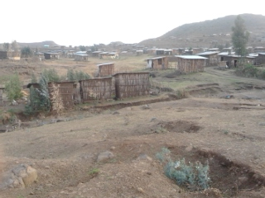
Figure 2: partial view of informal settlement Maraki sub-city (Koshie Sefer )

Slide 26
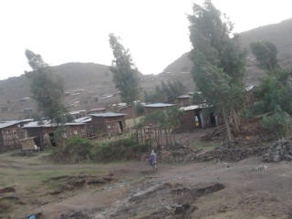
Figure 2: partial view of informal settlement Maraki sub-city (Zelan Sefer)

Slide 27
Summary
Large fraction of peri-urban agricultural land is highly subjected for unauthorized conversion.
The inaccessible and unplanned peri-urban area is the best alternative place for low-income households.
Local peri-urban landholders are the principal suppliers of land for informal market.
Land transaction in the informal market is mainly governed by trust and social sanction measures.
The hostile attitude of the government towards informal settlements should have to be revisited.

Slide 28
The way forward:
Participatory informal settlement upgrading:
to address urban development imbalances represented by informal settlements.
It engages and puts all key urban stakeholders–all levels of government, community representatives, civil society, non-government organizations, academia, private sector and, especially, informal settlers – at the heart of the process
Bull dosing or demolition and carrot and stick is not recommended strategy b/c of human rights
using cadaster systems for spatial plan and urban land management and administration(modern technologies)
Land is an important resource and it has to be used in appropriate and planned manner
This helps to prevent illegal settlements ahead of building
i.e. failing to plan is planning fail.

Slide 29
Government Leadership:
National government must play a leading role in recognizing informal settlement challenges.
provide the enabling environment to develop and implement the appropriate policies and plans, i.e. pro poor urban dwellers policies.
Actively working with regional and municipal governments
connect key stakeholders, harness local knowledge, enact policies and plans and manage incremental infrastructure development.

Slide 30
Systemic and city-wide scale’ approaches:
This includes efforts to 1) ensure equitable land management approaches,
2) recognize the multiple forms (formal and informal) of livelihood
3) improve and reintegrate informal settlements with trunk infrastructure and basic services via integrative planning and design,
4) clarify the administrative responsibility of peri-urban areas
Infill development, Housing at the centre:
strategic and integrated approaches to urban development must put housing at the centre of policy and urban contexts.

Slide 31
Thank you for your patience

