Slide 1
Transformation of Addis Ababa
The Need for Inclusive “Neighborhoods”

Slide 2
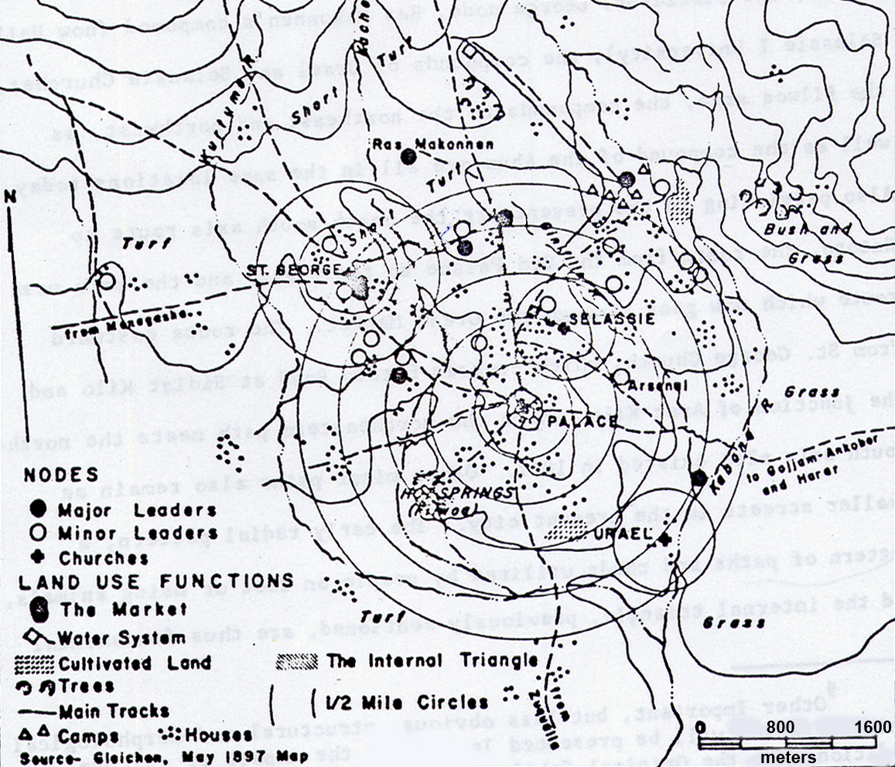
Conglomeration of Homogeneous neighbourhoods/Sefers
Addis Ababa’s early Organization:
Circular concentric settlement
Patterns neighbourhoods surrounding
houses of nobility, and Churches
City survey from 1961:
212 square kilometers, 58 per cent of total
land owned by 1768 persons, each owning
more than 10,000 m². Twelve per cent of
the land belonged to the church.
Pankhurst (1962)
After “Nobility”
Dejazmach Wube (Wube bereha),
Fitawrari Aba Karan (Aba Karan sefer),
Habtegiorghis Deldey and
Ras Mekonen Deldey.
The Palace Guards’ Quarter
(Kibur Zebegna),
the Butchers’ Quarter (Siga meda),
the Workers’ Quarter (Serategna sefer),
Riflemens’ Quarter (Tebmenja Yaz).
After churches:
Tekelehaimanot,
Urael,
Giorghis.
Cherkos
After ethnic lines
Wello sefer
The in-between open spaces used as additional camp sites, pastures, crops, market areas or occasional ceremonies

Slide 3
Neighbourhood of communities
Homogeneity: value, culture, way of life, etc
Territory/Place (space + human activity + meaning)
Context (where? orientation, how? Construction, what? meaning)
Identity
Coziness
Sense of belonging

Slide 4
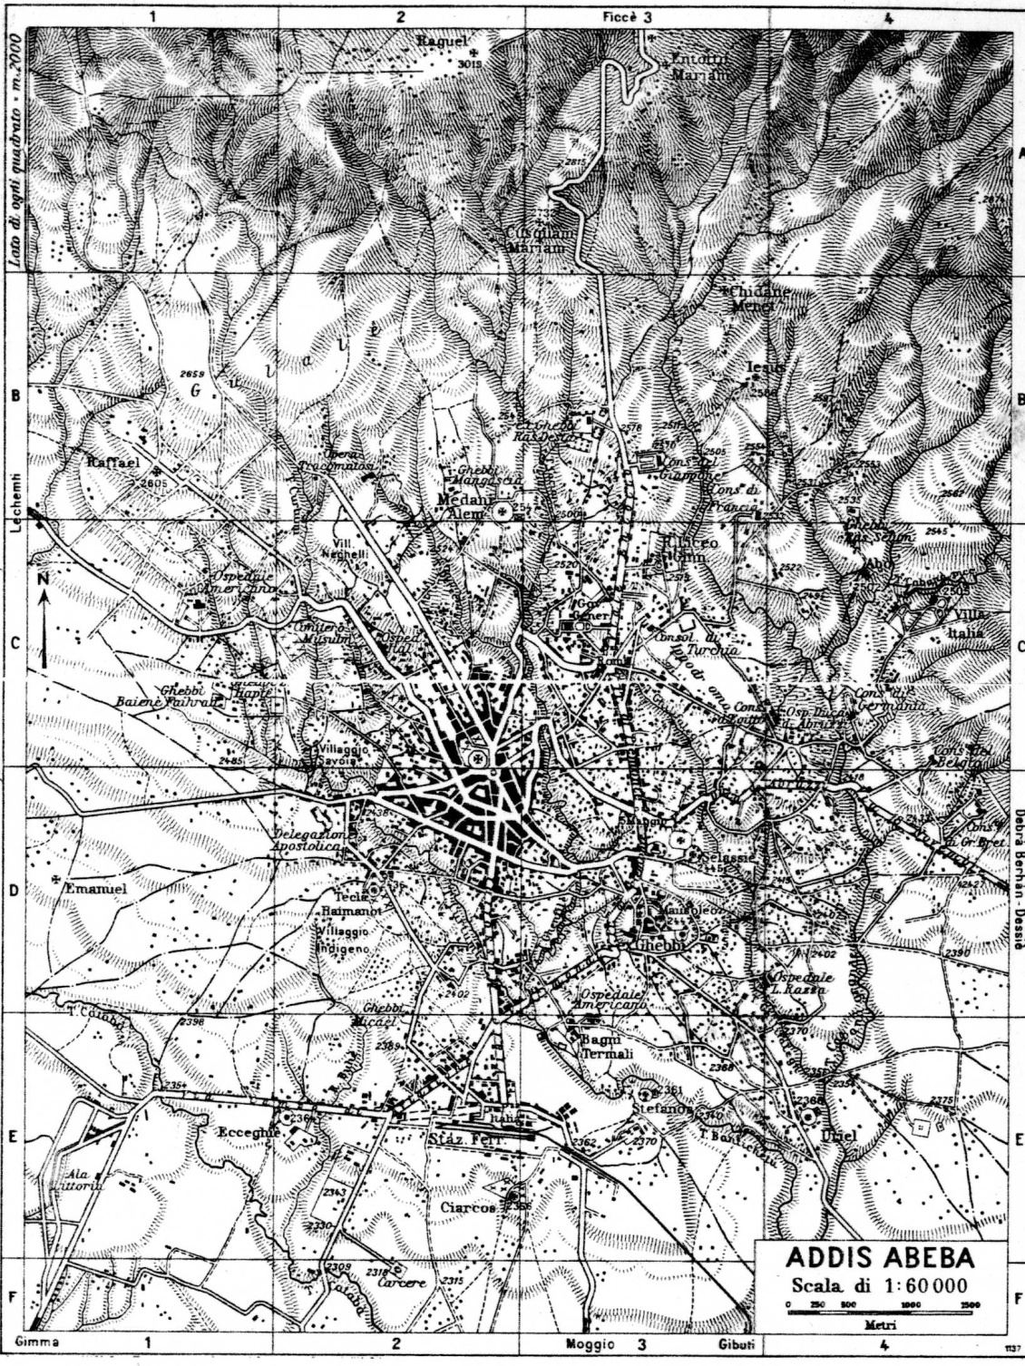
Introductions of
Ethio–Djibouti railway and
vehicles
Expansion of city towards
southern part
Provision of wider roads
Infiltration of newcomers
Large open spaces between
nodes started to be filled in

Slide 5
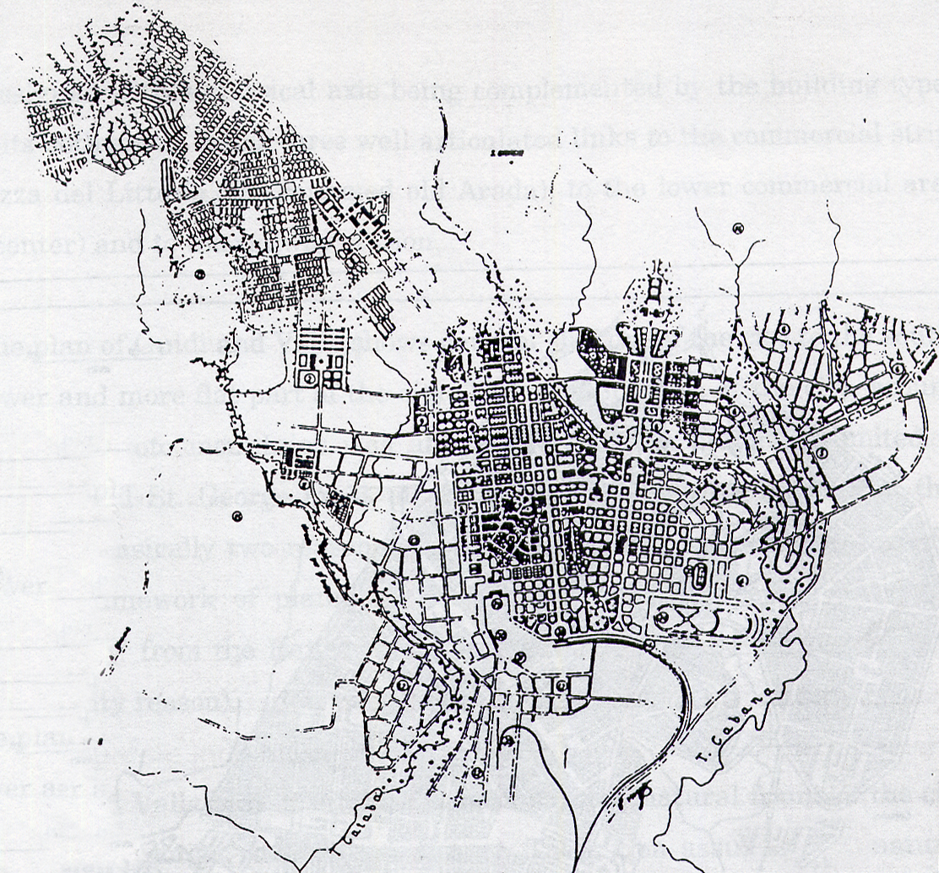
Segregated neighborhoods
The period of the Italian occupation (1936-1941)
Addis Ababa, capital city of annexed territories of East Africa – the “new Rome”.
Guidi and Valle (1936) master plan: based on segregation
Original settlement of “natives” was either left untouched or was cleared, replaced by modern housing and office blocks
Road network replaced by grid layout.
Piazza, Casanchis, Popolare .
Merkato: adjacent to the “native city”, an extension area with grid layout.

Slide 6
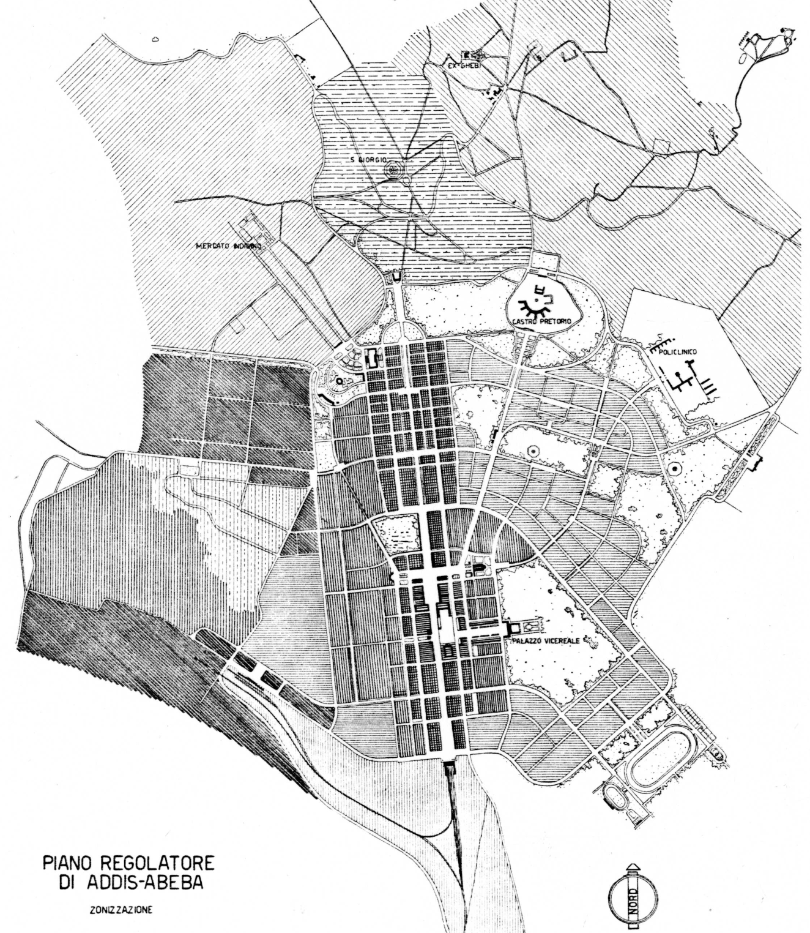
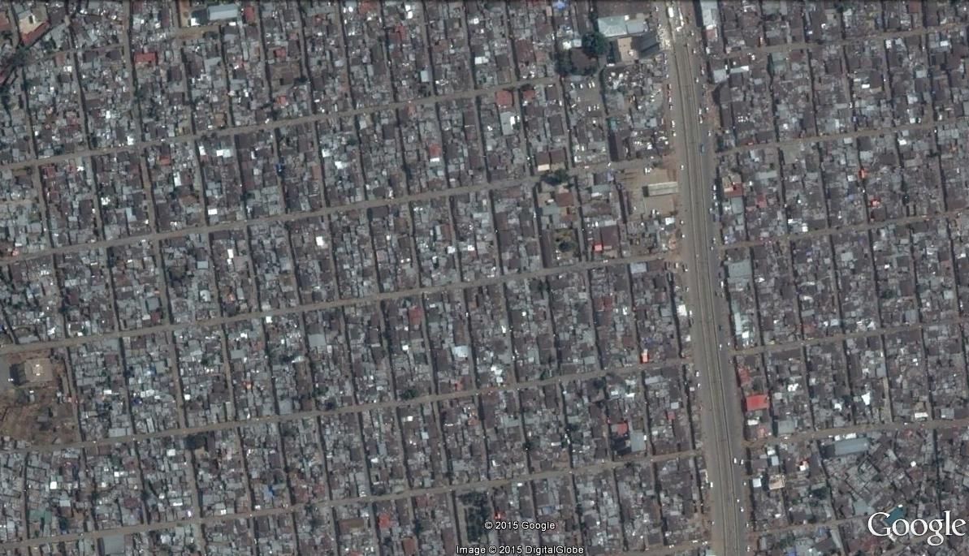
Zonning plan by Italians 1938

Slide 7
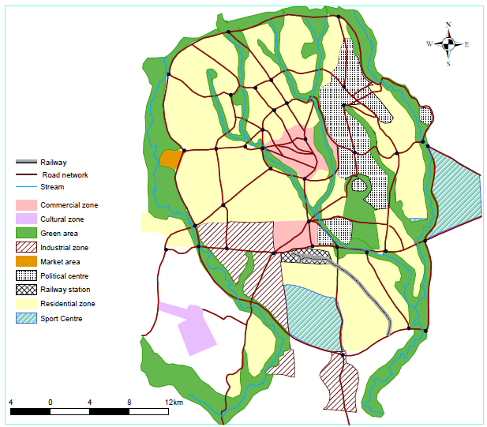
The neighborhood
basic unit of city
British architect Sir Patrick
Abercombie’s plan,
prepared 1954-1956
Abolished segregation, organic layout, neighbourhood unit
Radial street network and ring roads
Satellite settlements: Kolfe, Gerji and Mekanissa
With his death in 1957 plan left at the stage of guideline
Source: Yirgalem Mahiteme, 2007

Slide 8
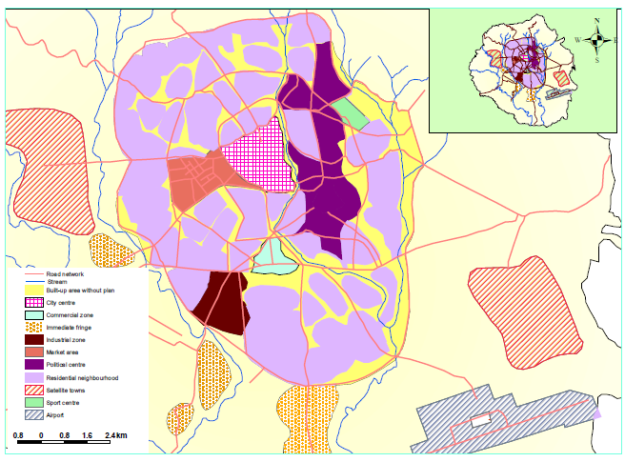
1959, Bolton Hennessy and Partners
Refined Abercombie’s plan to accommodate more population
Some part of proposed street layout and satellite towns implemented.
Neighborhood concept remained on paper
Source: Yirgalem Mahiteme, 2007

Slide 9
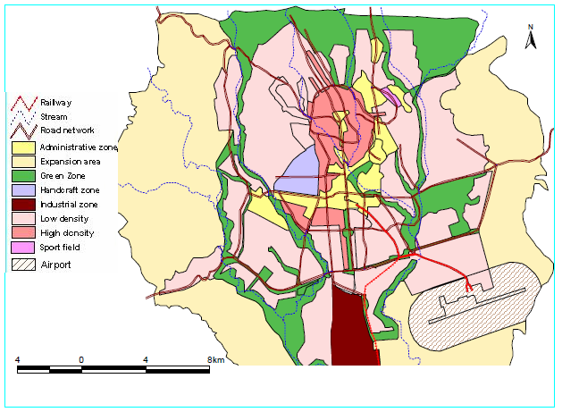
French architect Luis De
Marien (1965)
Similar to Italian plan, emphasis on form and geometry rather than spatial planning
  axial layouts: city as a trade and political centre
Though in an ad-hoc and sporadic manner, had been used in guiding the city
Considerable part of plan implemented, coincidence with construction boom of 60s
Source: Yirgalem Mahiteme, 2007

Slide 10
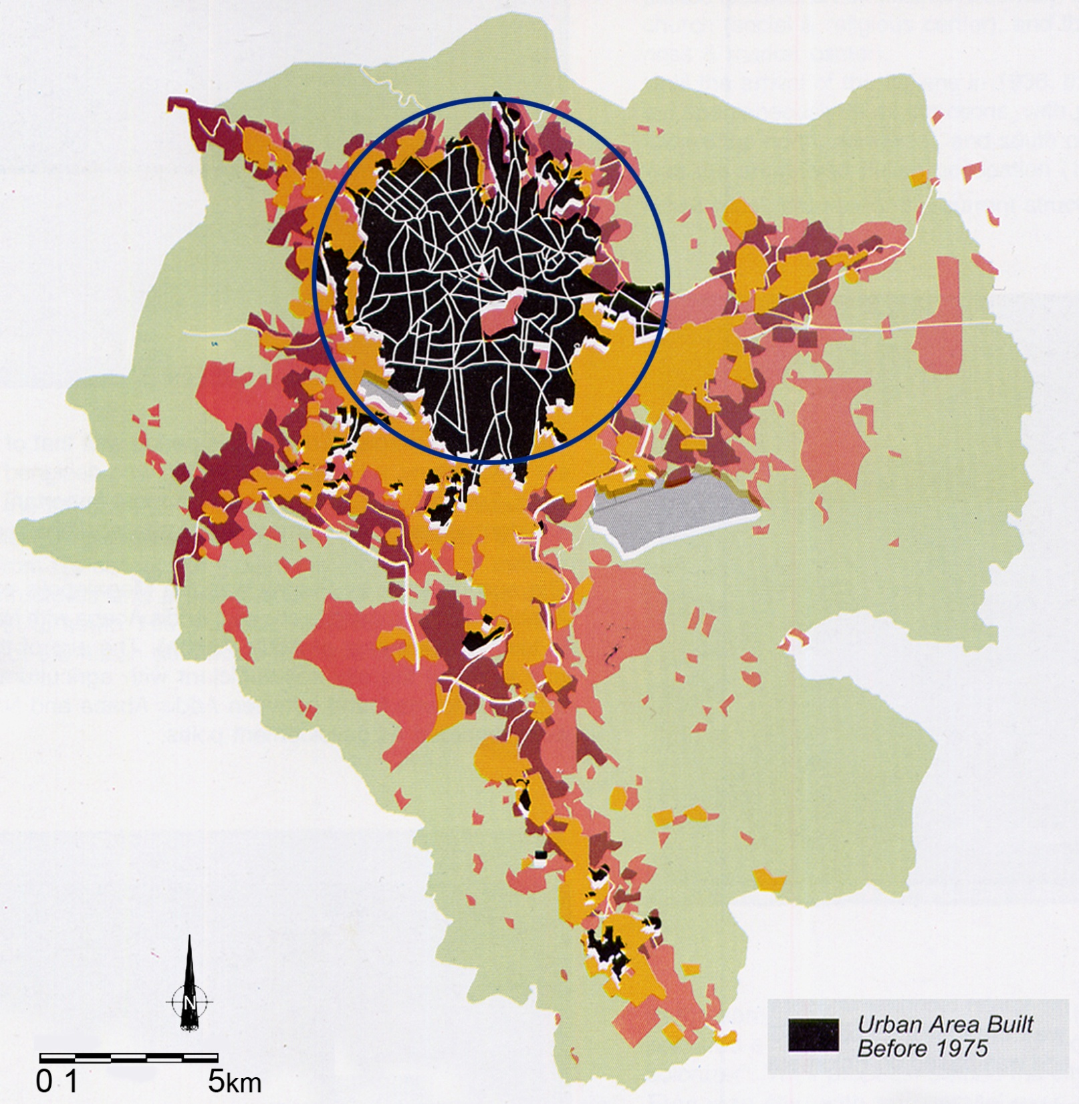
1986 master
plan
It took 8 years
to be legalized
and by then it
became irrelevant
owing to the
new ‘Market
economy’
1974-2002

Slide 11
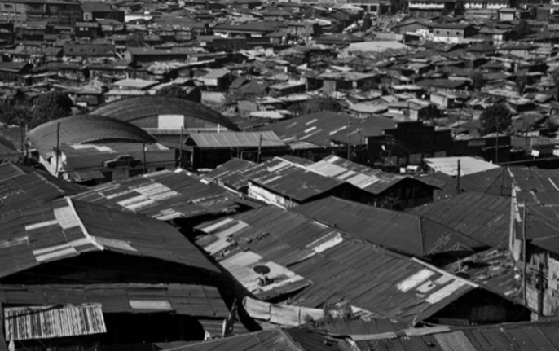
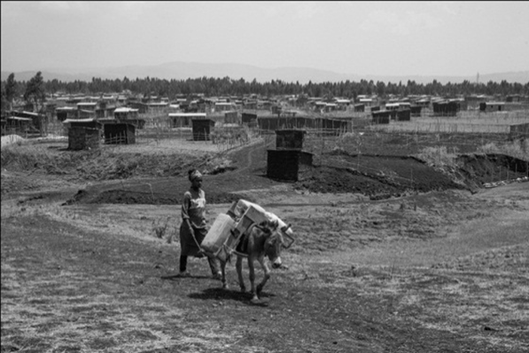

Slide 12
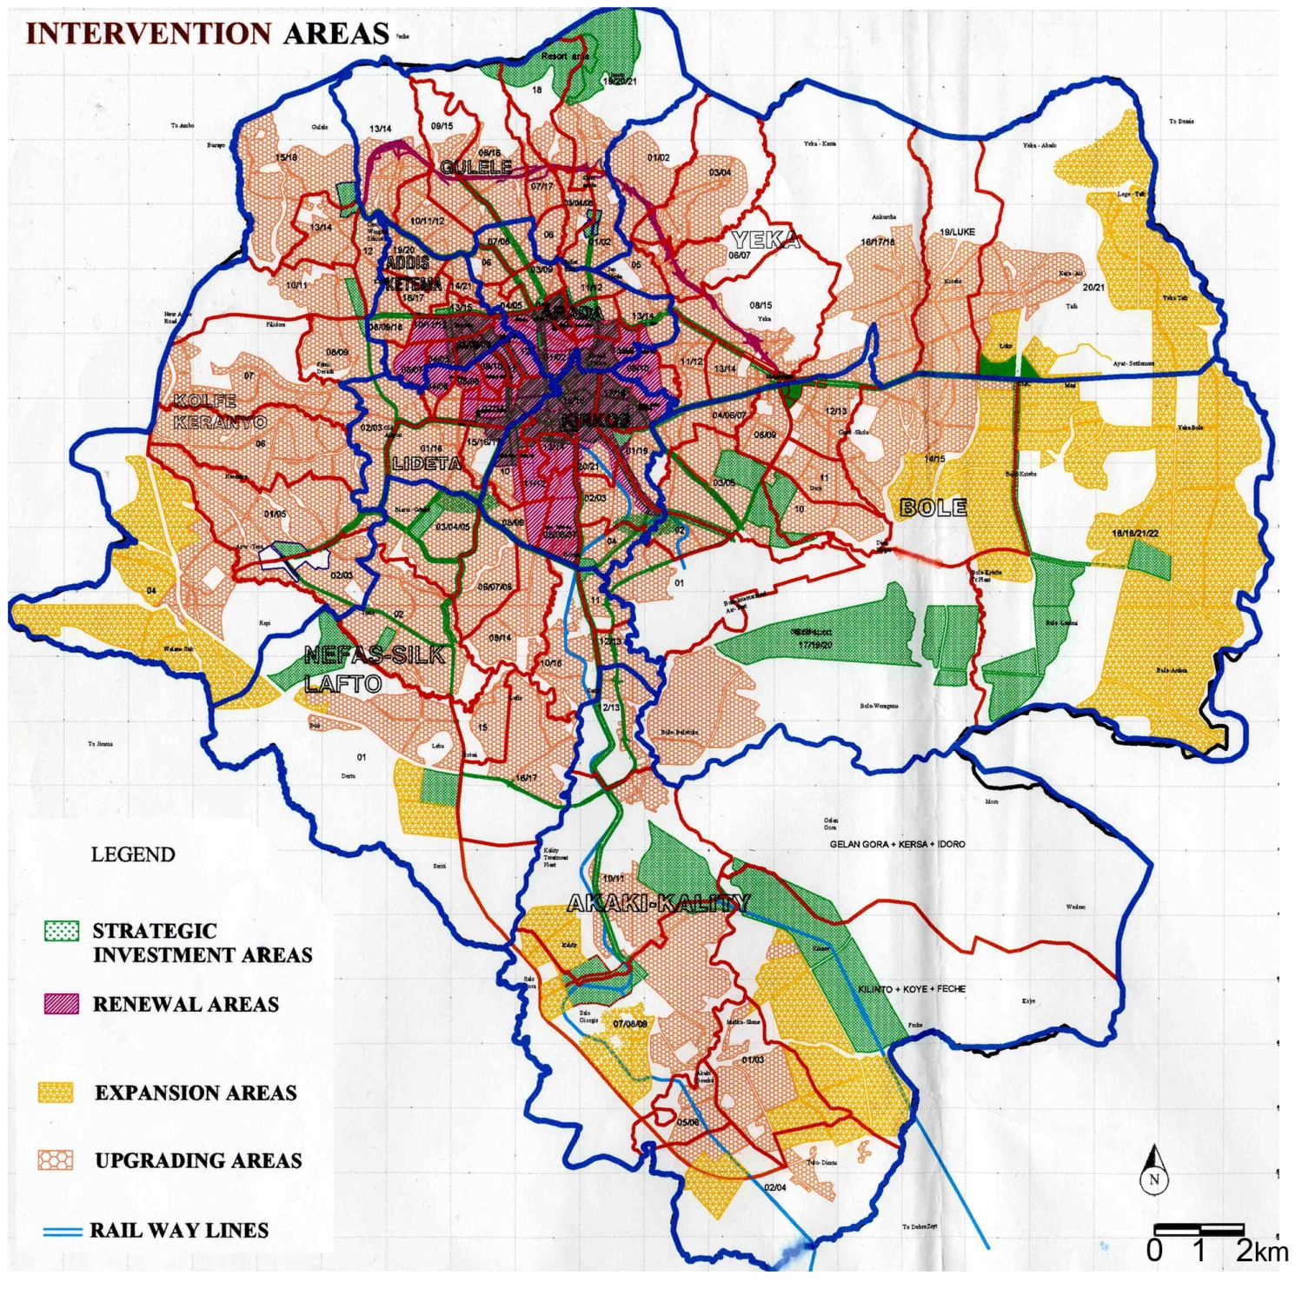
2002: Revised master plan

Slide 14
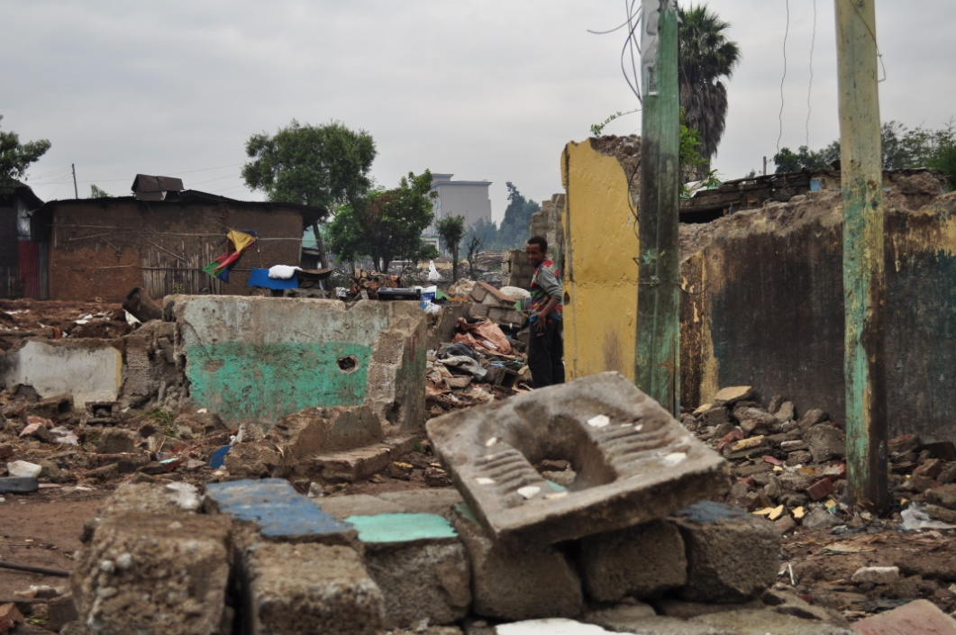
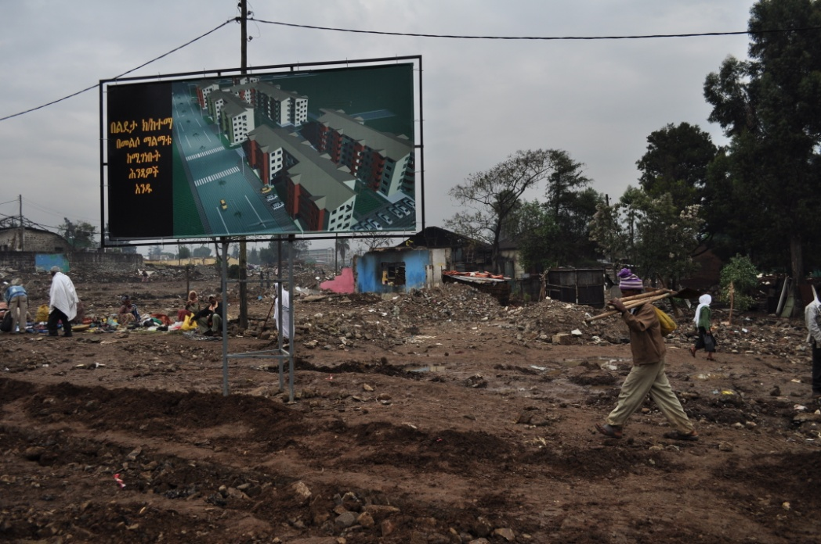
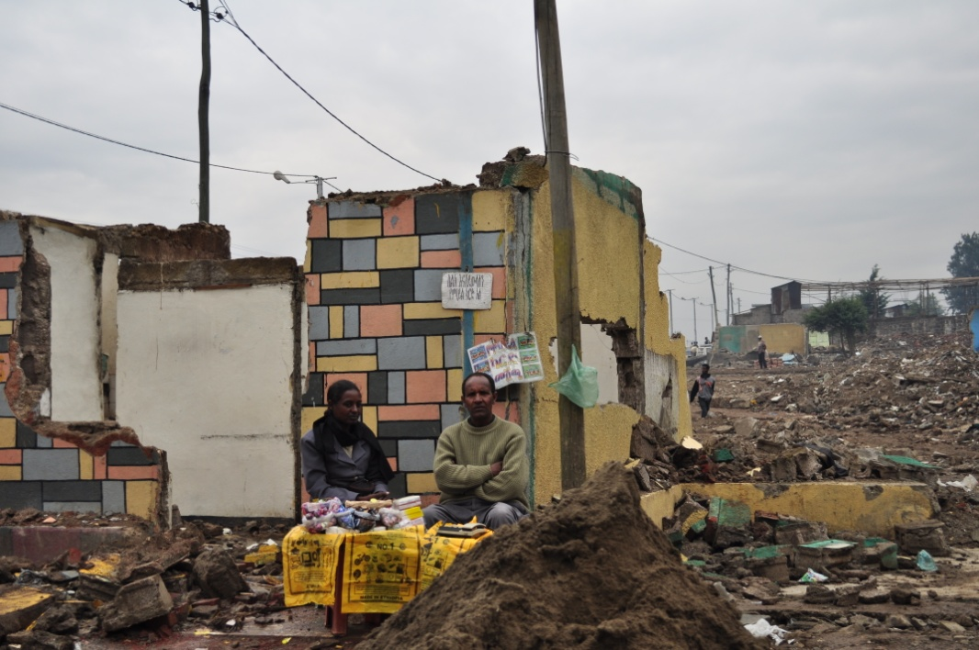
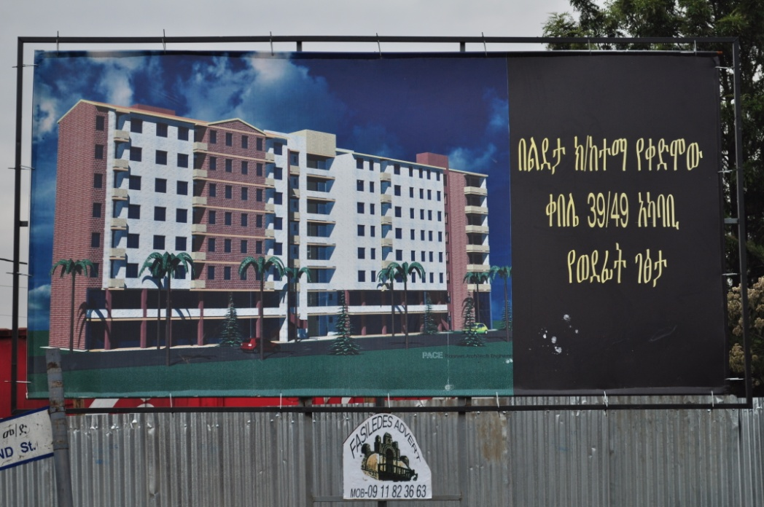

Slide 15
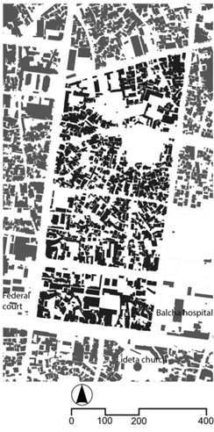
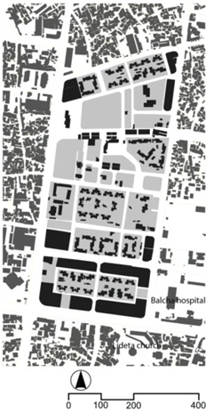
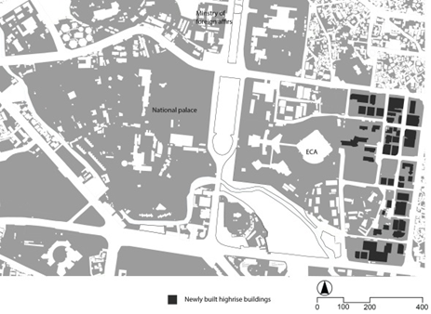
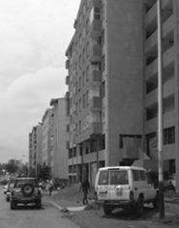
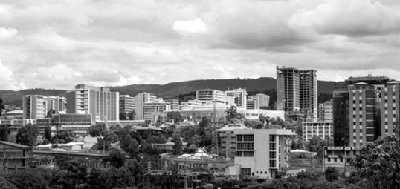
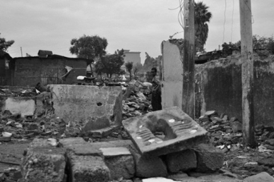

Slide 16
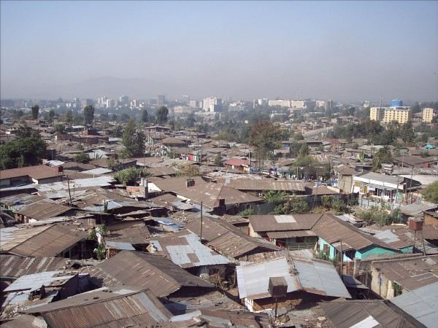
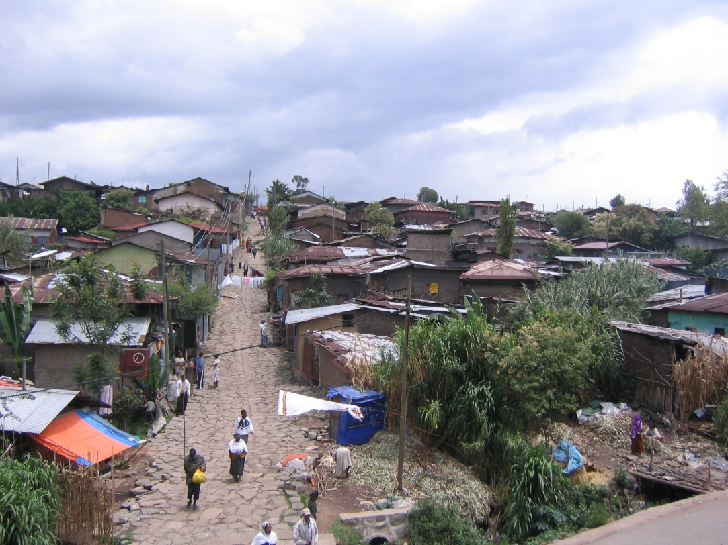
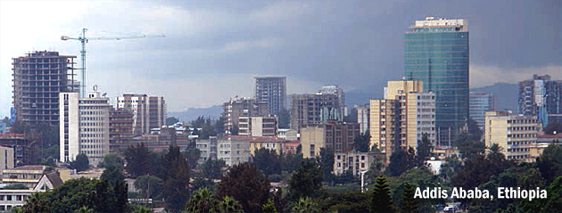

Slide 17
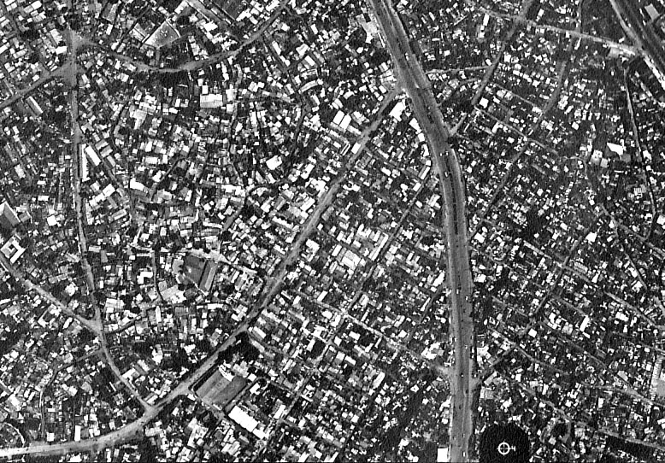

Slide 18
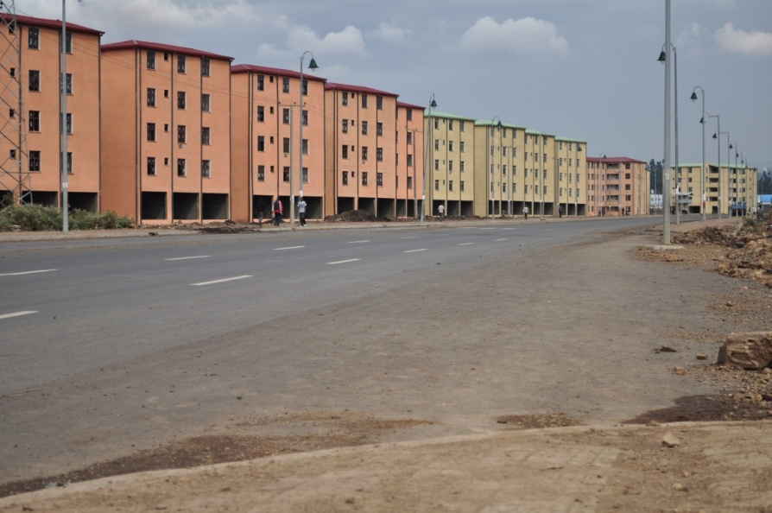

Slide 19
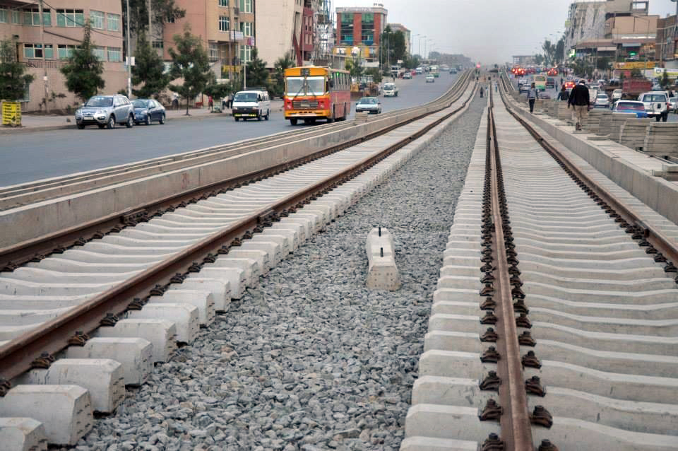
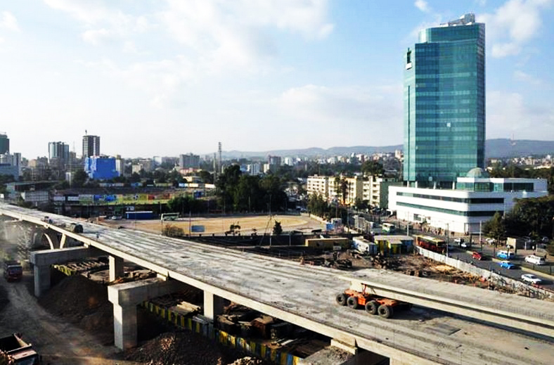

Slide 20
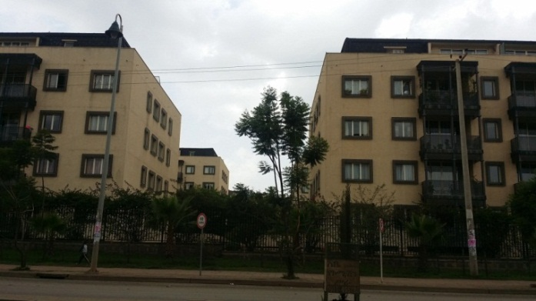
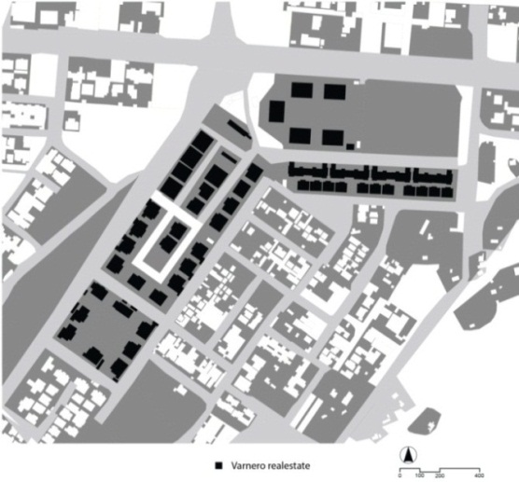

Slide 21
Crises facing Neighbourhood of communities
The emergence of a divided city
Influx of people migrating for economic necessity
Searching for factory work, Industrial zones
Political refugees
Globalization

Slide 22
 | Territorial forces | Functional forces
Location | ‘Space of place’ (geographically bounded) | ‘Space of flow’
Actors | Community with shared values | Anonymous individuals and trans-national/regional corporations
Resources | Relatively fixed: ecology | Mobile: technology, fast communication and management
Goal | Positive change | Economic growth

Slide 23
Neighborhood of communities (territoriality)
Unity in Harmony
Disintegrated/Divided Neighborhoods (Functionalism)
Disunity
4) Networked Open and Inclusive Neighborhoods
Unity in diversity

Slide 24
Networked, Open and Onclusive neighbourhoods
Neighbourhood without obstacles but with access to its opportunities to all its inhabitants (Spatial and non Spatial)
obstacles (cost, health ,danger, accessibility, congestion, discrimination and exclusion)
opportunities (Services, goods, proximity, freedom, social encounter, collaboration and solidarity)
Diversity and plurality (Learning to live with differences)
Equality and partnership of women and men
Participation of all peoples in generating and applying knowledge
Respect for both rights and responsibilities
To become more human and alive
A city of networked Open and inclusive Neighbourhoods
(Open and inclusive city)

Slide 25
Contemporary urban neighbourhoods are not necessarily social units of community, but are physical units with strong cognitive values

Slide 26
Learning from “informal” settlements
Balancing Silence/open spaces and Objects/buildings

Slide 27
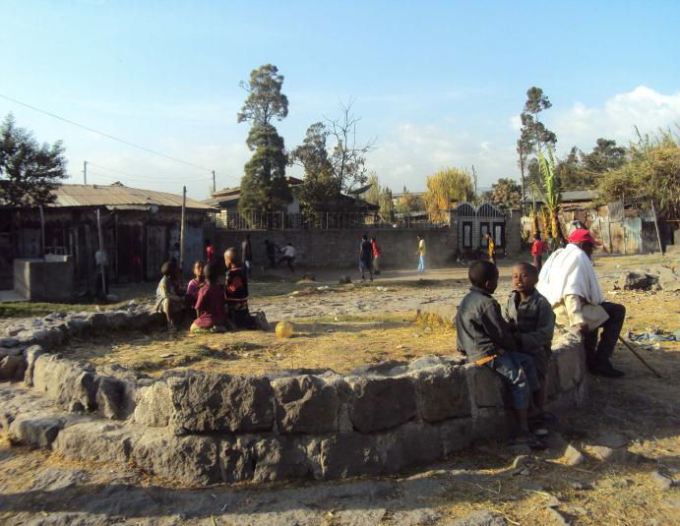
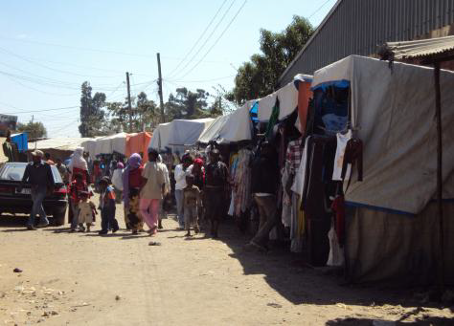
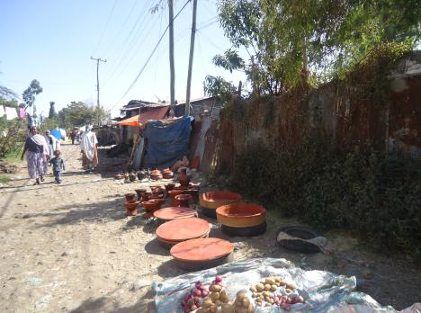
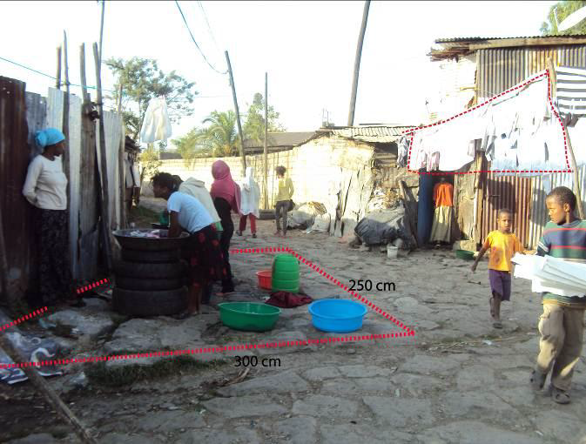

Slide 28
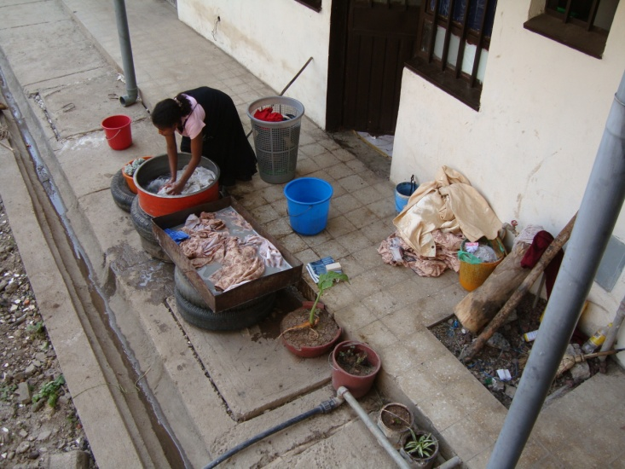
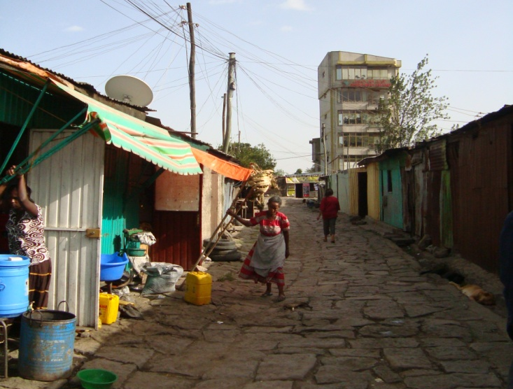
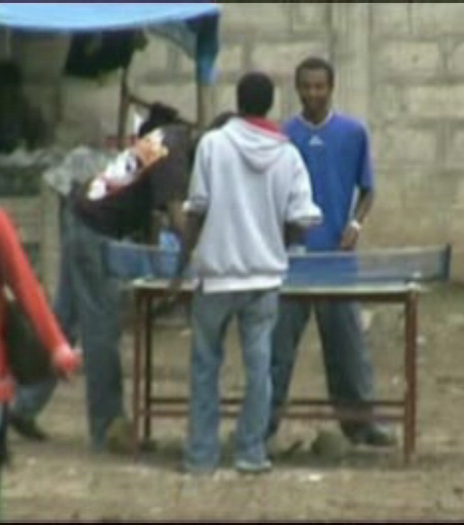
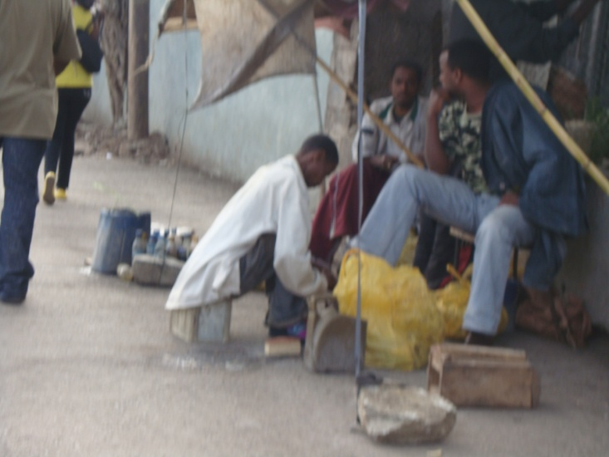
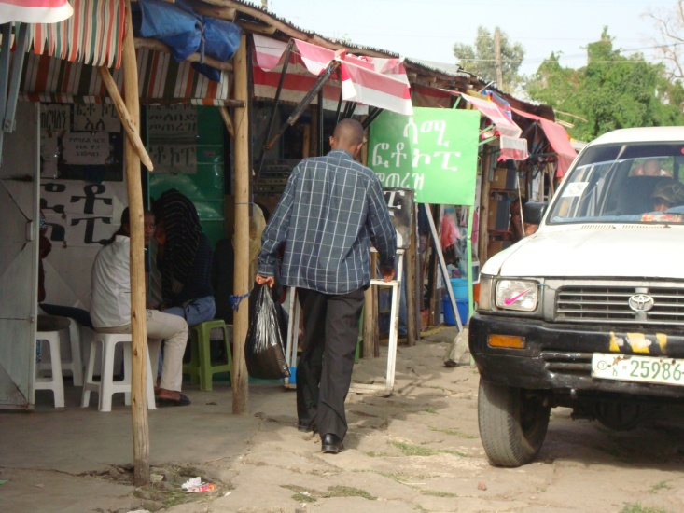
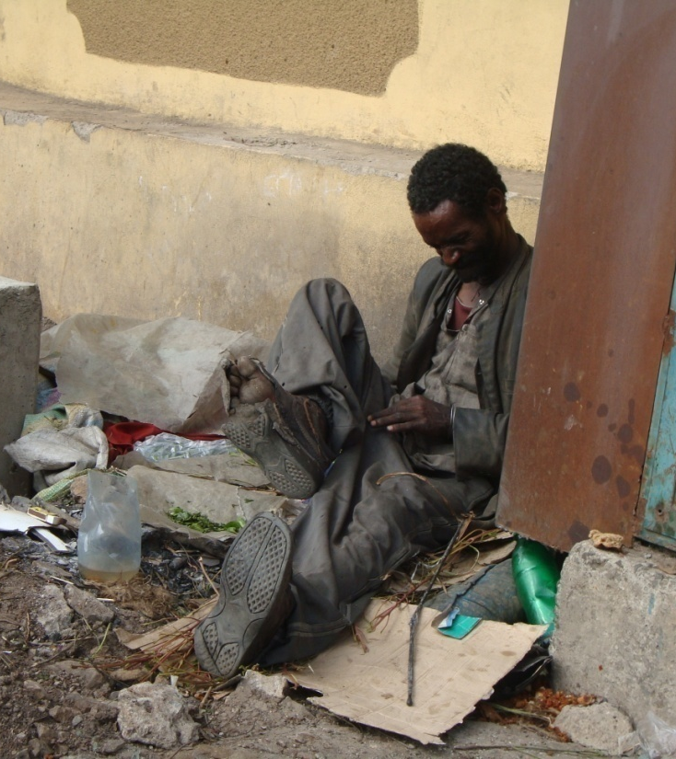
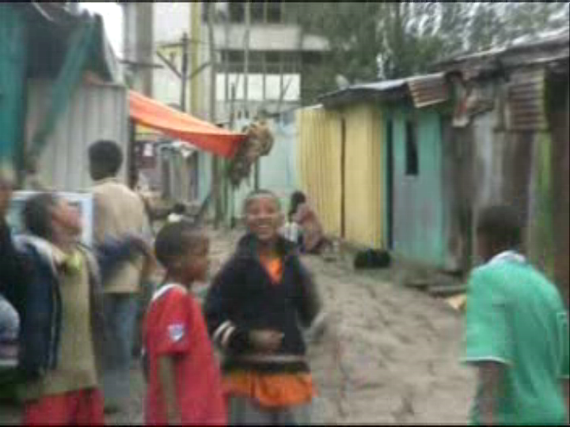
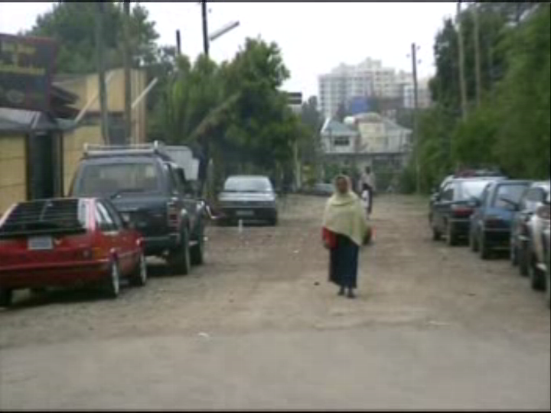

Slide 29
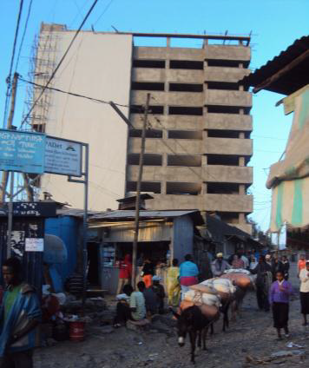
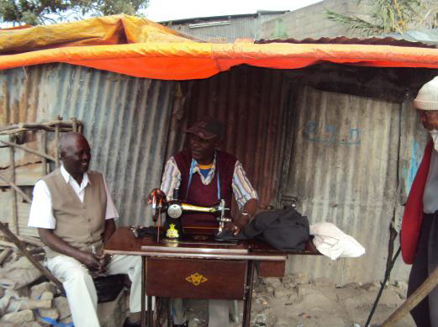

Slide 30
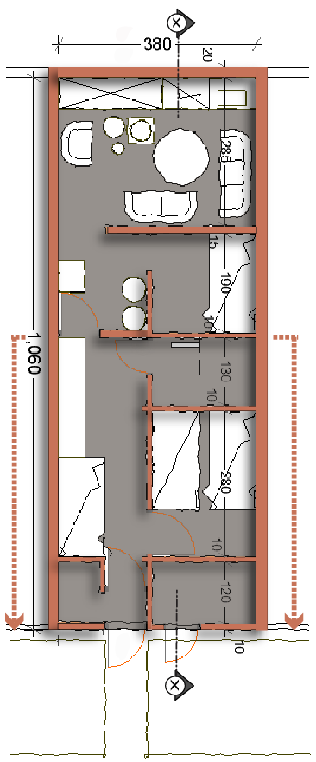
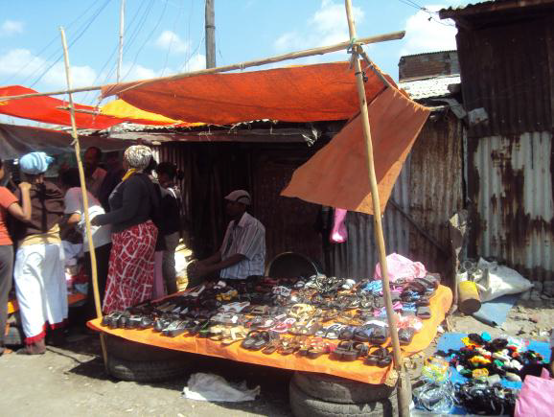
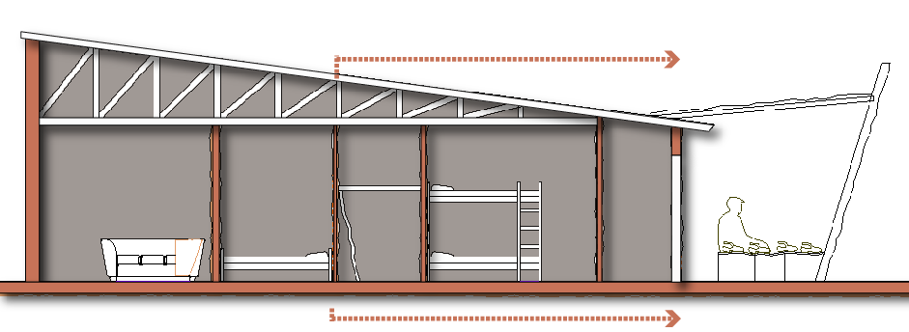
1. Living and cooking space
2. Space for preparing beverages
3. Storage space with KOTE
4. Space for selling local beverage and rental bunk bed
5. Rental bunk bed room
6. Goat keeping space
7. Rental storage for the street marketers
8. Cloth and shoe display of street market

Slide 31
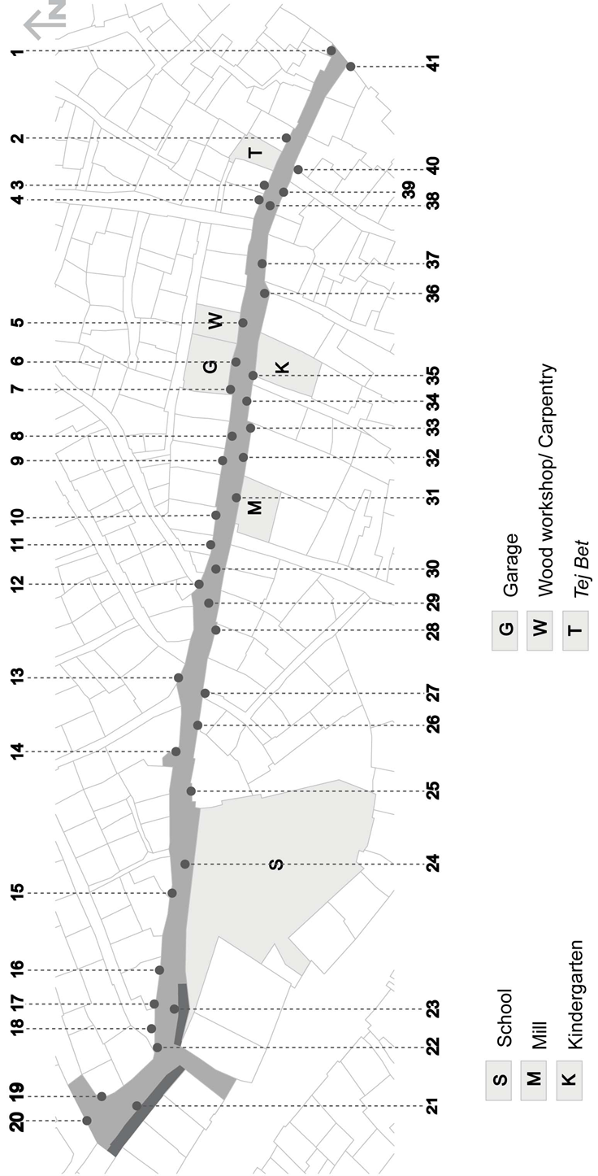
Places of activities | Activity 1 | Activity 2 | Activity 3 | Activity 4
1 | Coffee and tea business | Meeting place | Sitting place
2 | Gulit
3 | Coffee and tea business | Meeting place | Sitting place
4 | Sitting place | Meeting place
5 | Carpentry activities
6 | Garage activities
7 | Gulit | Meeting place | Cooking/food prep
8 | Little children playing
9 | Blow-drying
10 | Sitting place | Meeting place | Cooking/food prep
11 | Garbage collection
12 | Sitting place | Meeting place
13 | Sitting place | Meeting place
14 | Sitting place | Meeting place | Cooking/food prep
15 | Gulit
16 | Cooking/ food prep
17 | Garbage collection
18 | Cloth washing drying
19 | Cloth drying robes
20 | Cloth drying robes
21 | Arkebe shop extensions | Meeting places | Cooking/food prep | Sitting
22 | Sitting place | Meetingl place
23 | Arkebe shop extensions | Social places | Cooking/food prep
24 | Football play area | Meeting place
25 | Cloth washing drying | Cooking/food prep
26 | Cloth washing drying | Cooking/food prep
27 | Gulit
28 | Cooking/food prep | Blow drying
29 | Football play area | Meeting place
30 | Cloth drying robes
31 | Sitting place | Cooking/food prep | Meeting place
32 | Cooking/food prep
33 | Cloth washing/ drying
34 | Gulit | Meeting place | Cooking/food prep
35 | Gulit
36 | Garbage collection
37 | Sitting area | Meeting place
38 | Little children playing
39 | Charcoal selling
40 | Charcoal selling
41 | Gulit

Slide 32
Lessons from the ground
Spatial, Social and Economic aspects
Multilayered Street and Open spaces (voids)
Business
Household activities
Recreation
Social / cultural activities
Small block size
Horizontal density
Incremental, extensions, transformations, evolution

Slide 33
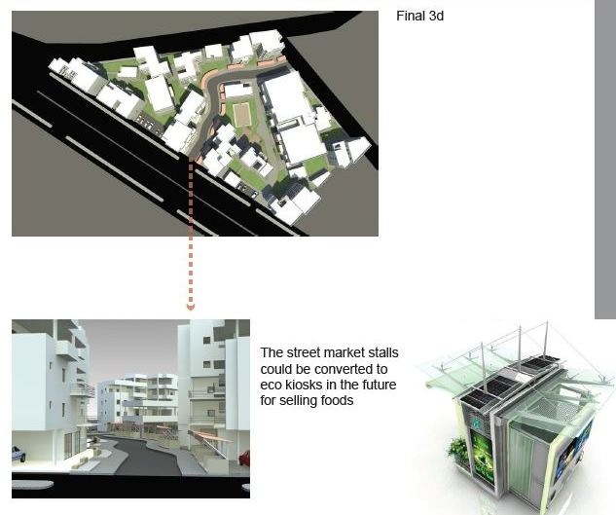

Slide 34

Original settlement
Temporary shelter
Condominium

Slide 35


Small sized blocks
Hierarchy of spaces
The ‘street’ & the ‘interface’

Slide 36
Low-rise density

Slide 37
Open Space/ Silence as a resource
Starting from the design of open spaces and not typology
Space should be seen as a resource and not a left-over or a byproduct risking appropriation and misuse

Slide 38



Slide 39



Slide 40



Slide 41



Slide 42


Slide 43


Slide 44


Slide 45


Slide 46
Proposals and projects
from
Parcel – Block - Void
To
Void – Block – Parcel
(Topology – morphology – typology)

Slide 47



Proposals
Open Space, Green Scheme and Parking
Green Corridor
As can be seen in these pictures, the height of building is
not highly dominating for pedestrians to enjoy the open
space
It has also a space for a central sculpture may be in
remembrance of an historical event like the Bashe Wolde
person and/or phenomenon
As one goes from the Silassie Church Building into the
site, at the right hand side there is pedestrian only green
open space; at the left hand side though, at there is a
parking spot with both outdoor and underground scheme
Fig. Aerial View into the Plaza
Fig. Sectional Drawing Through the Plaza
Fig. Top View into the Plaza and enclosing Buildings

Slide 48

Perimeter block
Set back
Height
Openings

Slide 49

“A house is a machine for living”
The void (street/
open space) is a machine for living!

Slide 50

“The traditionalists tried to laugh the picture off. They said Malevich had gone mad, he must’ve painted the black square in the dark! His response was straightforward: ‘I am glad I am not like you. I can go further and further into the wilderness because it’s only there that transformation will take place. My black square is a bare and frameless icon for our times. Arise, comrades, and free yourselves from the tyranny of objects!’”
Andrew Graham-Dixon quoting Kazimir Malevich in the BBC documentary, the Art of Russia, episode 2

Slide 51
Physical, Social and Economic Spaces
Business
Household activities
Recreation
Social / cultural activities

Slide 52
Neighborhood of communities (‘Us’ and ‘Them’)
Enclaves of isolated neighborhoods
Unity in Harmony
Disintegrated/Divided Neighborhoods (‘I’ and ‘Him/Her’)
Disunity
Networked Open and Inclusive Neighborhoods (‘I’ & ‘Us’)
Many connected neighborhoods that allow pluralism and diverity
Unity in diversity

