Slide 2
ERASMUS+
Erasmus+ is the EU Programme in the fields of education, training, youth and sport for the period 2014-2020
Capacity-building in the field of higher education based on multilateral partnerships, between higher education institutions from Programme and eligible Partner Countries

Slide 3
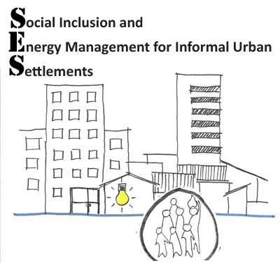
Social Inclusion and Energy Management for Informal Urban Settlements (SES)
Project Nr.: 573046-EPP-1_2015-1-AT-EPPKA2-CBHE-JP
Program:
ERASMUS plus/ Capacity Building in Higher Education (CBHE)
Funding Institution:
EACEA (Education, Audiovisual and Culture Executive Agency of the European Commission)
Duration:
October 2016 – October 2019

Slide 4
ITC Twente,
Netherlands
University Kassel, Germany
Danube University Krems (DUK)
Universität für Weiterbildung, Austria

Slide 5
Mekelle

Slide 6
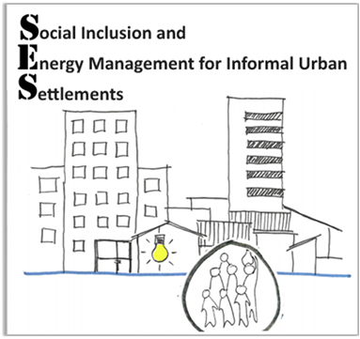
PROJECT PARTNERS
• Ethiopian Institute of Architecture,
Building Construction and
City Development (EiABC),
Addis Ababa, Ethiopia
• University of Gondar, Gondar, Ethiopia
• University of Mekelle, Mekelle, Ethiopia
• Danube University Krems, Austria (coordinator)
• Faculty of Geo-Information Science and Earth Observation (ITC), Enschede, The Netherlands
• Universität Kassel, Kassel, Germany

Slide 7
Project Management Group
at DUK (Danube University Krems)
Faculty of Business and Globalisation
(Univ.-Prof. Mag. Dr. Gerald Steiner)
Andrea Höltl
Dep. Migration & Globalization
(Prof. Gudrun Biffl/Univ.-Prof. Dr. Mathias Czaika)
Project Coordinator: Tania Berger
Dep. Management & Economics
(Univ.-Prof. Dr. Barbara Brenner)
Helena Sieberth
Romana Bates
Project Steering Comitee
Javier Martinez ITC Twente, NL
Peter Gotsch University Kassel, D
Atsede Tegegne University of Gondar
Dawit Benti EiABC, Addis Ababa
Daniel Semunugus University of Mekelle

Slide 8
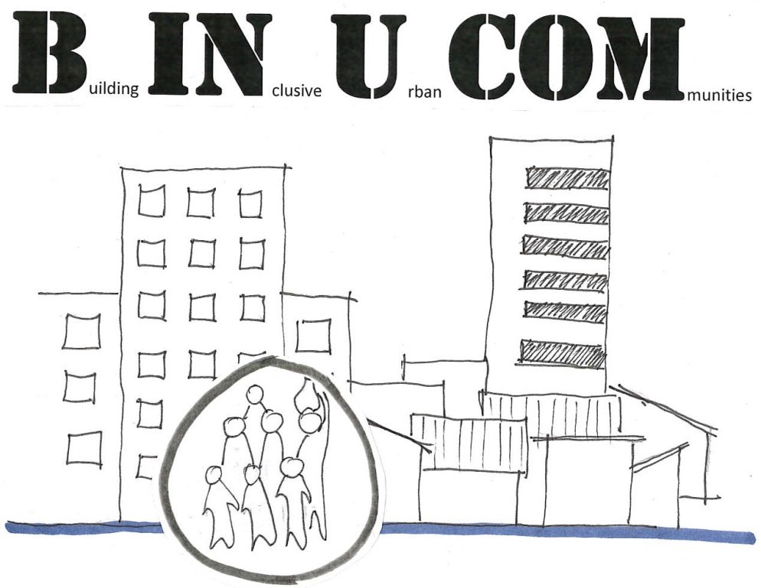
Please don‘t get confused!
India
Ethiopia

Slide 9
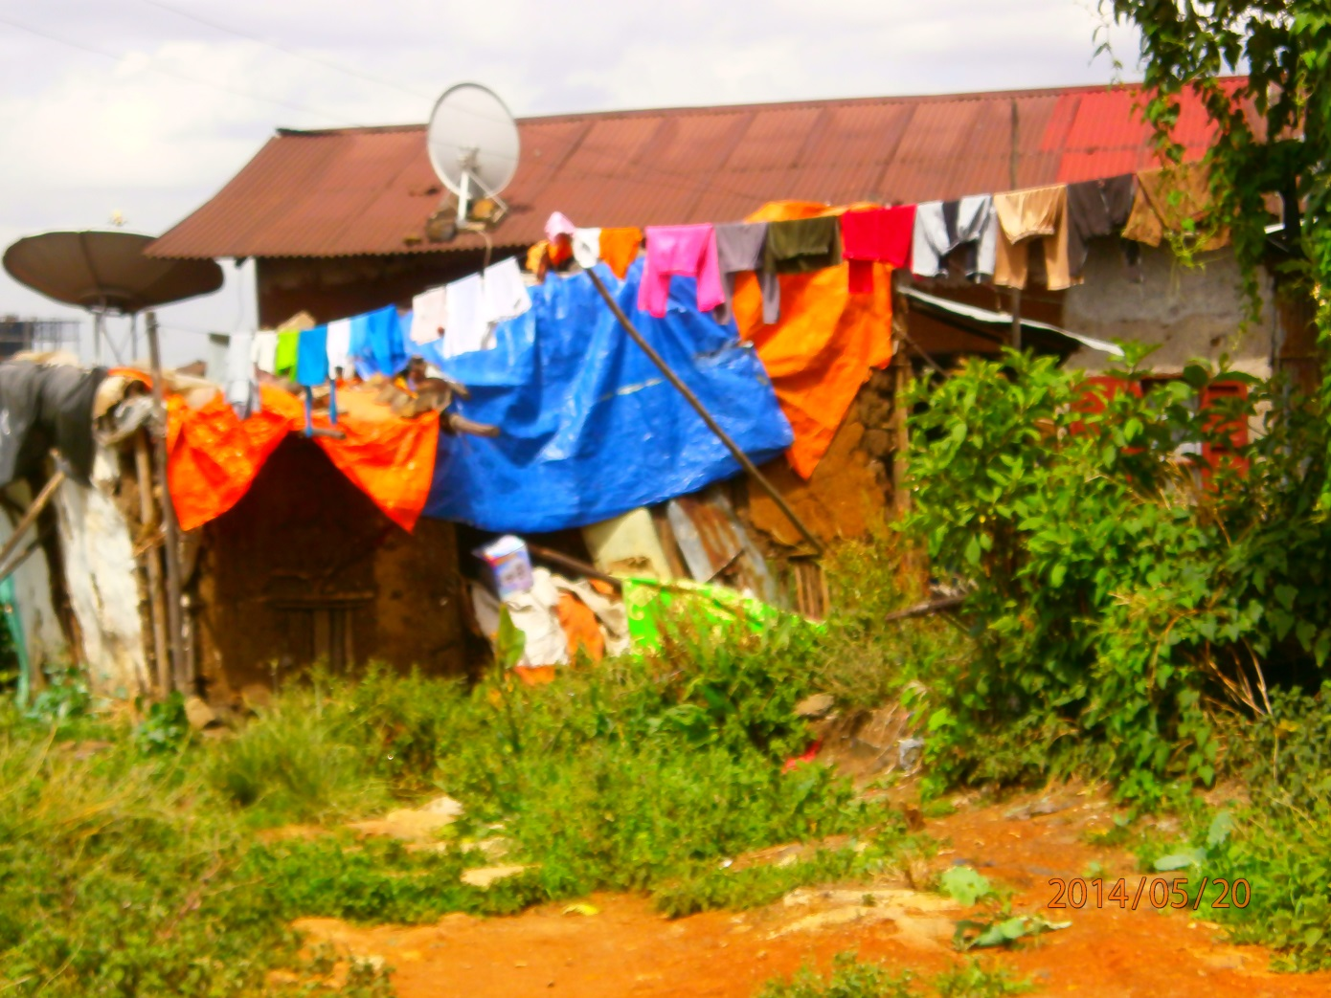
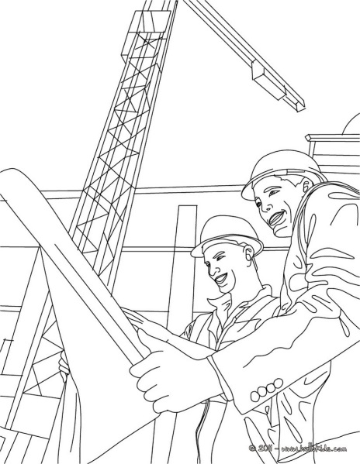
Improve higher education for architects, urban planners & related professionals to enable them to deal with the complex challenges of sustainable social housing for the urban poor

Slide 10
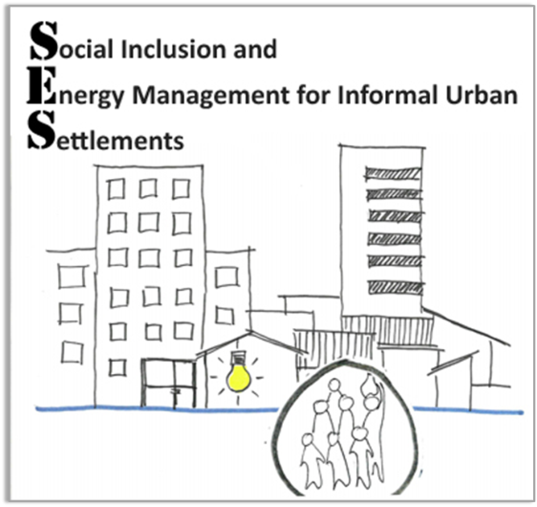
Expected outcomes
Open Educational Resources
3 regional profiles
12 case studies
12 course descriptions
(following MIT’s OpenCourseWare model)
Increased relevance of architecture and planning studies
by introducing multidisciplinary topics like
social inclusion
sustainable energy management
participatory mapping
sustainable urban development
External trainings for professionals
3 local dissemination workshops
2 national conferences

Slide 11
3 Regional Profiles
New Curricula Elements & Modules
4 Thematic Trainings
Up to 14 Case Studies
2 National Conferences &
3 Regional Dissemination Workshops
Stakeholder Trainings

Slide 12
Sustainable Energy Management
Sustainable Urban Development
Social Inclusion
Participatory Mapping

Slide 13
Genesis and pattern of peripheral informal settlements in Addis Ababa
Livelihood situation and housing affordability in informal settlements of Addis Ababa towards a more inclusive settlement
Social Inclusion
Social capital across different neighborhood settlements in Gondar and in Addis Ababa: Comparative Study
Situation of informality in Mekelle
Social inclusion and participatory planning and design in Mekelle City

Slide 14
Potentials of affordable alternative power supply in informal settlements
Sustainable Energy Management
Energy management in informal urban settlements, strategy and design
Energy management in case of multistory residential buildings (condominiums)

Slide 15
Informality and socio-spatial sustainability in residential areas of Addis Ababa
Participatory Mapping
Quality of life in urban informal settlements
Overall mapping of the Mekelle city’s housing characters

Slide 16
The new face of Addis Ababa: Towards narrowing the gap between the persistence of informality and emerging prosperity
Sustainable Urban Development
Drivers of informal settlement formation
Housing Typologies in Mekelle City

Slide 17
partner | Nr. | Titel
EiABC
 | 1 | Genesis and pattern of peripheral informal settlements in Addis Ababa
 | 2 | Livelihood Situation and Housing affordability in informal settlements of Addis Ababa towards a more inclusive settlement
 | 3 | Potentials of affordable alternative power supply in Informal Settlements
 | 4 | Informality and socio-spatial sustainability in residential areas of Addis Ababa
 | 5 | The new face of Addis Ababa: Towards narrowing the gap between the persistence of informality and emerging prosperity
UoG | 1 | Social Capital Across Different Neighborhood Settlements in Gondar and in Addis Ababa: Comparative Study
 | 2 | Energy management in informal urban settlements, strategy and design
 | 3 | Quality of life in urban informal settlement
 | 4 | Drivers of informal settlement formation
UoM | 1 | Situation of Informality in Mekelle
 | 2 | Social inclusion and participatory planning and design in Mekelle City
 | 3 | Energy management in case of multistory residential buildings (condominiums)
 | 4 | Overall mapping of the Mekelle city’s housing character
 | 5 | Housing Typologies in Mekelle City

Slide 18
