Slide 1


Why study informality: changing meanings and expanding scopes
By Frew Mengistu (PhD)
Social Inclusion and & Energy Management for Informal Settlements
National Consultation Meeting
Gondar

Slide 2
Content
Part One: Informal settlements and sectors
Part Two: the urban transition in developing countries & informality
Part Three: Formal – Informal institutions
Part Four: Informality in the face of 21st urban challenges

Slide 3
Part One:
Informal Settlements and Sectors

Slide 4
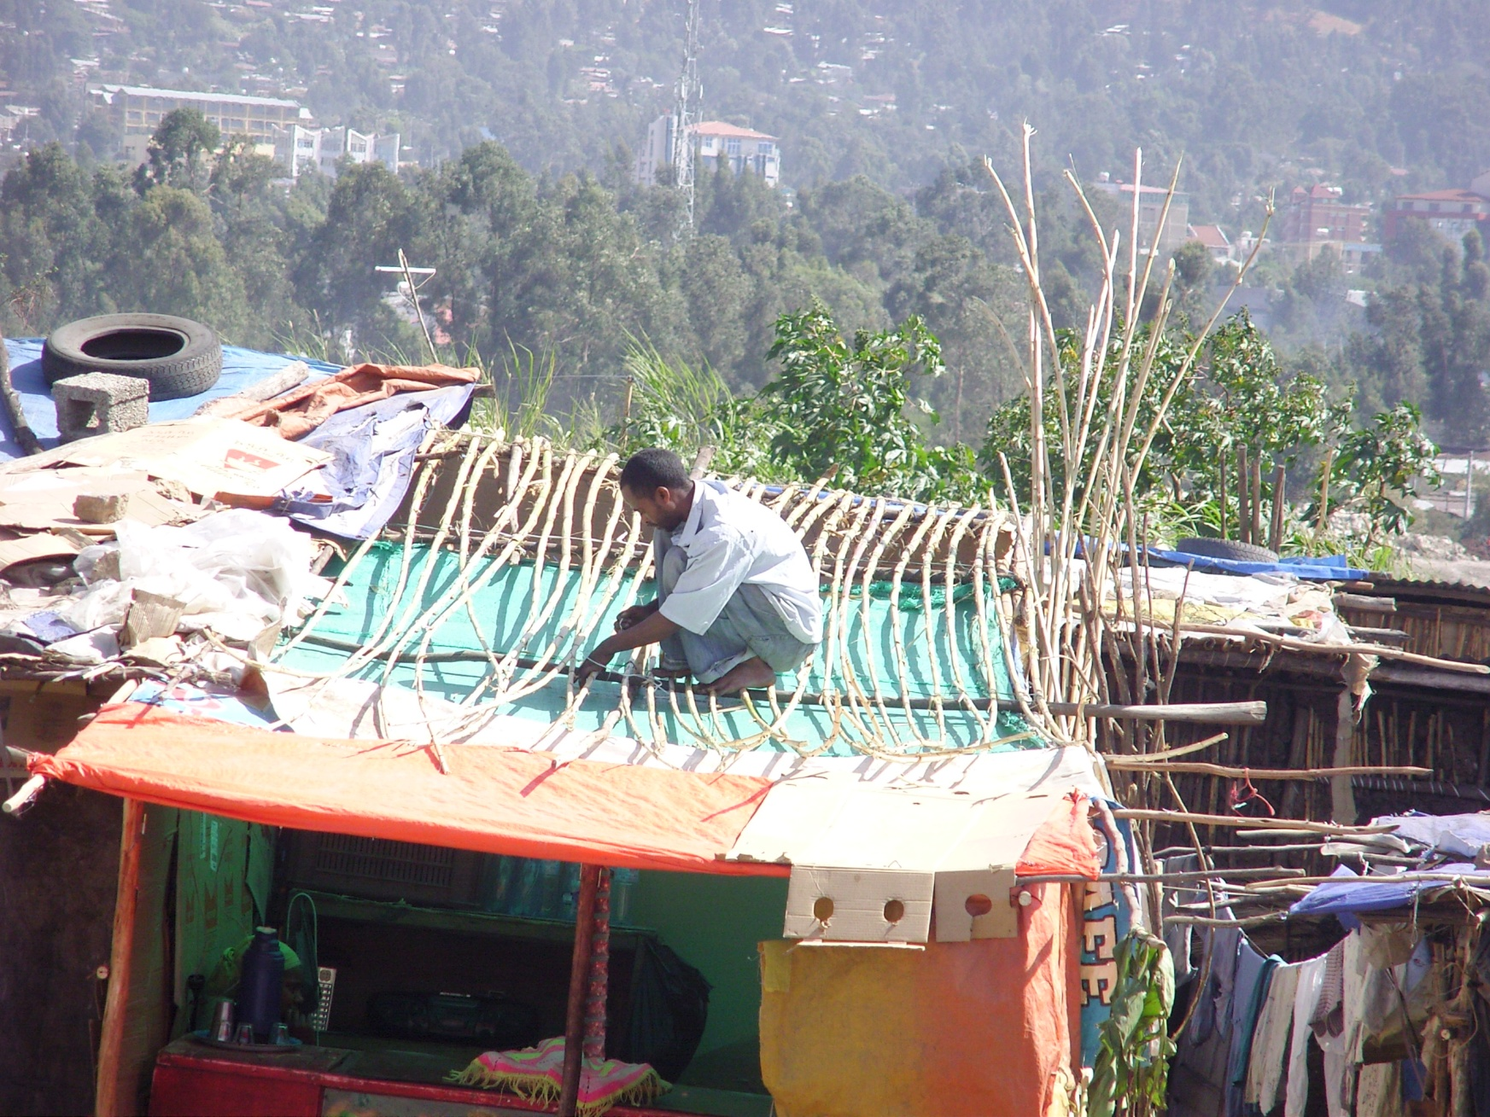
Formal – informality through pictures

Slide 5
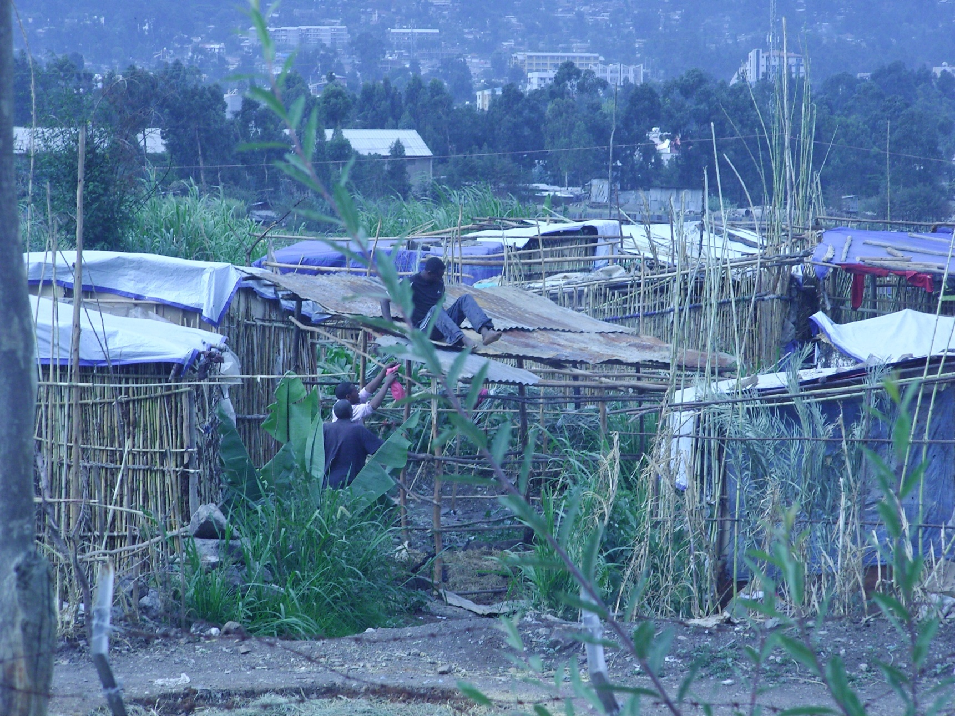
Formal – informality through pictures

Slide 6
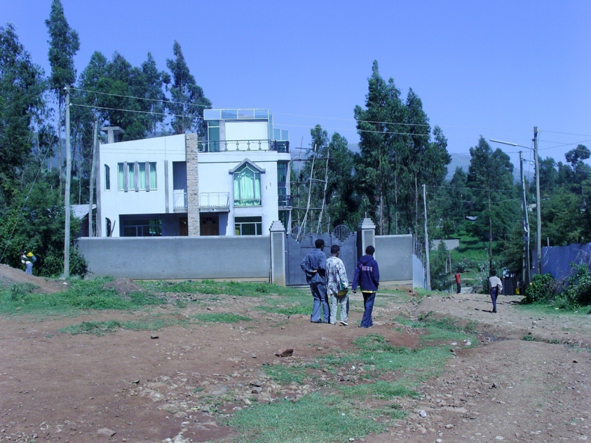
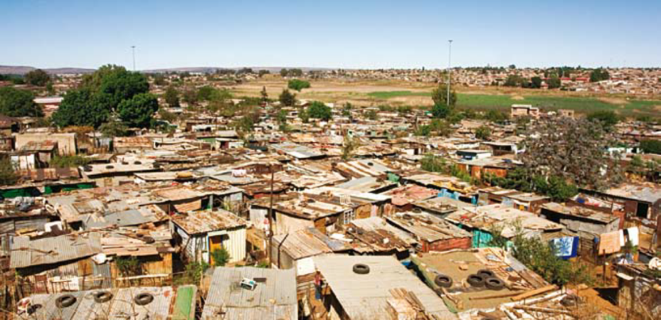
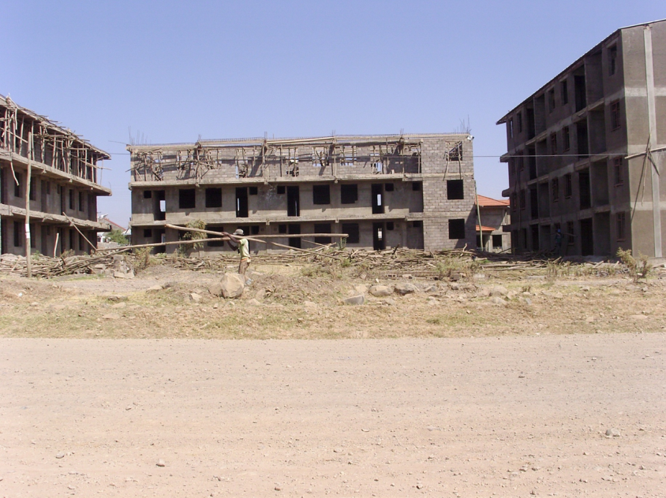
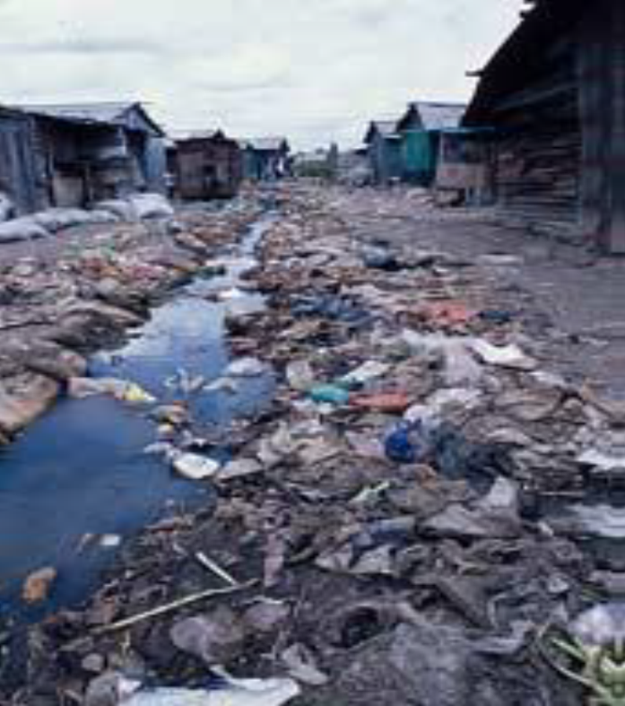
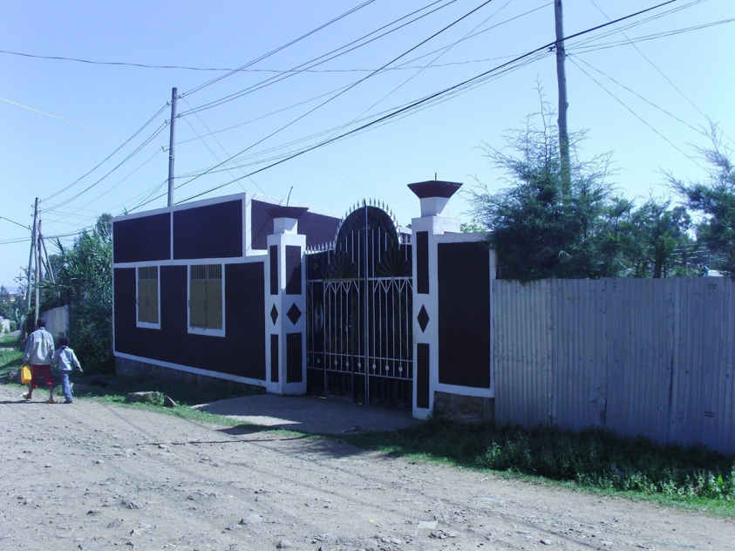

Informality - Reflections
Which of the following settlement is informal?
1
4
3
2
5

Slide 7
Favelas in Rio de Janeiro (Brazil)

Slide 8
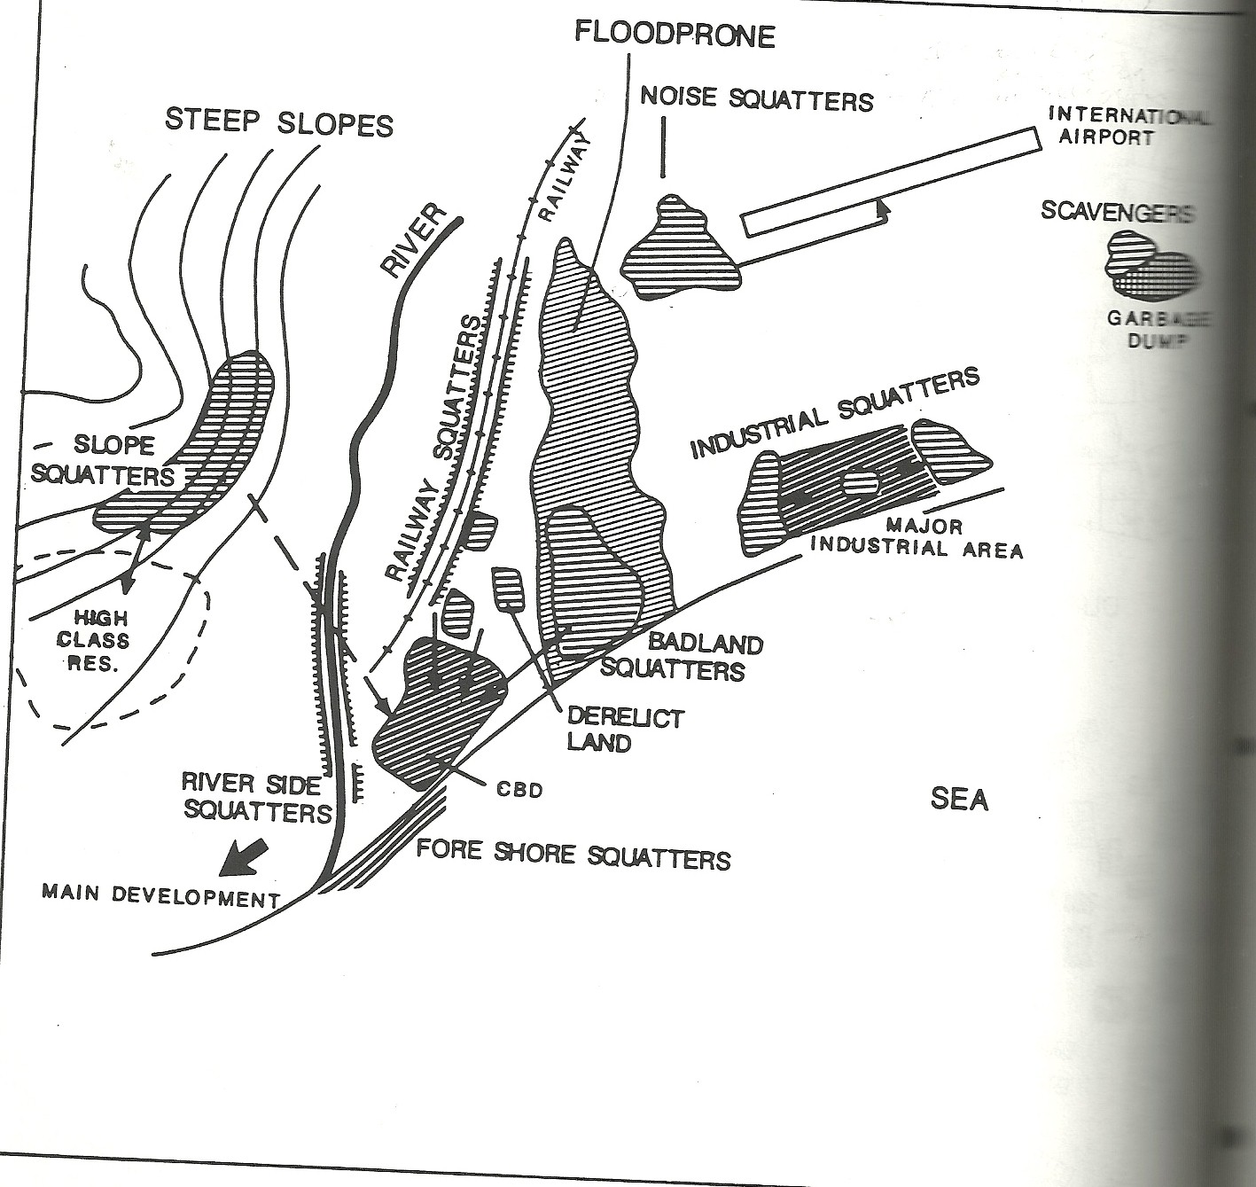
Location of Informal settlements
Location

Slide 9
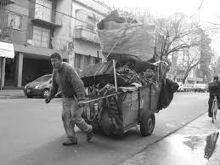
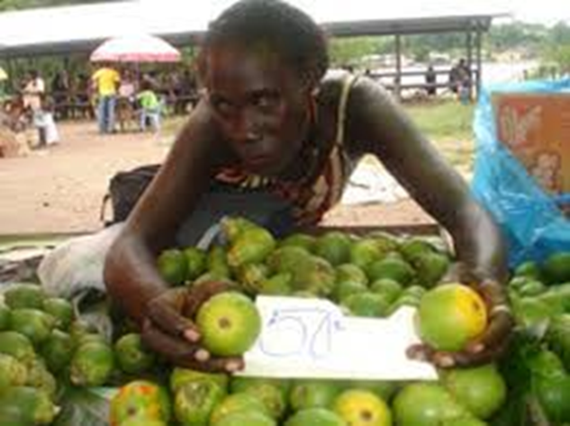
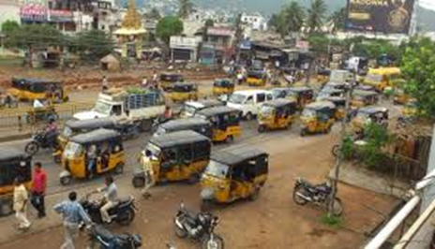
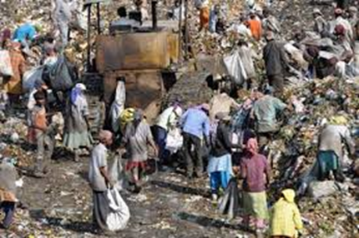
Informality: sectors

Slide 10
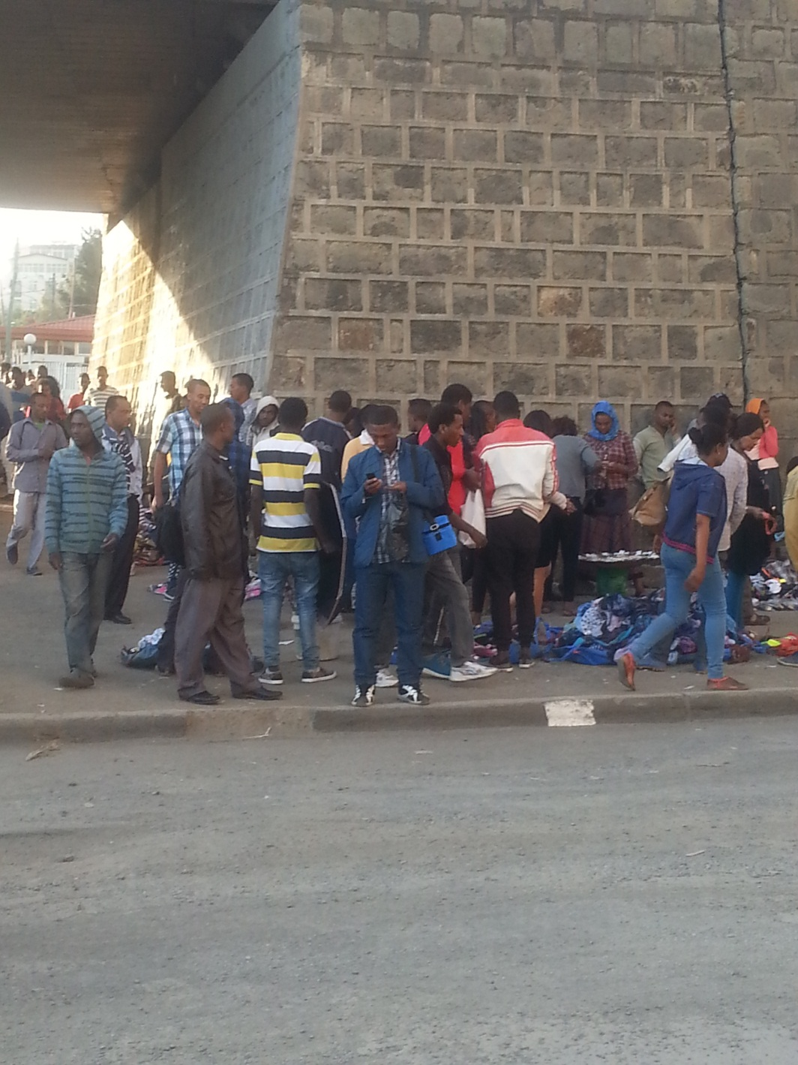
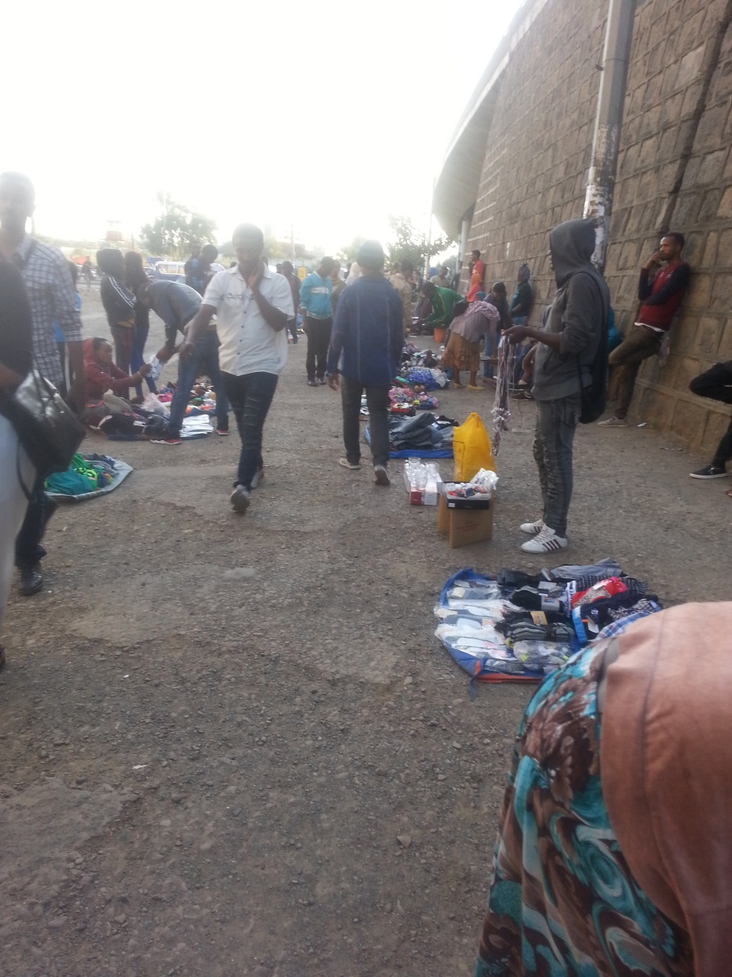
Street (side) vending
Street (side) vending

Slide 11
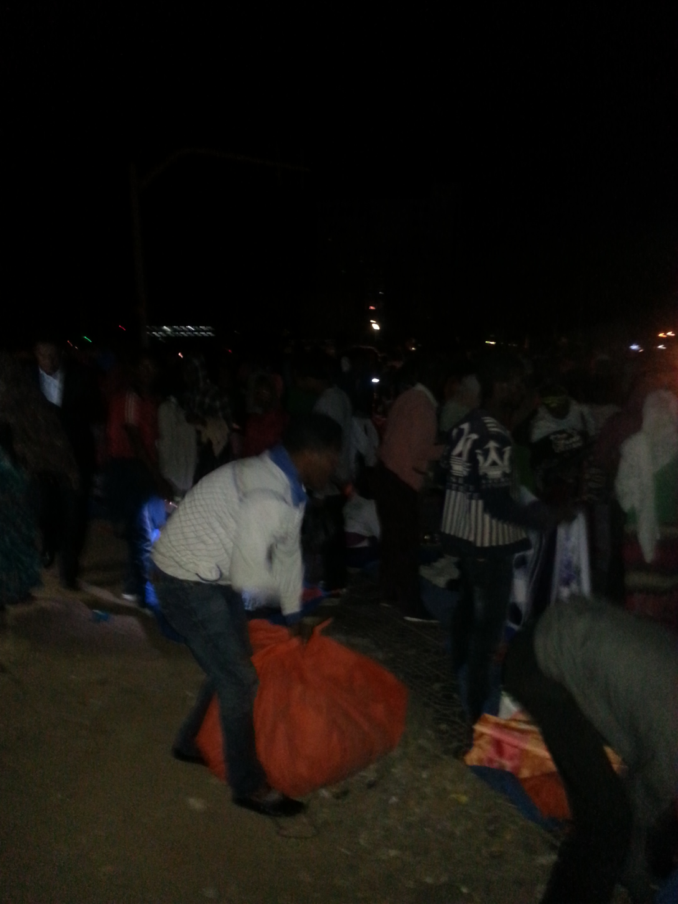
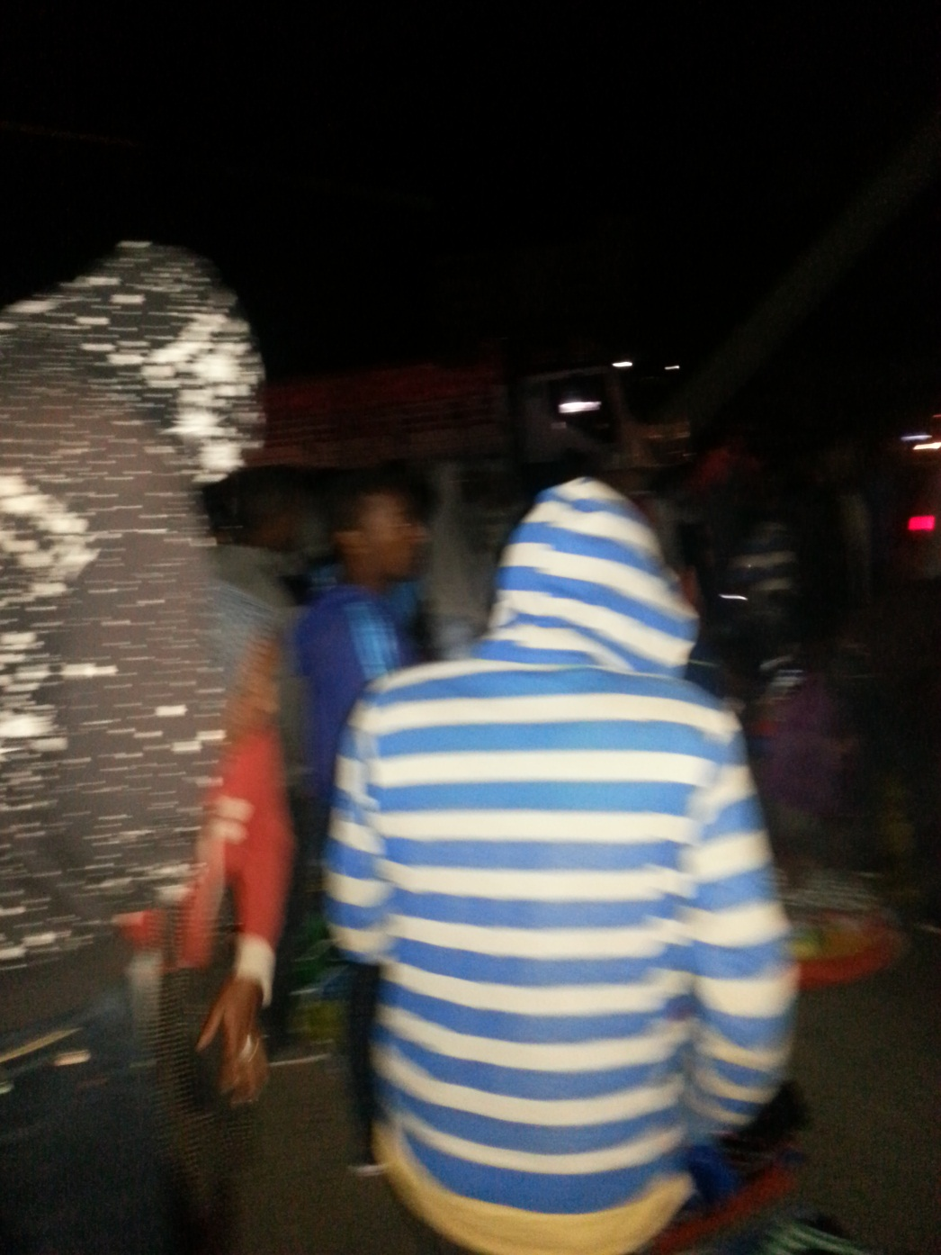
Megenagna street vending

Slide 12
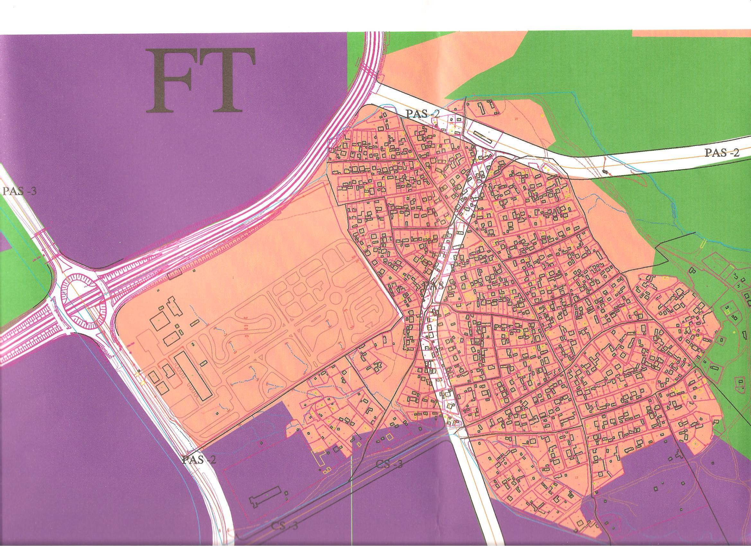
WORKU SEFER: a consolidated settlement
A
MA
Drivers Training
Centre
B

Slide 13

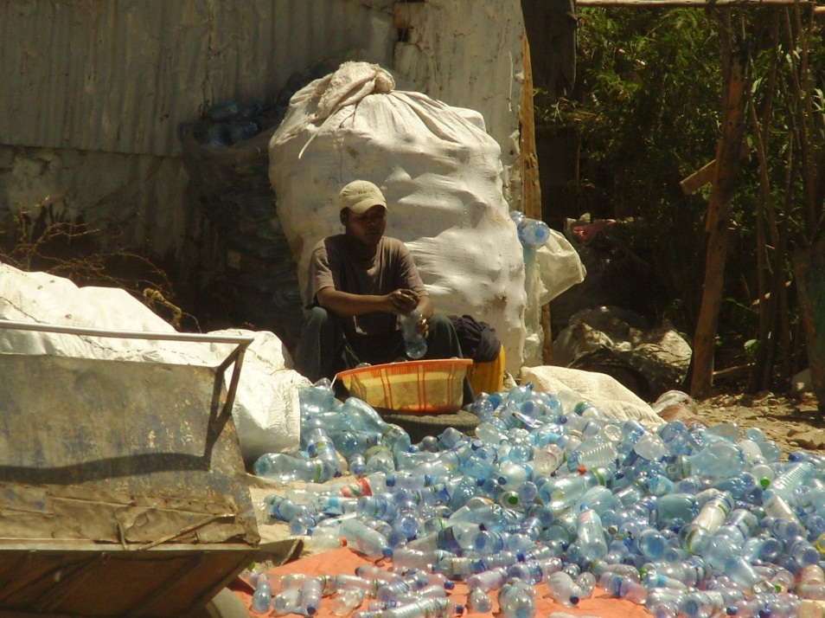
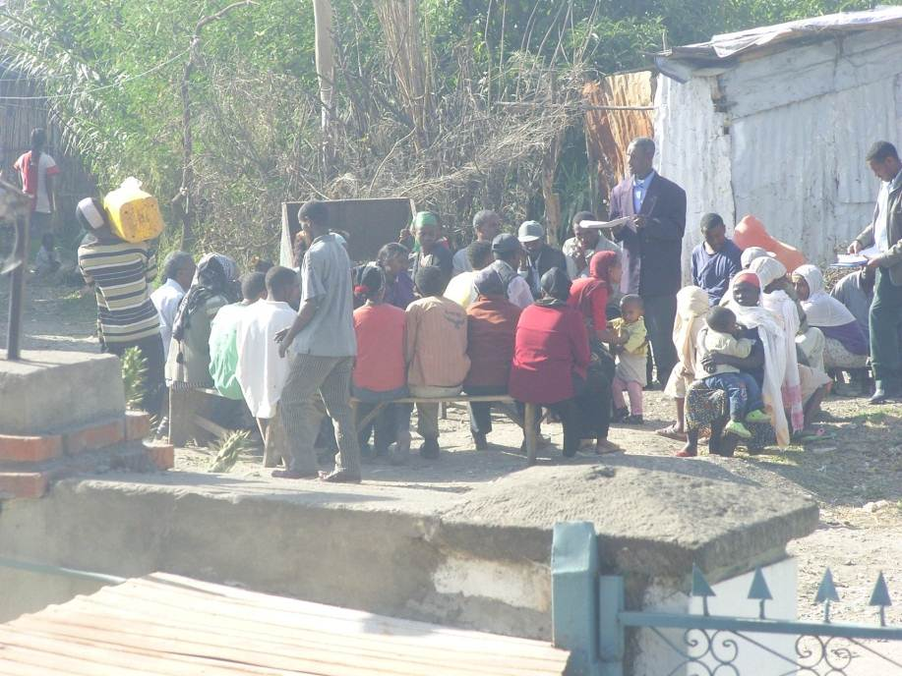
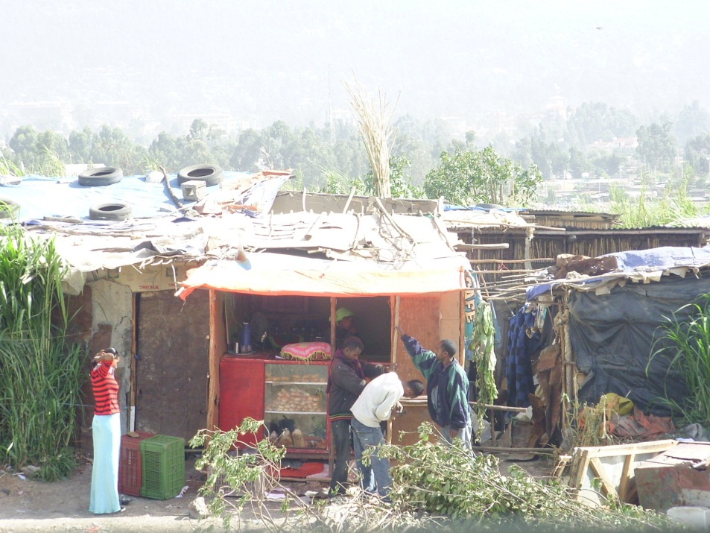
Informality: livelihood

Slide 14
COMPONENTS AND DIMENSIONS OF INFORMALITY
Components & Dimensions :
POLITICAL: Exclusion from policy & planning decision making, disconnected from urban or national political issues, unable to organize themselves to infuenece decision making,
powerlessness
SOCIAL/CULTURAL
TENURE INSECURITY & THREAT OF
EVICTION
LACK OF ACCESS TO HEALTH & EDU.
FAMILY BREAKDOWN, ORPHAN
CRIME AND SENSE OF INSECURITY
LOST CULTURAL IDENTITY AND SELF ESTEEM
ECONOMIC FINANCIAL
THREAT of UNEMPLOYMENT
NON-PRODUCTIVE JOBS
LACK OF CREDIT WORTHINESS
PERIPHERAL ECONOMIC ACTIVITIES
INFORMALITY
ENVIRONMENTAL/PHYSICAL
LACK OF INFRASTRUCTURE AND
SERVICES, POOR DRIANAGE
.SLUMIZATION, LACK of SANITATION
SUBSTANDARD SHELTER
HIGH EXPOSURE TO POLLUTANTS
LOCATION ON HIGH RISK AREAS

Slide 15
Origin of the concept of informality
Oscar Lewis: studied the urban poor in Pureto Rico and Mexico in the late 1950s and early 60s; advanced a theory of the “ culture of poverty” much in common with Chicago School views
Hart Keith (a German Anthropologist) (1973) Informal Income Opportunities and Urban Employment in Ghana’, used the term “ informal sector” for the first time and made the distinction between formal and informal sectors
Report of Employment Mission in Kenya under the World Employment Programme of the International Labour Organization – ILO 1972

Slide 16
Understanding Informality
Informality
Non conforming to regulations, registration requirements and tax obligations
Non-conformist but legitimate (not totally legal but are socially acceptable or perceived right)
Informal properties are properties acquired without formal titling and/or built without an official building permit and planning consent (Hansen and Mariken 2004:9).

Slide 17
Understanding informality
Informal:
Existence of conditions and processes which are not recognized, sanctioned or controlled by any official criteria and/or mechanisms
Informal economy:
Income-earning activities unregulated by the institutions of society in a legal and social environment in which similar activities are regulated (Castells and Portes 1989)

Slide 18
Informality: categorization
licit : not totally legal, but socially acceptable
Illicit: ‘illegal’ or disapproved by society
FORMAL
C
D
A
B
CRIMINAL
F
E
INFORMAL
Process of production & distribution | Final product | Economy type
+ | + | Formal
- | + | Informal
+ or - | - | Criminal
NB . + Licit, - Illicit

Slide 19
Understanding informality
Extra legal = outside of the law, beyond the scope of the law or the states regulatory framework (Royston, 2006; de Soto 1989)
The unregulated production of otherwise licit (allowed or legal, socially perceived right) goods and services (Castells and Portes 1989)
Informality is not unregulated rather a deregulated system (Roy Ananya ,2009):
Deregulation that involves purposive action and planning
As a mode of regulation (self-regulation by actors themselves replacing regulation by the state )

Slide 20
Understanding Informality
Illegality = activities prohibited by law, subversion (weaken an established system) of the law
Criminality = violating laws which safeguard moral principles through fraud (cheating), theft or exploitation of others.
Criminality: Specialize in the production of goods and services socially defined illicit (illegal or disapproved by society)
Illicit = ‘illegal’ or disapproved by society (licit = allowed or socially perceived right)

Slide 21
Informality : categorization
Voluntary informalisation
Many middle income families construct expensive houses on illegal and unserviced land to reduce costs and circumvent bureaucracy and corruption.
Voluntarily involving in illegal action by individuals from middle and upper income groups to reduce cost and circumvent bureaucracy (van Dijk and Fransen, 2008).
Exclusionary informalization
The majority who due to the alienating requirements of the statutory land tenure and building laws, are constrained to operate informally.
When it is difficult to access land through legal channels either due to bureaucracy, corruption and related market failures (i.e. exclusionary processes); people are left with only informal means.

Slide 22
Informal settlements: Local terms
Local terms:
LOCAL TERM | COUNTRY
Aashwa’i | Egypt
Bidonvilles | Former french colonies
Colonias | Texas, Arizona, New Mexico & California (USA)
Favelas | Brazil
Gecekondu | Turkey
Kampungs | Indonesia, Malaysia
Katchi abadis | Pakistan
Ye Cherka Betoch | Ethiopia

Slide 23
Lessons from informality
Formal-informal development processes
1
Planning
4
2
Formal Devt. Process
Occupation
Informal Devt.
Process
Servicing
3
Building

Slide 24
Cocktail of Approaches to manage informal settlements
Land Policy
Land sharing
Land readjustment
Guided land Devt
Land swapping Eminent domain
Perceived tenure
Customary
Occupancy
Anti-eviction
Adverse possession
Group tenure
Lease
Tenure type
Land assembling
Tools
Upgrading
Partial renewal & upgrading
Regeneration
Revitalization
Rejuvenation
Site and services
+core housing
Upgradable service provision
Incremental & Upgradable
standards
Planning
Intervention
instruments
INFORMALITY
Inclusive planning
Advocacy planning
Communicative Plan.
Incremental Plan.
Appreciative plan.
Collaborative Plan.
Policy responses
Regularization
Formalization
Legalization
Incorporation
Experimenting Planning strands

Slide 25
Regularization vs Incorporation
Regularization | Incorporation
Requires compliance with regulations | Combining informality as an existing and valuable phenomena as long as basic public safety maintained
Requires to adhere to standards of building permit | Relies on gradual improvement and meeting upgradable standards
Often relies on titling (the most costly and complex type of tenure to institute, requires a formal plot survey and check all rival claims) | Linked to different types of tenure security e.g. anti -eviction, adverse possession rather than solely relying on tilting
May result to gentrification forcing dwellers to sell and move to other informal settlements (Gonzalez 2009) | Group tenure as guarantee

Slide 26
Part Two:
The Urban Transformation in Developing Countries & Informality

Slide 27
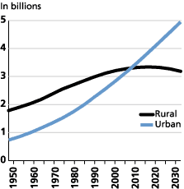
Urban & Rural Population 1950-2030
2008
Source: UN, World Urbanization Prospects: The 2003 Revision (2004).

Slide 28
Urban curve /logistic curve
100
Urban population as percentage of total population
Urbanization in developed countries speeded after 1850
Terminal stage
80
Acceleration stage
60
40
Initial stage
20
0
2000
1800
1900
Time
Northam Ray (1979) Urban Geography, John Wiley publications , New York

Slide 29
Levels of Urbanization International Comparison
Table 1: Levels of Urbanization and Metropolitan Growth Rates, National Averages by Region and Years
 | Urbanization Level1 | Urban Population2 In million | Number of large cities3 Over 1.5 million people | Growth Rate4
Regions\Year | 1950 1970 1990 2010 | 1950 1970 1990 2010 | 1950 1970 1990 2010 | 1950 - 2010
World Africa Asia Europe Latin America North America Oceania | 28.8 36.1 42.6 50.5 14.4 23.6 32.1 40.0 16.3 22.7 31.5 42.2 51.3 62.8 69.8 72.8 41.4 57.1 70.3 79.6 63.9 73.8 75.4 82.1 62.0 70.8 70.7 70.2 | 729 1,330 2,255 3,486 33 87 205 413 229 483 1,003 1,757 281 412 503 533 69 163 311 469 110 171 213 289 8 14 19 25 | 41 91 160 277 1 3 15 34 11 35 69 139 17 21 23 24 3 11 26 42 8 19 25 34 1 2 2 4 | 2.61 4.23 3.40 1.07 3.18 1.61 1.92
Source: UN World Urbanization Prospects, 2009, http://esa.un.org/unpd/wup/index.htm

Slide 30
Urbanization Level and GDP
10 20 30 40 50 60 70 80 90 100
Percentage of urban population 2009
Brazil
Jordan
Colombia
Korea
Turkey
Morocco
Indonesia
Georgia
China
Vietnam
India
Sri Lanka
Rwanda
5000 10000 15000 20000 25000
GDP per capita 2010

Slide 31
Categories of countries by urban transition
Countries with the demographic transition completed but still in the peripheral capitalism of transition to market economy e.g. Latin American countries, some post-communism transitional economies of Eastern Europe;
Countries where the demographic transition has not yet been completed and categorised as developing countries without an industrial base and found to be at an early stage of transition to market economy e.g. former socialist oriented states e.g. Ethiopia, Tanzania, Mali;

Slide 32
Categories of countries by urban transition
3. Countries where the demographic transition has been stabilised with matured capitalist economy e.g. OECD countries
4. Countries where the demographic transition is either dynamically progressing or is policy regulated and are classified as emerging market economies e.g. emerging economies and China.

Slide 33
Categories of countries by urban transition
The second category of countries are demographically still in the ‘peopling’ process. The demographic transition has not yet stabilised, marked by an ongoing high rate of rural-urban migration and a high rate of urban growth.
The reality is that, within the foreseeable future, large numbers of people will not be absorbed in the formal economic sector and will have to generate their own survival activities, via the small-scale - and often the informal - economic sector.
Proposition: failing to manage informality is failing to manage the urban transition in the case of the second category of countries

Slide 34
What matters is the way we manage informality
First of all we don’t make differences between exclusionary informality and voluntarily informality
We think in terms of homogenous property rights rather than bundle of property rights/portion of rights in one single plot of land
Why do informal property owners/operators don’t pay tax?
Why do we always think occupying urban space in terms of holding certificates or lease agreements?
Why does occupancy permit of buildings require once and for all completion of the construction?

Slide 35
Continuum in Tenure Right
Informal – Formal Continuum
Perceived
Tenure
Adverse
possession
Occupancy
Leases
Formal
Informal
Customary
Anti -evictions
Group Tenure
Registered
Freehold
Source: UN HABITAT-Global Campaign for Secure Tenure , Jan.2007, Oslo

Slide 36
Part Three:
Formal – Informal Institutions

Slide 37
Basic concepts- formal vs. informal institutions
Formal institutions
Formally created rules of the game
Refer to state bodies and state enforced rules
Communicated through official channels
Are seldom the immediate sources of choice in daily interactions
Examples:
National constitution, government statute or common law and contracts, property rights
Informal institutions
Conventions or codes of conduct that are not formally specified but structure social relations
Refer to civic, religious, kinship, “societal” rules
Are self- enforcing institutions
Socially shared rules communicated and enforced outside the officially sanctioned channels
Examples:
Norms of behavior, conventions, customs, moral, taboos, customary rights

Slide 38
Typology of Formal-informal Institutional Interactions/Interfaces
 | Effective formal institutions | Ineffective formal institutions
Compatible Goals | Complementary | Substitutive
Conflicting Goals | Accommodating | Competing
In the context of effective formal institutions + actors pursue compatible goals = informal institutions tend to be complementary
Effective formal institutions + actors pursuing conflicting goals = accommodative
Ineffective formal institutions + actors seeking to achieve outcomes that formal institutions were expected but failed to deliver = substitutive
Weak or ineffective formal institutions + actors pursuing conflicting goals = competing

Slide 39
Modelling formal-informal institutional interfaces
Formal-informal institutional interfaces
Level of effectiveness of formal institutions
Effective
Accommodating
Complementary
Ineffective
Competing
Substitutive
Conflicting
Compatible
Degree of compatibility: Actors goal vs. expectations from outcomes of formal institutions

Slide 40
Modelling formal-informal institutional interfaces
Formal-informal institutional interfaces
substitutive
Competing
Substitutive
Competing
INFORMAL SETTLEMENT- WORKU SEFER
COOPERATIVES HOUSING-AYER TENA
REAL ESTATE DEVELOPMENT - DEVELOPERS
complementary
Accommodating
complementary
REAL ESTATE DEVELOPMENT-by PETTY PROVIDERS
MERKATO COMMERCIAL CENTRE REDEVLOPMENT

Slide 41
Cases of the development of informal institutions for Chinese transformation
The Household Contract Responsibility System (China’s Rural Land Lease System)
Started from local experiment in a south Chinese village in the late 1970s
Replacing people’s communes, farm households become production units making decisions on what to grow and to sell
Allowed farmers to lease land (“contracting land”) for over 30 years from a rural collective
Enhanced agricultural development
Allowed Chinese peasants to retain a larger share of agricultural surpluses to be transferred to rural industries

Slide 42
China
Contd…
Zhao Ziyang the then party secretary of Sichuan province reacted to this local experiment with four don’ts institutional trial policy
  Don’t publicize
  Don’t oppose
  Don’t support
  Don’t stop them ( Wang 1989:16)
Overtime nurtured into a national institutional model

Slide 43
China
2. The emergence of the Township and Village Enterprise
Was the main driver Chinese rural industrialization
Deng Xiaoping (1989:5) reaction:
“ Enterprises boomed in the country side as if a strange army appeared suddenly from nowhere. This is not the achievement of our central government. This was not something I had thought about nor had the other comrades.”

Slide 44
India: the Functioning Anarchy
An Epithet used by the US Ambassador to India when departing from his post – John Kenneth Galbraith (1958)
India – known as the most populous democracy or the largest democracy
India characterized by chaotic traffic
India where corruption turned into major political issue
The bandh “ complete shutdown” as protest

Slide 45
India: the Functioning Anarchy
Where the rich use agents and paying to get things done while the poor continue to suffer most crimes committed against them and even go largely unreported
However India is growing remarkably and it is functioning mainly due to the people driven by motivation of faith and pragmatic realism – the sign of functioning anarchy.

Slide 46
Part Four:
Informality in the face of 21st urban challenges

Slide 47
Informality : some figures…
2/5th of the economically active population of the developing countries are engaged in informal economic activity
More than 30% of the developing world GNP (44% of GNP of Africa) and 70% of its workers are outside the formal economy.
It is estimated 1.5 billion of the world urban population will live under poverty in 2025; 40% in Africa
Initially it was considered as temporary phenomena which will eventually disappear as industrialization progresses
Now it has become one of the most compelling urban challenges of the 21st century

Slide 48
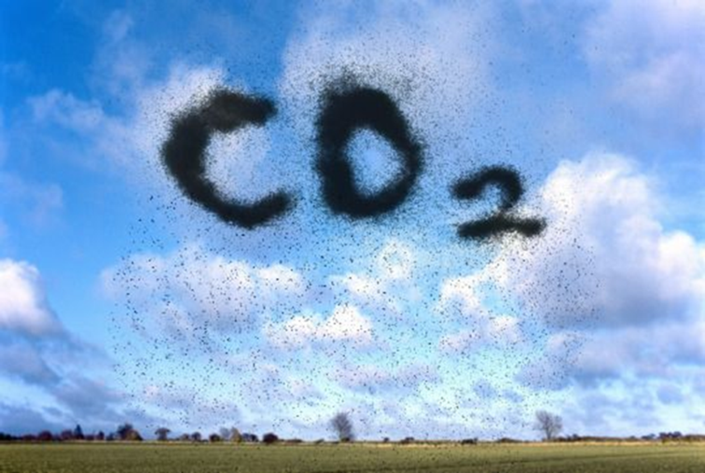
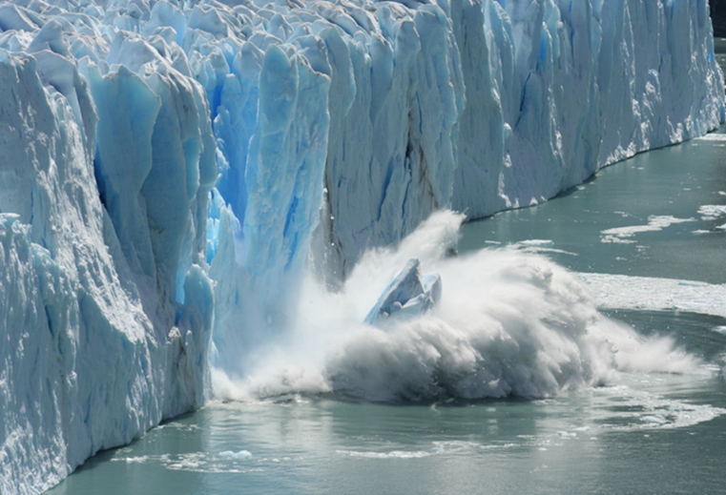

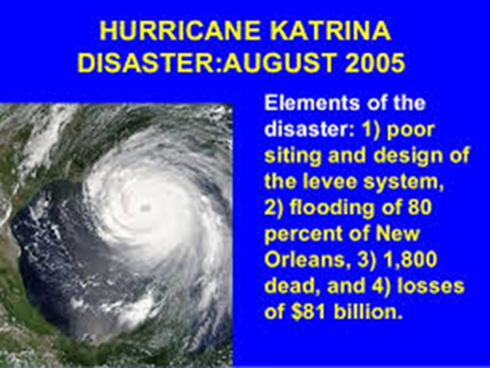
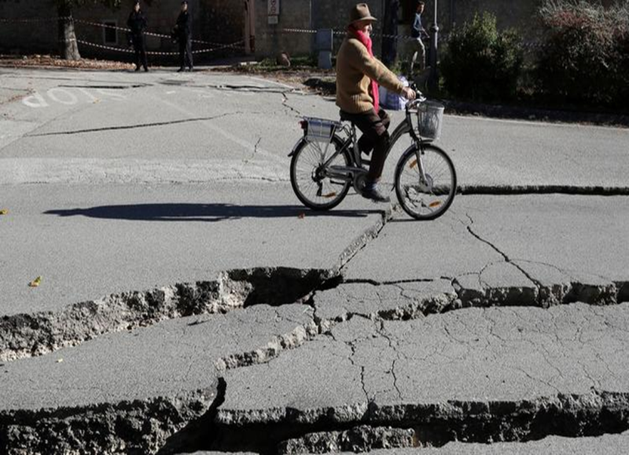
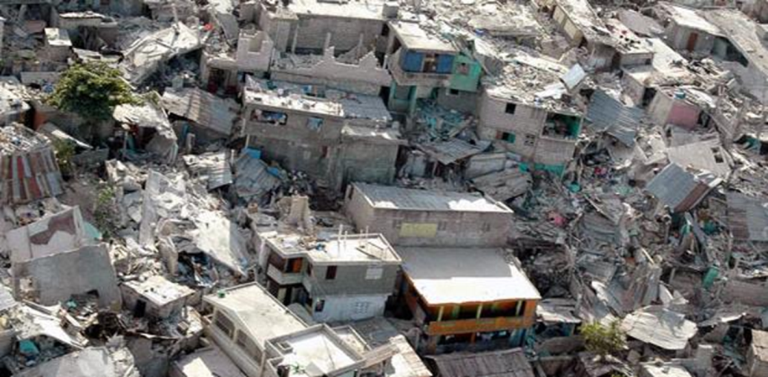
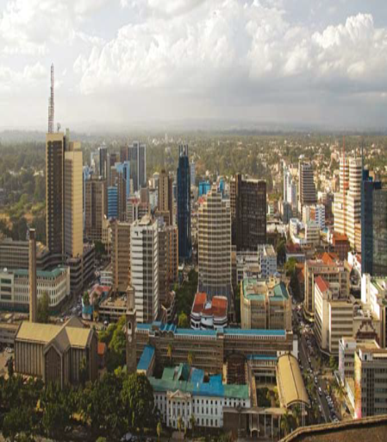
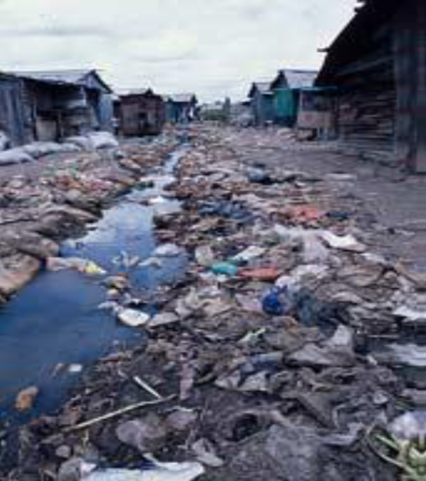
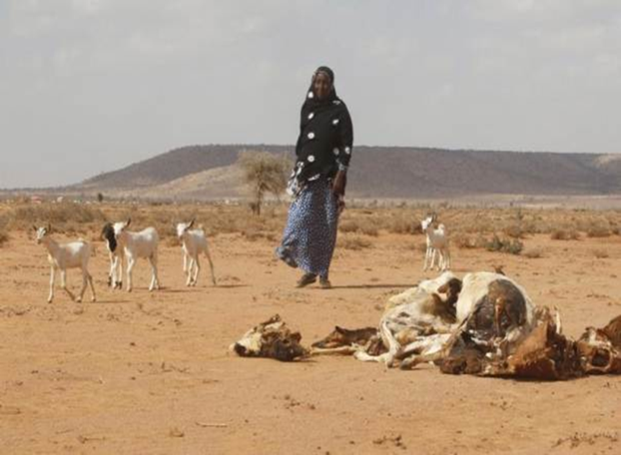
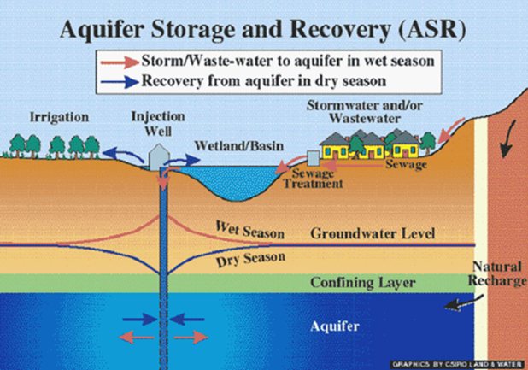
21st century urban challenges
GLOBAL WARMING
NATURAL DISASTERS
DROUGHT
RESOURCE DEPLETION
BAD GOVERNANCE

Slide 49
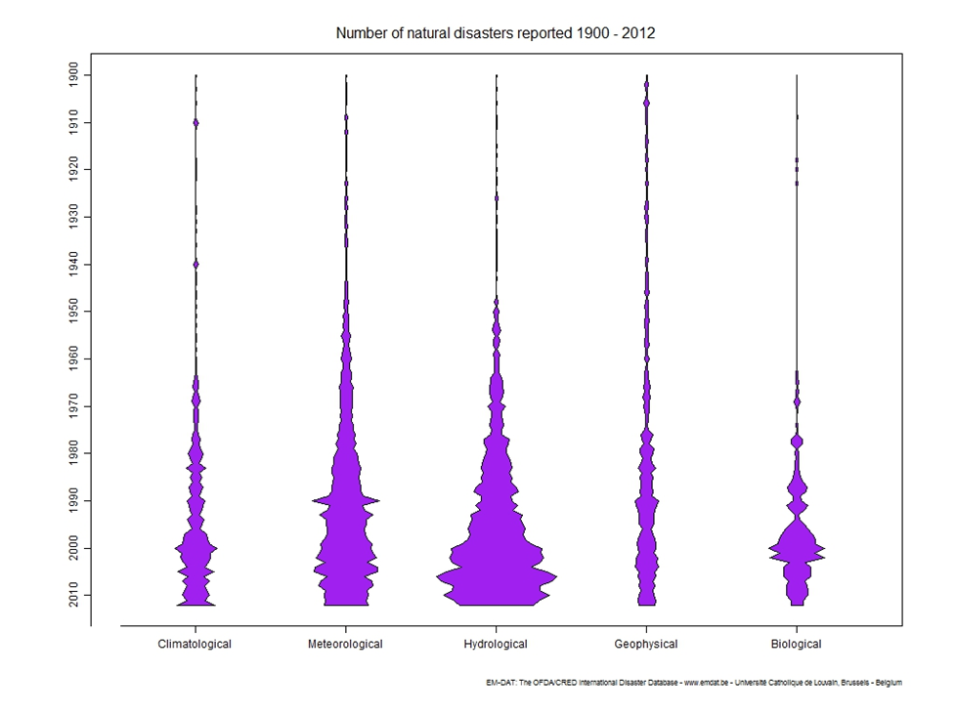
Number of natural disasters 1900-2012

Slide 50
PLANNING RESPONSES
Planning cities as complex adaptive systems (CaCAS) Doak & Karadimitriou 2006, Guy and Henneberry 2000, Webster and Lai 2006, Coetzee and Serfontein 2002, Hamdi 2004 [CAS = a system made up of many variables or inputs whose outcomes are non-linear, unpredictable and characterized by uncertainity]
Interactive
Pro-active
Strategic planning & IDP
Strategic, flexible, action oriented, linked to the budget
Reactive
The Master Plan
(To emulate western planning,
state directed city building)
non reactive/ Inactive
Do nothing – benign neglect:
things get alright by themselves

Slide 51


Strategic planning
Strategic planning
D
E
2
Where do we want to be?
3
How can we reach there?
C
1
Where are we now?
A
B

Slide 52
Conclusion by UN HABITAT on relevance of planning
“While the forces impacting upon the growth and change of cities have changed dramatically, in many parts of the world, planning systems have changed very little and are now frequent contributors to urban problems rather than function as tools for human and environmental improvement.” UN HABITAT Global Report 2009

Slide 53
Strands in urban planning
Spontaneity
Muddling through
Incremental planning
Ad vocative planning
Leverage planning
Accommodative planning
Appreciative planning
Inclusive planning
Communicative planning
Adaptive planning
Collaborative planning
New Urbanism- physical remedies for urban socio-economic problems
Decision theoretic planning
Planning Armageddon
Popular planning

Slide 54
Planning Cities As Complex Adaptive System
Our 21st century is characterized by complexity, uncertainty and unpredictability
The aftermaths of man made and natural disasters are unfolding dramatically
Some propositions
Adaptability to climate change and building resilience cannot depend solely on recourse to authority of the state and decisions of professional planners

Slide 55
Some propositions
Rather depend on partnership, self-organizing networks, grassroots mobilization, autonomous action by local actors, use of local experiments and tailor-made processes , participation and cooperation
This requires a change of paradigm => government to governance, politics to polity, hierarchy to heterarchy
Research on informality/self-organization and spontaneity might lend an opportunity to cope up with the 21st urban challenges.

Slide 56
THANK YOU VERY MUCH

