Slide 1
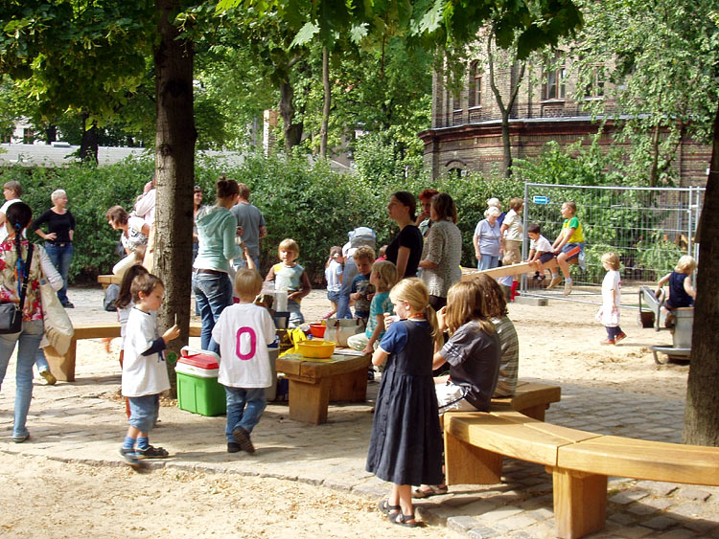
Uwe Altrock
The Social Dimension of Urban Regeneration

Slide 2
Outline
Introduction
Policy approaches and experiences
The German case
Conclusions

Slide 3
Policy approaches
Negligence
Eviction
Self-Help and In-Situ Upgrading
Enabling
Resettlement
Participatory Slum Improvement
(UN Habitat 2003)

Slide 4
Forced Evictions (Persons)
Region | 1998-2000 | 2001-2002 | 2003-2006 | 2007-2008
Africa | 1,607,435 | 4,086,971 | 1,967,486 | 270,660
Europe | 23,728 | 172,429 | 16,266 | 13,286
The Americas | 135,569 | 692,390 | 152,949 | 433,296
Asia and the Pacific | 2,529,246 | 1,787,097 | 2,140,906 | 872,926
Total | 4,294,978 | 6,738,887 | 4,277,607 | 1,590,168
Source: COHRE 2002-2009

Slide 5
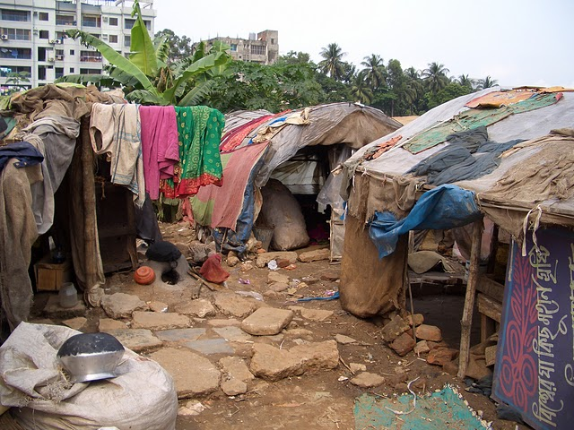
Informal Development as
a Challenge for Urban Planning

Slide 6
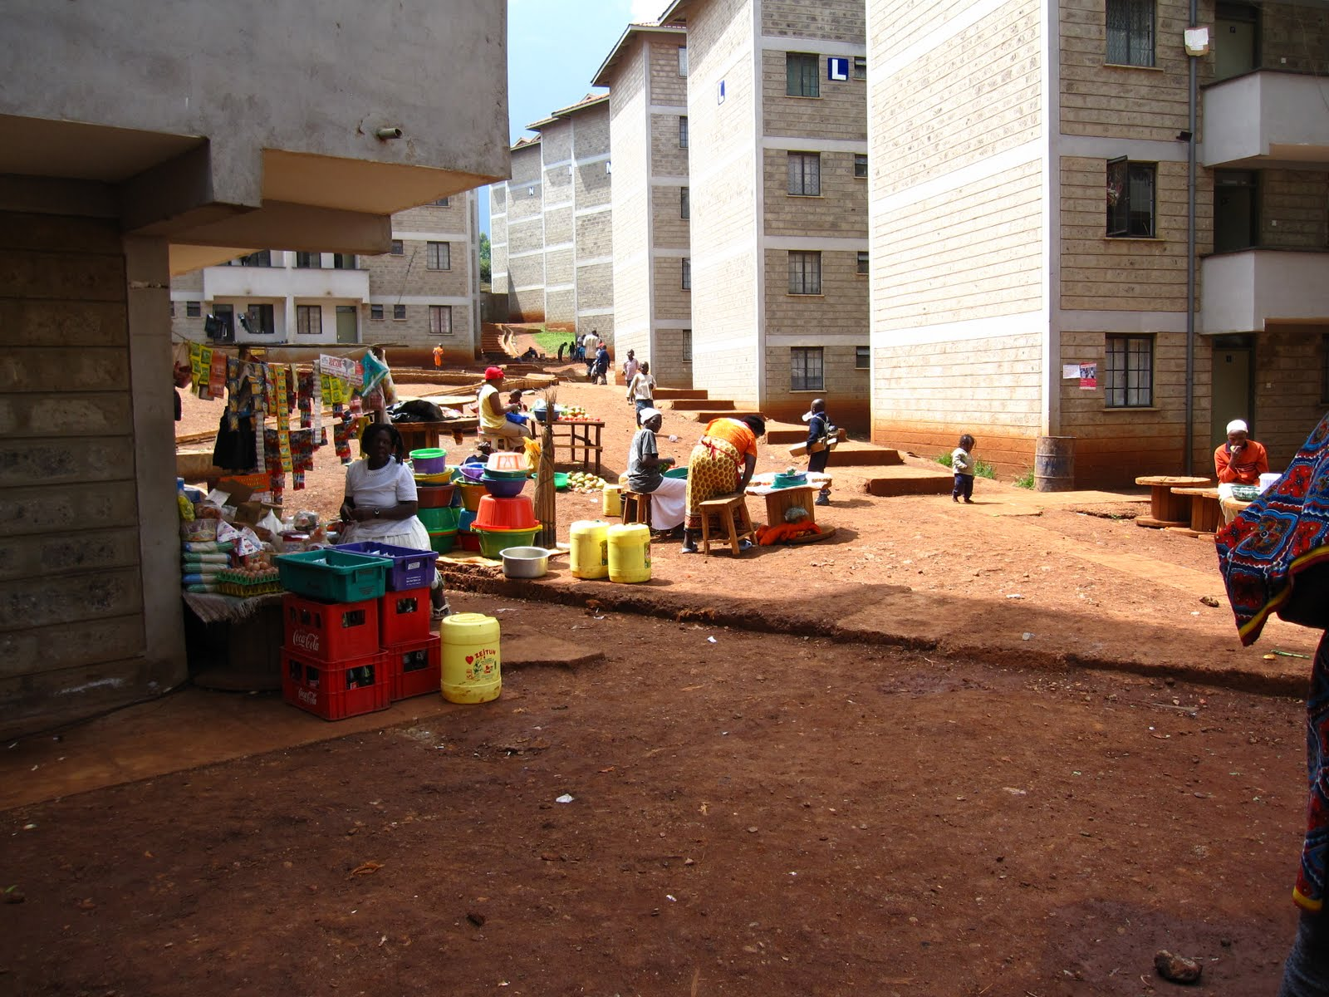
Eviction and Resettlement
http://1.bp.blogspot.com/_7pIRco-g8QU/S20vz8EO0-I/AAAAAAAAAFE/S970o8smCBs/s1600/IMG_2133.JPG

Slide 7
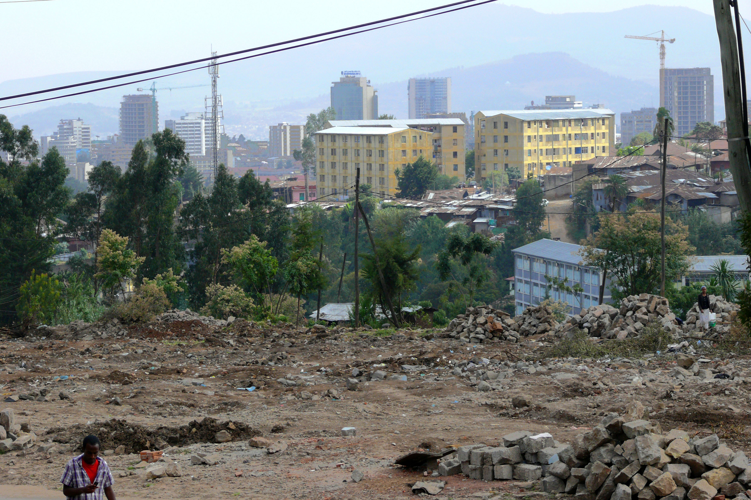
Addis Ababa: Demolition and densification

Slide 8
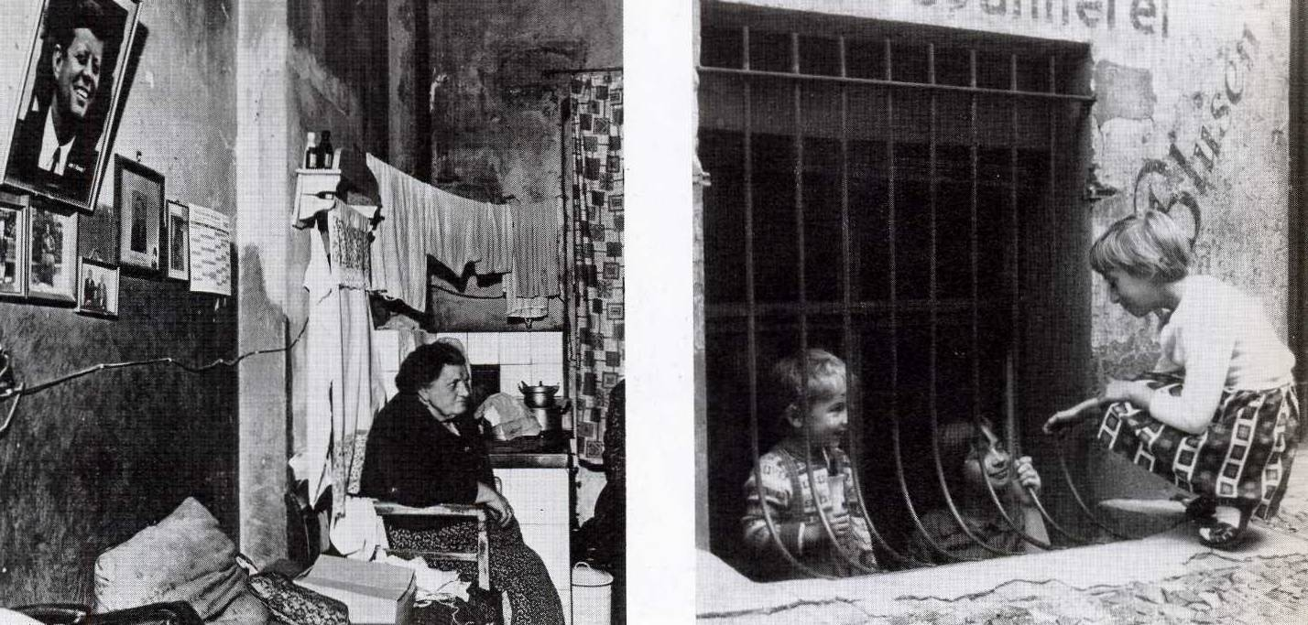
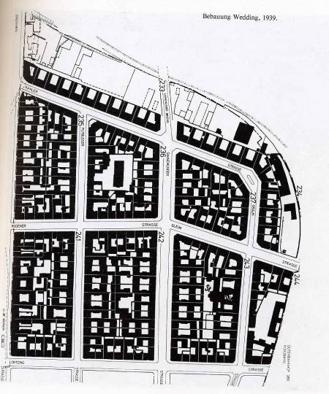
Early urban regeneration in Germany

Slide 9
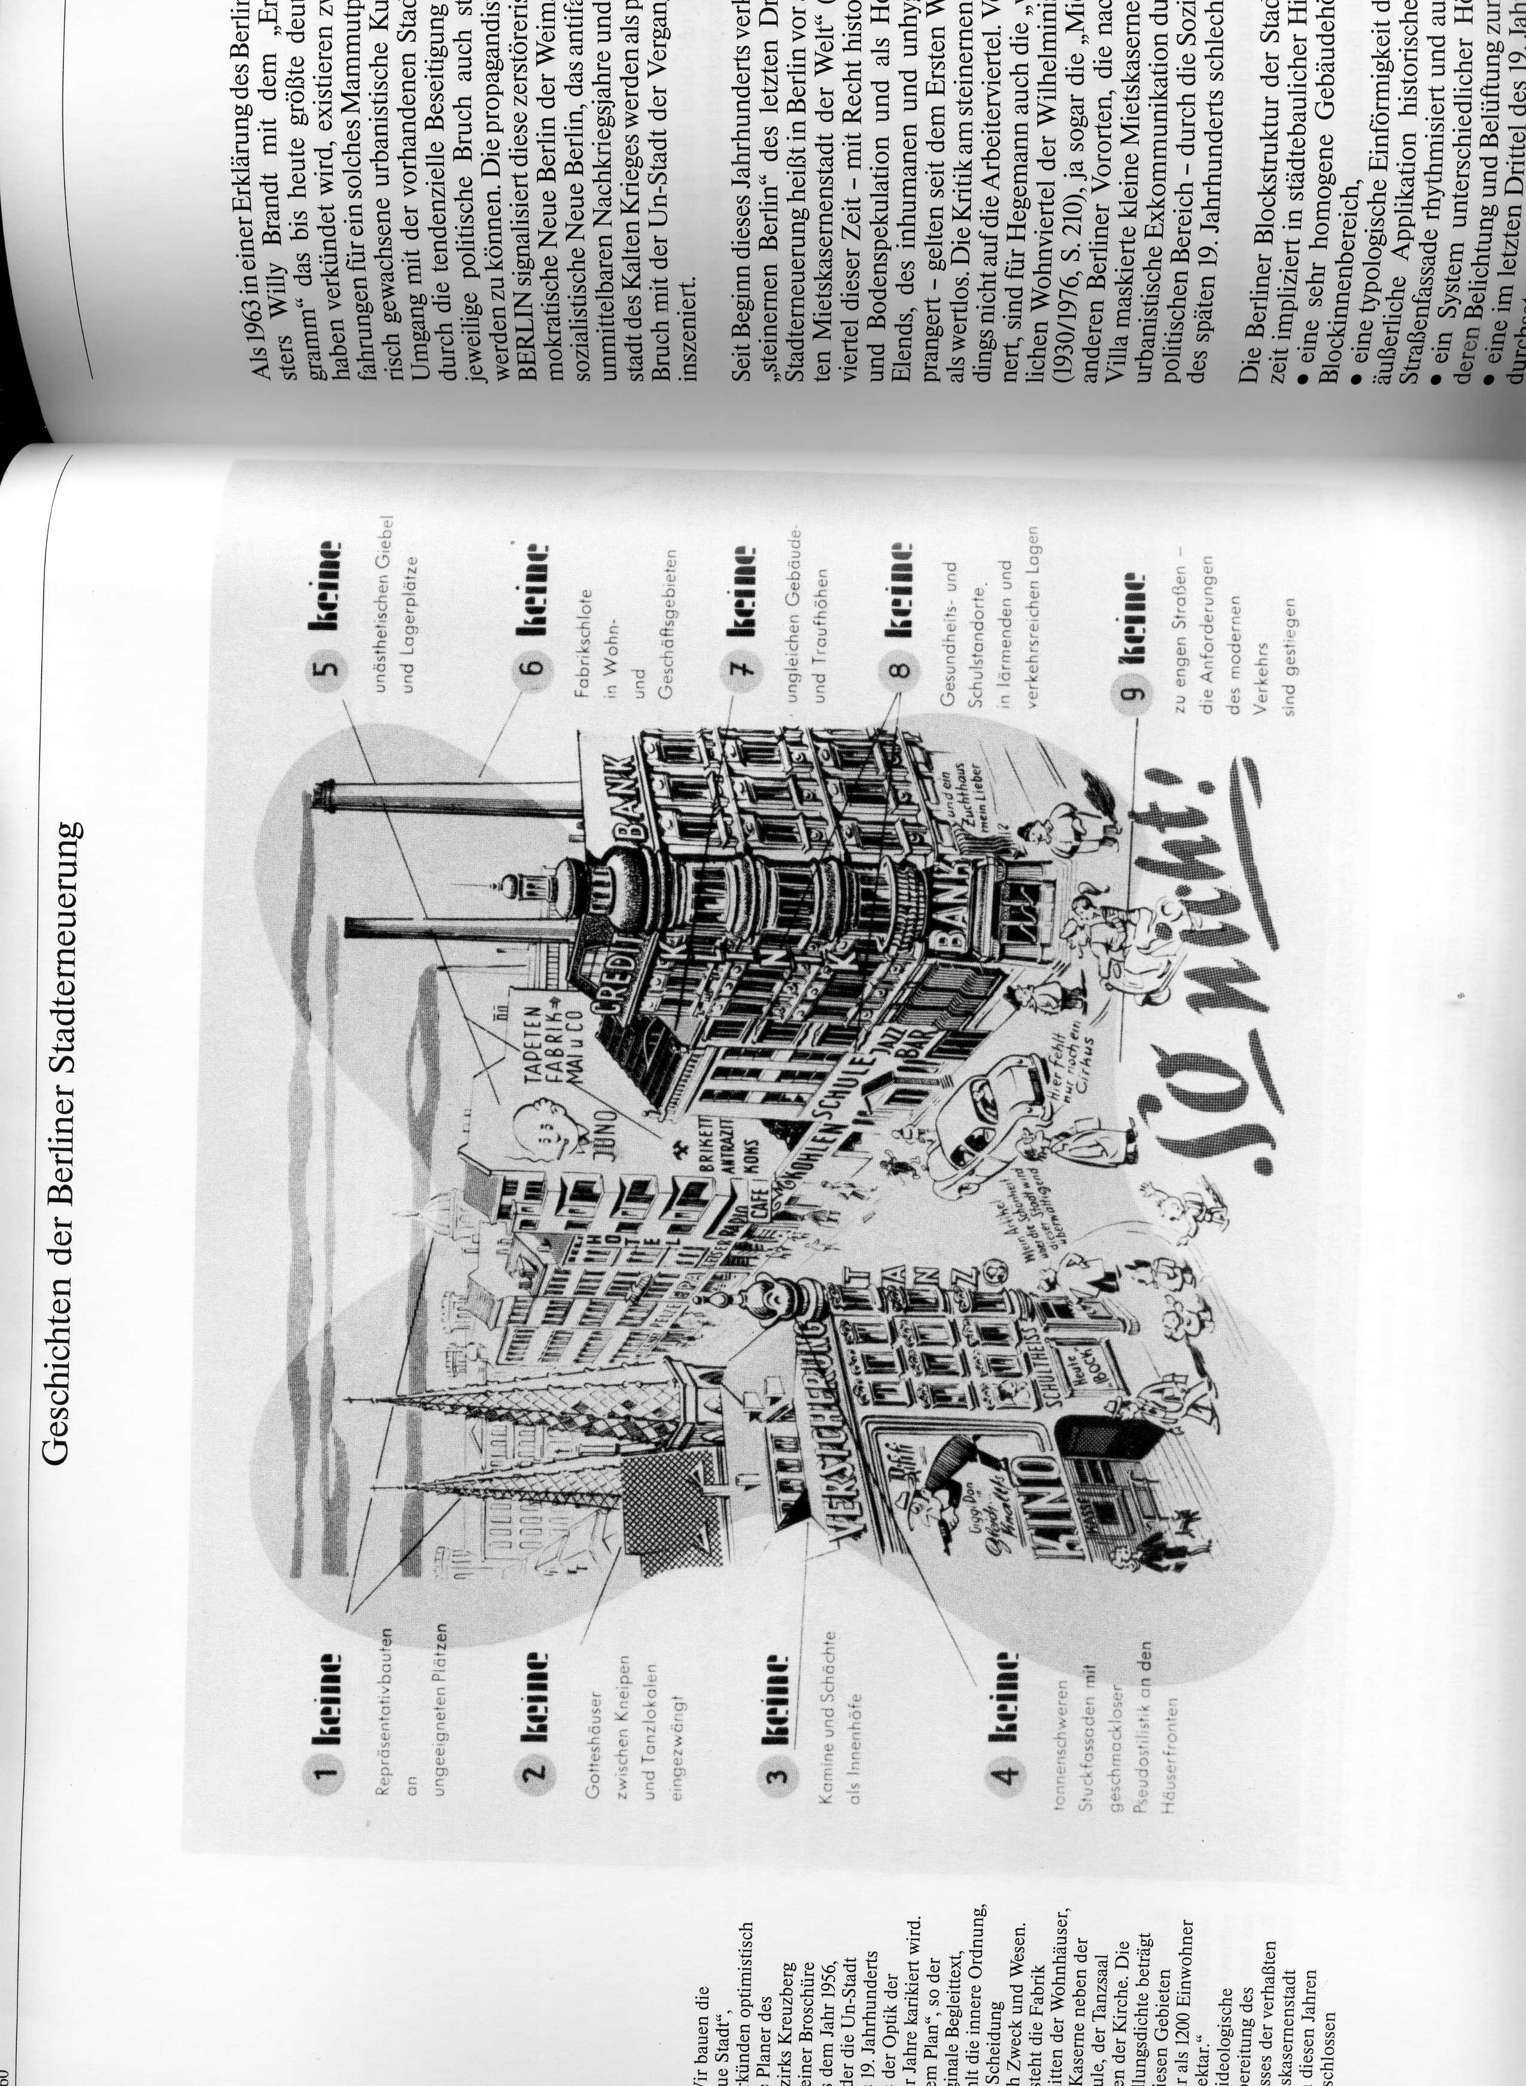

Slide 10
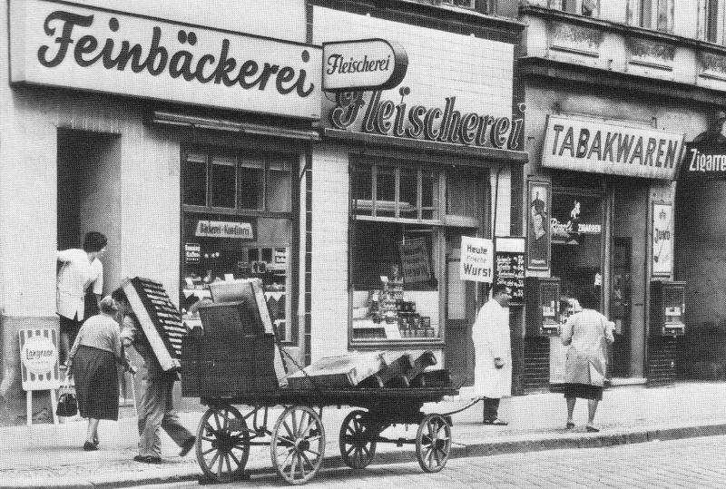
Urban problems?

Slide 11
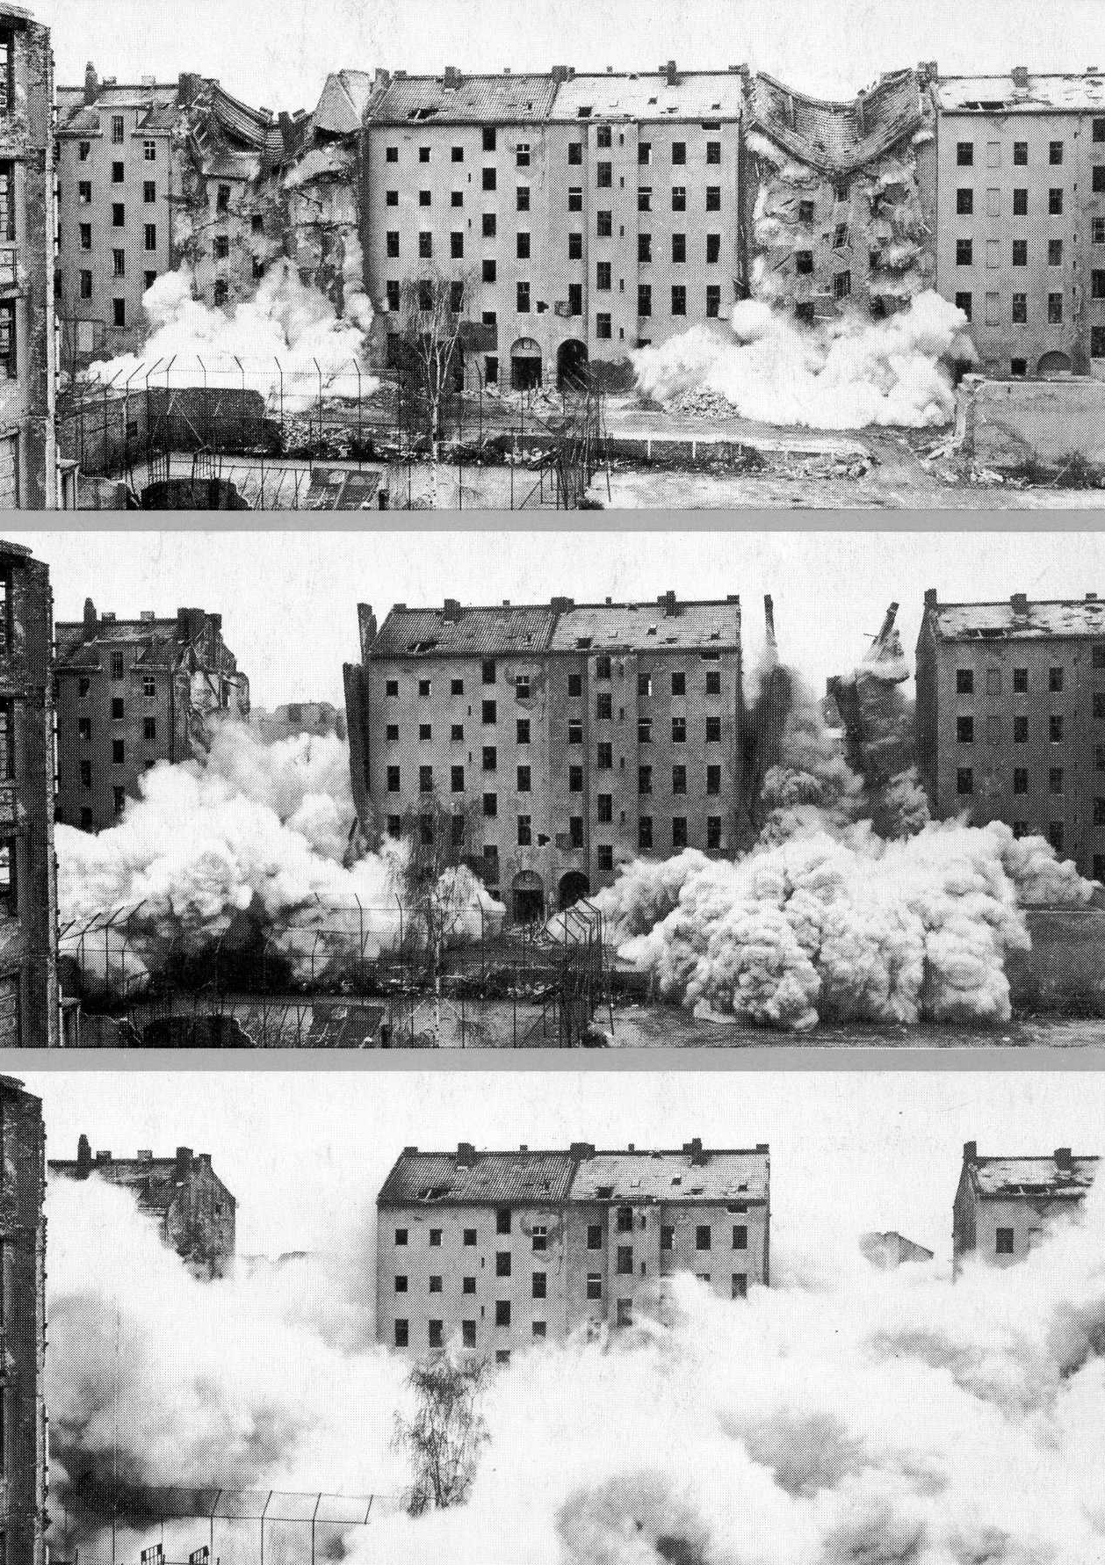
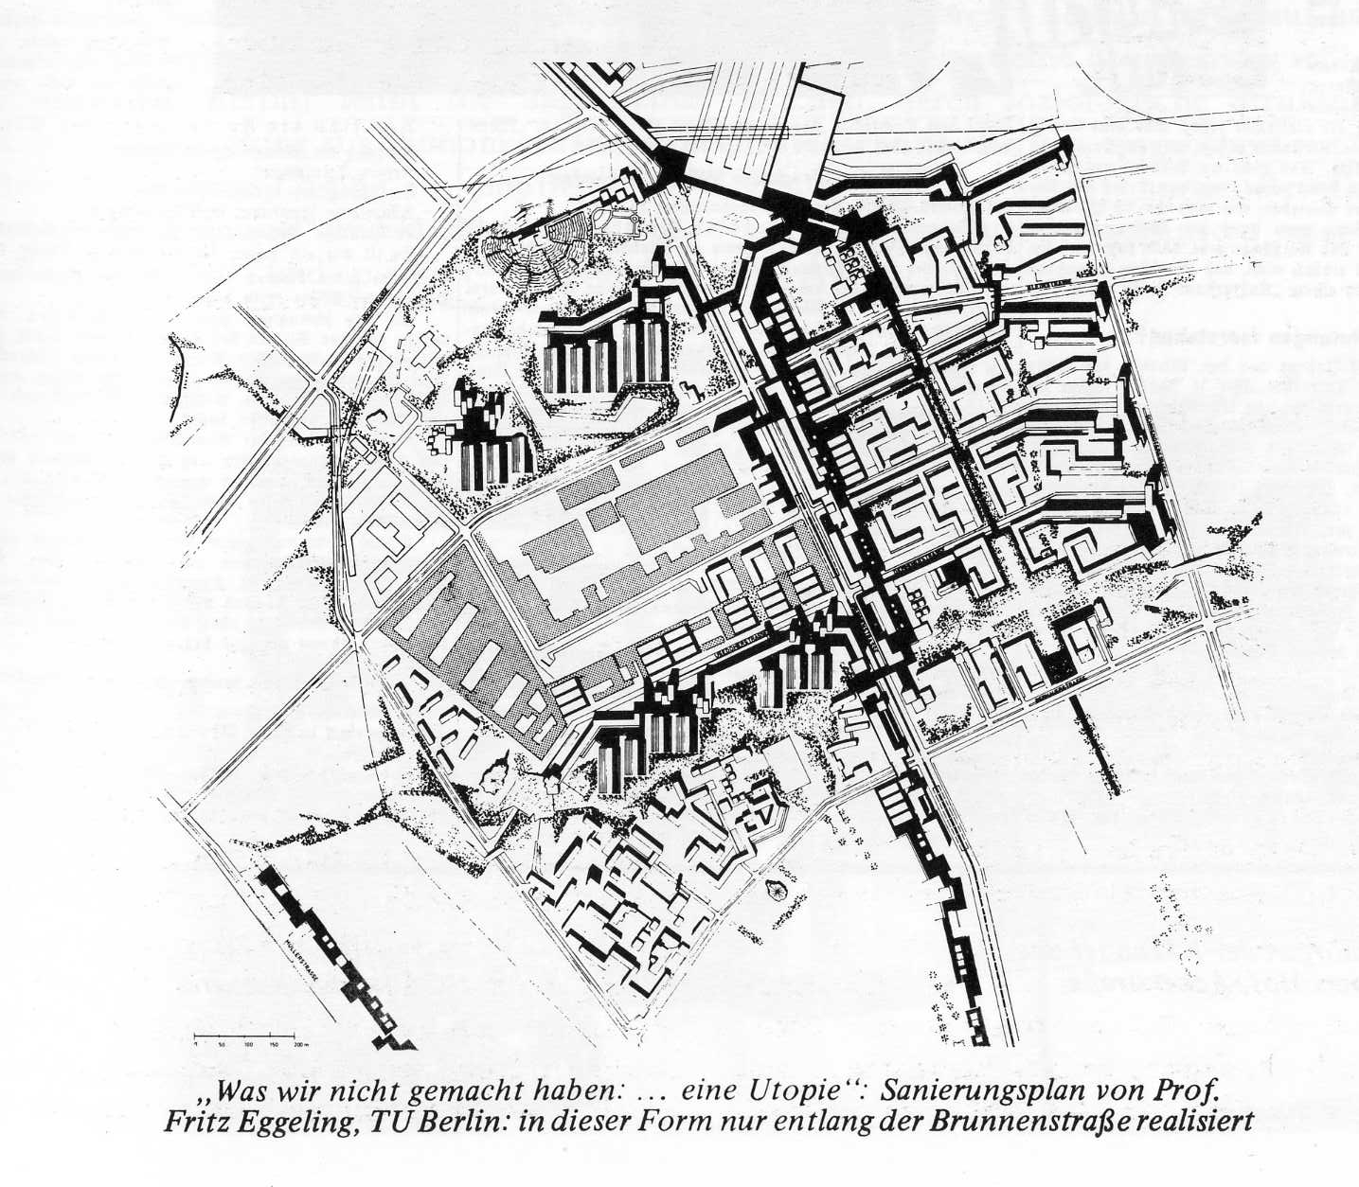

Slide 12
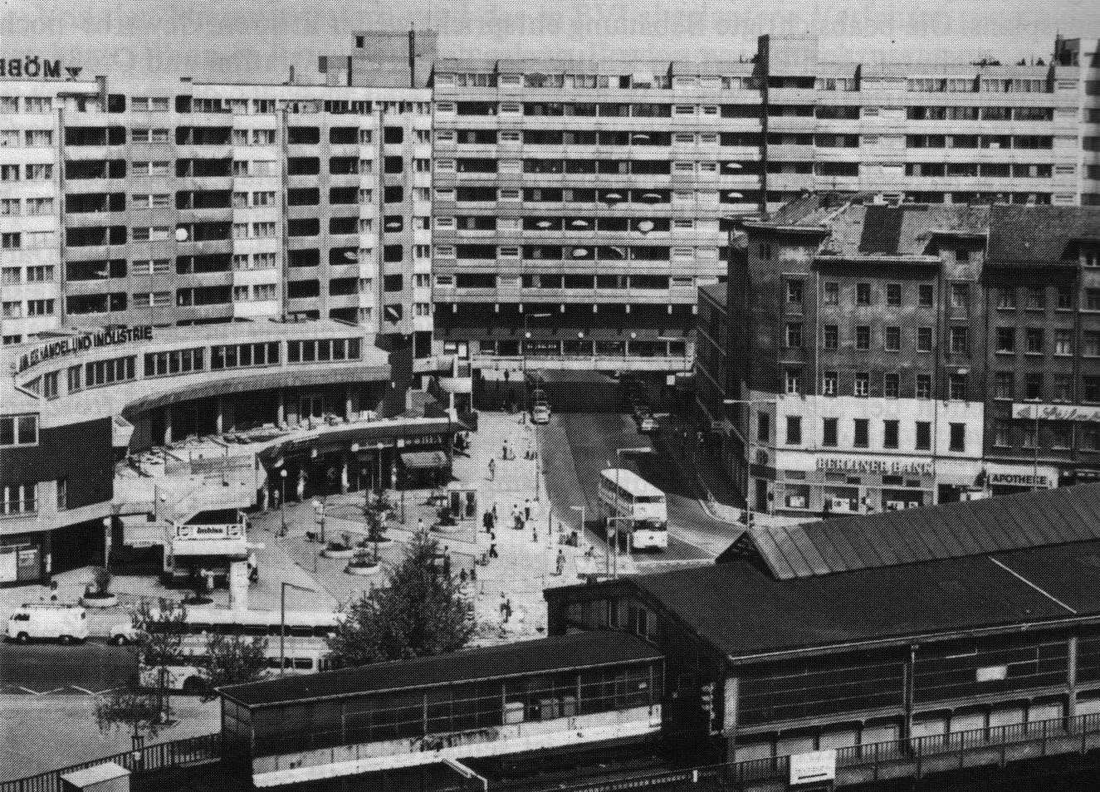
The early practice of regeneration

Slide 13
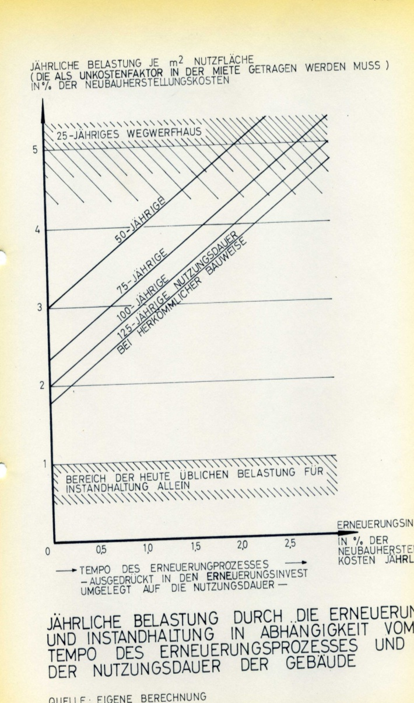
Early criticisms

Slide 14
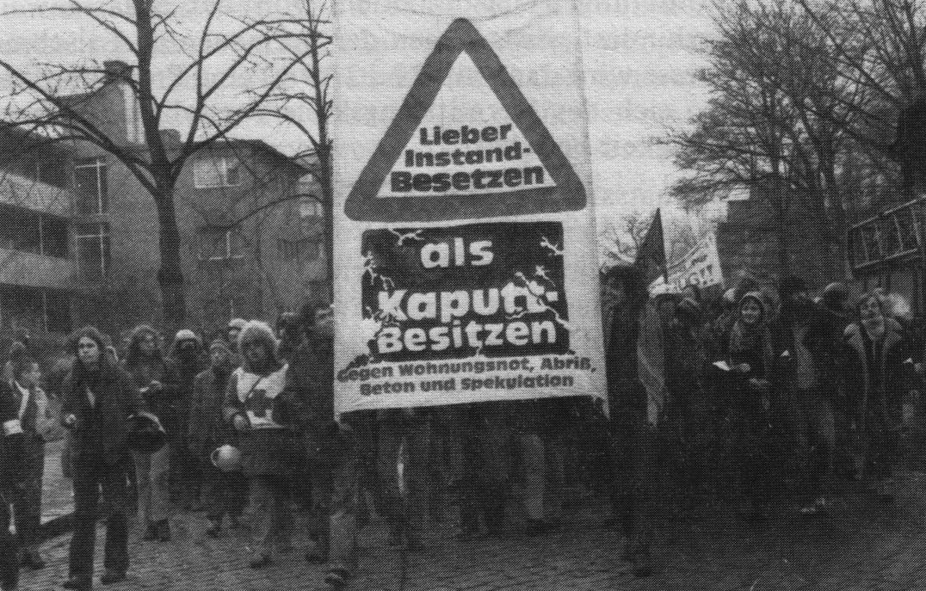
Public resistance

Slide 15
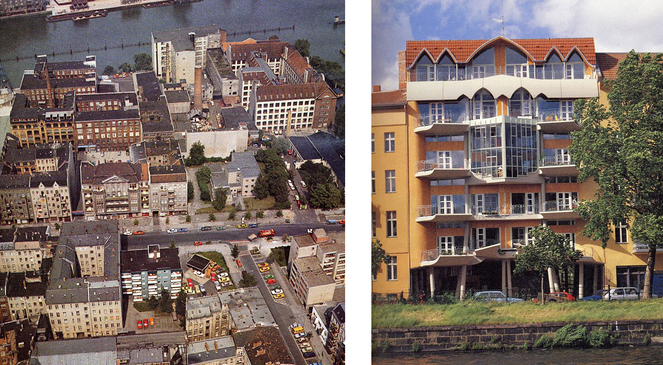
Careful urban regeneration

Slide 16
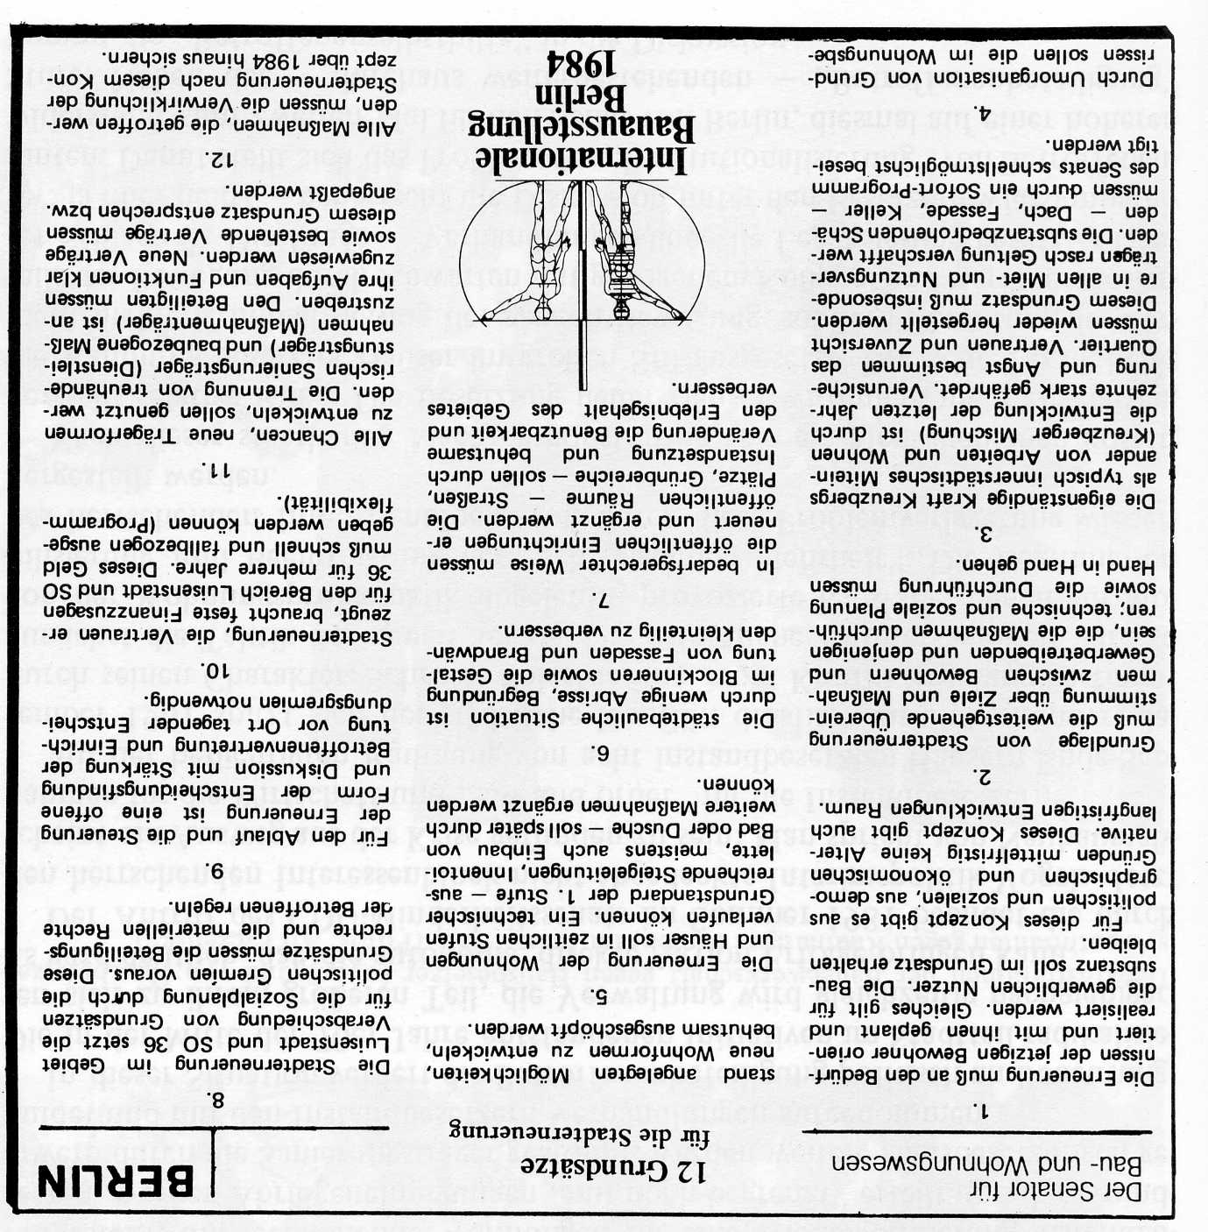
Twelve Principles

Slide 17
Twelve Principles
Urban renewal must be planned with the current residents and entrepreneurs. Their tangible rights must be respected.
The renewal of houses and buildings must be gradual and must be completed little by little.
The physical situation must be improved by minimum demolition, by green development in courtyards, and by the decoration of facades.
Public facilities such as streets, squares and parks must be renewed and preserved in accordance with public needs.

Slide 18
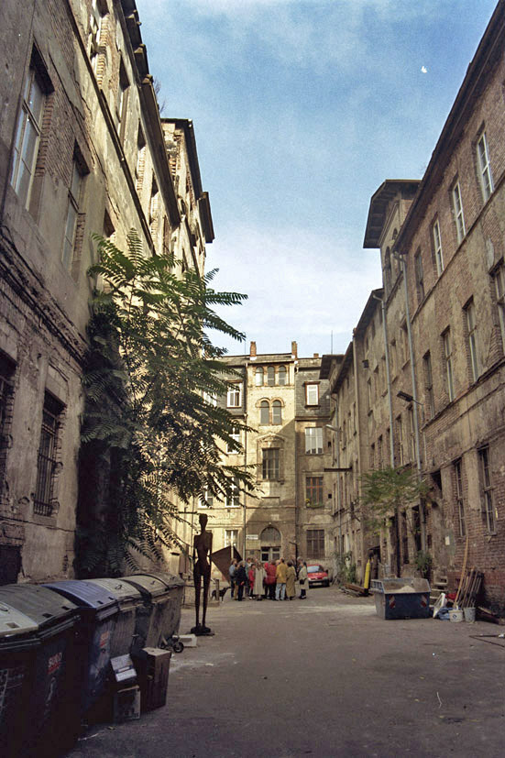
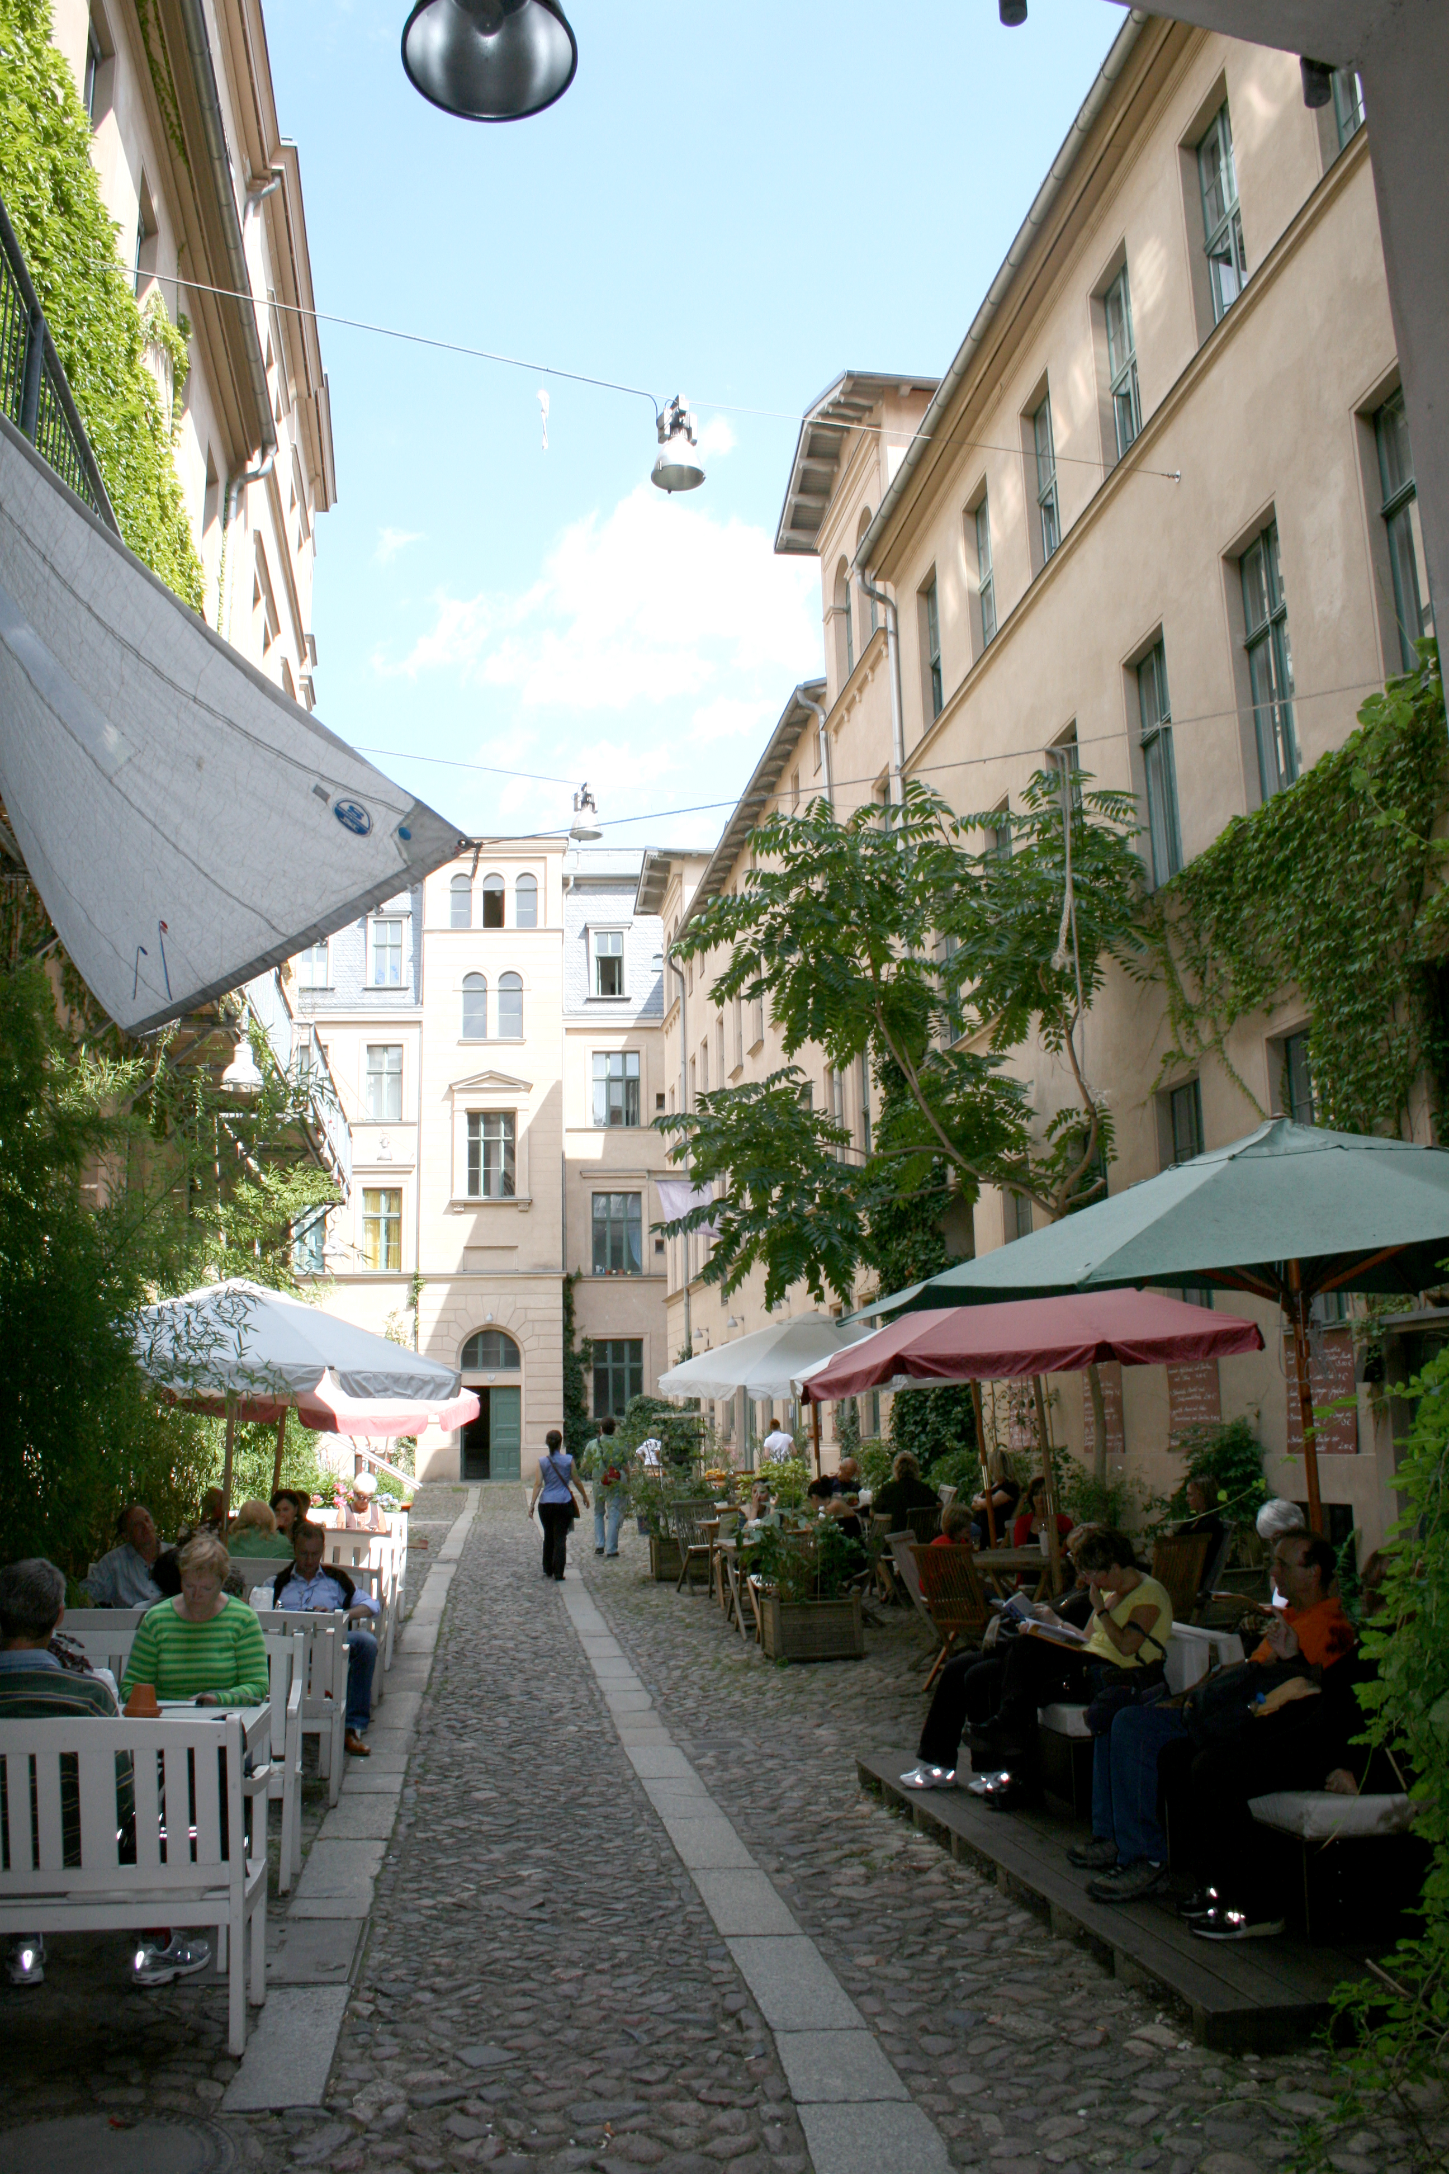
Ökonomische Wirkungen

Slide 19
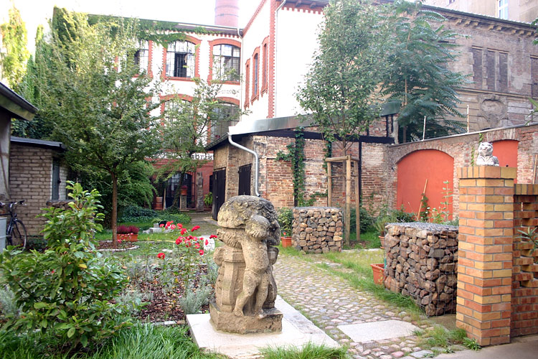
The legacy of careful urban regeneration

Slide 20
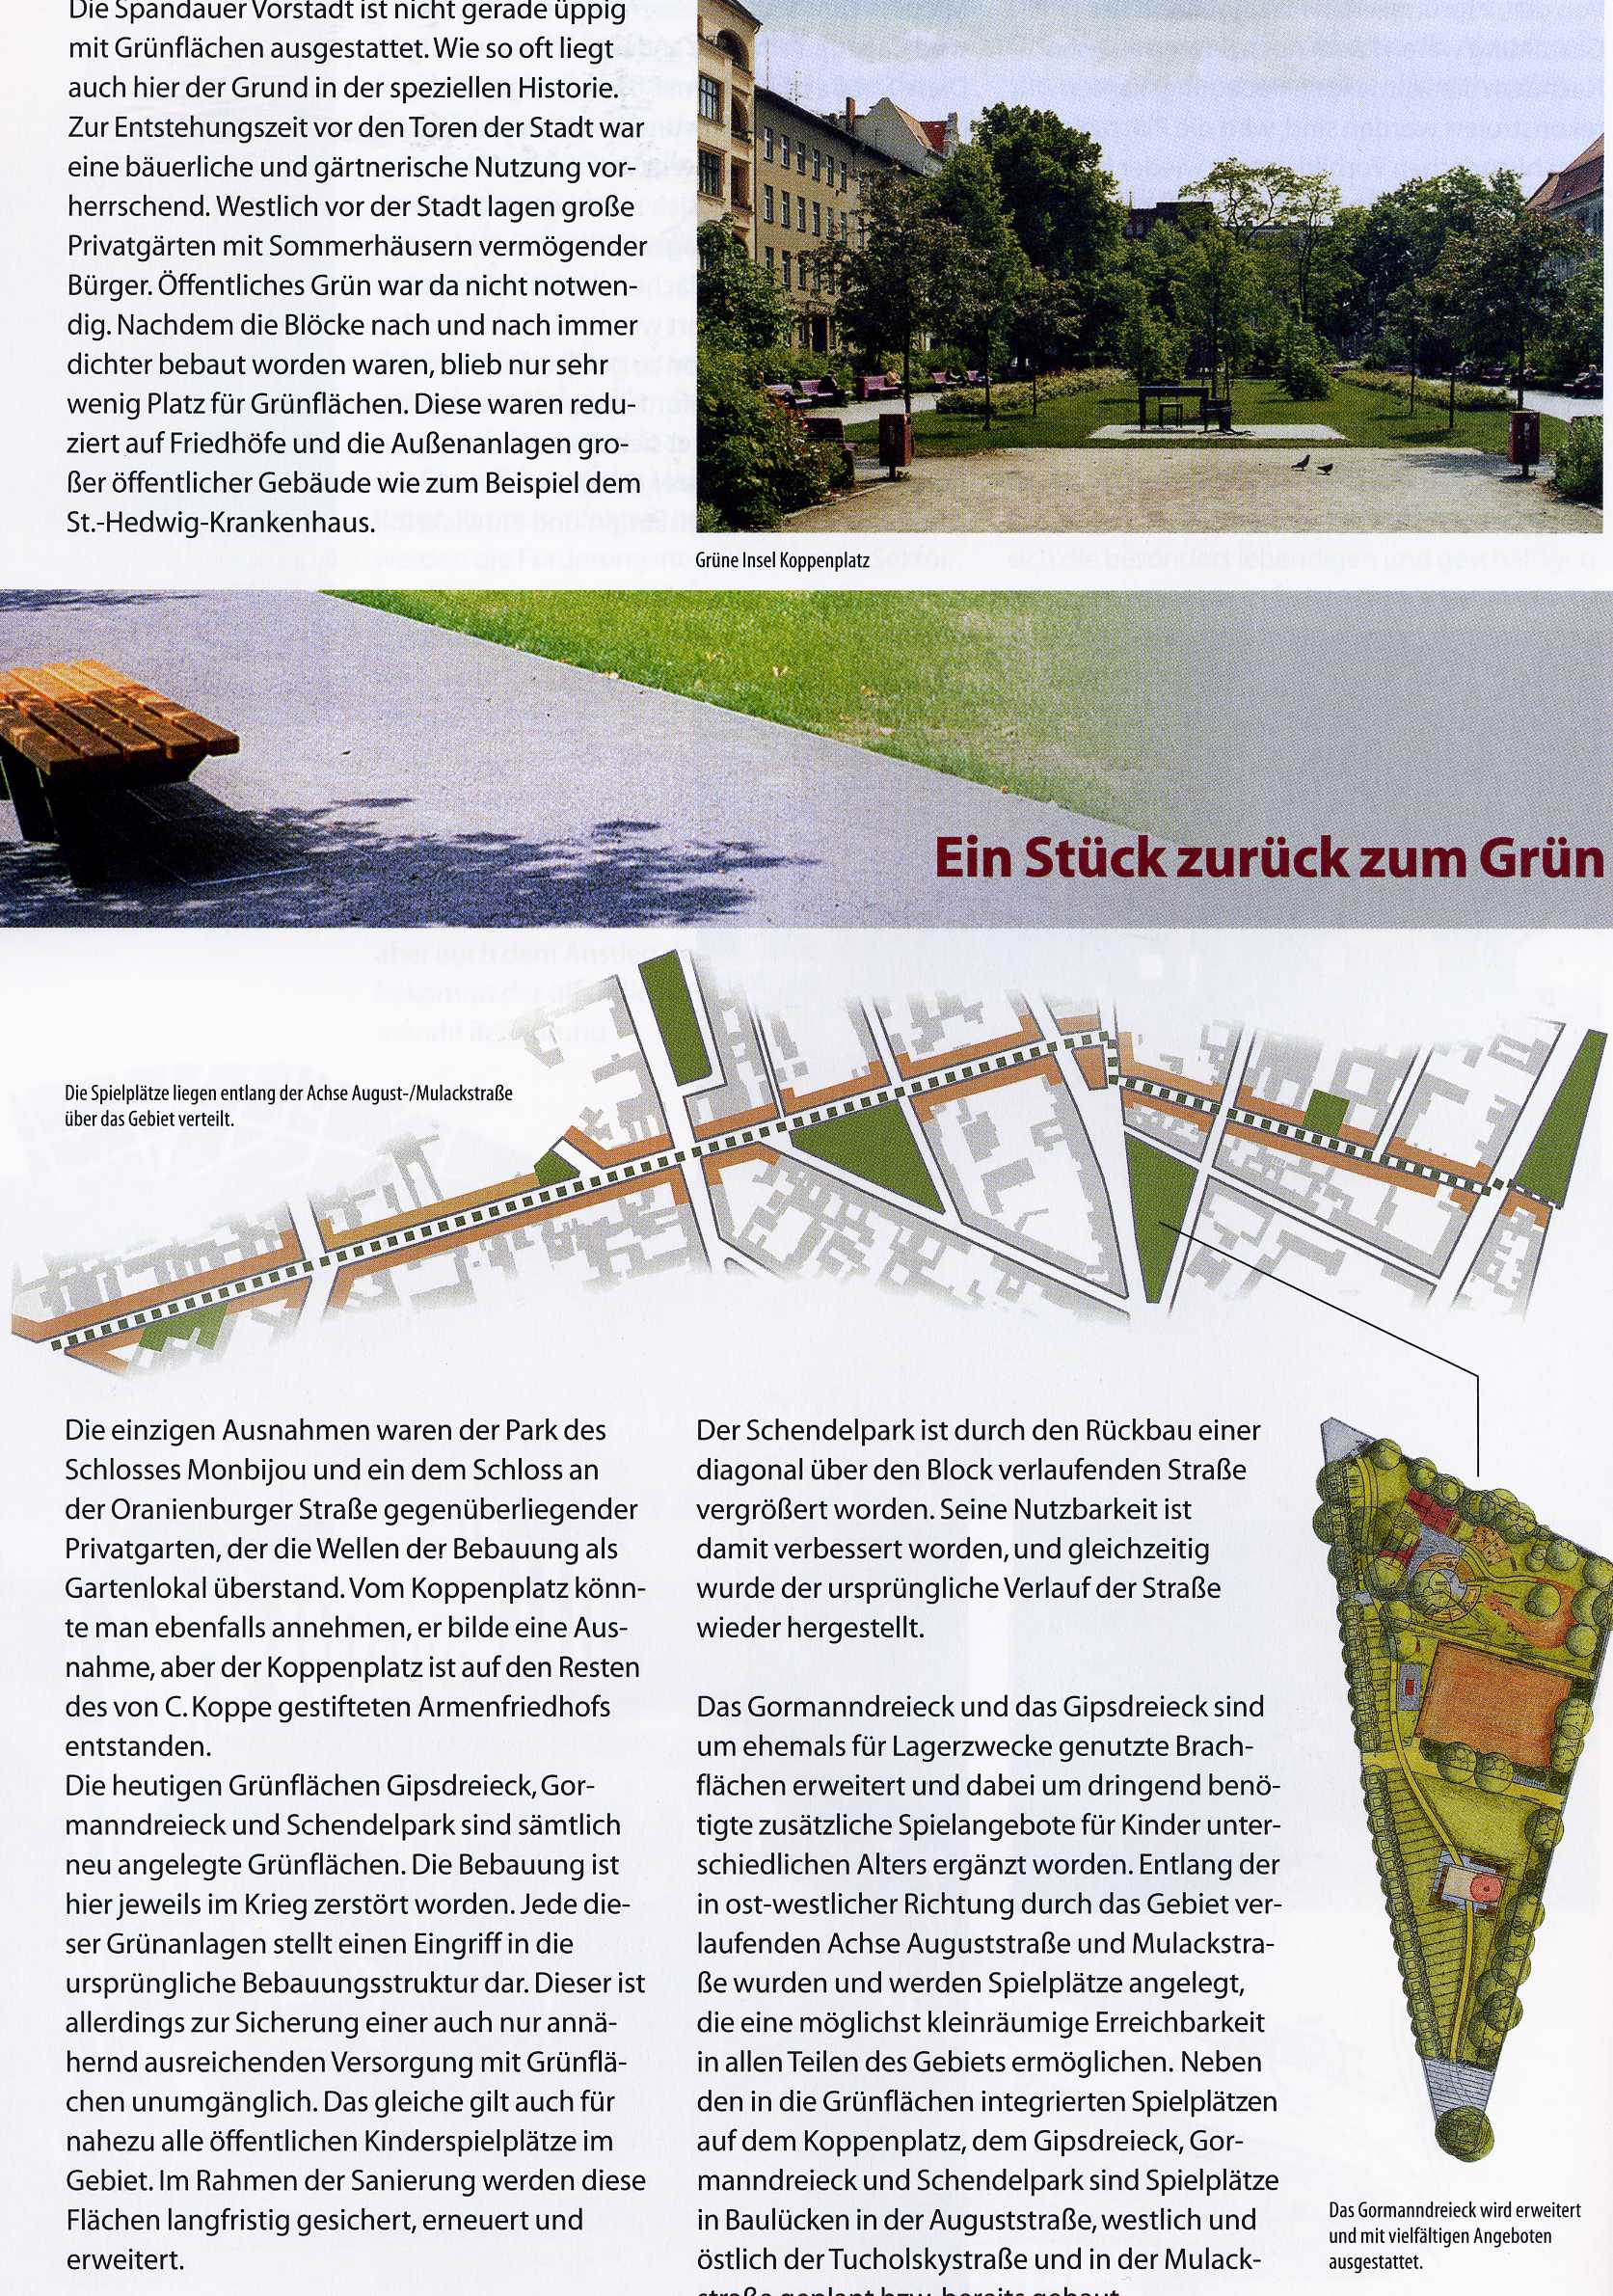
Livability

Slide 21
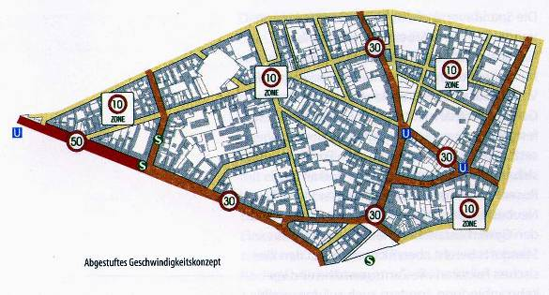
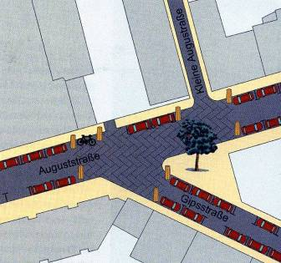
Traffic calming

Slide 22
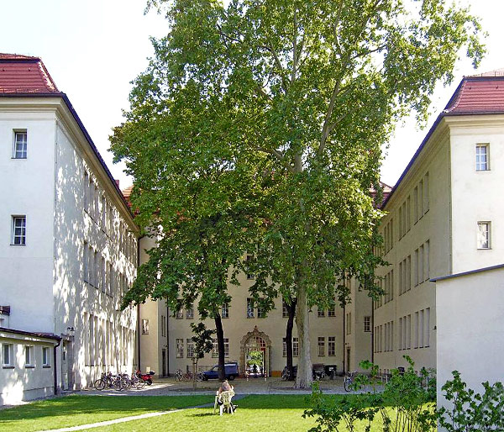
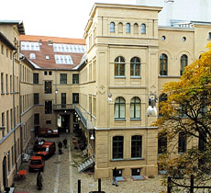
Preservation of listed structures

Slide 23
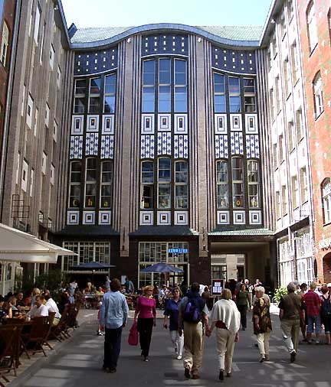
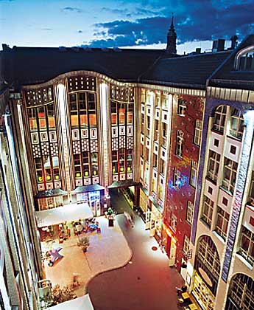
Adaptive reuse

Slide 24
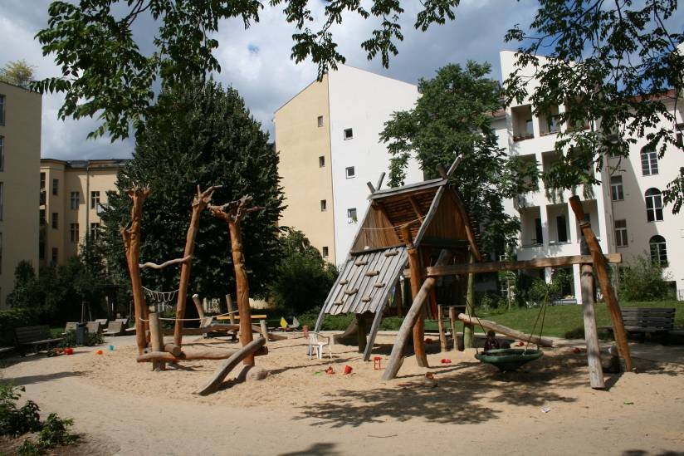
Participatory planning

Slide 25
Careful regeneration
Successful regeneration of housing stock
Requires public subsidies for social housing schemes
Is able to include the local population to a certain extent

Slide 26
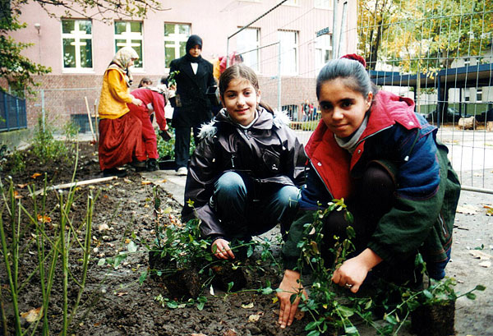
Soziokulturelle Wirkungen
Socially integrative upgrading

Slide 27
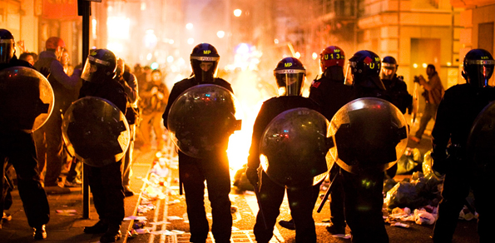
Soziokulturelle Wirkungen
[Riots]
Paris, London

Slide 28
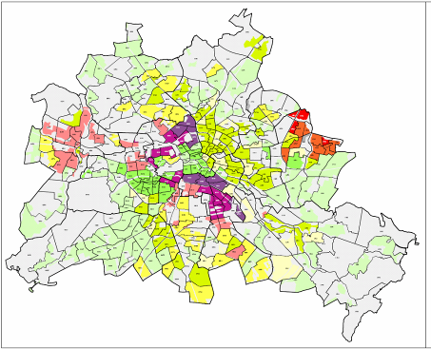
Challenges for social cohesion
Selective outmigration
Concentrations of “urban problems”
Central issues
  Employment
  Qualification
  Education
  Identification
  Empowerment

Slide 29
Objectives
Integration of migrant communities via educational system
Reducing stigmatization
Empowerment and self-organization
Creating places of cultural exchange and integration
Support of ethnic economies

Slide 30
Strategies
Integration as multi-dimensional field of action
  Upgrading of housing environment and public space
  Social and cultural infrastructure, education
  Local economy
  Participatory planning
  Education

Slide 31
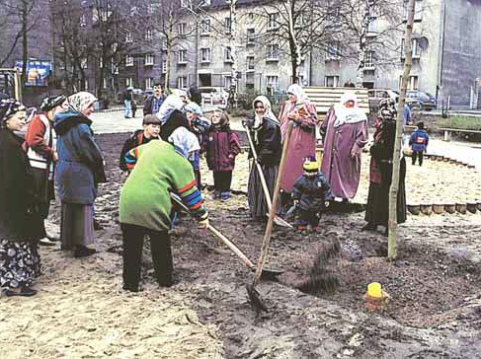
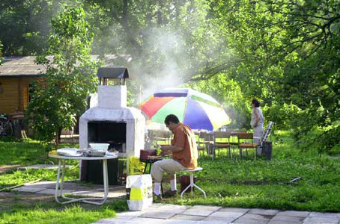
Strategies
Upgrading of housing environment and public space
  Upgrading of neglected areas and building entrances
  Individual housing solutions and ownership
  Intercultural gardens
  Meeting points
  Conflict management in public space
  Creation of arrival cities

Slide 32
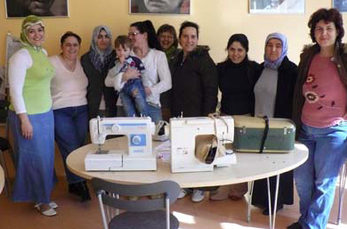
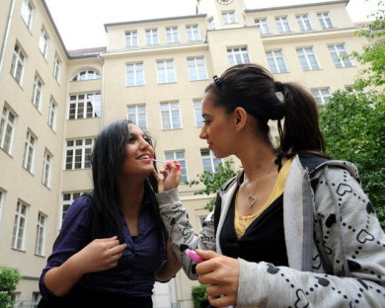
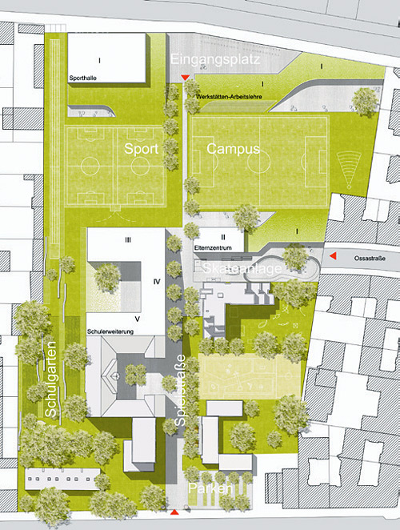
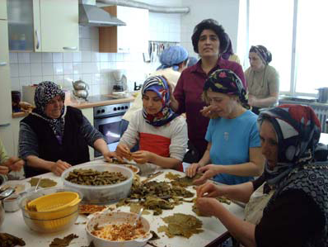
Strategies
Social and cultural infrastructure, education
  Neighborhood festivals
  Multicultural neighborhood centers
  Self-help centers
  Integration of educational solutions

Slide 33
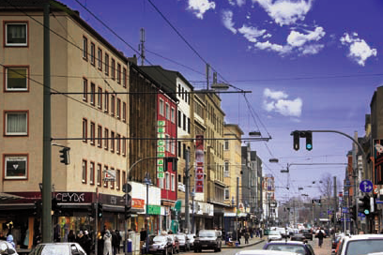
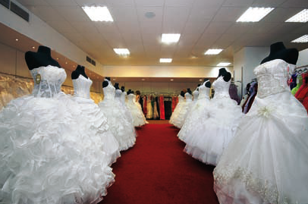
Strategies
Local Economy
  Partnerships in education
  Support of niche economies
  Qualification and coaching
  Neighborhood marketing
  Marketing of ethnic traditions

Slide 34
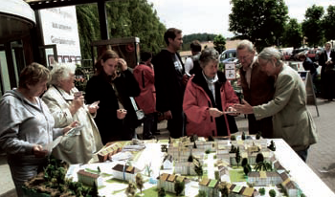
Strategies
Participatory planning
  Multilingual planning and information
  Integration of migrant organizations in neighborhood activities and self-administration
  Support of self-organized meeting points
  Informal meetings and conflict resolution

Slide 35
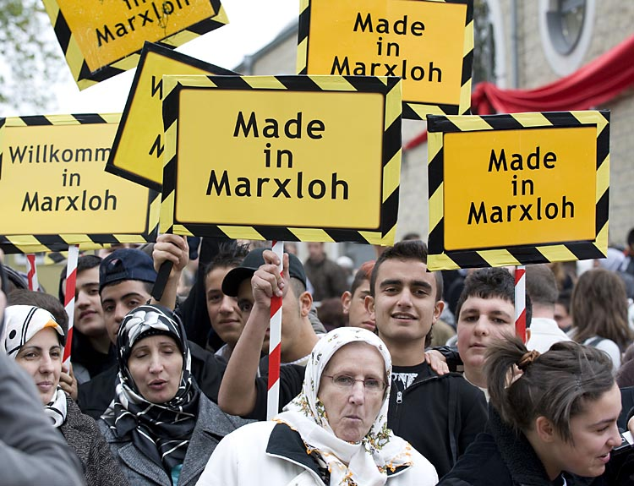

Slide 36
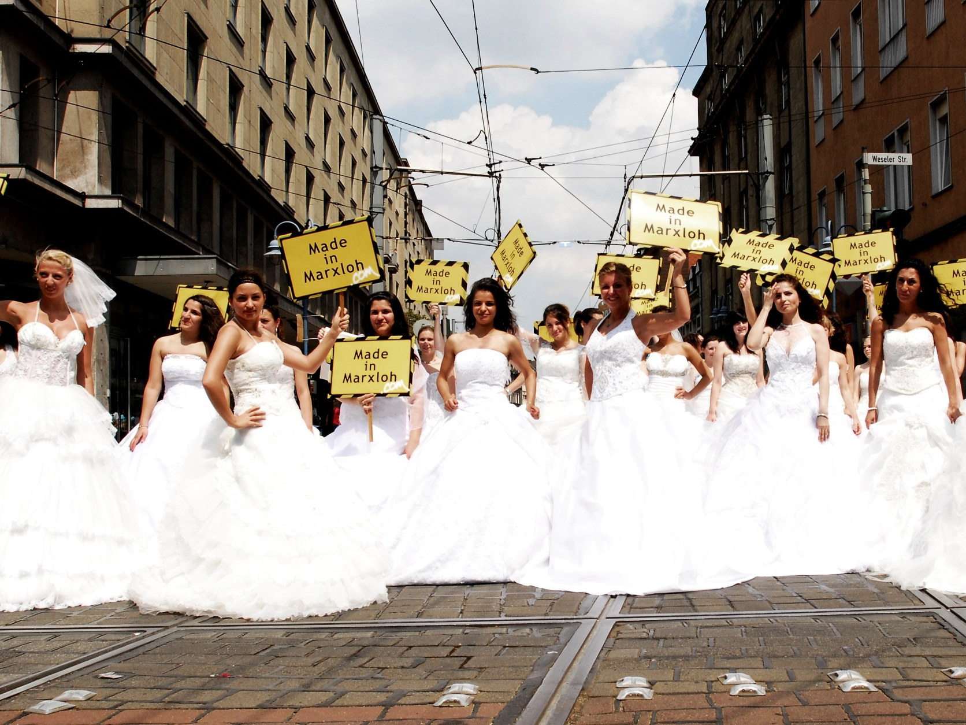

Slide 37
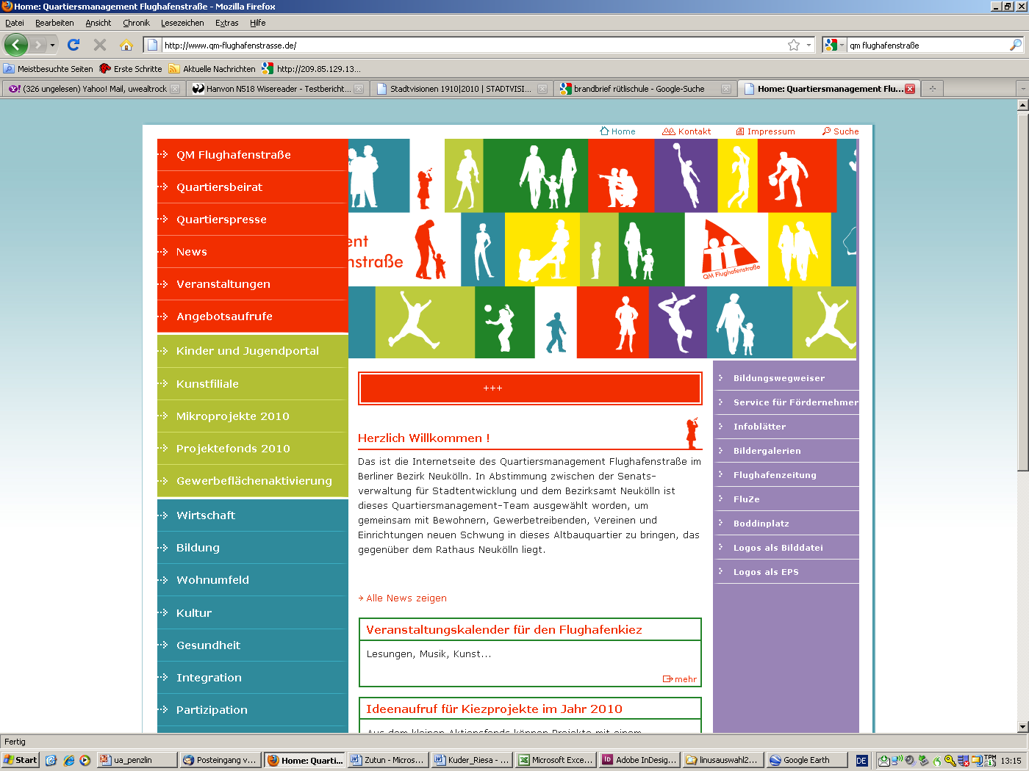
Neighbourhood Management

Slide 38
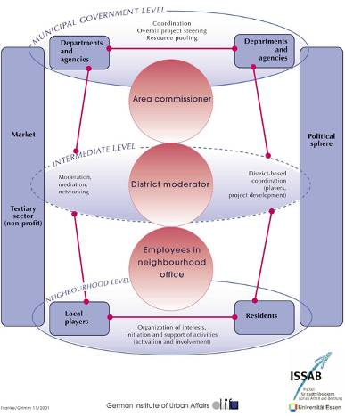
Neighbourhood management
The concept of neighbourhood management
  Bundling of resources and expertise
  Integrated action plans
  Local neighbourhood managers
  Empowerment
  Evaluation and monitoring

Slide 39
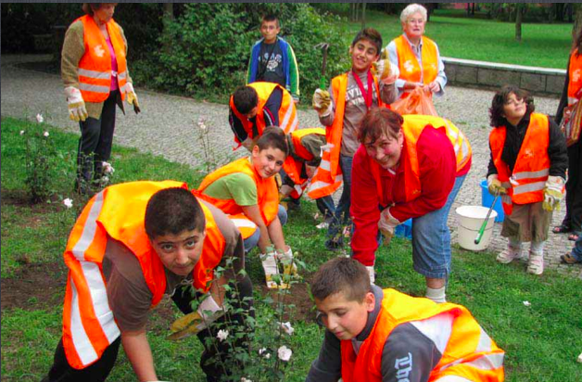
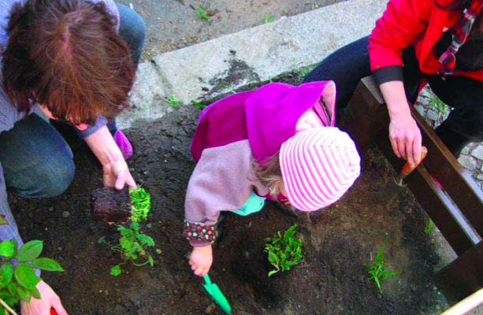
Neighbourhood management

Slide 40
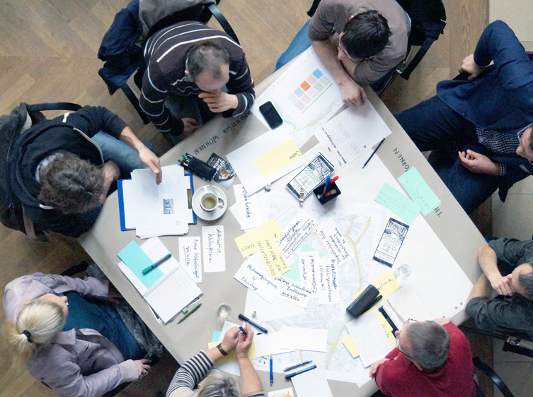
Neighbourhood Juries and Funds

Slide 41
Neighbourhood juries

Slide 42
Neighbourhood juries

Slide 43
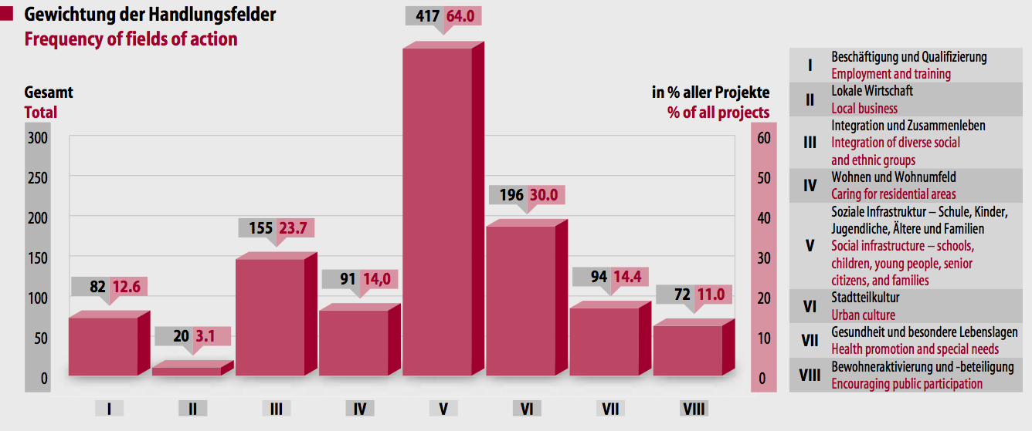
Neighbourhood juries

Slide 44
Socially integrative upgrading: Summary
Integrated strategies linking spatial, social, economic and other policies
Empowerment and communicative action contributing to stabilization of neighborhoods

Slide 45
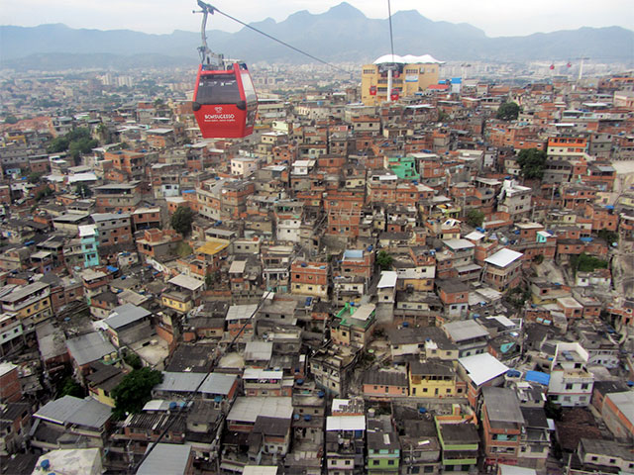
Rio de Janeiro: Case study Favela-Bairro

Slide 46
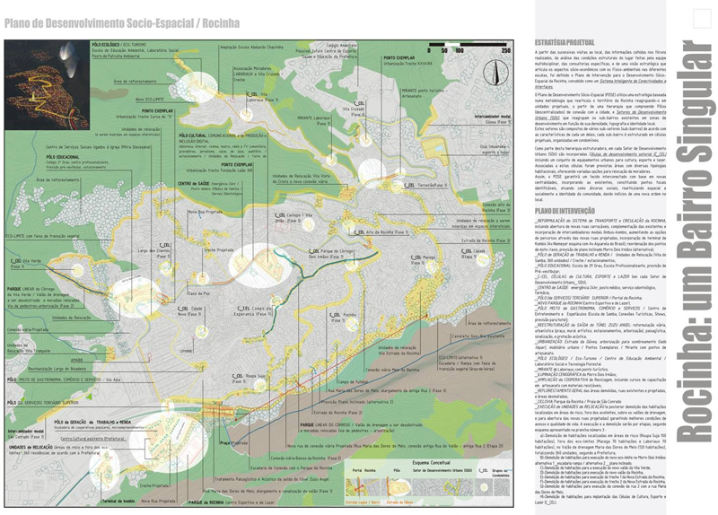
Rio de Janeiro: Case study Favela-Bairro

Slide 47
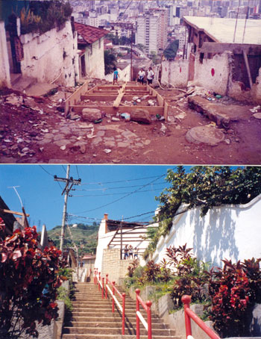
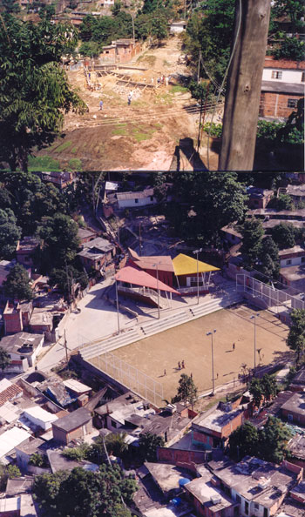
Rio de Janeiro: Case study Favela-Bairro

Slide 48

Rio de Janeiro: Case study Favela-Bairro

Slide 49

Rio de Janeiro: Case study Favela-Bairro

Slide 50

Rio de Janeiro: Case study Favela-Bairro

Slide 51
Conclusions
Socially integrative regeneration requires slow and careful upgrading of the existing structures
Improvement of infrastructure is crucial
Participation and empowerment contribute to mobilizing the resources of the local population

Slide 52

Thank you!

