Slide 1
challenges IN infrastructure provision to informal settlement areas
The Case of ULGDP_II in Mekelle City
Abdurahim M.
RMCBM-T Project Engineer

Slide 2
Contents
                About the Program
                Challenges
                Cases
                Wayout Experiences

Slide 3
ULGDP_II
PROGRAM DEVELOPMENT OBJECTIVES,KEY RESULTS & REWARD
    To promot the institutional and organizational performance of participating urban local governments in developing and sustaining urban infrastructure and services.
    ‘……P for R……’ rewarding for each indicator organized as DLIs.
    Enhance participation of citizens in ULG’s planning, budgeting and implememntaion.
    Improved infrastructure, service delivery and Operations and Maintenance systems

Slide 4
Program Rewards
    The disbursement system for DLIs I, II, and III is flexible and rewards actual performance of ULGs.

Slide 5
The investment menu
Infrastructure/Service
Roads
Construction or rehabilitation of roads that require significant resettlement of people (more than 200 people) will not be eligible for funding under the ULGDP II.
Integrated multiple infrastructure and land services (residential, micro and small enterprises, industrial zones)
Infrastructure/Service
Sanitation (liquid waste) infrastructure
Solid waste management facilities
Infrastructure/Service
Urban drainage
Built facilities
Urban parks and greenery
Consultancy services for design and contract management
Capacity Building Support

Slide 6
Infrastructure provision
Key Program Principles for Infrastructure provision
    Participatory decision making and Accessibility to infrastructure (DLI 2.1.)
    Equity, sharing benefits and Empowerment of the poor and women. (DLI 2.2 & DLI 3.1)
    Feasibility, legal (DLI 1.8, DLI 2.5, 2.7& 2.8)
    Economic reliability and demand based planning (DLI 3.4)

Slide 7
The case of Mekelle
Performance of last three years
    Why?
Year | No of Projects | Budget (ETB) | No of projects at informal settlement areas | Amount allocated to informal settlement (ETB)
2007 | 99 | 219,121,736.92 | 3 | 320,000.00
2008 | 84 | 243,926,397.00 | 1 | 926,397.00
2009 | 74 | 294,262,831.97 | 1 | 472,512,.00

Slide 8
Challenges
    Physical challenges:- associated to the physical attributes of informal settlement such as Right of way, remoteness etc.
    Socio-Political challenges:- the need to address the public interest & Deepening Good governance.
    Legality Issues:- the complexities of Regularization and its impacts on trends of informal settlement.

Slide 9
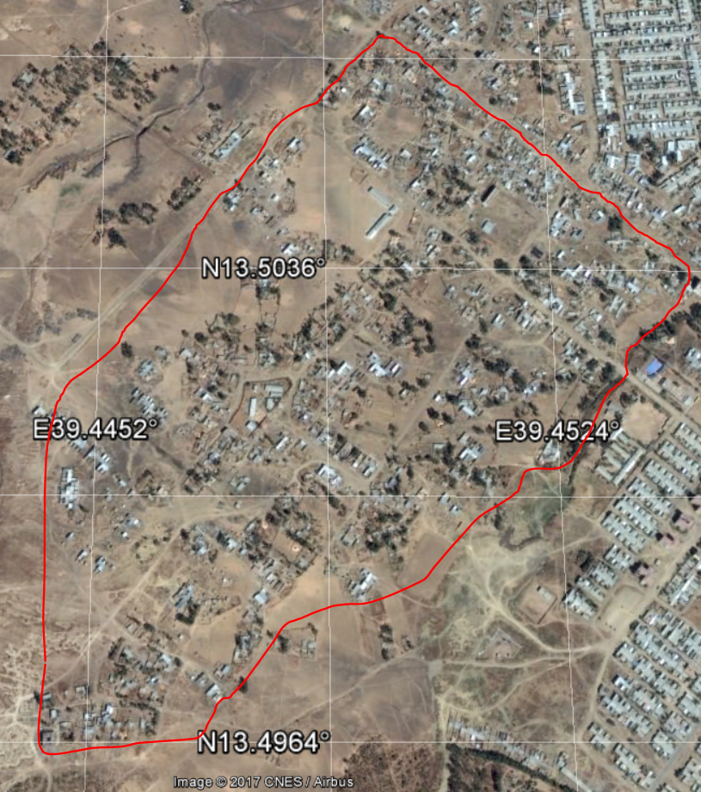
The case of Mekelle_Adi daero area
Description
    A large area, originally rural, but incorporated to the city as a result of expansion.
    Only 2.5-3km from the center of the city
    A mass of native dwellers. however, new dwellers settled in need of cheap land or profit considering future land values.
    Rapid and uncontrolled construction of new settlements.

Slide 10
The case of Mekelle_Adi daero area
Challenge 1:- Planning infrastructure
    SP, during preparations, only consider these areas as vacant and an option for expansions.
    When considered, Planning interventions doesn’t align with existing situations due rapid changes during planning periods.
    The Gap between the need and Financial Capacity of the city, Revenue .

Slide 11
The case of Mekelle_Adi daero area
Challenge 2:- Implementation infrastructure
    Governmet the only provider
    Environmental and social safeguard compliance. Issues of land compensation, Compliant handling etc...
    Clearing the Right of way and identifying Urban land use proposals for infrastructure provision.

Slide 12
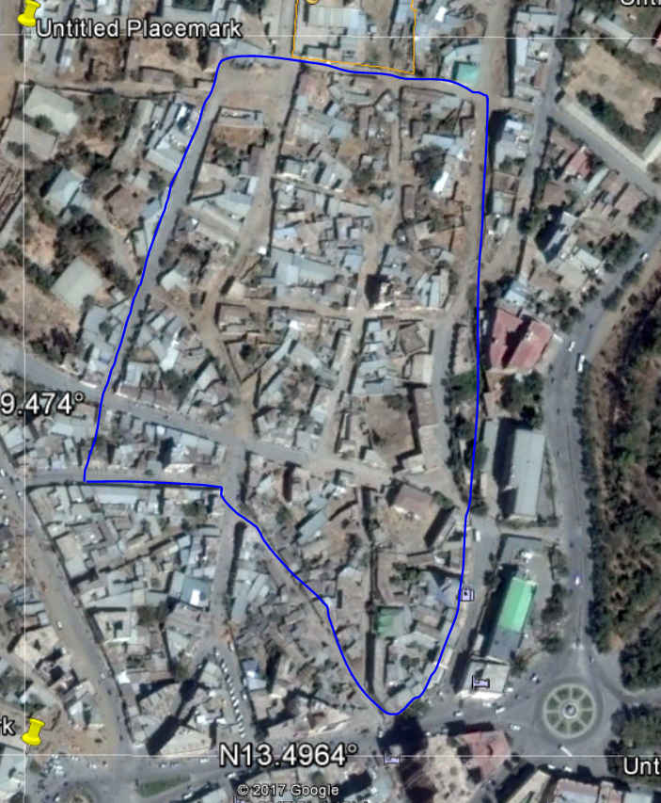
The case of Mekelle_Adi-eslam Area
Description
    A small area to the east side of the Atse Yohaness Palace, one of the oldest settlements of the town.
    Dwellers are strongly attached to the locality in economic and socio-cultural aspects.
    Ownership and title deeds have been transferred to Generations with out any document.
    (Homogenous/pocketed/Harmonized/Poched/Integrated/Engulfed/Segregated...) informal settlement

Slide 13
The case of Mekelle_Adi-eslam Area
Challenge 1:- physical
    Unclear right of way as a result of unplanned settlement,
    Accessibility problems,
    Dilapidated housing and lack of basic services

Slide 14
The case of Mekelle_Adi-eslam Area
Challenge 1:- Socio-economic
    Unmatched need for income generation, economic stability, Job opportunity
    Social integration
    Health and sanitation issues

Slide 15
The case of Mekelle_what’s done
    Public initiated infrastructure provision, at Adi-daero, like water stand pipes, Electrification.
    Intervention on critical infrastructure needs such as arterial roads and major storm water drainage lines and Communal toilets. (Adi-eslam area)
    Infrastructure Provision as bargaining opportunity to negotiate with local community.
    Implementation of programs that promote local economic development and Job opportunity through local resource utilization.

Slide 16
THANK YOU !

