Slide 1
HOUSING DEVELOPMENT AND INDUSTRY
Mekele situation and proposed solutions
Sep 2017 Gonder
CONFIDENTIAL AND PROPRIETARY - ALL WORK IS INFORMED BY THE ILO STANDARDS FOR ACCOMMODATION

Slide 2
Contents
▪ Context of Mekele city and surrounding industrial parks
▪
▪
▪
Housing demand and supply
Possible design choices for proposed solution
Infrastructure needs for housing and design implications
4

Slide 3
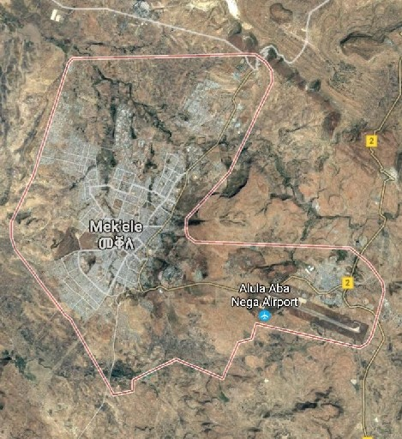
Mekele is the economic,
social
and
cultural
hub
of
the
north, with
a
population
of
over
400,000
General city infor- mation
Population 400,499 (2016)
Growth rate 4.8%
Region Capital of Tigray, 780 KM
north of Addis Ababa
Zone Northern
Ethnic groups Tigray (96.2%)
Area 24.44 km2
Household size 3.8
Population 9,000/km2
Density
Amhara (2.26%)
Mekele
Industrial develop- ments
There are 3 types of industrial developments:
1) Expansion of existing manufacturing
operations, e.g., cement, steel manufacturing
2) New regionally and privately developed
industrial parks: DBL, Velocity, Chemical
factory
3) IPDC – developed industrial parks
and car assembly, pharmaceuticals, etc.
Infra- structure
▪ Currently only ~60% of water demand is met
safety
▪ Challenges also exist with sewage, fire and

Slide 4
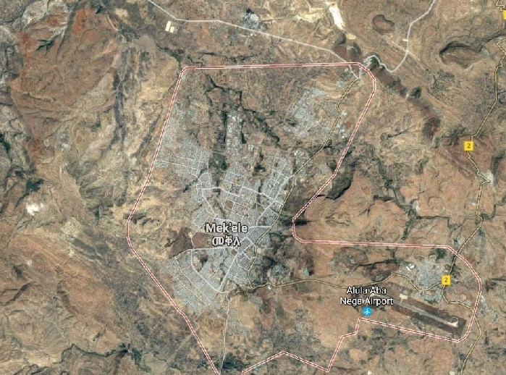
Mekele has existing manufacturing operations and
expects large-scale industrial
parks
in
textiles
and
chemicals
x
Industrial development
Map of Mekele city and surrounding manufacturing companies Area of Expected # of
(in brackets estimated number of workers in May 2017) Mekele Description workers, 2021¹
Velocity
ufacturing (including other investors)
(3,000)
Tigray state chemical
assembly (8,000)
MAA and
manufacturing DBL (0)
98% complete with operations likely to
▪ No settlement in direct proximity, distance to
▪ Existing metal industry and car assembly by
_{A}
B ^{Ce}
man
(1,60
North
Mekele
A Private industrial park by Velocity 18,000
▪ Started operations with ~3,000 workers for
Velocity
▪ Plans to expand to ~20,000 workers by 2019
20,000
▪ No settlement in direct proximity, distance to
Mekele is ~5km
B Cement factory 2,000
industrial
park
ment
0)
Qwiha
C Qwiha local manufacturing: 7,000
▪ MAA Garmet and Textiles operating since 2004,
now has ~1,500 workers, and plans to
double capacity
▪ 3,000-4,000 additional local workers from
Qwiha employed in other industries
E DBL & new Italian investor 15,000
▪ DBL plans to start operations this year
▪ Expansion to ~10,000 workers by 2019 ^{27,000}
▪ In addition, a new Italian investor is likely to move to the area
D Chemical industrial park of 75 hectares 5,000
▪ Under construction currently through Chinese
company
▪ Seeking financing support from Exim bank of
China and US sources
Steel and auto ^{G}
industrial park (0)
_{D}
F
C Qwiha E
ha
IPDC industrial park (0)
other Qwi
(3,000)
5 km
IPDC
park
(South-
west)
F ▪ As of early June, 75-hectare of development is 20,000
commence in 2018 (no investors yet) Mekele is ~5km
Mekele city²
G Steel and auto assembly² 8,000
Mesfin industrial Engineering
1 Low end of range; assumptions detailed later in document
2 Not covered in housing review due to expected low growth
Total 2021
worker expectation¹
75,000

Slide 5
Contents
▪
Context of Mekele city and surrounding industrial parks
▪ Housing demand and supply
▪
▪
Possible design choices for proposed solution
Infrastructure needs for housing and design implications
7

Slide 6
HOUSING DEMAND
Mekele’s rapid growth leads to an expected demand
of
~40,000 units over
# of people¹
the
next 5 years to house
160,000-180,000
people
Mekele has an existing unmet housing demand and expects growth…
Housing demand in Mekele for the next 5 years (2017-2022)
# of units
50,000 – 110,000 – 160,000 –
60,000 120,000 180,000
27,500 – 30,000 40,000 – 45,000
Existing need for Demand due Total demand formal housing to growth of over 5 years settlements population
Currently living in informal settlements
▪ The city estimates the total
demand excluding
industrial developments as
▪ 27,500 units can be attributed to organic growth of the city (4.8%
increase)
▪ The remaining 12,500 units
to existing unmet need for
40,000 – 45,000 units
12,500 – 15,000
annual population
required can be attributed
formal housing
1 Assuming estimate of 4 people per household (rounded city average from 3.8)
SOURCE: Interviews with Mekele City Administration (Mayor’s office, Land and master planning) citing Mekele housing demand ₈
survey

Slide 7
HOUSING DEMAND
New housing has to comply with standards,
and
take
the
specific
needs
of
worker
demographics
into account
High-quality housing has tangible advantages
Requirements on design
▪ Well-rested workers will be more
▪ Low-quality housing leads to high
▪ Compliance will avoid negative
consumers, as investors are seen to
▪ Compliance with standards is a
DFIs, especially IFC
▪ Compliance with standards ensures
accommodation
▪ ILO and IFC have developed
standards for bedrooms
(occupancy, size, furnishing,
ventilation and lighting of
bedrooms), facilities (water
access, sanitation, cooking,
laundry) and operations and maintenance
▪ Specific demographic
needs of workers need to
be considered, e.g.
– Female workers
– Different ethnic groups
Labour productivity
productive
employee turnover
Public relations
publicity and attract ethical
uphold human rights
Investment support
prerequisite for investment from
Safeguarding of workers
that workers have safe
SOURCE: ILO, IFC, Housing expert interviews 11

Slide 8
HOUSING SUPPLY
In terms of supply, there is a large scale affordable housing development
called
Mizer
in
progress,
which
leaves
a
gap
of
at
least
31,000 units
Housing gap
Velocity
Qwiha
IPDC
The Mizer integrated housing solution will address less than half of the total demand
over the next five years
Demand and supply of housing units in Mekele over next 5 years
Number of housing units (people¹), 2017-2021
13,500
_{40,000hh - 45,000hh} (54,200)
31,000 – 36,000
(124,000 – 144,000)
(160,000 - 180,000)
^{20,000hh} 2,265hh
^{(80,000)} (10,000)
36,235
Demand for Worker demand Mizer scheme NUDP
formal housing from industrial (details follow) Gergembes³
developments²
Remaining demand for formal housing
1 Assuming estimate of 4 people per household (rounded city average); household size also applies to proposed dorm solution
2 Low end of range from previous analysis
3 Townhouses near Qwiha planned in the urban design plan for Gergembes of Ministry of Urban Development, Housing &
Construction, supported by World Bank

Slide 9
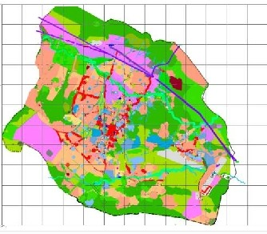
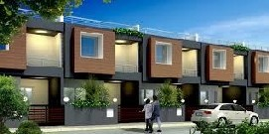
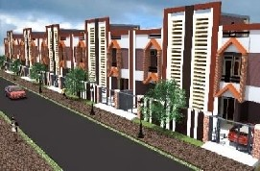
HOUSING SUPPLY
Phase 1 of Mizer housing scheme
aims
to
build
11,400
units
in
the
#
next 2-3
Number of people¹
years
and
20,000
by
2022
Location of Mizer housing scheme and overall design
Ramp-up and ownership plans for housing
^{IPDC} Sample houses under the Mizer
Mizer integrated village Scheme
Overview of Mizer scheme
▪ Infrastructure to service land is provided by government free of charge
for large-scale housing developments (serviced with electricity, etc.)
development area.
▪ 6 types of units with different layout are offered with 65-70m² NIS,
▪ Mekele Housing agency: is involved in consultancy and enforcement of construction standards during the construction phase
Supply of housing units through Mizer scheme
Number of units
45,600 34,400 80,000
20,000
Phase 1: Phase 2: Total
2019/2020 2021/2022
8,600
11,400
▪ 569 associations “Mahiber” /
11,380 households / ~60,000
people.
▪ Construction of 94.5
hectares started on the
week of May 22nd on 94.5
hectares
▪ The scheme mainly caters for civil servants, members
of the military & police force
and residents of Mekele
▪ 431 association “Mahiber”/
8620
households
/ ~34,000
people
▪ Land registration process is complete
▪
Land covers a total of 700 hectares, with houses of G+1 design
▪
Public transport will be available to the city from the housing
with each unit containing 3 rooms, a kitchen, a toilet and a living area
1 Based on 4 people per room

Slide 10
HOUSING SUPPLY
The
Mizer scheme will likely be
unaffordable
for
low-income workers
Initial contribution of home owners
Provided by Dedebit MF
The Mizer scheme is not designed for low-income industrial workers
80% of cost of construction for the Mizer units is provided by Dedebit MF (DMf) and the rest is covered by the house owners
To-date, uptake has been:
▪ 40% residents of Mekele, civil servant
▪ 60% workers of various industries with
▪ The Mizer scheme relies on participation
finishing)
for loan which is likely unaffordable for
recently moved to the city
▪ This restricts affordability of the rent
▪ There is no regulation, the house owners are free to rent the units on free market, at an estimated price of 2,500 – 5,000 ETB/ Unit. depending on layout and internal
▪ This would translate to a cost of 450-1250
ETB/worker, assuming a minimum of 6
▪ Sharing of flats between multiple workers will likely be an unattractive option for landlords, leading to even higher prices
Financing structure of Mizer Scheme, ETB, in thousands
240 (100%)
Initial deposit Initial loan Additional loan Total
▪ Financing structure:
– The home owners need to contribute 20% cost of construction initially and borrow 30% additional from the Dedebit Micro finance (DMF) in order to get land
– DMF will release the remaining 50% of cost of construction to the home owners at different stages of construction
– The loan repayment period is 15 years with interest rate of 11.9%
▪ Land costs: The house owners are expected to pay a land lease priced at 485
ETB/m2 with installment period of 50 years at 9% interest rate after completion
of the house construction
▪ Construction costs: A centralized sourcing and procurement method is used for the construction materials (Messebo Cement factory, Guna construction material supplier company and SME suppliers)
Phase 1 audience
workers in Mekele( Military, police, etc.)
120 (50%)
monthly salary above 2,000ETB
Financing and owner- ship
48 (20%)
72 (30%)
of owners in construction (in particular for
▪
Ownership requires 20% down payments
workers, in particular for workers who
Rental prices
finishing
workers in one unit
Note: Internal partitioning and finishing is not included in the cost of construction (Which is estimated to cost additional 60,000 –
100,000 ETB per unit for the home owners)

Slide 11
Contents
▪
▪
Context of Mekele city and surrounding industrial parks
Housing demand and supply
▪ Possible design choices for proposed solution
▪
Infrastructure needs for housing and design implications
17

Slide 12
CENTRALISED SOLUTION
We have proposed a high level design
for
a
housing
solution
in
each
area
–
along
three critical dimensions
Current situation in Mekele
Design choices addressed in this chapter
▪
Three major industrial areas
around Mekele will require
housing dedicated to workers
with very low incomes, that
cannot be serviced by current
plans
Demographic composition of
workers requires a broader
housing solution in addition to
dormitories
Future highway between the three industrial developments makes transit a possible enabler
1▪ Ideal location of housing developments for each area of employment growth
2▪ Appropriate design of housing for low-income workers
3▪ Resulting economics and required
support from investors for housing
per area
▪
▪
18

Slide 13
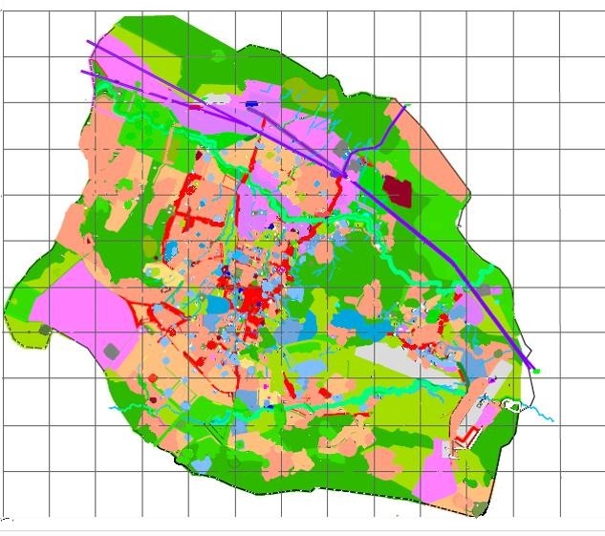
CENTRALISED SOLUTION: LOCATION
1
Land is available in walking distance to the IPDC and Qwiha
developments,
for
Velocity
a
short
transit
might be required
Land availability based on Mekele city master plan
▪ Sufficient undeveloped land for
housing is available in walking
▪ For IPDC and Qwiha: these areas are registered as future residential areas
▪ Housing options for Velocity park:
designated for future industrial
– A short distance transit solution
would be required (~4km
distance following roads and
bridge)
distance of Velocity, the master
a mixed commercial plus
considered
Industrial developments
Residential space – available
Residential space - settled
Green area
Proposed for housing
▪ Velocity
land available for housing
4km away
distance to all developments1
▪
90 ha of
in the master plan
–
Land in vicinity of Velocity is
development
▪ Qwiha, including DBL
▪ 41 hectare of land for housing within walking distance
–
To provide housing within walking
▪ IPDC industrial park, 1000 ha
▪ 263 ha of land
housing available
plan would have to be adjusted or
residential development could be
5 km
1 Land requirement for 100,000 workers in G+4 model is ~33 hectares

Slide 14
CENTRALISED SOLUTION: LOCATION
1
Housing solutions located in
walking
distance
to
the
employment
opportunities
are
preferred
Reasons to focus on housing close to the parks
Transportation costs are significant compared to affordable rents
▪ There is no significant difference in cost to provide infrastructure in the city centre to areas close the parks
▪ Currently Velocity is paying 300 ETB / month / worker for transit
▪ This is more than the affordable rent of ~250 ETB for
workers with minimum income
minimum cost of ~135 ETB - still significant compared to affordable rent
▪ Optimizing the transit system would require:
traffic prone roads
– High volume and utilisation on trips at shift start and shift end
– Phased start of shifts to allow for 4 return trips /day
– Busses can be used the remaining hours for public transit leading to an effective 20% decrease in Capex
▪ Transportation costs are significant
for the long distances outside the
city
▪ Optimizing the transportation solution would lead to
▪ The city centre is densely populated, and dormitory housing with transportation solution would lead
to further congestion
– Location of housing to allow bus routes to avoid
– Central pick-up locations as single stops

Slide 15
CENTRALISED SOLUTION: DESIGN FOR LOW-INCOME WORKERS
2
Workers with income below 1,500 ETB
per
month will require
dormitory
solutions
subsidized
by
employers
✓ ^{Can be provided at}
60-80% of workers are expected
to be in this income group
scale in vicinity of parks
Salary range of workers (example industries) Example housing solutions
ETB / month
Current condominium model ✓
Managers Mizer scheme (50-70m2) ✓
5,000
_{Studio units (20-30m}2_{) through low}
cost housing developer ✓
Supervisors in _{2,500}
textile and
garment industry
6 occupants per unit of 50-70m²) ✓
▪ Th in i init
1,50
▪ Do onl h
c sca
▪ Th at s c
th
inv
ndustrial parks will ially earn less than
0 ETB per month
rmitories are the
le for this group
cale and standards
estors to facilitate
e majority of workers
y affordable
ousing solution that
an be provided at
Mizer scheme with shared rooms (4-
ey can be developed
Heavy industry, ^{1,500}
construction
material workers
Textile operators,
Workers in food Dormitories, subsidized by
an be controlled to
e expectations of
access to subsidies
processing, ⁷⁵⁰ employers (4 occupants in 16m²) ✓
1 Difficult to get investor subsidy since it doesn`t follow the ILO standard of 4m² bed room space per worker
21

Slide 16
CENTRALISED SOLUTION: DESIGN FOR LOW-INCOME WORKERS
2
There are two potential options
to
supply
the
need
for
affordable
family housing
Option to service
demographic need Description
▪ Design: Change design from de-sizing units from 65m² -
70m² to 20m²-30m² per unit
either through IPDC or Mekele city administration providing capex; regulate rental prices for affordable housing
▪ Invite international players, e.g., Tata Housing to design a
Land and infrastructure are provided for free by Mekele city
Extend Mizer scheme with a lower-cost model
▪ Ownership: Change to a centralized ownership scheme,
Central development of low-cost dorms or condominiums
low-cost solution of G+1 housing for couples or families
▪
to maintain cost-competitiveness, as seen in Mizer scheme

Slide 17
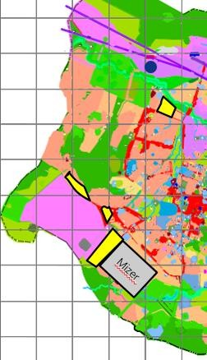
CENTRALISED SOLUTION: RESULTING ECONOMICS
3
A transportation solution might be required for Velocity
if
dormitories
in
walking
distance
are
not
possible
Map of Velocity and IPDC parks, with Dormitories in walking distance to Velocity would
possible transportation routes require a change of the city master plan
▪ There is ample unoccupied land available in close
vicinity to Velocity; however, it is designated for
▪ The closest land designated for housing is in
₂ ▪ If the urban masterplan is not adjusted to allow
solution will be required, through one of two options:
–1 Transit to the potential dormitories ~4km away from Velocity, requiring an estimated
transit cost of 105 ETB / worker / month¹
–₂ Transit to the potential dormitories near IPDC
estimated transit cost of ~135 ETB / worker /
month¹; route availability is contingent on the
planned highway (shown in brown)
Planned highway route
Potential land available for housing
# Transit option to
housing from Velocity
Park
Velocity
industrial development
1
~4km walking distance (bridge crossing required)
for housing closer to the park, a transportation
industrial park and Mizer, ~10 km, requiring
5 km
1 Assuming the costs of transportation can be optimised, including use of busses for public transportation during downtime
SOURCE: Mekele land administration master planning; international press search on public bus OPEX benchmarks ₂₉

Slide 18
Contents
▪
▪
▪
Context of Mekele city and surrounding industrial parks
Housing demand and supply
Possible design choices for proposed solution
▪ Infrastructure needs for housing and design implications
30

Slide 19
Mekele infrastructure will need to be expanded for increased usage
workers – already constrained water supply is particularly critical
from
Overview over Mekele infrastructure supply and demand for new housing
Discussed next
Projected utility demand for Mekele industrial workers (domestic usage)
Assumption For all Mekele workers
per worker requiring housing¹ Current city capacity and expansion plans
▪ 0.02 m3 / ▪ 1,760 – 3,100 m3 / day ▪ 38,000 m3 / day
demand in 2017) of up to 25%
while industrial users are expected to provide supply their own
water, with technical assistance from Tigray Water Association
_{▪ Same as ▪ Same as above} ▪ Developments can be connected to sewer as part of cost for
▪ Availability of treatment plant to be confirmed
▪ 2 L/day/ ▪ 176,000 – 310,000 L / ▪ High priority for Mekele mayor due to city shortage
▪ 180 kWh/ ▪ 15.8 – 27.9 GWh / year ▪ City suffers frequent power outages
development with connection of high-voltage lines
Water
day / capita
(up to 10% of city total
▪
▪
Highest priority for Mekele due to supply constraint and losses
Residential and commercial water will be provided by the city,
Waste water
above
serviced land
Solid Waste
capita
day
▪
Current DFI support exists conducting diagnostic
Electricity
year/capita
▪
Expansion plans include a substation near IPDC under
1 Based on range from ramp-up numbers provided earlier in document (54,000 – 115,000 workers) ₃₁
SOURCE : Tigray Water Association; Mekele city interviews

Slide 20
INFRASTRUCTURE
Water will be a challenge for housing developments, current supply
only meets
60% of demand,
causing residents
to get water only
1x
per
week
Unmet demand
Supply (consumption)
PRELIMINARY - TO BE REFINED
Industrial parks source
their own water
Mekele city focus is on addressing the residential and commercial water shortage in the next 5 years
▪
Each industrial
park is drilling
their own
boreholes for
production (e.g.,
DBL has two
boreholes and
currently provide
the excess water to
Mekele city water
supply system)
Although there
have been no well
field recharging
initiatives, there is
no immediate
threat to the
aquifer capacity
Estimate of future demand with outside-in assumptions
2017 actual consumption
and projected demand by Drivers of demand growth in 2021 estimated supply and
user type, m3 per day next 5 years demand, m3 per day
Demand growth of 7-15% YoY, _{85,000 – 115,000}
driven by:
▪ City growth rate of 4.8% YoY
10,000 – 40,000
▪ Industrial park population of
63,800 ^{~100,000 workers}
▪ Increase in consumption per capita of 1.5% YoY
Supply growth
▪ City efforts to address to
address the challenge: Gereb
_{Residential} Segel is expected to start _{Residential}
_{and other}1 operations in January 2018, _{and other}1
supplying 250 L/second. This
^{Only ~60% of water demand} can potentially be upgraded
is met, and water is rationed _{to 500 L/second in 5 years}
residents currently only get
_{water once per week}
Current
challeng
▪ Ther losse
25%
▪ Dam
tre
are capi
inte
ETB 1
const
cost f
Sege
▪ Long
invol buil on Gi but t
take 3
to be
oper
es:
s of 20- and water
tal
.12 bn ruction
or Gereb l Dam
-term
ba river,
-4 years
e are
atment plant
75,000
nsive, e.g.,
▪
38,000
supply plan
ves
ding a dam
his will
come
ational
1 Municipal and commercial
SOURCE: Consulting report (Ensuring water availability in Mekelle City, Northern Ethiopia: evaluation of the water supply sub- ₃₂
project, Temitope D. Timothy Oyedotun); Mekele water supply service

Slide 21
Water scarcity in Mekele must inform overall design choices for new housing
developments (1/2)
Levers
Description
Use
Estimated cost
Water saving measures
Low flow toilets
Reduced flushing volume
(e.g. 4 L)
-
▪ Comparable to standard toilets
Low flow taps
Reduced flow volume or flow
breaks
-
▪ Comparable to standard fittings
Water
supply:
rainwater
collection
Rainwater collection- buildings
Collection from tiled roof into
tanks, minimum treatment:
pump back into system
▪
▪
Service water¹
Additional
treatment:
drinking water
▪
CAPEX (tank, piping, pumps)
Approx. 70% cost conventional
system²
OPEX 0,5 * CAPEX
▪
Rainwater
collection-
aquifer
recharge
Collection from roofs or
surface and recharge into
aquifer by wells or
percolation
Drinking water
▪
▪
CAPEX (pumping system, piping,
wells)-approx. 1/10 cost tanks
OPEX 9,0 * CAPEX
Rainwater collection- surface storage
Collection in earth dam or
smaller weirs (depending on
topography)
Service water
With treatment:
drinking water
▪
CAPEX (earth works, pumping
system, piping, treatment)-approx.
1/5 cost tanks
OPEX 2,0 * CAPEX
▪
1 Service water: flushing toilets, outside cleaning, irrigation/landscaping, fire fighting
2 WB NUDP report for Gergembes calculates $320,000 for water supply system for 15-17,000 people
3 Only roof catchments considered. Obviously, collecting surfaces on paved roads would increase amount of water
SOURCE : Water expert; global case studies; World Bank’s NUDP report 33

Slide 22
Water scarcity in Mekele must
inform
overall
design
choices for new housing
developments
Levers
(2/2)
Description
Use
Cost
Water
supply
augment-
tation
Mix system:
rainwater plus
grey water
treatment
▪
Collection rainwater into
tanks. Collection of grey
water⁴ and treatment.
Mixing of the two
Service water⁵
▪
CAPEX (tanks, piping, pumps,
treatment); Approx. 114% cost
conventional system;
OPEX 5,0 * CAPEX
▪
▪
Grey water treatment
Collection of grey water⁶
and treatment
Service water
▪
CAPEX (tanks, piping, pumps,
treatment); Approx. 140% cost
conventional system
OPEX 5,0 * CAPEX
▪
Constructed wetlands
Pre-treatment for solids
removal + reed beds-
treatment of sewerage
Irrigation
▪
▪
CAPEX (earth works, pumping
system, piping, treatment)
OPEX 2,0 * CAPEX
Improved seepage on outside surfaces
Roads, parking, etc.
Recharge of
aquifers
Diminished
flooding
Cost comparable to standard fittings
4 Light grey water: bathtubs and bathroom sinks + laundry
5 Treatment for drinking quality: very expensive
6 Treatment for drinking quality: very expensive
SOURCE : Water expert; global case studies; World Bank’s NUDP report 34

Slide 23
Mekele can take three types of actions at the city level to address the
water
challenges
Type of action International examples Description of levers
▪ California’s Arcata ▪ Assessment current water demand and use and forecast future ^{constructed wetlands} ▪ Implement efficient water use actions (leaks reduction,
in Northern China, rainwater harvesting, etc.)
fees, improve water fees collection, education, incentives for
▪ Augmentation supply availability (groundwater recharge, surface
reservoirs, etc.)
▪ Australia’s IUWM ▪ Policy level: control of land use to limit soil erosion, management
▪ Infrastructure development: water transfers, dams, etc.
▪ Local activities: re-afforestation, protection water sources,
▪ Constructed Wetlands ▪ Recycling treated industrial wastewater for industrial reuse and
▪ China’s eco-industrial
▪ Taiwan’s housing
1. Improvement of
water supply and
sanitation system in
Mekelle city
▪
Rainwater harvesting
wastewater treatment plant and recycling, sewerage water plant,
Singapore, and Tokyo
▪
Implement demand management strategies (restructure water
water saving appliances-especially commercial users)
2. Improvement water
resources
management around
Mekelle
strategy
of the territory, decentralized catchment protection
agricultural practices
3. Propose options of
cooperation with IP
for conjoint water
saving and
management
in Nepal or California
agriculture
parks
gray water
Mekele can also explore PPP options for water management

Slide 24
Thank you

