Slide 1
Projecting the Implication of Urban Population Growth on Urban Facilities in Amhara Region: An Application of SPECTRUM Model
Belete Debebe,
Population Studies Department, UoG
Email: beleaman2005@gmail.com
National Consultation Meeting
September 30, 2017 @ Taye Belay Hotel
Gondar, Ethiopia

Slide 2
Presentation Outline
Background
Objective
Methods and Materials
Data Sources
Methods of Projection
Data Analysis
Description about the Model
Result
Implication

Slide 3
Background of the Study
the world is rapidly becoming urban.
Since 1850 only 2% of the world population lived in cities of 100,000 or more people
At present more than (50%) 3.3 billion of world population lived in urban areas.
But, the magnitude of urbanization differs in time and place.
Hence, urbanization is an inevitable phenomenon
It is the outcome of demographic, social, economic, and political development

Slide 4
Background…
Ethiopia is characterized by a low proportion of urban population, but rapid rate of urbanization compared to other countries in sub-Saharan Africa.
The proportion of total population living in urban centers was
6 percent in 1960,
10.4% in 1980,
15% in 2000 and
slightly more than 16% in 2007

Slide 5
Background…
Despite the long history Amhara region remains the least-urbanized region in Ethiopia.
Only 12.3 percent of its population lives in urban areas.
The majority of living quarters in most cities and towns of the region are nothing more than slums that have mushroomed overnight as people flocking to cities found it impossible to find descent accommodations upon arrival.
The quality of available shelter is extremely poor

Slide 6
Background…
As shown in the 2007 population and housing census
Of the total housing units (591,428) in Amhara region urban area
about 92% are made of wood and mud
Housing Units by Number of Rooms and Average Number of Rooms Per Housing Unit
51% with one room
23.4% have two rooms
15% have three rooms (about 89% have three and below)
The rest (about 11%)have more than three rooms

Slide 7
Background…
Housing Units by Source of Drinking Water
44% of the urban resident their source of drinking water is tap outside compound
24% their source of drinking water was tap in compound shared
13% their source of drinking water was tap in compound private
Only 2.4% their source of drinking water tap inside the house
The remaining are different sources

Slide 8
Background….
Housing Units by Type of Toilet Facility
37.2% have no toilet facility
38% had pit latrine shared
17% had pit latrine private
Housing Units of Towns by Type of Kitchen
About 35% have no kitchen
57% have traditional kitchen outside the housing unit
6% have traditional kitchen inside the housing unit
Only about 2% have modern kitchen inside and outside the housing unit
Hence, the effect of increasing urban population is clearly evident in urban areas of the region

Slide 9
Background…
Urban infrastructures are seriously overtaxed by the burgeoning population, and providing adequate housing, sewerage, electricity, and other services will become more difficult as the population living in cities continues to grow

Slide 10
Background…
Thus, timely projected data on urban population growth and its consequence on urban development is a key input in order
to better assess current and future needs with respect to urban growth and
to set policy priorities to promote inclusive and equitable urban development.
to systematically track the implication of rapid urban population growth on urban services.

Slide 11
Objective of the Study
This study aims to project and raise awareness about the implication of rapid urban population growth on urban development in Amhara region using RAPID module in the Spectrum model from 2007 to 2037 based on hypothetical assumptions.

Slide 12
Data sources
Secondary data sources for the base year (refers to the period of 2007) were collected from:
Amhara Region Health Bureau and Federal Ministry of Health and Health Related Indicators (2007-2010),
Central Statistical Agency, Agricultural Sample Survey (2007-2010),
Population and Housing Census of Ethiopia (2007),
Amhara Region Urban Development Bureau and
other published and unpublished document: annual report, statistical abstract and so on.
Then based on data assumption was developed

Slide 13
Methods of Projection
RAPID (Resources for the Awareness of Population Impacts on Development) module in the SPECTRUM model was used to project the social and economic consequences of high fertility and rapid population growth on urbanization and urban development in Amhara region.

Slide 14
Data Analysis
The data were analyzed using SPECTRUM Suit 4 Model developed by Health Policy Project
SPECTRUM is a window-based system of integrated policy model designed to produce information that is
useful for policy formulation
to set priorities

Slide 15
Model Assumption
Two different population scenarios were assumed using a demographic projection tool
Using RAPID module in the SPECTRUM model;
the total urban population,
number of population in major cities,
annual new urban households and
trends of urban youth growth in urban centers in the next 30 years (2007-2037) is projected

Slide 16
Result
The projection result revealed
Under slow fertility declining scenario, Amhara region’s urban population is projected to increase from 2.4 million in 2007 to 9.1 million in 2037 - an increase of about 7 million which is about four times the 2007 census urban population number
Under fast fertility declining scenario, Amhara region’s urban population is projected to increase from 2.4 million in 2007 to 8.2 million in 2037 an increase of about 6 million people which almost three times the urban population number of the 2007 census
Hence, it is under slow fertility declining scenario, the urban population is projected to grow more.

Slide 17
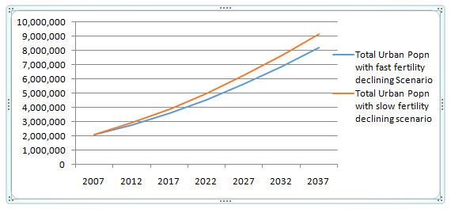
Total Urban Population with slow and fast fertility scenario

Slide 18
Results…
In both cases one can notice that the proportion of people reside in urban area of the region is increasing.
The increase magnitude of the urban population can have many implication on urban facilities: shortage of housing
Currently, a large share of the urban population look for housing solution
in the private rental sector or
informality by purchasing land from farmers in peri-urban areas
the government policies excluded the poor by focusing housing and land supply on:
Condominium that are not affordable to the poor
Auctions of land leases which do not satisfy the demand
Hence, the projection warn and aware government to set priorities and alternative policies on housing

Slide 19
Projected population of major cities in Amhara region
The projection result also revealed an increasing tendency of population in major cities
Under slow fertility declining scenario, the population of major cities is projected to increase from 259,803 in 2007 to 2,786,409 in 2037
Under fast fertility declining scenario, the population of major cities is projected to increase from 259,803 in 2007 to 2,133,227 in 2037.
In both cases the annual change rate of the population in major cities in the next 30 years period will be very high

Slide 20
Projected population of major cities….
In only thirty years, the population of major urban centers of the region will be multiplied 4 times.
A very rapid growth of population of major cities requires an enormous amount of resources necessary for housing, service, jobs, infrastructure, environmental protection, and more in general for economic development.

Slide 21
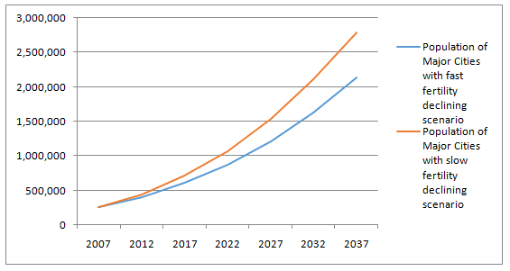
Population of major cities in Amhara region (2007-2037)

Slide 22
Projected urban youth in urban areas of Amhara region (2007-2037)
Youth are the region’s greatest asset to benefit from the region’s demographic dividend for the present and in the future period.
They also represent a group with serious vulnerabilities unless serious attention will be taken into consideration by planners and decision makers in the future period.
the urban youth population in Amhara region is expected to increase from 821,568 in 2007 to 2.6 million (fast) and 2.9 million (slow), respectively by the year 2037, a difference of nearly 300,000 fewer urban youths.

Slide 23
Projected urban youth……
Currently, youth unemployment is a serious concern in urban areas of the region due to
rural-urban migration,
the mismatch between the demand for and supply of labor,
the low entrepreneurial capacity of the youth
the growing youth population in need of government employment
it is the fast fertility declining scenario can help address youth unemployment and related social problems such as crime, violence, and health issues, which can arise when there is a lack of opportunities for urban youth.
Thus government has to make advance preparation

Slide 24
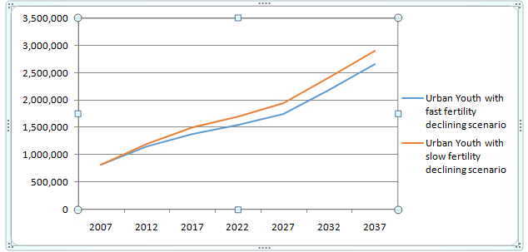
Projected urban youth…..

Slide 25
Projected annual new urban households
The projection result depicted
with the slow fertility declining scenario, the annual new urban households between 2007 and 2037 in Amhara region would need about 742,854 new housing units
But, with fast fertility declining scenario 499,579 new housing units would require between 2007 and 2037
The projection revealed under fast declining scenario, the annual number of new urban houses required is projected to grow at a higher rate
Hence, government has to make advance preparations to deal with the basic needs of its growing new urban households in terms of jobs and housing as well as education and health services.

Slide 26
Projected annual new urban….
Rapid urban growth and building new urban houses each year puts continual pressure on urban infrastructure, including water and sanitation, roads and transport, and energy.
The associated high housing demand leads to
deficits in urban housing,
the creation of slums including informal settlement and
adverse social and health-related outcomes.

Slide 27
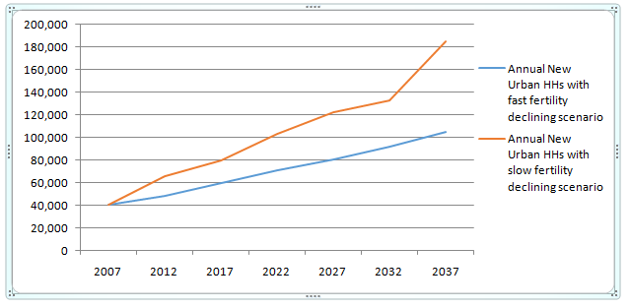
Projected annual new urban households….

Slide 28
Implication
The projection result suggests that the urban population would grow at a higher rate in Amhara region in the coming 30 years.
Amhara region has to make advance preparations to deal with the basic needs of its growing urban population in terms of jobs and housing as well as education and health services.

Slide 29
Implication…
The current (2007) urban population of about 2.4 million is expected to grow to about 8.2 (fast) and 9.1 (slow) million in 2037.
This would mean that there would be close to 6-7 million additional urban populations by 2037.
Every addition brings new pressure on basic urban service needs which is not financially and technically easily attainable
Taking into account the projected population about 2.9 and 2.6 million additional youth population is expected by 2037, which translates into higher demand for jobs and basic social services.
Therefore, the government should create an enabling environment for inclusive local economic development that will create jobs and employment opportunities to the youth, among others.

Slide 30
Implication…
In terms of households, there will be close to 499,579 and 742,854 additional new urban household for which 499,579 and 742,854 housing units will be required in the coming 30 years with fast and slow fertility declining scenario assuming a one to one household-housing unit ratio
In the absence of adequate, affordable urban services a growing population translates into growing urban poverty
Failure to address the future demand of housing unit will result in
proliferation of informal settlement and of congested slum settlements.

Slide 31
Policy Implication…
Rapid urbanization and urban population growth could severely limit development if it is not managed in such a way that supports economic development and buttresses social welfare improvements.
excessively rapid urbanization could out-strip the region’s capacity and capability to manage the process of urbanization if appropriate actions are not taken in a timely manner.

Slide 32
References
Cohen, B (2006). Urbanization in Developing Countries: Current trends and future projections and key challenges for sustainability. Technology in Society, 28: 63-80
CSA (2008). The 2007 Population and Housing Census. Preliminary Report at National Level, Addis Ababa.
Ethiopian Economic Association (2005/2006). Report on the Ethiopian Economy: Unemployment Challenges and Prospects, Volume V. Addis Ababa, Ethiopia.
Ministry of Urban Development, Housing and Construction (MUDHCo) (2015a). National Urban Development Spatial Plan - Draft Final report.
Selome Bekele and Assefa Hailemariam (2010). Population Dynamics and Environment in Ethiopia: An Overview – in Edwards, Sue (ed.), Ethiopian Environment Review no. 1. Forum for Environment, Addis Ababa.
Stover, J. and Kirmeryer (2005). DemProj Version 4, a computer program for making Population Projections. SPECTRUM System of Policy Models. Futures Group and Research Triangle Institute, Washington, USA.
Tegegn GebreEgziabher (2002). Urban Policy and Strategy in Ethiopia, Report on the 2nd National Conference on "Urban Development Planning and Implementation: Towards paving the way for partnership, May 14- 16 Adama.
Teller and Assefa HaileMariam (2010). The Demographic Transition and Development in Africa: The Unique Case of Ethiopia.
UN-HABITAT (2008). The States of African Cities. A framework for addressing urban challenges in Africa, United Nations Human Settlement Program. Nairobi.
UN-HABITAT (2010). State of the World’s Cities Report, “Bridging the Urban Divide” United Nations Human Settlements Programme.
UN-HABITAT (2011). Integrated Housing Development Program: Condominium Housing In Ethiopia, Nairobi, Kenya.
UN-HABITAT (2012b). State of the World’s Cities Report 2012/2013: Prosperity of Cities. Nairobi, Kenya: UN-Habitat.

Slide 33
Thank You!

