Slide 1
developing Project Led Education the spatial engineering programme Mark Brussel, 13/06/17

Slide 2
content
Brief introduction to Spatial Engineering
Problem Based Learning in SE
Characteristics
Staff and student roles
Project 1: Climate resilient cities
Triangles of educational alignment and Bloom’s
Intended learning outcomes
Teaching methods
Assessment
Linking learning outcomes and assessment
Application in your case studies

Slide 3
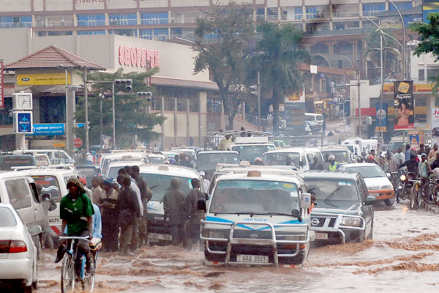
Real world “wicked” problems
Wicked Problems
Notes:
A wicked problem is in fact a system of interrelated problems where there are many players and the problem adapts – it changes and anything you do will change the problem. So what ca you do to find a solution? Learn about the problem, study and watch the system, appericiation of other points of view, become skilled in how to use the system and educate stakeholders.
Example of flooding which is only a problem when we intended the flooded area for other purposes. We can do as in this picture; put up a warning sign (which does not really solve the problem but prevents more problems from occurring (hopefully) or we can build dykes which move the problem into another area. So most spatial problems are wicked problems.

Slide 4
Multidisciplinary programme
Learn about all three knowledge areas to solve wicked problems
Technical Engineering
Spatial Planning &
Governance
Spatial
Information
Notes:
To learn about the system you need 3 core knowledge areas. Technical engineering to be able to model and understand the physical processes, spatial information to know where, when and what is happening, and spatial planning an governance to be able to use for interventions as well as predict socio economic drivers. For each an explanation follows

Slide 5
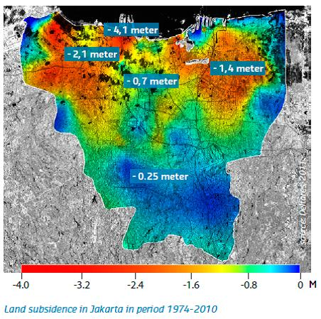
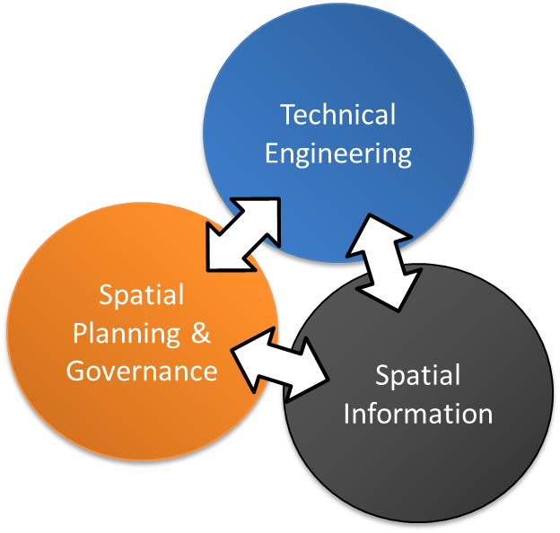
Use spatial information
to quantify the problem
to provide data for modelling and predicting future effects
to communicate about possible interventions
Notes:
The map is an example of where what is happening in time: It is Jakarta in Indonesia and it is slowly sinking: between 1974 and 2010 more than 4 meters due to the extraction of groundwater.

Slide 6
Use technical engineering
to measure and model
to design interventions
to innovate
Notes:
The picture is a flood model simulation for the Kampala area

Slide 7
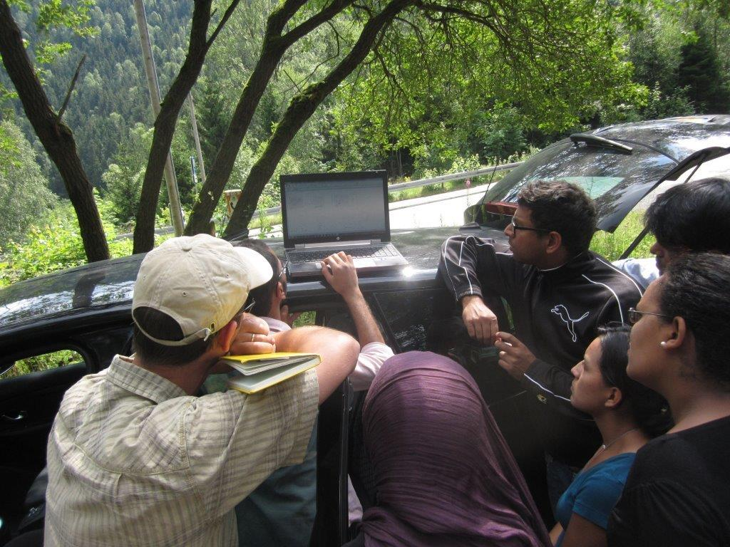
Use spatial planning and governance
to ensure socially robust interventions
to include stakeholders
to understand socio-economic drivers of change
= The place where science meets society!
Notes:
Socially robust interventions are those that are sustainable for the stakeholders involved. An example of non sustainable intervention is in Kampala the flood drainage that was build; it is not maintained and therefore does not solve the flooding problem. It increased the problems for the inhabitants of the city because they can not cross the drainage canal everywhere. An other example of a solution creating new problems.

Slide 8
Programme – first year
YEAR 1
Project 1 (15 EC)
Quartile 1
Key knowledge fields
Project 2 (15 EC)
Quartile 2
Technical Engineering
Spatial Planning & Governance
Elective (7,5 EC)
Quartile 3
Project 3 (15 EC)
Spatial Information
Fieldtrip (7,5 EC)
Quartile 4
Notes:
Problem based – project led education:
A mix of specialist lectures and project work
Group and individual assignments for example “design a sustainable intervention”
Find your specialism in the context of real life problems
Project outcome discussed with professionals/stakeholders
International Class room:
Mix between Dutch and international students from different backgrounds!
Student Centered:
Student responsibility to obtain the knowledge needed to solve the problem!

Slide 9
Programme – Second year
Electives
Topic selection, Individual electives in support of MSc research topic and proposal writing
15 EC
Research proposal
MSc research
MSc research, individual thesis but can be within a group effort related to existing projects
30 EC
Internship
Choice: internship, Industry or PhD preparation
15 EC
Industry
Scientific
Notes:
International (project) context (examples: Integrated flood management in Thailand, Earthquake aftermath in Nepal, East Africa food security, European climate change projects, UaV damage assessment)
Go in depth in a problem related to:
data and model quality,
future predictions,
governance issues,
(geo) physical processes
design/creation of a decision support system,
data quality and uncertainty propagation
….

Slide 10
characteristics of projects in SE
Are oriented to real world problems
Are formulated in an open manner, students have a lot of freedom to develop solutions
Are student-centred in that sense, students are in the driving seat
Help students to develop a wide range of skills
Involve active learning
Involve group work (in an international setting)
Draw on knowledge from a range of disciplines
Help students to develop a better grasp of theory and to develop new and powerful skills

Slide 11
Staff roles
Focus shifts from arranging and providing content to facilitating and organising the learning process
Providing more of a tutoring type guidance rather than direct inputs into problem solving
More individual guidance of students through Personal Development Portfolio
Emphasis on providing feedback during the process
More attention to the nature and role of assessments

Slide 12
Student roles
Students need to work within the boundaries of the project assignment
Students are in the driver seat, they should take initiative, the staff is facilitating but in principle not steering
This demands a pro-active attitude of students and the development of project management skills.
Students are encouraged to use a wide range of skills to develop and apply theoretical knowledge to practical situations

Slide 13
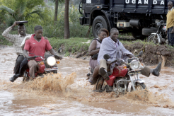
Project 1: Climate resilient cities
The students will be subdivided in groups of 5.
The students develop a water vision for the city of Kampala, taking account of current and future developments, and propose a number of spatial interventions.
Each group has to come up with a combination of one (or more) hard engineering and one (or more) soft engineering interventions. These interventions need to be designed and presented.

Slide 14
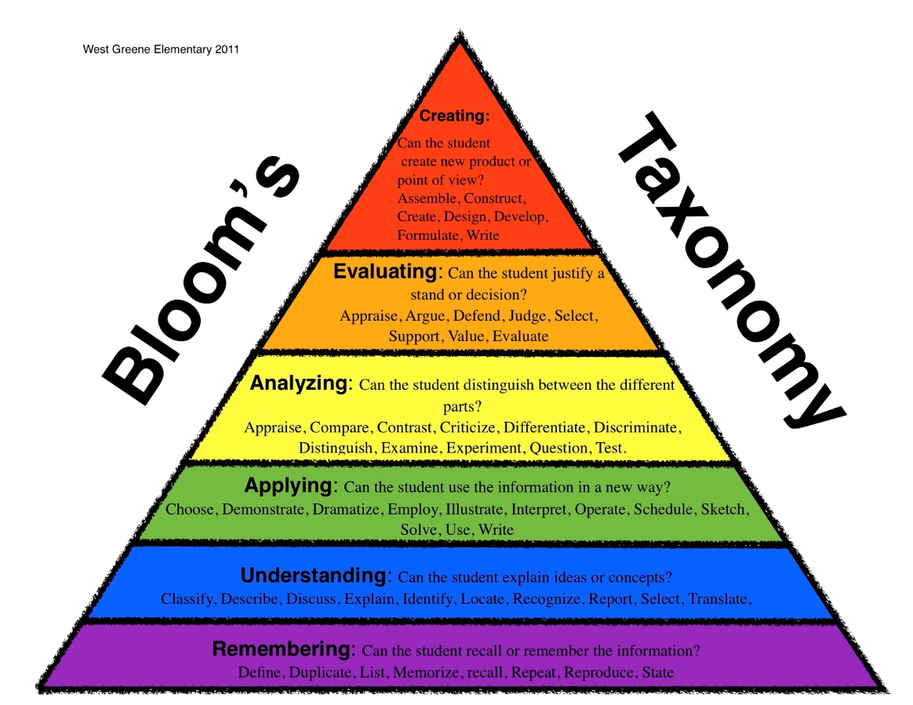
Two triangles….
Educational Alignment
Bloom’s Triangle
Learning Outcomes
Assessment
Teaching
Methods

Slide 15
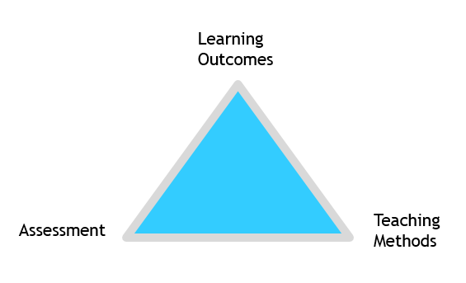
main Intended learning outcomes Based on 3TU MSc protocol
Is capable of integrated knowledge development
Is competent to do research in a purposeful and methodological way
Is competent in design of interventions for sustainable development
Has an academic approach to the development, justified use and validation of theories and models
Has Intellectual skills for scientific reasoning
Is competent in co-operating and communicating
Integrates developments in science and society
Is competent in working internationally as a global citizen

Slide 16
Teaching methods
Keynotes on main scientific disciplines involved in the programme, guided reading
1 EC choice topics on key subjects
Learning lines on academic skills, project management skills and internationalization skills
Tutorials on topics of interest, both taught and self-learning
Regular interaction and feedback sessions with the groups
Personal Development Portfolio

Slide 17
assessment
Inception report (group, 15%)
Personal Development Portfolio (individual, pass/fail)
Choice topic exams (written, individual, 20%)
Final report (group, 25%)
Oral exam (individual, 40%)
Feedback sessions (Formative)

Slide 18
Linking learning outcomes and assessment - Use of rubrics

Slide 19
Application to your case studies?
Development of key learning objectives
Discussing assessment methods
Establishing or rubrics for the combination of learning objective and assessment method

